Slide 1
2016 Winners
2017 Nominations
Presenters: Melanie Hetrick, Tillamook County Library & MacKenzie Ross, Silver Falls Library

Slide 2
What is ORCA?
Founded in 2010
Fun and exciting way for Oregon youth in grades 3-12 to become enthusiastic and discriminating readers
Students choose their favorite book in a real-life democratic process

Slide 3
How are the books chosen?
Oregon students, teachers, and librarians may nominate titles
Copyright date must be two years prior to when the list is announced
Nominations are reviewed by a committee of Oregon librarians, educators, and booksellers
Committee creates the final list!
Notes:
Copyright date 2 years prior in order to make sure affordable paperbacks available

Slide 4
Committee Members
Chair: Nina Kramer (Albina Library, Portland)
Lisa Elliott (Tigard Public Library) Kathryn Harmon (Neah-Kah-Nie School, Rockaway Beach) Melanie Hetrick (Tillamook County Library) Beth LaForce (George Fox University, Newberg) Marie LeJeune (Western Oregon University, Monmouth) Kiva Liljequist (Metropolitan Learning Center, Portland) Jessica Marie (Salem Public Library) Laurie Nordahl (North Bend High School) Kira Porton (A Children’s Place Bookstore, Portland) MacKenzie Ross (Silver Falls Library, Silverton) Karen Timmermans (Pacific University, Forest Grove) Denise Willms (Port Orford Public Library)

Slide 5
And the 2016 winners are...

Slide 6
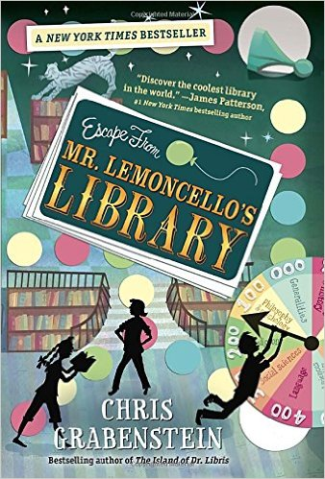
2016 ORCA Upper Elementary Winner
If you liked Escape from Mr. Lemoncello’s Library…
You might like these other best sellers by Chris Grabenstein:
Mr. Lemoncello’s Library Olympics and The Island of Dr. Libris

Slide 7
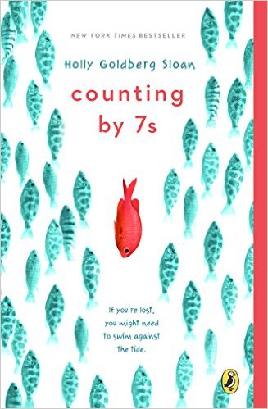
2016 ORCA Middle School Winner
If you liked Counting by 7s…
You might like these other best sellers:
Out of my Mind by Sharon Draper
Wonder by R.J. Palacio
Mockingbird by Kathryn Erskine

Slide 8
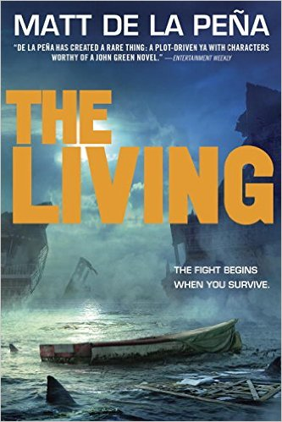
2016 ORCA High School Winner
If you liked The Living…
You might like these other best sellers by Matt de la Peña
The Hunted (sequel to The Living)
Mexican Whiteboy
The Infinity Ring series

Slide 9
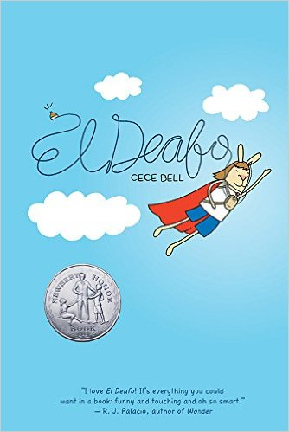
2017 ORCA Upper Elementary Nominees
El Deafo
By Cece Bell
Newbery Honor Medal
Author’s Site: https://cecebell.wordpress.com/
Author’s Talk: https://www.youtube.com/watch?v=Cnj5STG0SZo
Read-alikes: Roller Girl (Jameison), Drowned City (Brown)
Notes:
From Amazon: Going to school and making new friends can be tough. But going to school and making new friends while wearing a bulky hearing aid strapped to your chest? That requires superpowers! In this funny, poignant graphic novel memoir, author/illustrator Cece Bell chronicles her hearing loss at a young age and her subsequent experiences with the Phonic Ear, a very powerful—and very awkward—hearing aid. The Phonic Ear gives Cece the ability to hear—sometimes things she shouldn’t—but also isolates her from her classmates. She really just wants to fit in and find a true friend, someone who appreciates her as she is. After some trouble, she is finally able to harness the power of the Phonic Ear and become “El Deafo, Listener for All.” And more importantly, declare a place for herself in the world and find the friend she’s longed for.

Slide 10
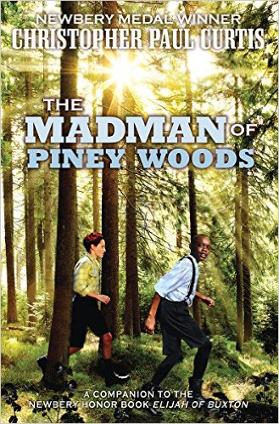
2017 ORCA Upper Elementary Nominees
The Madman of Piney Woods
By Christopher Paul Curtis
Author’s Site: http://www.nobodybutcurtis.com/
Video Interview: http://www.readingrockets.org/books/interviews/curtis
Enthusiastic readers will be delighted to jump 40 years into the future to learn about what happened to Elijah from Christopher Paul Curtis’ Newbery Honor Book & Coretta Scott King Award winner Elijah of Buxton.
Read-alikes: Bone by Bone (Johnston), Stella by Starlight (Draper)

Slide 11
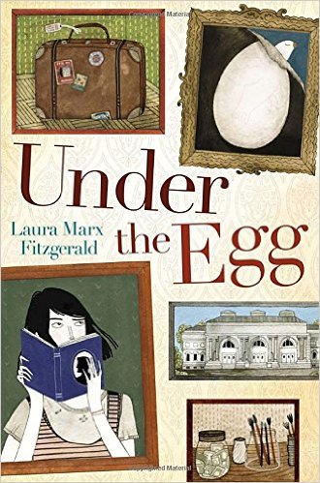
2017 ORCA Upper Elementary Nominees
Under the Egg
By Laura Marx Fitzgerald
A fast-paced mystery . . . If Dan Brown of The Da Vinci Code wrote middle-grade novels, this would be the one. — Kirkus Reviews
Author’s Site: http://www.lauramarxfitzgerald.com/#!books/cnec
Read-alikes: When You Reach Me (Stead), From the Mixed-Up Files of Mrs. Basil E. Frankweiler (Konigsburg)
Notes:
From Amazon: When Theodora Tenpenny spills a bottle of rubbing alcohol on her late grandfather’s painting, she discovers what seems to be an old Renaissance masterpiece underneath. That’s great news for Theo, who’s struggling to hang onto her family’s two-hundred-year-old townhouse and support her unstable mother on her grandfather’s legacy of $463. There’s just one problem: Theo’s grandfather was a security guard at the Metropolitan Museum of Art, and she worries the painting may be stolen. With the help of some unusual new friends, Theo's search for answers takes her all around Manhattan, and introduces her to a side of the city—and her grandfather—that she never knew. To solve the mystery, she'll have to abandon her hard-won self-reliance and build a community, one serendipitous friendship at a time.

Slide 12
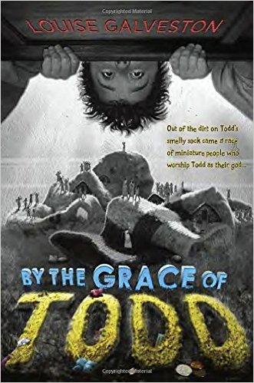
2017 ORCA Upper Elementary Nominees
By the Grace of Todd
By Louise Galveston
Author’s Site: http://www.bythegraceoftodd.com/index.html
Visit the author’s site to get the inside scoop into Todd’s world and how one dirty sock created a whole new world of tiny people.
Want to read more about the Toddlians and what they do when they think Todd has forgotten about them? Read In Todd We Trust.
Read-alike authors: Dan Gutman, Gordon Korman, Andrew Clements

Slide 13
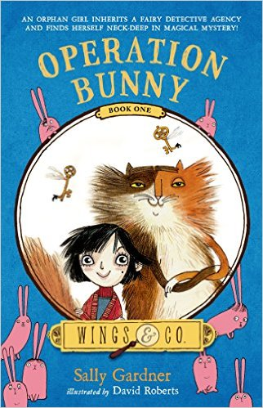
2017 ORCA Upper Elementary Nominees
Operation Bunny
By Sally Gardner
Author’s Site: http://www.sallygardner.net/
There is more fun and adventure with Wings & Co. in Three Pickled Herrings and The Vanishing of Billy Buckle!
Read-alikes: Matilda (Dahl), The Tilting House (Llewellyn)
Notes:
From Amazon: When Emily Vole inherits an abandoned shop, she discovers a magical world she never knew existed. And a fairy-hating witch, a mischievous set of golden keys, and a train full of brightly colored bunnies are just a few of the surprises that come with it.
With the help of a talking cat called Fidget and a grumpy fairy detective called Buster, it is up to Emily to save the fairies and get to the bottom of Operation Bunny.

Slide 14
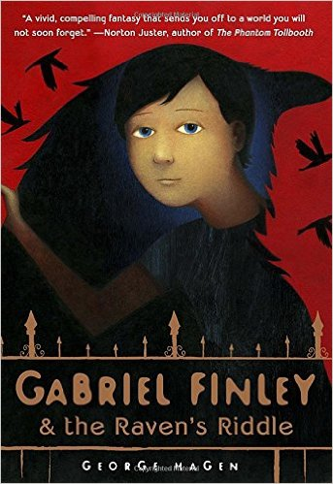
2017 ORCA Upper Elementary Nominees
Gabriel Finley & the Raven’s Riddle
By George Hagen
“A vivid, compelling fantasy that sends you off to a world you will not soon forget.” —Norton Juster
Author’s Site: http://www.georgehagen.com/
Discussion guides & activities: http://www.randomhousekids.com/brand/gabriel-finley/
If you liked Gabriel Finley & the Raven’s Riddle, you’ll probably like Katherine Rundell’s Rooftoppers.
Notes:
From Amazon: A tangle of ingenious riddles, a malevolent necklace called a torc, and flocks of menacing birds: these are just some of the obstacles that stand between Gabriel and his father, Adam Finley, who has vanished from their Brooklyn brownstone. When Gabriel rescues an orphaned baby raven named Paladin, he discovers a family secret: Finleys can bond with ravens in extraordinary ways. Along with Paladin and three valiant friends, Gabriel sets out to bring his father home. They soon discover that Adam is being held captive by the evil demon Corax—half man, half raven, and Adam’s very own disgraced brother—in a foreboding netherworld of birds called Aviopolis. With help from his army of ghoulish minions, the valravens, Corax is plotting to take over the land above, and now only Gabriel stands in his way.

Slide 15
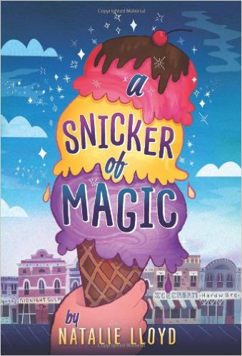
2017 ORCA Upper Elementary Nominees
A Snicker of Magic
By Natalie Lloyd
2017 OBOB Book
ALA Notable Children's Book, New York Times Book Review Editors' Choice, and E.B. White Honor Book
Author’s Site: http://www.natalielloyd.com/a-snicker-of-magic/
New from Natalie Lloyd: The Key to Extraordinary
Read-alikes: Escape from Mr. Lemoncello’s Library (Grabenstein), Savvy (Law)
Notes:
From Amazon: Introducing an extraordinary new voice---a magical debut that will make your skin tingle, your eyes glisten . . .and your heart sing. Midnight Gulch used to be a magical place, a town where people could sing up thunderstorms and dance up sunflowers. But that was long ago, before a curse drove the magic away. Twelve-year-old Felicity knows all about things like that; her nomadic mother is cursed with a wandering heart. But when she arrives in Midnight Gulch, Felicity thinks her luck's about to change. A "word collector," Felicity sees words everywhere---shining above strangers, tucked into church eves, and tangled up her dog's floppy ears---but Midnight Gulch is the first place she's ever seen the word "home." And then there's Jonah, a mysterious, spiky-haired do-gooder who shimmers with words Felicity's never seen before, words that make Felicity's heart beat a little faster. Felicity wants to stay in Midnight Gulch more than anything, but first, she'll need to figure out how to bring back the magic, breaking the spell that's been cast over the town . . . and her mother's broken heart.

Slide 16
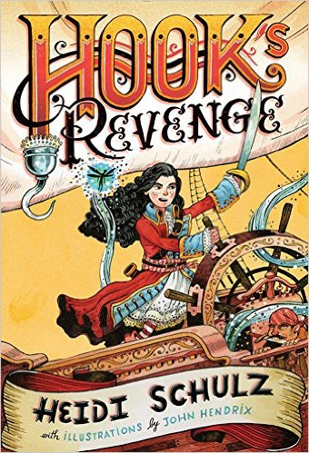
2017 ORCA Upper Elementary Nominees
Hook’s Revenge
By Heidi Schulz
2017 OBOB Book
New York Times Bestseller
2014 OCTE Oregon Spirit Award Honor Book
Author’s Site: http://heidischulzbooks.com/
If you liked Hook’s Revenge, you’ll probably like Schulz’s next book
Hook’s Revenge: The Pirate Code.
Read-alikes: Peter and the Starcatchers (Barry), The Brotherband Chronicles series (Flanagan)
Notes:
From Amazon: Twelve-year-old Jocelyn dreams of becoming every bit as daring as her infamous father, Captain James Hook. Her grandfather, on the other hand, intends to see her starched and pressed into a fine society lady. When she's sent to Miss Eliza Crumb-Biddlecomb's Finishing School for Young Ladies, Jocelyn's hopes of following in her father's fearsome footsteps are lost in a heap of dance lessons, white gloves, and way too much pink.
So when Jocelyn receives a letter from her father challenging her to avenge his untimely demise at the jaws of the Neverland crocodile, she doesn't hesitate-here at last is the adventure she has been waiting for. But Jocelyn finds that being a pirate is a bit more difficult than she'd bargained for. As if attempting to defeat the Neverland's most fearsome beast isn't enough to deal with, she's tasked with captaining a crew of woefully untrained pirates, outwitting cannibals wild for English cuisine, and rescuing her best friend from a certain pack of lost children, not to mention that pesky Peter Pan who keeps barging in uninvited.
The crocodile's clock is always ticking in Heidi Schulz's debut novel, a story told by an irascible narrator who is both dazzlingly witty and sharp as a sword. Will Jocelyn find the courage to beat the incessant monster before time runs out?

Slide 17
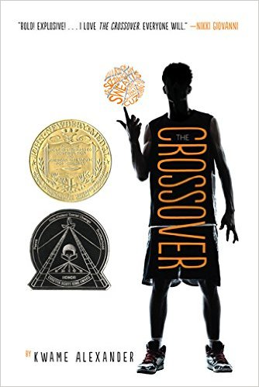
2017 ORCA Middle School Nominees
The Crossover
By Kwame Alexander
2016 Newbery Award
2016 Coretta Scott King Award Honor
Author’s Site: http://kwamealexander.com/index.php?page=about&family=books
Author’s Speech: https://www.youtube.com/watch?v=wnh3JNCMLq8
Left hanging by Crossover? Alexander continued the story in Booked.
Read alikes: Brown Girl Dreaming by Jacqueline Woodson and Serafina’s Promise by Anne E. Burg.
Notes:
From Amazon: He and his twin brother Jordan are awesome on the court. But Josh has more than basketball in his blood, he's got mad beats, too, that tell his family's story in verse, in this fast and furious middle grade novel of family and brotherhood from Kwame Alexander.
Josh and Jordan must come to grips with growing up on and off the court to realize breaking the rules comes at a terrible price, as their story's heart-stopping climax proves a game-changer for the entire family.

Slide 18
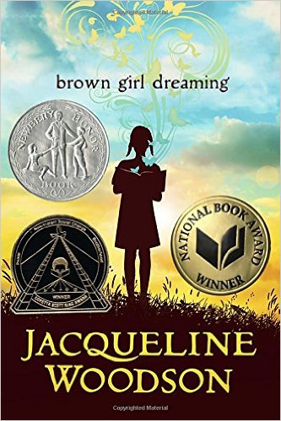
2017 ORCA Middle School Nominees
Brown Girl Dreaming
By Jacqueline Woodson
2016 Newbery Honor book
2016 National Book Award Winner
2016 Coretta Scott King Award Winner
Author page: http://www.jacquelinewoodson.com/
Woodson’s NPR Interview: http://www.npr.org/sections/codeswitch/2014/12/10/369736205/jacqueline-woodson-on-growing-up-coming-out-and-saying-hi-to-strangers
You might also like The Gaither Girls books by Rita Williams-Garcia and author Nikki Grimes.
Notes:
From Amazon: Raised in South Carolina and New York, Woodson always felt halfway home in each place. In vivid poems, she shares what it was like to grow up as an African American in the 1960s and 1970s, living with the remnants of Jim Crow and her growing awareness of the Civil Rights movement. Touching and powerful, each poem is both accessible and emotionally charged, each line a glimpse into a child’s soul as she searches for her place in the world. Woodson’s eloquent poetry also reflects the joy of finding her voice through writing stories, despite the fact that she struggled with reading as a child. Her love of stories inspired her and stayed with her, creating the first sparks of the gifted writer she was to become.

Slide 19
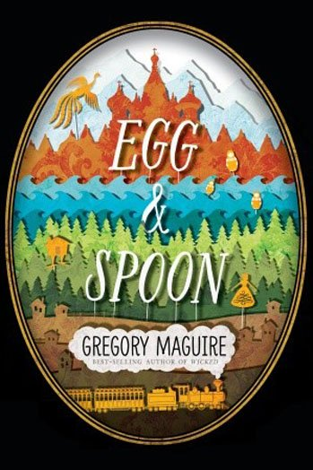
2017 ORCA Middle School Nominees
Egg & Spoon
By Gregory Maguire
YALSA Best Fiction for Young Adults: 2015
School Library Journal Best Books: 2014
Author’s Site: http://www.gregorymaguire.com/
Sunday Book Review, NYT: http://www.nytimes.com/2014/08/24/books/review/egg-spoon-by-gregory-maguire.html?_r=0
Read alikes: anything else by Gregory Maguire
Notes:
From Amazon: Elena Rudina lives in the impoverished Russian countryside, and there is no food. But then a train arrives in the village, a train carrying a cornucopia of food, untold wealth, and a noble family destined to visit the Tsar in Saint Petersburg—a family that includes Ekaterina, a girl of Elena’s age. When the two girls’ lives collide, an adventure is set in motion, an escapade that includes mistaken identity, a monk locked in a tower, a prince traveling incognito, and—in a starring role only Gregory Maguire could have conjured—Baba Yaga, witch of Russian folklore, in her ambulatory house perched on chicken legs.

Slide 20
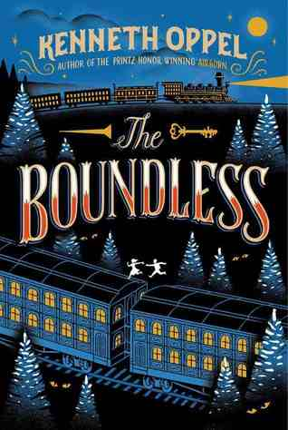
2017 ORCA Middle School Nominees
The Boundless
By Kenneth Oppel
ALA Notable Children's Books - Middle Readers Category: 2015
Booklist Editors' Choice - Books for Youth - Middle Readers Category: 2014
Ruth and Sylvia Schwartz Children's Book Awards (Ontario): YA-Middle Reader
School Library Journal Best Books: 2014
Author Site: http://www.kennethoppel.ca/
Read alikes: Airman by Eoin Colfer and The Blue Comet by Rosemary Wells
Notes:
From Amazon: The Boundless, the greatest train ever built, is on its maiden voyage across the country, and first-class passenger Will Everett is about to embark on the adventure of his life!
When Will ends up in possession of the key to a train car containing priceless treasures, he becomes the target of sinister figures from his past.
In order to survive, Will must join a traveling circus, enlisting the aid of Mr. Dorian, the ringmaster and leader of the troupe, and Maren, a girl his age who is an expert escape artist. With villains fast on their heels, can Will and Maren reach Will’s father and save The Boundless before someone winds up dead?

Slide 21
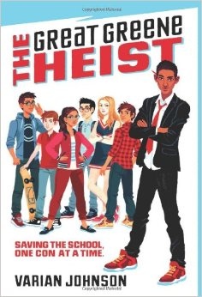
2017 ORCA Middle School Nominees
The Great Greene Heist
By Varian Johnson
ALA Notable Children's Books - Middle Readers Category: 2015
Author Site: http://www.varianjohnson.com/
SLJ Review of the Day article: http://blogs.slj.com/afuse8production/2014/05/01/review-of-the-day-the-great-greene-heist-by-varian-johnson/#_
If this book left you hanging, no worries! Johnson continued the story in To Catch A Cheat, published in January of 2016.
Read alikes: Loot by Jude Watson and Schooled by Gordon Korman
Notes:
From Amazon: Jackson Greene swears he's given up scheming. Then school bully Keith Sinclair announces he's running for Student Council president, against Jackson's former friend Gaby de la Cruz. Gaby wants Jackson to stay out of it -- but he knows Keith has "connections" to the principal, which could win him the presidency no matter the vote count.
So Jackson assembles a crack team: Hashemi Larijani, tech genius. Victor Cho, bankroll. Megan Feldman, science goddess. Charlie de la Cruz, reporter. Together they devise a plan that will take down Keith, win Gaby's respect, and make sure the election is done right. If they can pull it off, it will be remembered as the school's greatest con ever -- one worthy of the name THE GREAT GREENE HEIST.

Slide 22
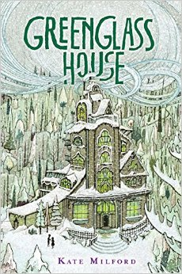
2017 ORCA Middle School Nominees
Greenglass House
By Kate Milford
2014 National Book Award Nominee for Young People’s Literature, 2014 Agatha Award Nominee for Best Children’s/Young Adult Novel, 2015 Edgar Award for Best Juvenile, 2016 Dorothy Canfield Fisher Children’s Book Award Nominee
Author Site: http://clockworkfoundry.com/2015/06/in-which-i-update-this-site-with-all-the-greenglass-news/
Read Alikes: Escape from Mr. Lemoncello’s Library by Chris Grabenstein and The Mysterious Benedict Society by Trenton Stewart
Notes:
From Amazon: It’s wintertime at Greenglass House. The creaky smuggler’s inn is always quiet during this season, and twelve-year-old Milo, the innkeepers’ adopted son, plans to spend his holidays relaxing. But on the first icy night of vacation, out of nowhere, the guest bell rings. Then rings again. And again. Soon Milo’s home is bursting with odd, secretive guests, each one bearing a strange story that is somehow connected to the rambling old house. As objects go missing and tempers flare, Milo and Meddy, the cook’s daughter, must decipher clues and untangle the web of deepening mysteries to discover the truth about Greenglass House—and themselves.

Slide 23
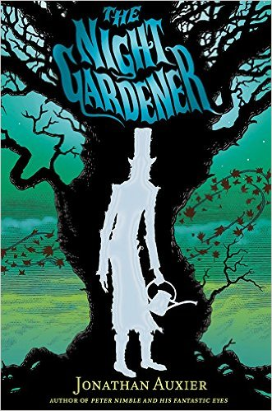
2017 ORCA Middle School Nominees
The Night Gardener
By Jonathan Auxier
ALA Notable Children's Books - Older Readers Category: 2015
International Reading Association Children's Book Award:Intermediate Fiction (post-2001 winners)
Monica Hughes Award for Science Fiction and Fantasy
School Library Journal Best Books: 2014
Westchester Fiction Award (California)
Author Site: http://www.thescop.com/
Read Alikes: The Nest by Kenneth Oppel and The Screaming Staircase by Jonathan Stroud
Notes:
Also many Canadian awards: (author is not Canadian, lives in PA)
Canadian Library Association Book of the Year for Children Award
Forest of Reading Awards (Ontario Library Association): Silver Birch Fiction Award
TD Canadian Children's Literature Award
From Amazon: This much-anticipated follow-up to Jonathan Auxier’s exceptional debut, Peter Nimble and His Fantastic Eyes, is a Victorian ghost story with shades of Washington Irving and Henry James. More than just a spooky tale, it’s also a moral fable about human greed and the power of storytelling.
The Night Gardener follows two abandoned Irish siblings who travel to work as servants at a creepy, crumbling English manor house. But the house and its family are not quite what they seem. Soon the children are confronted by a mysterious spectre and an ancient curse that threatens their very lives. With Auxier’s exquisite command of language, The Night Gardener is a mesmerizing read and a classic in the making.

Slide 24
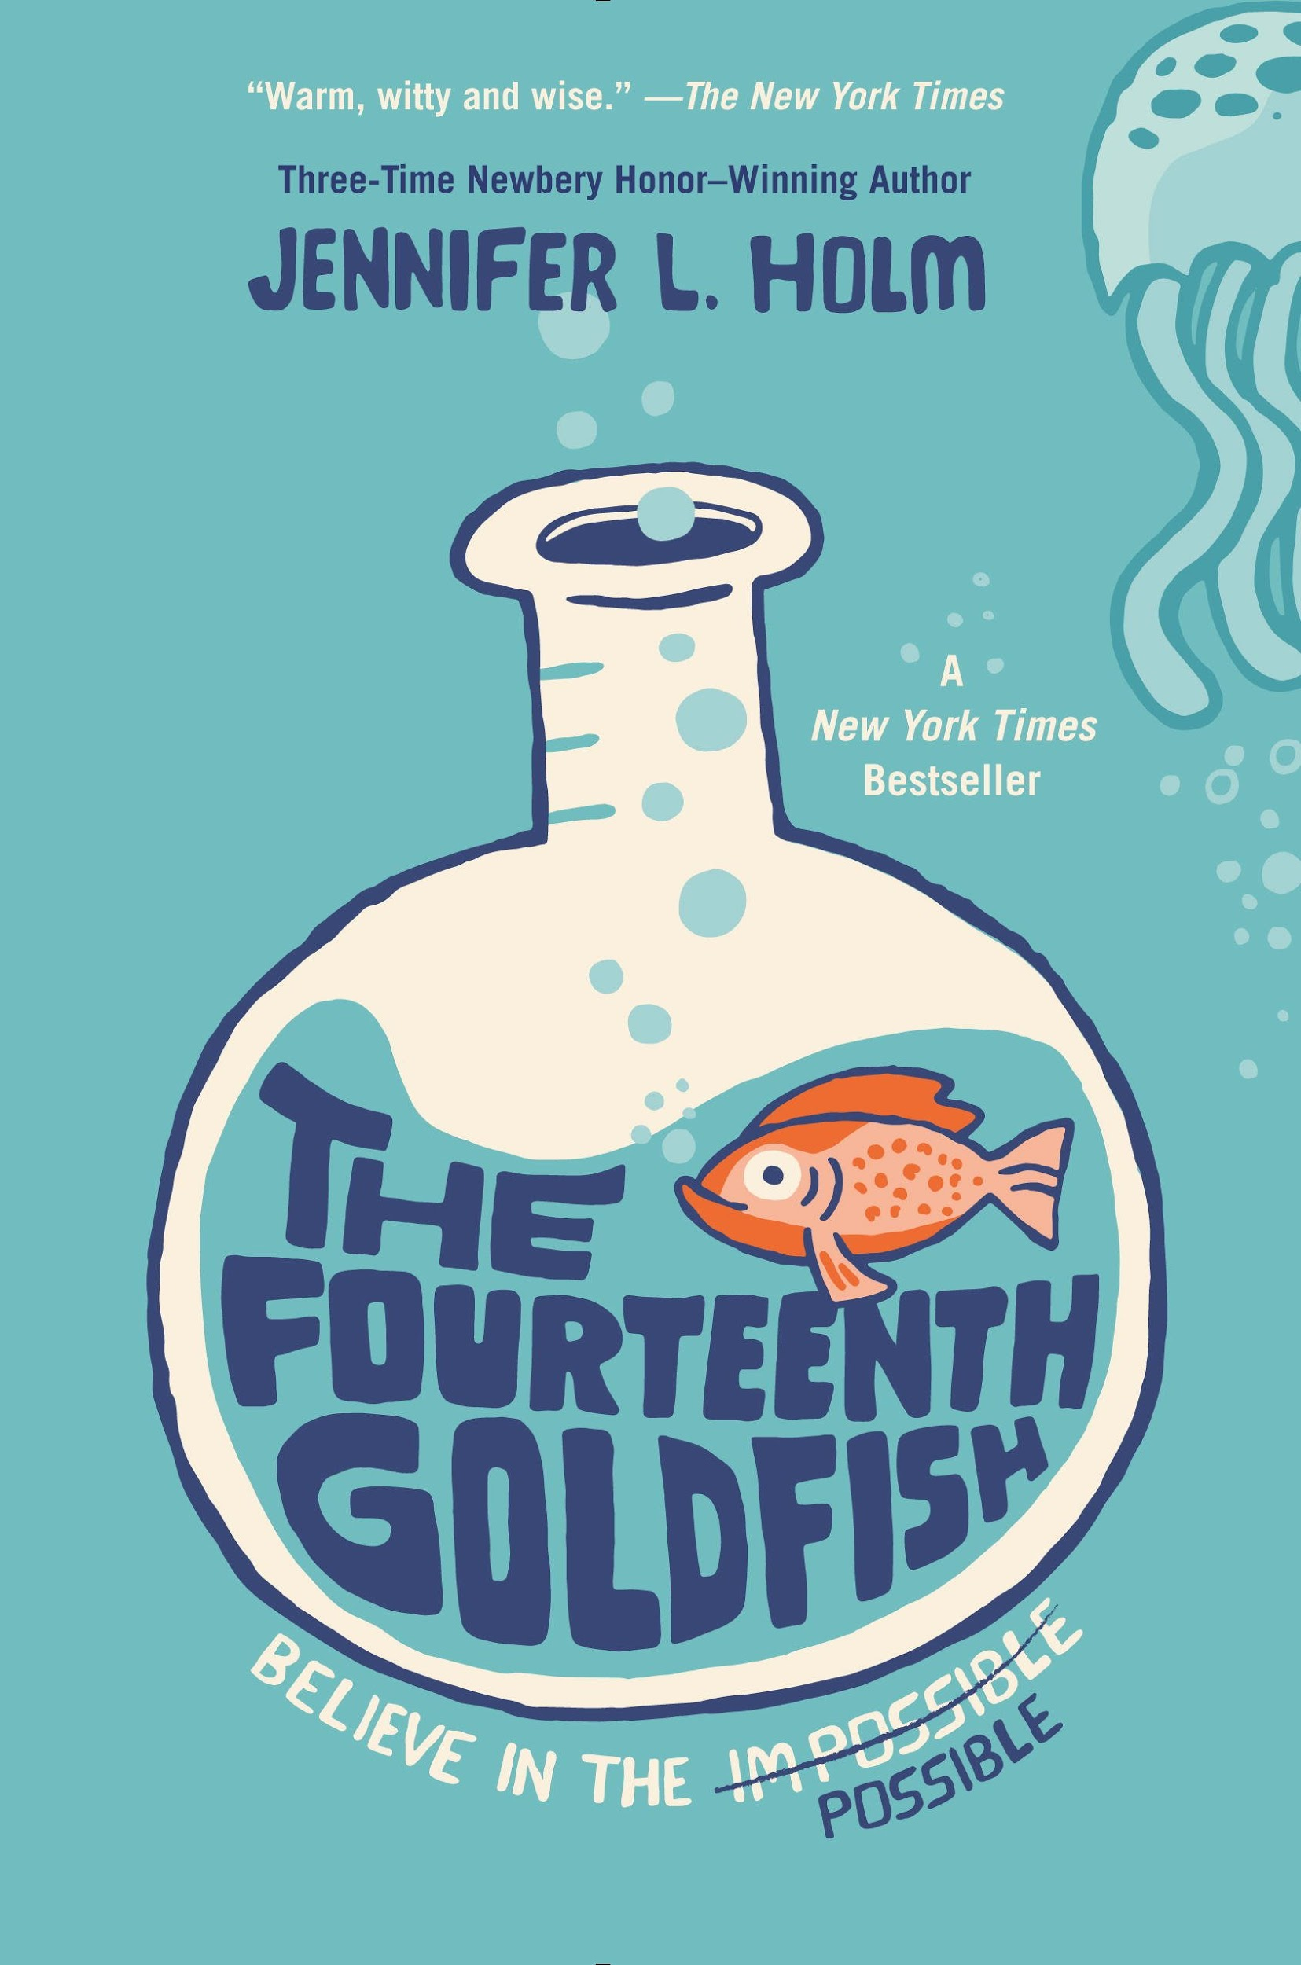
2017 ORCA Middle School Nominees
The Fourteenth Goldfish
By Jennifer L. Holm
Awards: ALA Notable Children's Books - Middle Readers Category: 2015
Author Site: http://www.jenniferholm.com/
New York Times Books Review, August 24, 2014:
“Youth, old age, life, death, love, possibilities, and – oh yes – goldfish all come together in this warm, witty and wise novel.”
Read Alikes: Wake Up Missing by Kate Messner and Tuck Everlasting by Natalie Babbitt
Notes:
Very prolific author: Squish, Babymouse,
From Amazon: Galileo. Newton. Salk. Oppenheimer. Science can change the world . . . but can it go too far?
Eleven-year-old Ellie has never liked change. She misses fifth grade. She misses her old best friend. She even misses her dearly departed goldfish. Then one day a strange boy shows up. He’s bossy. He’s cranky. And weirdly enough . . . he looks a lot like Ellie’s grandfather, a scientist who’s always been slightly obsessed with immortality. Could this gawky teenager really be Grandpa Melvin? Has he finally found the secret to eternal youth?
With a lighthearted touch and plenty of humor, Jennifer Holm celebrates the wonder of science and explores fascinating questions about life and death, family and friendship, immortality . . . and possibility.

Slide 25
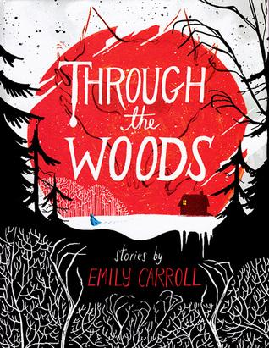
2017 ORCA High School Nominees
Through the Woods
By Emily Carroll
2015 Will Eisner Award Winner
Author’s Site: http://www.emcarroll.com/
Five deliciously creepy stories!
Read-alikes: The Undertaking of Lily Chen (Novgorodoff), The Sleeper and the Spindle (Gaiman), The Girl With all the Gifts (Carey)
Co-created a choose-your-own adventure video game: The Yawhg
Notes:
From Amazon: Journey through the woods in this sinister, compellingly spooky collection that features four brand-new stories and one phenomenally popular tale in print for the first time. These are fairy tales gone seriously wrong, where you can travel to “Our Neighbor’s House”—though coming back might be a problem. Or find yourself a young bride in a house that holds a terrible secret in “A Lady’s Hands Are Cold.” You might try to figure out what is haunting “My Friend Janna,” or discover that your brother’s fiancée may not be what she seems in “The Nesting Place.” And of course you must revisit the horror of “His Face All Red,” the breakout webcomic hit that has been gorgeously translated to the printed page.

Slide 26
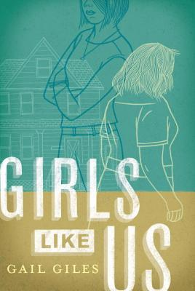
2017 ORCA High School Nominees
Girls Like Us
By Gail Giles
2015 Schneider Family Book Award Winner
Author’s Site: www.gailgiles.com
School Library Journal interviews Gail Giles: http://www.slj.com/2014/12/interviews/inside-special-education-gail-giles-and-girls-like-us/#_
Read-alikes: The Unlikely Hero of Room 13B (Toten), The Curious Incident of the Dog in the Night-Time (Haddon)
Notes:
From Amazon: Quincy and Biddy are both graduates of their high school’s special ed program, but they couldn’t be more different: suspicious Quincy faces the world with her fists up, while gentle Biddy is frightened to step outside her front door. When they’re thrown together as roommates in their first "real world" apartment, it initially seems to be an uneasy fit. But as Biddy’s past resurfaces and Quincy faces a harrowing experience that no one should have to go through alone, the two of them realize that they might have more in common than they thought — and more important, that they might be able to help each other move forward.

Slide 27
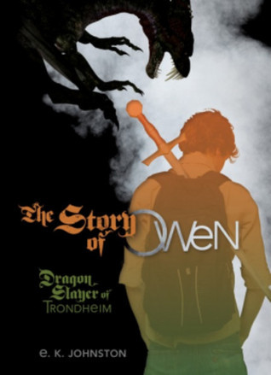
2017 ORCA High School Nominees
The Story of Owen: Dragon Slayer of Trondheim
By E.K. Johnston
2015 Morris Award Finalist
Author’s Site: http://ekjohnston.ca/
Discussion Guide: https://www.lernerbooks.com/digitalassets/Assets/Title%20Assets/13011/9781467710664/Discussion%20Guide.pdf
Sequel: Prairie Fire
Notes:
From Amazon: There have always been dragons. As far back as history is told, men and women have fought them, loyally defending their villages. Dragon slaying was a proud tradition. But dragons and humans have one thing in common: an insatiable appetite for fossil fuels. From the moment Henry Ford hired his first dragon slayer, no small town was safe. Dragon slayers flocked to cities, leaving more remote areas unprotected. Such was Trondheim's fate until Owen Thorskard arrived. At sixteen, with dragons advancing and his grades plummeting, Owen faced impossible odds armed only with a sword, his legacy, and the classmate who agreed to be his bard.

Slide 28
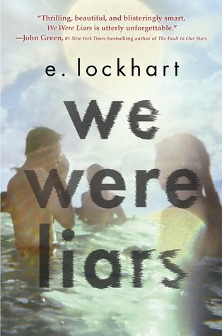
2017 ORCA High School Nominees
We Were Liars
By E. Lockhart
2014 Goodreads Choice Award Winner
Author’s Site:http://www.emilylockhart.com/
We Were Liars Tumblr: http://wewereliarsbook.tumblr.com/
Review: https://www.kirkusreviews.com/book-reviews/e-lockhart/we-were-liars/
Read-alikes: Chopsticks (Anthony), Burn for Burn (Han), This One Summer (Tamaki)
Notes:
From Amazon: A beautiful and distinguished family. A private island. A brilliant, damaged girl; a passionate, political boy. A group of four friends—the Liars—whose friendship turns destructive. A revolution. An accident. A secret. Lies upon lies. True love. The truth.

Slide 29
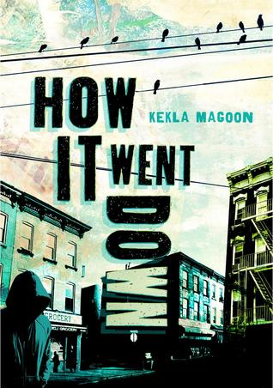
2017 ORCA High School Nominees
How It Went Down
By Kekla Magoon
2015 Coretta Scott King Award for Author Honor 2017 OBOB
Author’s Site: http://keklamagoon.com/
Discussion Guide: http://keklamagoon.com/wp-content/uploads/2011/12/how_it_went_down_reading_guide.pdf
Read-alike: All American Boys (Reynolds)
Notes:
From Amazon: When sixteen-year-old Tariq Johnson dies from two gunshot wounds, his community is thrown into an uproar. Tariq was black. The shooter, Jack Franklin, is white. In the aftermath of Tariq's death, everyone has something to say, but no two accounts of the events line up. Day by day, new twists further obscure the truth. Tariq's friends, family, and community struggle to make sense of the tragedy, and to cope with the hole left behind when a life is cut short. In their own words, they grapple for a way to say with certainty: This is how it went down.

Slide 30
2017 ORCA High School Nominees
I’ll Give You the Sun
By Jandy Nelson
2015 Printz Award Winner 2017 OBOB
Author’s Site: http://jandynelson.com/
Discussion Guide: http://www.penguin.com/yabookclub/books/ill-give-you-the-sun/
Read-alikes from YALSA: http://www.yalsa.ala.org/thehub/2015/09/08/12-books-for-fans-of-ill-give-you-the-sun-by-jandy-nelson/
Notes:
From Amazon: At first, Jude and her twin brother are Noah are inseparable. Noah draws constantly and is falling in love with the charismatic boy next door, while daredevil Jude wears red-red lipstick, cliff-dives, and does all the talking for both of them. Years later, they are barely speaking. Something has happened to change the twins in different yet equally devastating ways . . . but then Jude meets an intriguing, irresistible boy and a mysterious new mentor. The early years are Noah’s to tell; the later years are Jude’s. But they each have only half the story, and if they can only find their way back to one another, they’ll have a chance to remake their world.

Slide 31
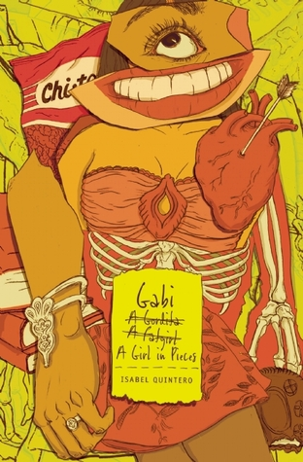
2017 ORCA High School Nominees
Gabi, a Girl in Pieces
By Isabel Quintero
2015 Morris Award Winner
Author’s Site: https://laisabelquintero.com/
Cover Artist’s Site: http://zpvisual.com/
Discussion Guide (aligned with Common Core Standards): http://www.cincopuntos.com/files/gabi_a-girl-in-pieces_teachers_guide.pdf
Read-alikes: Yaqui Delgado Wants to Kick Your Ass (Medina), The Absolutely True Diary of a Part-Time Indian (Alexie)
Notes:
From Amazon: Gabi Hernandez chronicles her last year in high school in her diary: college applications, Cindy's pregnancy, Sebastian's coming out, the cute boys, her father's meth habit, and the food she craves. And best of all, the poetry that helps forge her identity.

Slide 32
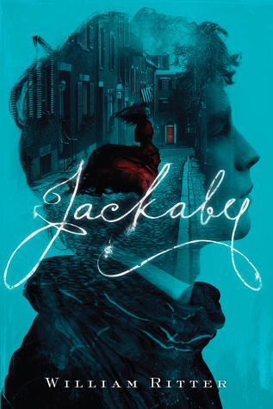
2017 ORCA High School Nominees
Jackaby
By William Ritter
2016 Oregon Book Award Finalist
Author’s Site: https://rwillritter.wordpress.com/
Author’s Twitter: https://twitter.com/Willothewords
Local author--lives in Springfield.
Tagline: Doctor Who meets Sherlock Holmes!
Sequels: Beastly Bones and Ghostly Echoes
Notes:
From Amazon: Newly arrived in New Fiddleham, New England, 1892, and in need of a job, Abigail Rook meets R. F. Jackaby, an investigator of the unexplained with a keen eye for the extraordinary--including the ability to see supernatural beings. Abigail has a gift for noticing ordinary but important details, which makes her perfect for the position of Jackaby’s assistant. On her first day, Abigail finds herself in the midst of a thrilling case: A serial killer is on the loose. The police are convinced it’s an ordinary villain, but Jackaby is certain the foul deeds are the work of the kind of creature whose very existence the local authorities--with the exception of a handsome young detective named Charlie Cane--seem adamant to deny.

Slide 33
For ORCA Resources, Visit the Blog...
https://oregonreaderschoiceaward.wordpress.com/
If you are interested in being involved with the ORCA Committee, contact the Chair at orca@olaweb.org
Thank you!

