Slide 1
What’s their story?
Using an online assessment tool to learn about patron skills
Digital Equity in Libraries
Notes:
What’s their story? Using an online assessment tool to learn about patron skills
We believe our patrons can use our electronic resources, but international assessment data tell a different story. The US population scores below the international average in problem solving in technology-rich environments, so Multnomah County Library and Portland State University are collaborating on a project funded by the Institute of Museum and Library Services to assess patrons’ online abilities and how those abilities map to common library tasks. Results will help inform how online library services are presented and will help ensure computer class content includes meaningful skills.

Slide 2
Who we are
Portland State University
Stephen Reder
Gloria Jacobs
Jill Castek
Multnomah County Library
Cindy Gibbon
Matthew Timberlake
Vailey Oehlke
Patricia Moran,
Youth Librarian
Amy Honisett,
Public Training Librarian

Slide 3
This work is supported by
Institute of Museum and Library Services
Advancing Digital Equity in Public Libraries: Assessing Library Patrons’ Problem Solving in Technology Rich Environments
(LG-06-14-0076)

Slide 4
What are we trying to find out?
Is the library offering the right kinds of training?
Can the library’s patrons use the library website?
Can the library’s patron use the library’s electronic resources?
Are our assumptions correct?
Problem solving in technology rich environments
Notes:
We believe our patrons can use our electronic resources, but international and United States assessment data tell a different story. The US population scores below the international average in problem solving in technology-rich environments,
What makes us think our patrons have an easier time?
To find out, Multnomah County Library and the Portland State University’s Literacy Language and Technology Research team are collaborating on a project funded by the Institute of Museum and Library Services. We are assessing patrons’ online abilities and how those abilities map to common library tasks.
We’re going to talk about how we’ve modified an assessment tool to make it work for our patrons, what we’re learning, and how we might use what we’ve learned.

Slide 5
Shared values and interests
MCL:
We reflect and serve a diverse community
We enable creation and learning
We build digital literacy
A safe place for informal learning.
LLTR:
Projects focus on acquisition of literacy
Digital literacy
Second languages among adults
Economically vulnerable and socially excluded patrons
Notes:
Why these two organizations?
Shared values and interests.
MCL provides nearly 900 computer stations for the public. Nearly two million people access public PC and wifi sessions at Multnomah County Library each year.
Digital literacy, digital skills and building digital equity is important to us.
Our current priorities include providing access, training and technology to everyone, and to partner with other organizations to expand the scope and impact of our work and ensure success in a digital world.
The Literacy Language and Technology group has worked a lot with data from the programme for international assessment of adult competencies, as well as doing much work on how adults acquire digital literacy skills.

Slide 6
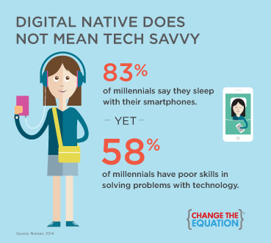
Why?
To avoid making assumptions about what our patrons can do
Notes:
The library focuses on digital literacy and digital skill building because it is important to know not only how to use a computer, but also how to evaluate online information and navigate online.
Digital literacy means being able to figure out how to get through a government form online, how to distinguish between a fraudulent student loan site and the FAFSA site, and being able to leverage technology to one’s own advantage by determining how, when and whether or not to take classes online, bank online and keep in touch with family and friends online.
Providing digital literacy facilitation, as well as skill building classes, at the library promotes equity. The library is a free, safe, approachable place for all learners. The library is a place to explore and pursue lifelong learning, with the support of a librarian. You do not need money, social capital, or a formal education to use the library.
Currently offer very basic computer classes, and we assume that most people can use our resources (databases, electronic resources, online catalog, app).
We also assume that people who have digital skills (can use a mouse, etc.) can use our website.
We also assume that we should be offering higher level classes.
Are our assumptions correct?

Slide 7
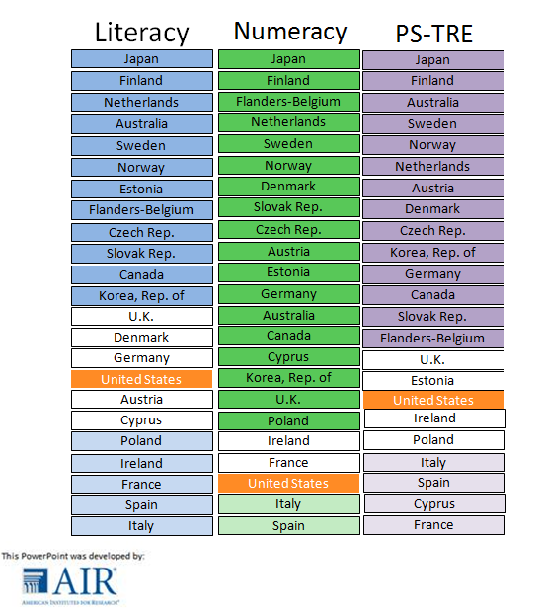
What is PIAAC?
Programme for
Assessment of
Adult
Competencies
Literacy, numeracy, problem solving.
Notes:
I mentioned an international assessment. It is called the PIAAC survey; the programme for assessment of adult competencies.
We wanted to see how our patrons score in relation to the rest of US adults.
The assessment was designed to measure skills of the adult working-age population in the US and internationally. It was administered in 2011/2012 in 23 countries. It assessed people 16 - 65, excluding people who are institutionalized. The assessment provides international comparison to better understand U.S. global competitiveness.
The assessment measures literacy and numeracy skills, as well as skills in problem solving in technology rich environments (PS-TRE)

Slide 8
What is PS-TRE?
Using digital technology, communication tools and networks to acquire and evaluate information, communicate with others and perform practical tasks.
Problem solving in technology rich environments
Notes:
Problem solving in technology rich environments, or PSTRE, represents a domain of competence where digital skills meet cognitive skills.
PSTRE includes skills like sorting emails into the appropriate folders, shopping online, filling out forms - the skills we help our patrons with every day.
This means not just following instructions, but using the Internet to solve problems in your own life, even if your problem is just buying a pair of shoes.
The first PIAAC problem-solving survey focuses on the abilities to solve problems for personal, work and civic purposes by setting up appropriate goals and plans, and accessing and making use of information through computers and computer networks.
How is this different from having computer skills? Computer skills underlie PSTRE, but PSTRE includes cognitive dimensions, specifically:
Setting and monitoring progress,
Planning,
Acquiring and evaluating information,
Using information

Slide 9
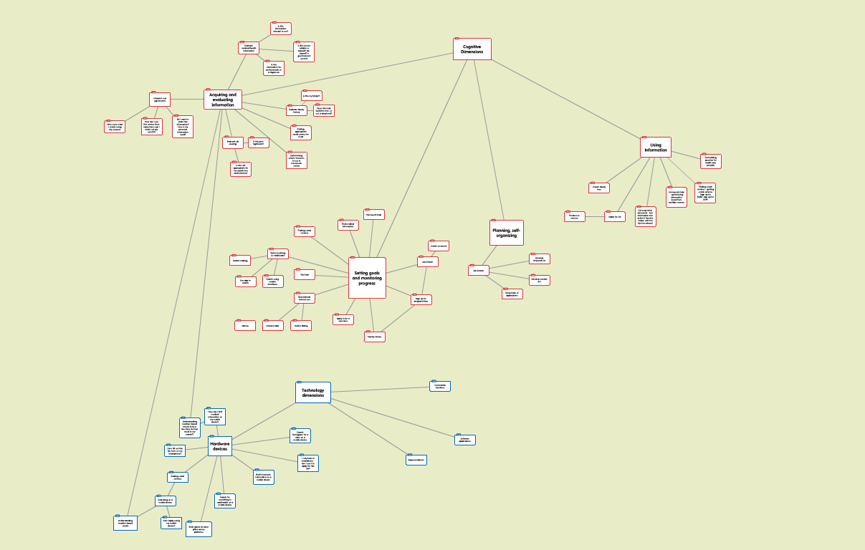
PIAAC framework
Notes:
Here’s what it looks like.

Slide 10
Notes:
We broke down those elements and thought about how they relate to some common tasks people do in the library (or using library resources)

Slide 11
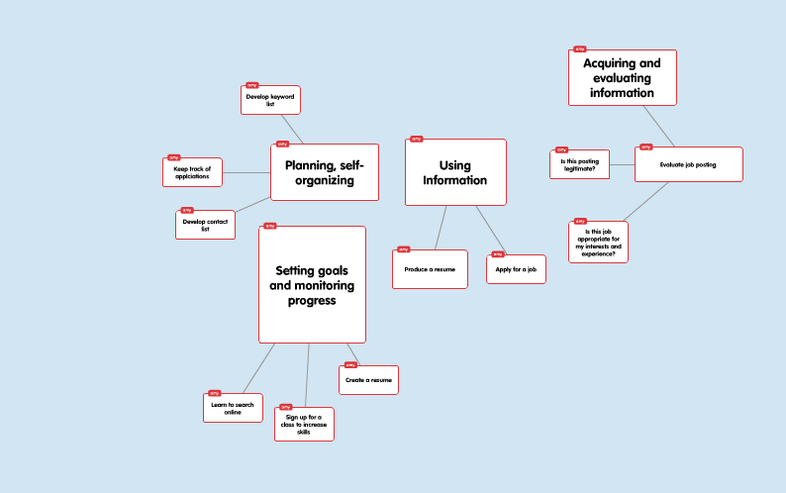
Notes:
Then we focused on one project a patron might take on at the library, searching for a job.

Slide 12
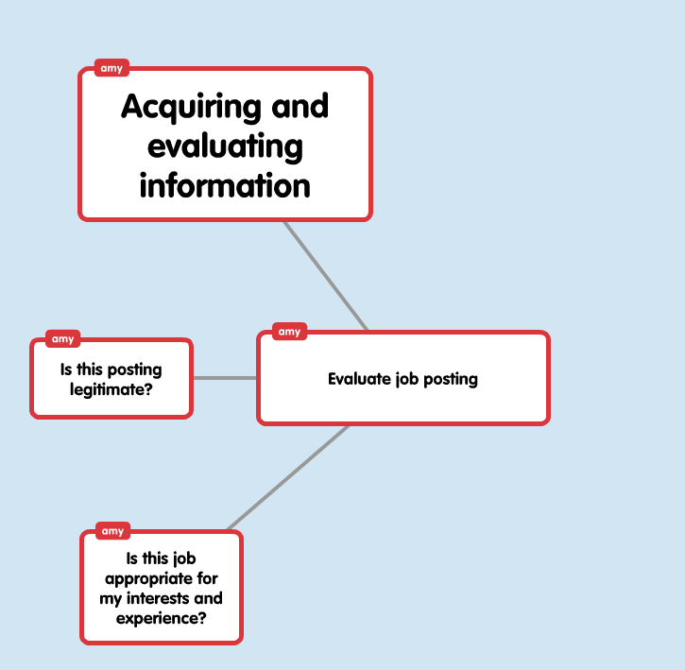
Notes:
Here's an example.

Slide 13
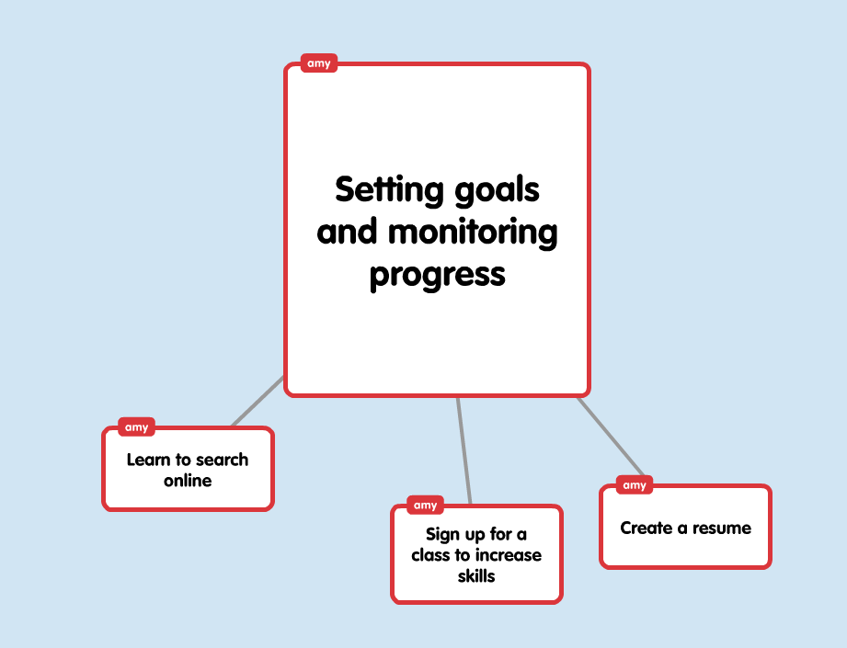

Slide 14
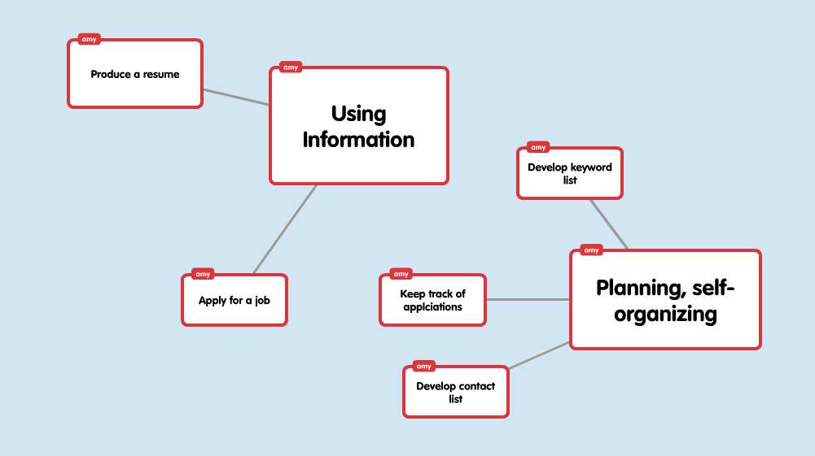

Slide 15
30%
Of adults in the US are likely to have difficulty sorting through emails and organizing them into folders provided for them.
Notes:
US scores were
•Lower than in 14 countries
•Not significantly different than in 4 countries
•Higher than no other country
•Italy, Spain, Cyprus and France did not include this domain in their assessment
The people being assessed had the option of opting out of the PSTRE portion of the test. Those who did take the PSTRE portion had to complete an assessement of computer skills first to make sure they had the requisite skills to continue (scrolling, using a mouse).
You can see here that one of the skills mentioned is sorting through emails and organizing the emails in folders provided for them, a skill I’m sure all of us use every day.
Do you see this with your patrons? With your students?
How do we address this? What are the implications? Why does it matter?

Slide 16
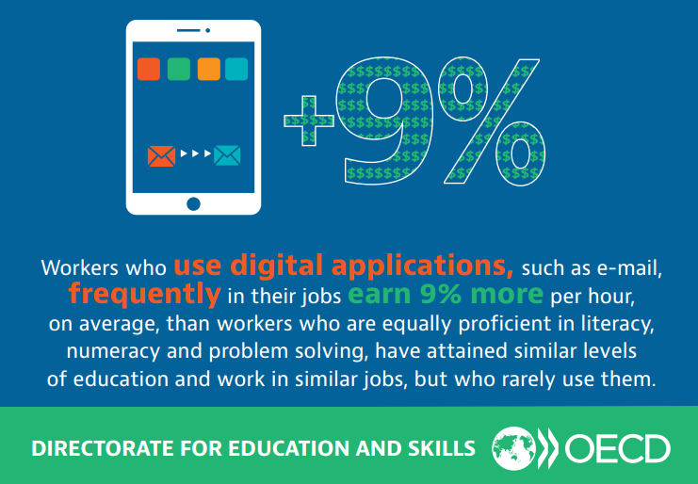
On average, people at the highest skill level earn more than twice as much as people at the lowest skill level.
Notes:
We need these skills for many daily activities, and there is solid data showing that people who have no experience using digital devices have lower income and are less likely to participate in the labor force (internationally)
Do you think lower skills mean lower digital engagement?
Getting slightly more skilled can really help with earnings.
Seeing how US population did on the PSTRE portion of the PIAAC assessment, do we need to ask ourselves:
Are our patrons capable of using online library resources?
Do we need to adapt our user interface if our community struggles with problem solving in technology-rich environments?
We need to know if the skills of our community align with national skill levels so that we can design appropriate training AND so that we can take skill levels into account with elements of our online resources over which we have some control.
So here’s what we’re doing.

Slide 17
Education and Skills Online (ESO)
Notes:
The Organisation for Economic Co-operation and Development (OECD) developed an online assessment designed to provide individual level results linked to PIAAC, so an online PIAAC assessment available to purchase. This is the tool we’re using to assess our patrons.

Slide 18
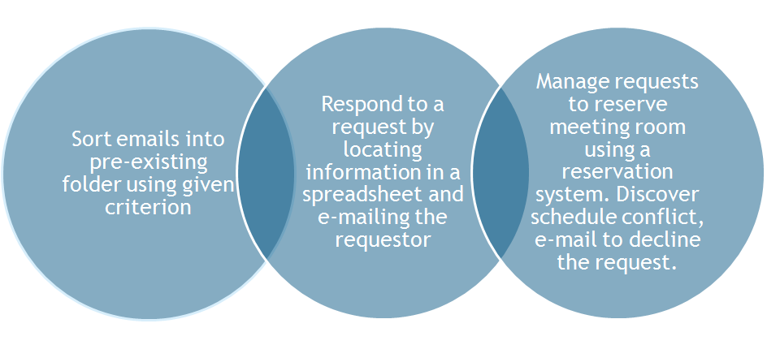
What does the assessment tell us?
Notes:
The assessment scores into levels.
Level 1 - The task is performed in a single and familiar environment and the goal is explicitly stated in operational terms. Solving the problem requires a relatively small number of steps and the use of a restricted range of operators and does not demand a significant amount of monitoring across a large number of actions
Level 2 - The task requires switching between two different applications and involves multiple steps and operators. It also requires some amount of monitoring. Making use of the available tools greatly facilitates identifying the relevant entries.
Level 3 - The task involves multiple applications, a large number of steps, a built-in impasse, and the discovery and use of ad hoc commands in a novel environment. The test-taker has to establish a plan and monitor its implementation in order to minimize the number of conflicts. In addition, the test-taker has to transfer information from one application (e-mail) to another (the room-reservation tool).

Slide 19
Notes:
Does this look like a modern browser? The assessment uses unfamiliar interfaces in order to assess the assessee’s facility in unfamiliar online environments.

Slide 20
Adaptation of assessment
Notes:
The OECD believes that PSTRE skills are impossible to untangle from literacy skills, so the assessment requires that the test taker scores (200) or above in the literacy section. Because of this, the assessment forces people to go through the literacy and numeracy components before unlocking the PSTRE section. Numeracy scores do not matter.
We did not want to ask our patrons to go through extra hours of assessment, since we would not be using that information. We felt that the ability to complete our screening survey ensures that the patron is able to read well enough to complete the assessment.

Slide 21
Gaming the assessment
Notes:
Because the assessment is set up so that people have to go through the literacy and numeracy portions, before accessing the PSTRE, we have to prepare the assessments for patrons. We prepared a cheat sheet, so that we can attain the necessary score.
We recruited volunteers to do this data entry.

Slide 22
Background questionnaire
Notes:
This also means that the person being assessed can’t do the background questionnaire either.

Slide 23
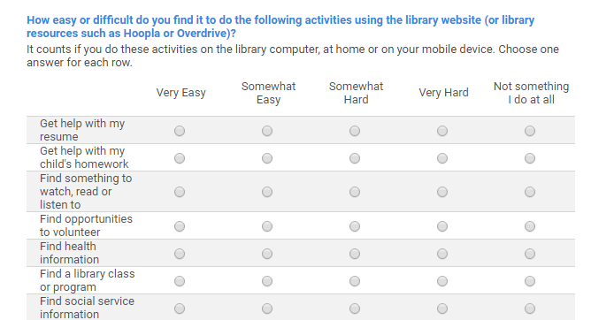
Notes:
We duplicated most of the questions and took the opportunity to add questions of our own. This is how we hope to determine whether or not PSTRE scores relate to how people use the library. Do people with low or average scores (or high scores) have a hard time doing what they want to do at the library?
Our screening survey also replicates the digital skills test we mentioned before - we assess our patrons’ computer skills in advance, so that we don’t invite people without the requisite skills to take the assessment.

Slide 24
Notes:
The survey shows us if the patron can click. We added a “hidden highlight” test to determine whether the patron can use a mouse to highlight (a necessary skill for the assessment).

Slide 25
Staff pilot
Notes:
Before rolling this assessment out to patrons, we wanted to get staff input and buy in. By asking staff to take the assessment, we hoped we could interrupt difficulties in advance, discover the best ways to frame the assessment for our patrons, and be prepared for any potential problems. We also wanted to give staff a chance to see what the assessment is like so that they can answer patron questions.

Slide 26
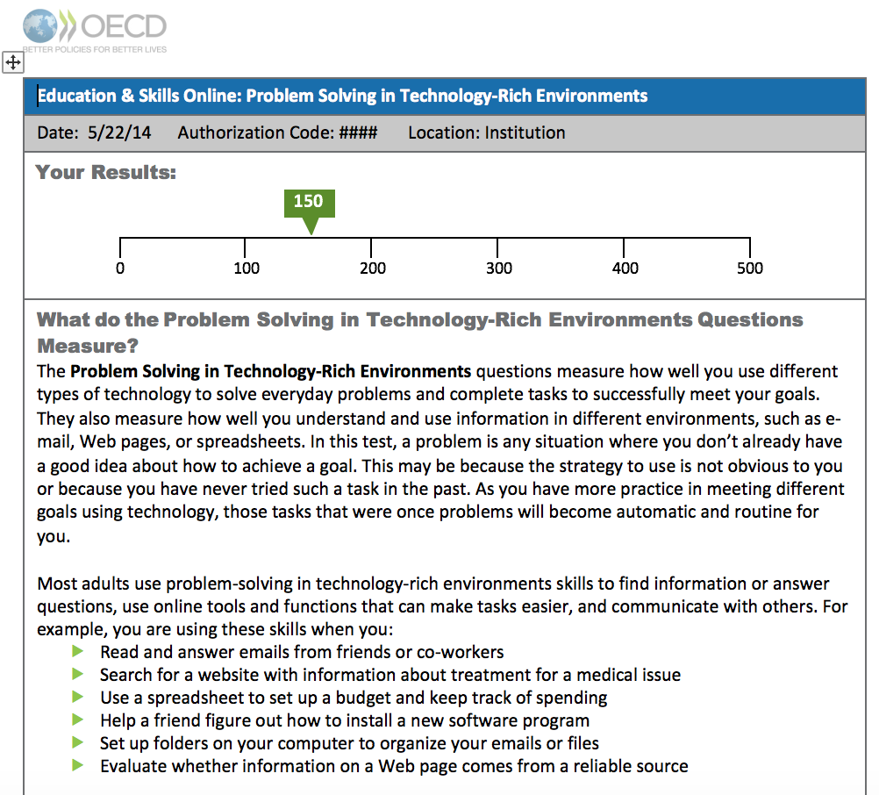
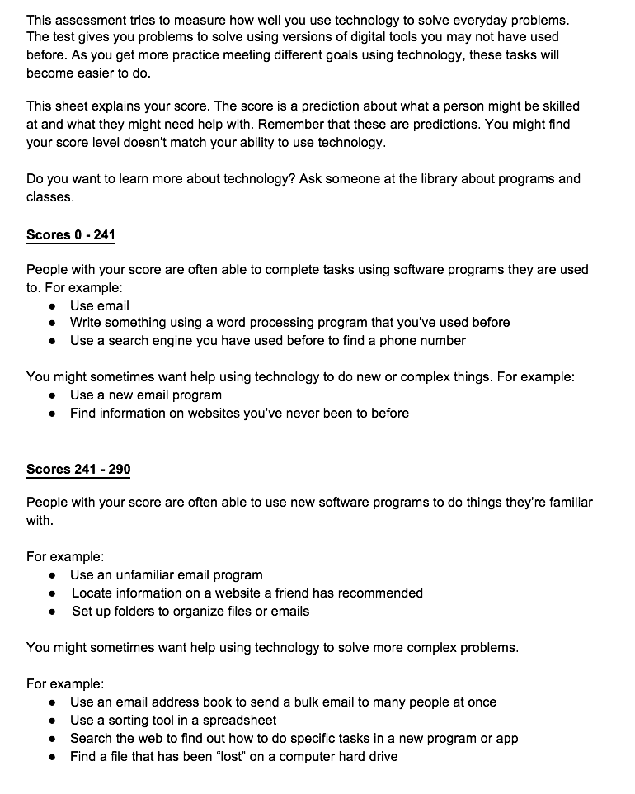
Collaboration is key
Notes:
This project would not have worked without the staff pilot. Staff were incredibly patient, and generous with their time and feedback. Because of this pilot, we improved our protocol, making sure to let patrons know that the interface in the assessment looks weird, and why.
We also learned that the score report generated by the assessment tool is intimidating and dense, so we reworked it using more plain language and adding white space, and including info about taking classes at the library, so that the patron doesn’t feel helpless if their score is not where they’d like.
In general, staff thought the assessment was difficult and might be upsetting for our patrons.

Slide 27
Spanish
Notes:
We also learned something VERY important from the staff pilot - the Spanish language assessment does not use language that staff feel our Spanish speaking patrons will be able to decipher. The language is apparently highly academic. Because of this input, and the input of a bilingual librarian on our team, we have decided NOT to offer the assessment in Spanish.

Slide 28
Results
Notes:
Stories:
Patrons let me know: This is interesting, this reminds me of when I worked, I liked this, this gave me confidence.
A few patrons have let me know they’d like to take some classes and then take the assessment again, which is awesome - shows engagement with learning.
As of now, the number of responses we have is far too low to make any predictions about future responses.

Slide 29
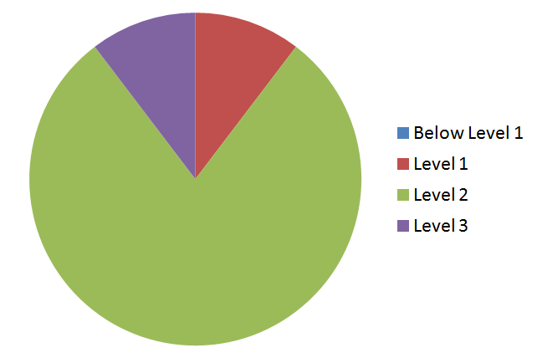
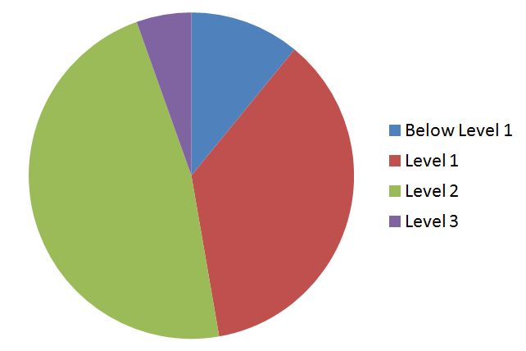
Small sample
Staff - 27 total
Patrons - 55 total
Notes:
Early examination of preliminary data - we don’t know where this will go. Trends are suggested, but may shift as we collect more data.
Staff: 27 took the assessment
Patrons: 55 took assessment
Most people who take this assessment score at level 2.

Slide 30
What does it mean?
Notes:
So, most staff and most patrons (so far) score at level 2. Staff score slightly higher, but not much. Perhaps this means that we need to think about a more collaborative model of digital instruction when we’re thinking about instruction beyond the basics of turning on the computer, using a mouse and getting to the Internet.

Slide 31
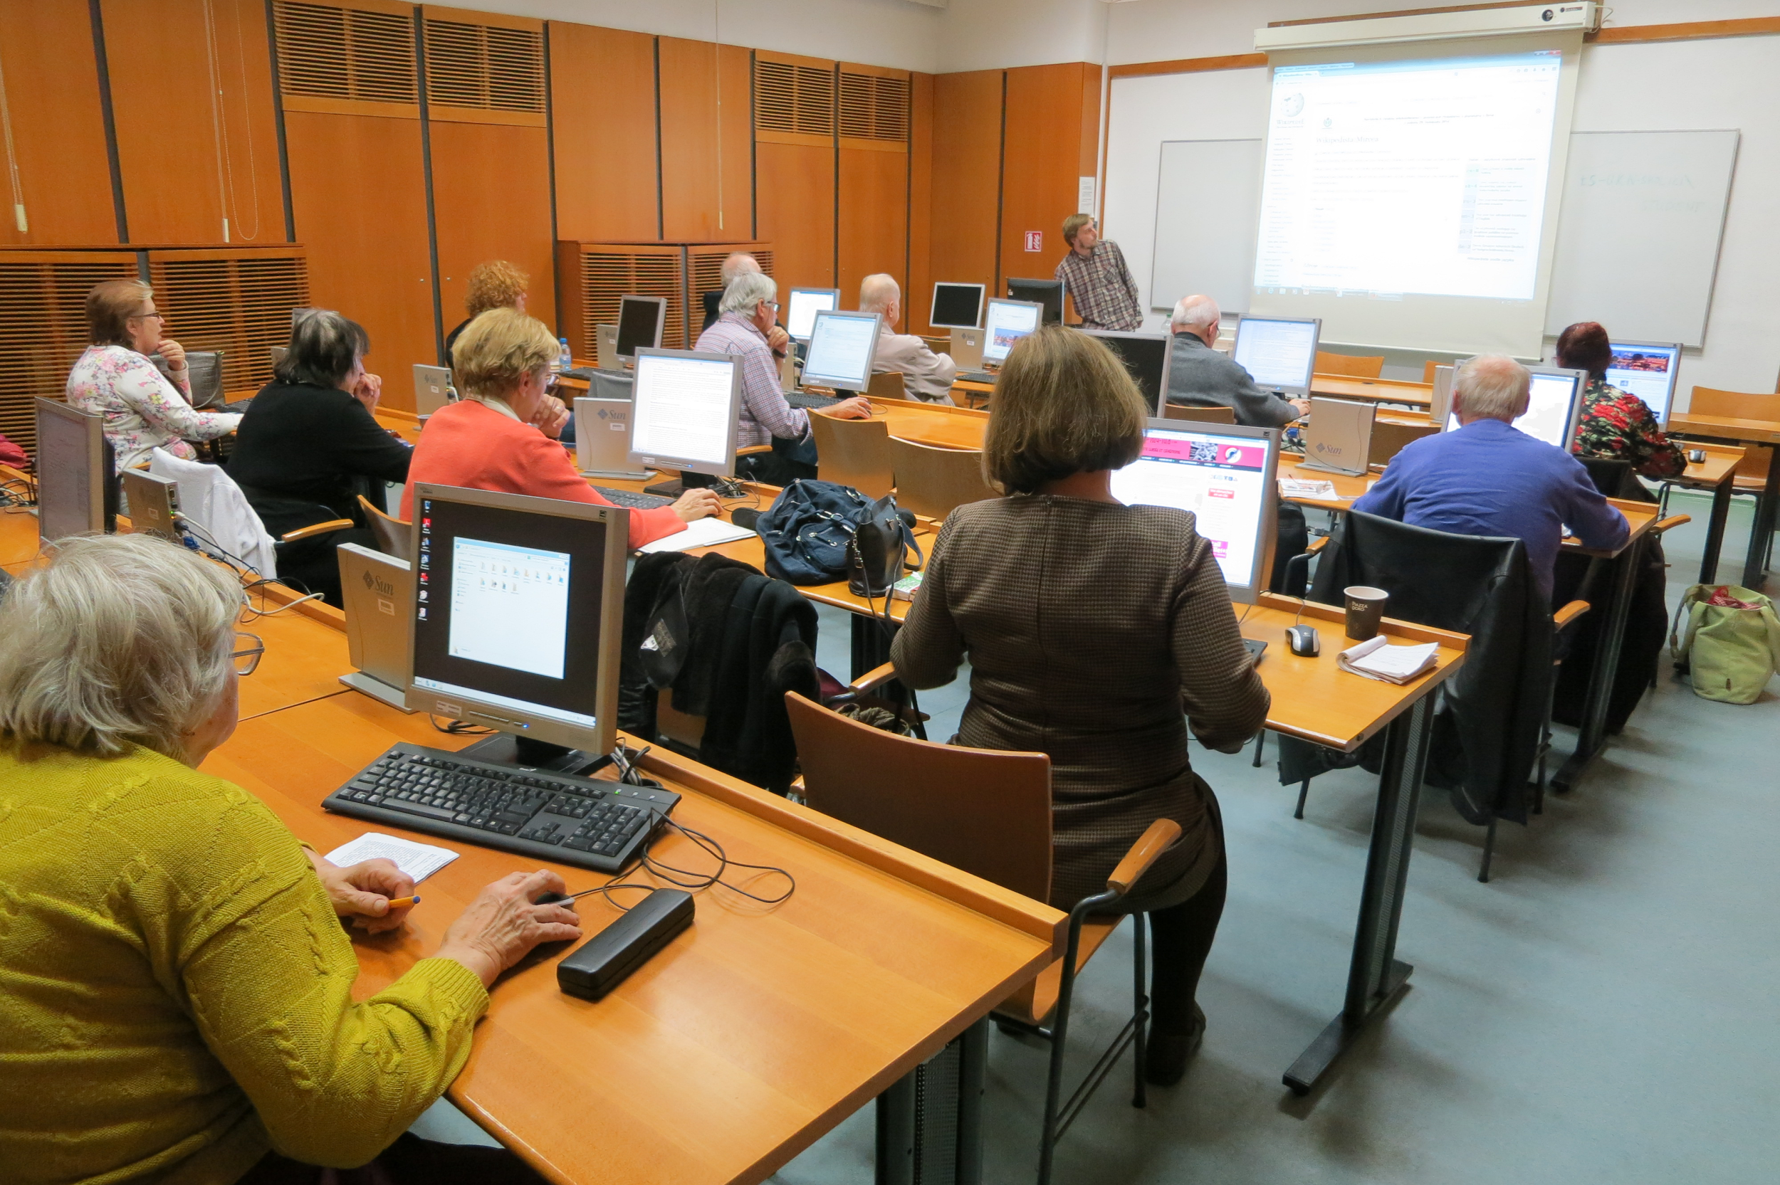
By Pavla Pelikánová (Own work) [CC BY-SA 4.0 (http://creativecommons.org/licenses/by-sa/4.0)], via Wikimedia Commons
Notes:
Maybe less like this and more like

Slide 32
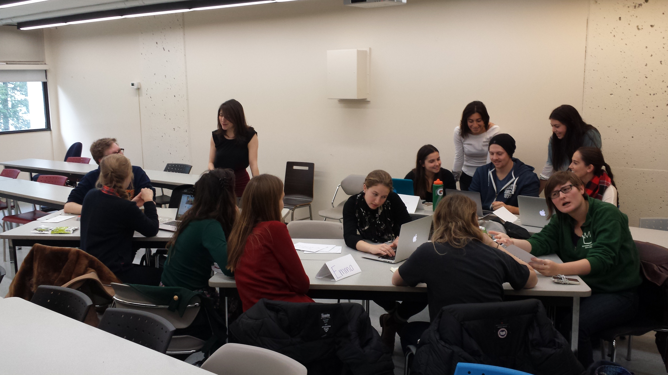
By MonstreDélicat - Own work, CC BY-SA 4.0, https://commons.wikimedia.org/w/index.php?curid=45229162
Notes:
this .
It could also mean that in order to support true digital equity and opportunity, we need to figure out a way to include these cognitive concepts in our training, whether it’s one-on-one or in a classroom.

Slide 33
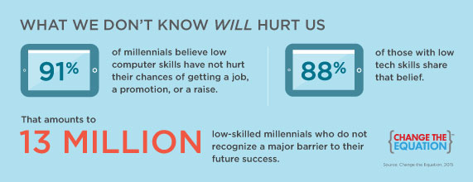
How can we reach people who don’t know they need help?
Notes:
I think it also means that we need to promote our classes in a different way (or an additional way), getting patrons and/or students who have basic computer skills in so that they can get some digital literacy training, as well. I think it means including critical thinking and evaluation in every class we offer, and trying to incorporate those concepts as much as possible when we’re doing informal training in the library (at the reference desk, etc…).
What does that look like? I don’t know… what do you think?

Slide 34
Find information and infographics at the piaac gateway
http://piaacgateway.com/

