Slide 1
Telling the Library’s Story through
LINKED DATA
Crystal Trice, Washington County Cooperative Library Services

Slide 2
1996
2006
2016
Notes:
Let’s say you wanted to know if your local library was open right now.
But let’s also say it’s 1996. What would you do?
What if it were 2006?
What if it were today?
The World Wide Web made data more accessible. Linked Data is making it easier to find.

Slide 3
Notes:
Before the World Wide Web, documents were housed on individual computers. That meant the data was not easily shared.
Tim Berners-Lee, the inventor of HTML, asked people to put their documents online.

Slide 4
?
?
?
?
?
?
?
Notes:
And they did! The Internet is full of documents you can read, and follow links.
Which works well for humans, but not so well for computers. They don’t understand the relationships between things, so they can’t do anything with the data.
There is unlocked potential of doing stuff with the data contained in all these webpages.

Slide 5
Notes:
So, Tim Berners-Lee suggested that people break their webpages up into distinct data that tells computers about the relationships.
And people started experimenting with the semantic web, or linked data. When webpages are broken into individual data points and their relationships,
then powerful connections can be made by the computers.

Slide 6
www.w3.org/TR/rdf11-primer/example-graph-iris.jpg
Notes:
In simple terms, linked data is the relationship between things, and it can be read like a sentence. For example, Bob knows Alice.
This is a sample graph from the W3 website. It shows the linked data and relationships for two websites: Bob’s and a site about the Mona Lisa.
Because of linked data, the computer understands these relationships, and can compile them in a useful way to humans.
In the arrows, you can see some of the linked data frameworks used on the web: foaf, schema, and rdf. They work interchangeably, and are adaptable for each website’s needs.

Slide 7
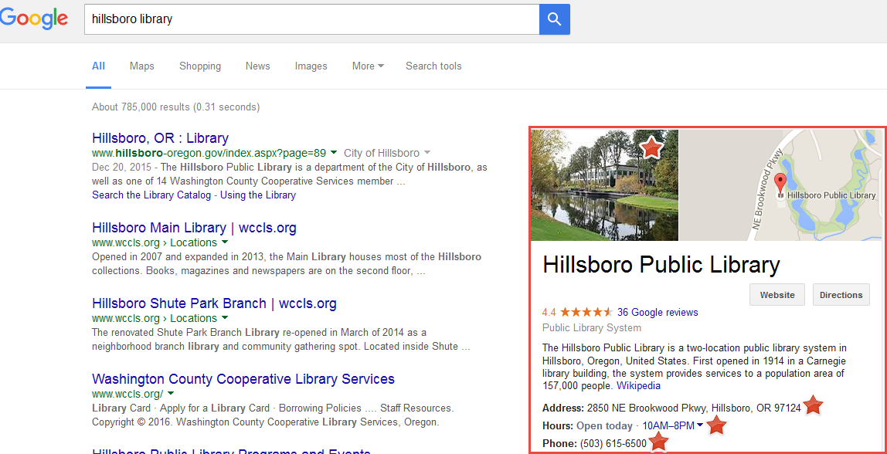
Notes:
Linked data has potential applications that are useful for libraries.
1. Opportunities for cataloging efficiency and innovation
2. More creative applications based on library metadata
3. People can more easily find library resources on the web. Google, Yahoo!, and bing all use linked data in search results.
This is what we’ve focused on at WCCLS – getting noticed on the web.
And we are… we think. Here’s a search for Hillsboro Library on Google. In the “knowledge graph” box on the right, we think at least some of this information is a direct result of linked data. (Fairly certain the photo and open hours; not as sure about the address and phone number.)
Because we are a Cooperative, Hillsboro Public Library has its own website, so Google will also pull data from that and other sources and only Google knows how they decide what data to feature in the “knowledge graph” box.
Let’s backup now and talk about how WCCLS added linked data to our website.

Slide 8
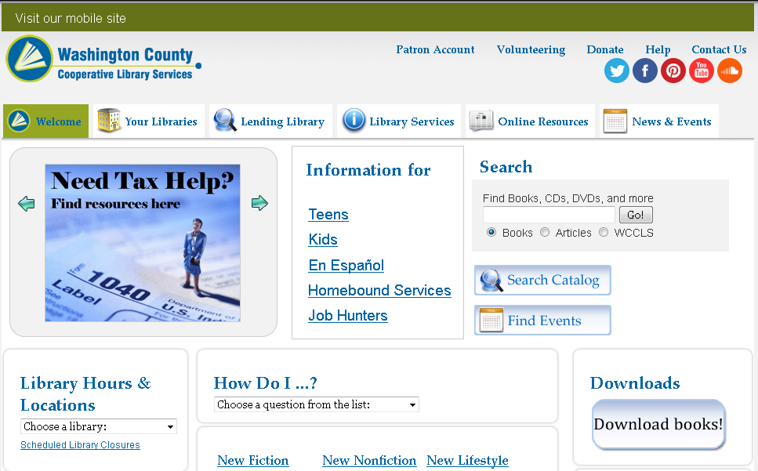
wccls.org on Drupal 6
Notes:
Our previous website was built on the Drupal 6 content management system. Because Drupal 6 was headed for end-of-life, we needed to move to Drupal 7. There wasn’t a simple way to migrate our site, and we wanted to improve usability, so we decided to rebuild the site from scratch.

Slide 9
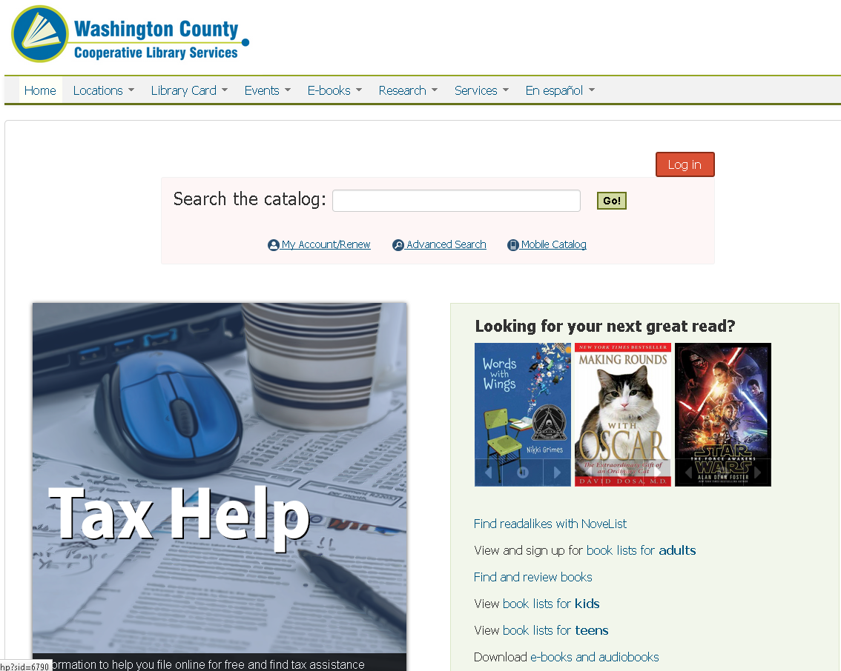
wccls.org on Drupal 7
Notes:
Drupal 7 automatically adds some linked data to all pages, and we have no control over what or how it is done. This is built into Drupal’s Core. It uses several schemas to do so, including Dublin Core and Friend of a Friend.
Marie Martin, our webmaster, decided to increase our use of linked data with our new website since we had the ability to do so. She selected the schema.org module to see if adding the linked data would help make our content more visible in search engines.

Slide 10
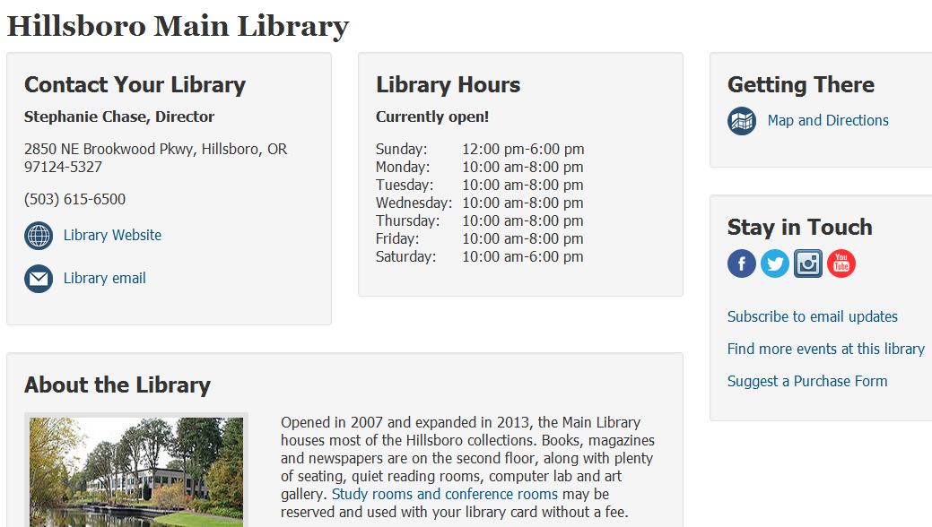
schema:Organization
schema:contactType
schema:address
schema:map
schema:telephone
schema:url
schema:email
schema:openingHoursSpecification
schema:photo
schema:about
Notes:
The Schema.org module allows us to add a schema.org type and property to each of our content types.
For example, our Library pages are a type of Schema.org “Organization”. From here we add further definition to the individual elements of a given content type.
Continuing with our Library pages, we’ve identified the picture of the library as a photo of the organization;
the descriptive text as the “about” content;
the director as the “Contact Type”;
the address as the address;
the link to Google Maps as a map;
the library website address as the official URL;
and the list of library hours as the “openingHoursSpecification”.
Drupal actually has over 70 other modules if you want more control over your RDF, but schema.org seems to be meeting our needs.

Slide 11
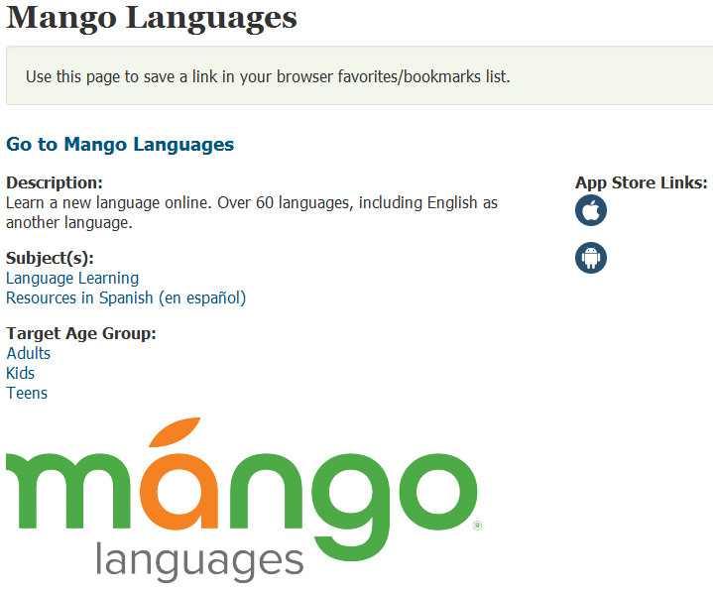
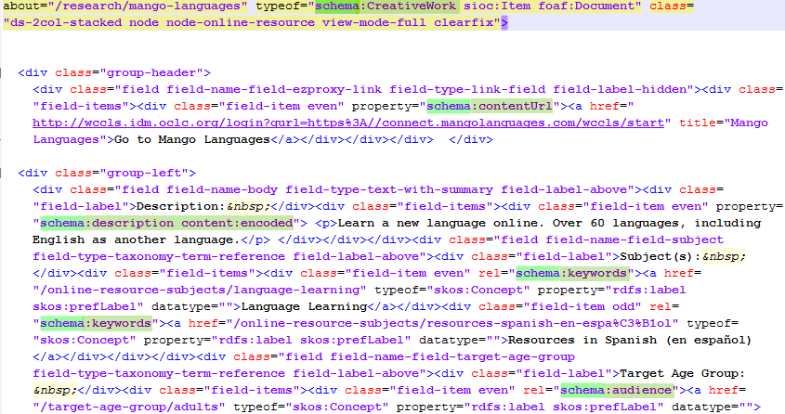
Notes:
Here’s a screenshot of how linked data appears in the HTML for the other area that we’ve added data for: Research resources. You can see the schema properties highlighted in green within the code.

Slide 12
Notes:
The Google Developer page on Structured Data for local business information indicates that using the openHoursSpecification for hours will help get that data into the knowledge graph about your business. Hours information is present for all of our member library websites, but as far as we know is not marked as such in the HTML with RDF data on their own sites.

Slide 13
Notes:
We also think that some of our research resources are appearing more in search results, depending on if people search for words in the resource descriptions.

Slide 14
Notes:
Is it worth it? It took Marie approximately two hours to add the linked data necessary to our library locations and research pages. This includes time searching the online schema.org to see which terms would work for us, and trying it in the Drupal module schema.org. We think that’s a small investment for what we hope is really helping people’s search results. Just having the open hours available is a big plus.
And in the overall scheme of linked data: By making the computers happy (helping them understand the meaning of what we put on the web), humans will be happier with their search results, too.

