Slide 1
Stark Raving OYAN
Book Rave and Graphic Rave Revealed
With
Sonja Somerville, Salem Public Library Traci Glass, Eugene Public Library Ian Duncanson, Beaverton City Library

Slide 2
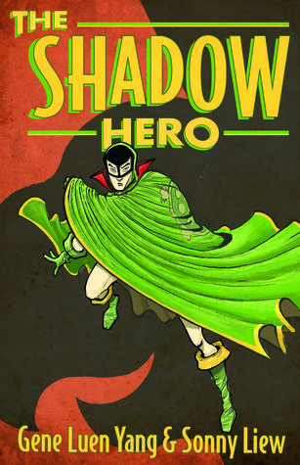
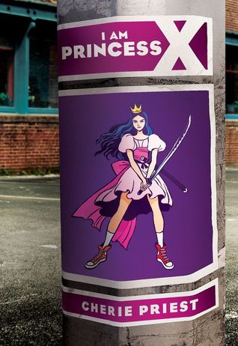
Sonja – Uniquely Heroic

Slide 3
Ian – Oddly Connected

Slide 4
Traci – Rooted in History

Slide 5
Sonja – Again with the History

Slide 6
Ian – Little More History

Slide 7
Traci – Trouble on the Home Front

Slide 8
Sonja – Misguided Loyalties

Slide 9
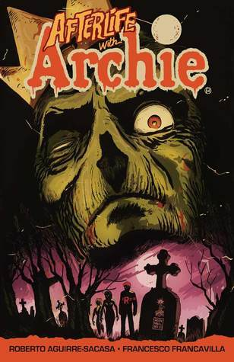
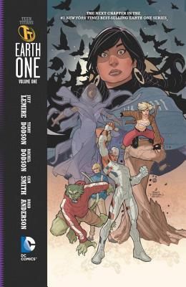
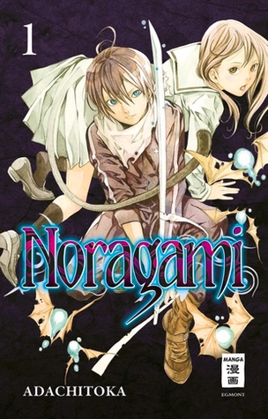
Ian – Graphic Thrills

Slide 10
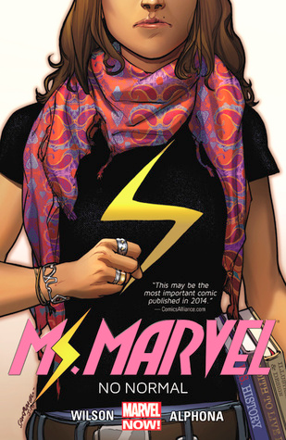
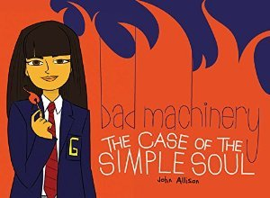
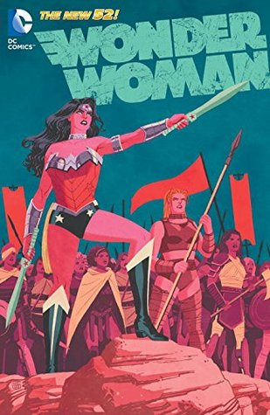
Traci – More Graphic Thrills

Slide 11
Sonja – Inspiring Reality

Slide 12
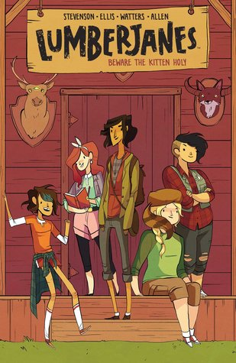
Ian – Tough Situations

Slide 13
Traci – Supernatural Vibes

Slide 14
Sonja – Deeply Creepy

Slide 15
Ian – Girls Figure it Out

Slide 16
Traci – Overcoming Challenges

Slide 17
And now ….
The Even-More Super-Secret Ravers Choice Selections
of
Recently Discovered Books that Blew Our Minds!

Slide 18
Sonja – Hot Stuff
February 2016
March 2016
March 2016

Slide 19
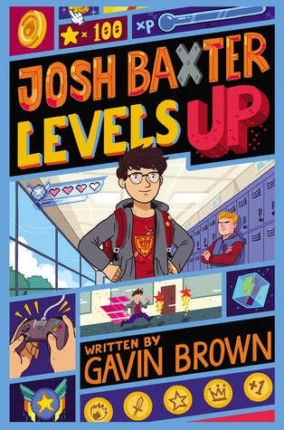
Ian – From Dark to Light
January 2016
January 2016
February 2016

Slide 20
Traci – Extreme Circumstances
February 2016
April 2016
October 2016

