Slide 1
Embedded Professionals at the Library
OLA Conference
Bend, Oregon
April 22, 2016

Slide 2
Introductions
Paul Addis, Reference Librarian (Coos Bay PL)
Gary Furuyama (Digital Literacy & Job Skills Trainer, AmeriCorps)
Sarah Kelley (Program Director, Thrive C.O.)
Liisa Sjoblom (Community Librarian, DPL)
Kevin Barclay (Assistant Director, DPL)

Slide 3
A Brief History of Embedded
Journalism
Academic Libraries
“Provide specialized services to specific groups where they are co-located.”
Public Libraries
Community Reference (Douglas County, CO)
Notes:
Embedded Journalism

Slide 4
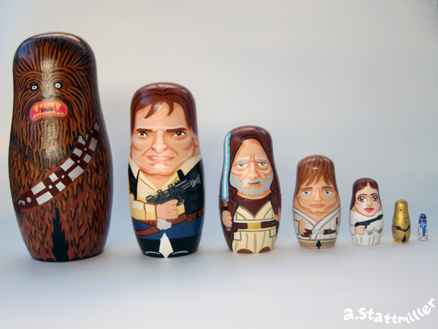
Embedded Professionals
Social Workers
Attorneys
Business Mentors
Health Care
Employment and Career Support
Tax Assistance

Slide 5
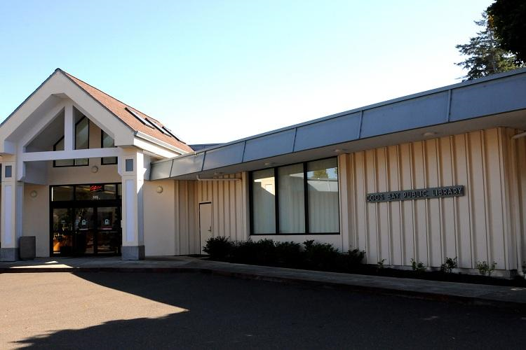
Coos Bay Issues
Large Digital Divide
Difficulty recruiting & retaining volunteers
Solution—AmeriCorps Member

Slide 6
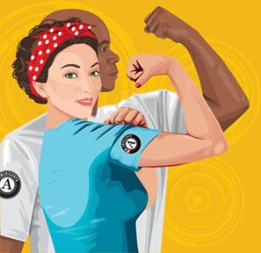
How to Get an AmeriCorps Member
Apply for Project
Rolling Interviews
Library’s Financial Contribution—Cash Match
Notes:
Embedded Journalism

Slide 7
AmeriCorps Sites Provide
Cash match per member service year
Training, professional development, and mentorship for member
Funding for travel, supplies, and materials
Office space
Recruitment strategies
Notes:
Embedded Journalism

Slide 8
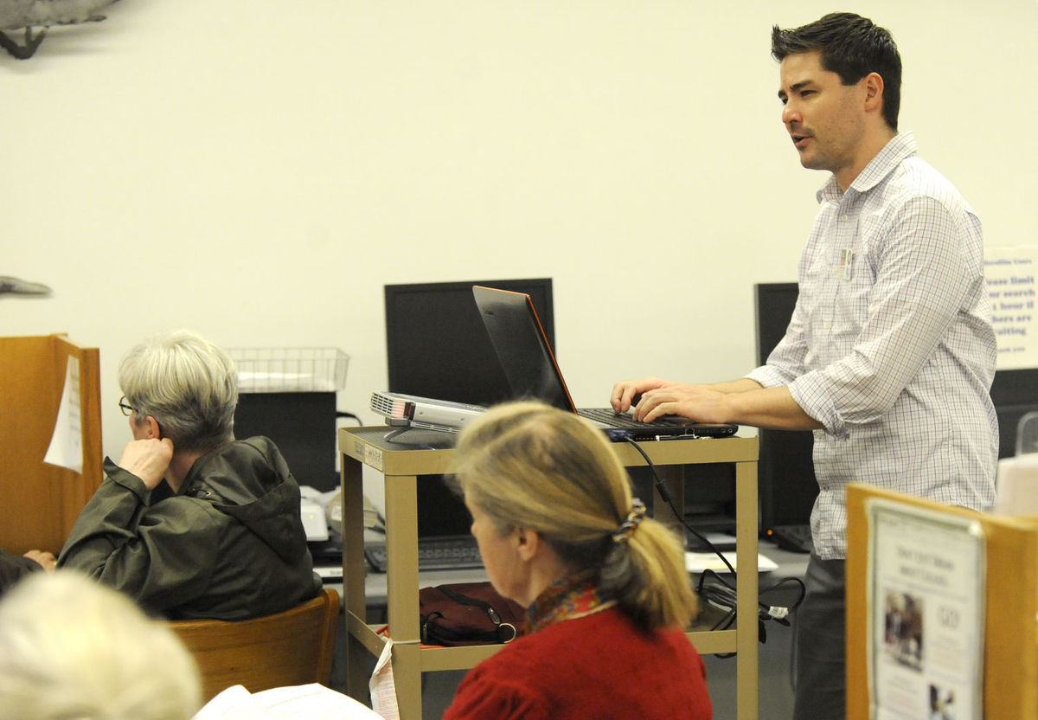
Member Benefits
Monthly Stipend ($1,139)
Education Benefit ($5,645)
Plus . . .
Notes:
Embedded Journalism

Slide 9
Contact
Coos Bay Library—Paul Addis, paddis@cclsd.org
Coos Bay Library/AmeriCorps—Gary Furuyama, gfuruyama@cclsd.org
AmeriCorps UCAN—Sarah McGregor, Director, Sarah.McGregor@ucancap.org
AmeriCorps Oregon, Paul Brown at Oregon Volunteers, (888) 353-4483
Notes:
Embedded Journalism

Slide 10
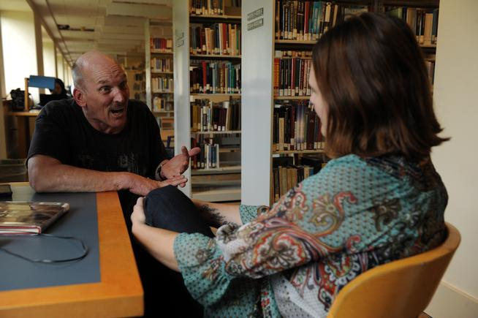
Social Worker in the Library, Thrive Central Oregon
History of SWiTL
Examples of SWiTL
Program Designs
SWiTL at DPL
Notes:
Embedded Journalism

Slide 11
Thrive Services Provided at DPL
Connecting Customers to the support resources they seek
Weekly, walk-in availability
Community Partnerships
Library Support
thrivecentraloregon@gmail.com
Notes:
Embedded Journalism

Slide 12
SCORE at DPL
Supported by the SBA
Retired Business Professionals
Formation, Growth, and Success

Slide 13
SCORE at DPL
Weekly Counseling Sessions
30-minute walk-in appointments
Monthly Workshops
Business Planning & Goal Setting
Managing Your Operations
Basic Selling Techniques for Small Business
Social Media: You’re Social, Now What?
Small Business Financing Options

Slide 14
SCORE Benefits for DPL
Improved Community Relations
Referrals
Access to the Business Community
Private Confidential Sessions
Centrally Located/Easily Accessible
Immediate Access to Business Resources
Visibility
Cost

Slide 15
Potential Legal Partnerships at DPL
Deschutes County Law Library
Lawyer-in-the-Library
Models Across the U.S.
Solano County Library, Benicia, CA
Enoch Pratt Free Library, Baltimore, MD
Alameda County Law Library, Oakland, CA

Slide 16
Challenges and Opportunities Q&A

