Slide 1
Lessons in Leadership: Stories from the Field
Elaine Hirsch, Lewis & Clark
Uta Hussong-Christian, OSU
Suzanne Sager, PSU
Steve Silver, Northwest Christian
Ian Scofield , OSU
OLA Annual Conference
April 22, 2016
Notes:
Good Morning! Thank you for being here with us today for Lessons in Leadership: Stories from the Field. I’m Uta Hussong-Christian from Oregon State. I will be moderating this panel today. I’ll introduce our four panelists in just a moment. I want to start by sharing just briefly the way this panel came about. At its simplest, it was the combination of two session proposals related to leadership - one proposal by Elaine Hirsch and one by me. One proposal was focused on highlighting and showcasing opportunities to get professionally involved, especially in OLA...a timely proposal especially considering yesterday’s lunchtime remarks about how OLA depends on involvement from its members to do what it does at all levels of the organization. The other proposal was focused on sharing leadership tips from library staff who had attended professional development or leadership training...training that is often expensive and not always accessible to anyone and everyone who wants it. So Elaine and I have attempted to craft a session that combines those two ideas into one session...a session that broadly focuses on a variety of professional development opportunities and how those trainings impacted the kinds of leadership each panelist has provided or facilitated for the organizations with which they are involved. Today they will share with you their leadership stories.
Our panelists, in order, are:
Ian Scofield from Oregon State University (I’d like to welcome Ian as one of the conference’s first time attendees)
Suzanne Sager from Portland State University
Elaine Hirsch from Lewis and Clark College and
Steve Silver from Northwest Christian University
Before we jump into their presentations, I do want to say a few words about leadership. If I asked each one of you for a definition of leadership, we’d probably get about as many different definitions as there are attendees today. Some define it by personality traits, some define it by results achieved, some simply define it as the position at the top of an organization or entity.

Slide 2
Leadership is a process of social influence, which maximizes the efforts of others, towards the achievement of a goal.
- Kevin Kruse, 2013
Notes:
But one definition that resonated with me is the one offered by Kevin Kruse, a Forbes contributor and NY Times bestselling author. Kruse’s definition of leadership opens up the path for employees at every level of an organization to become leaders. His definition takes the emphasis off individual achievement, and those at the top of the organization, and makes it clear that no matter where one is in the library, one can lead.

Slide 3
LEADERSHIP
“Social influence” enables leadership at any level…something that libraries and library organizations depend on to thrive.
Notes:
When leaders are present or developed at every level of the organization, libraries and library organizations thrive.
I think each panelist today has a story to share about how they are working toward or working on social influence that betters their organization as a whole. Let’s see what you all think.

Slide 4
Ian Scofield
Electronic Resources Technician
Oregon State University Libraries & Press

Slide 5
About Me
Library Technician III @ OSU Libraries since 2007
Electronic Resources Management
Acquisitions Team Member
Legacy ILS Administration (2012-2014)
SILS representative for E-resources/Acquisitions (2013-present)
Part-Time Undergraduate @ OSU 2007-2012 (BA English Literature)
Photo: “OSU Valley Library”, Gary Halvorson, OSU Archives
Notes:
LT 3 @ OSU 9 years. Main duties - E-resources access management, supporting Acquisitions staff with e-resource purchase issues, and Collection development with E-resources collection evaluation projects. 5 years ago, became the administrator for our now be decommissioned catalog system (iii Millennium), and am now new catalog expert lead (ALMA/PRIMO)- E-resources, Acquisitions, and Administration. Over my OSU time, we had several staff retirements and unit manager transitions. Also a part-time undergraduate English Literature 1st 5 years.

Slide 6
“A-ha!”: Anyone Can Be a Leader
Photo: “Manila Bay Sunset” by Waiting for serendipity, used under CC BY 3.0
Notes:
Today, I want to talk to you about some of my experiences that have reinforced in me this idea that Anyone Can Be a Leader. I specifically want to show how some of the best professional development opportunities I have had have led to some great breakthroughs or some great opportunities to make an impact in my organization. In particular, it was the “A-Ha” moments within my professional development experiences that were most impactful for me and ultimately for OSU Libraries.

Slide 7
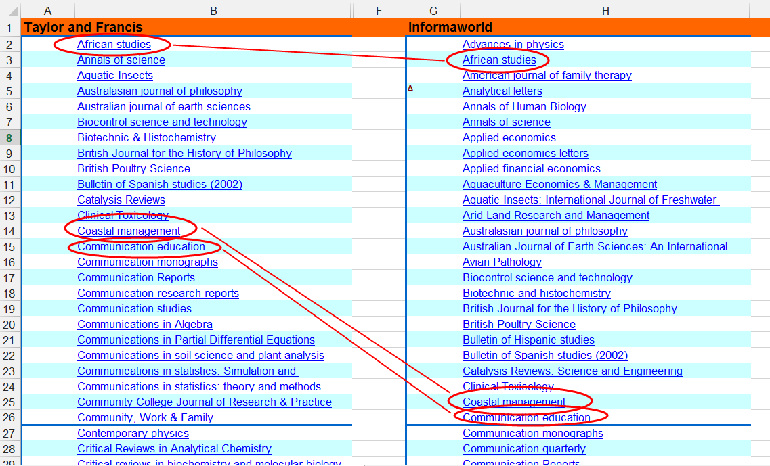
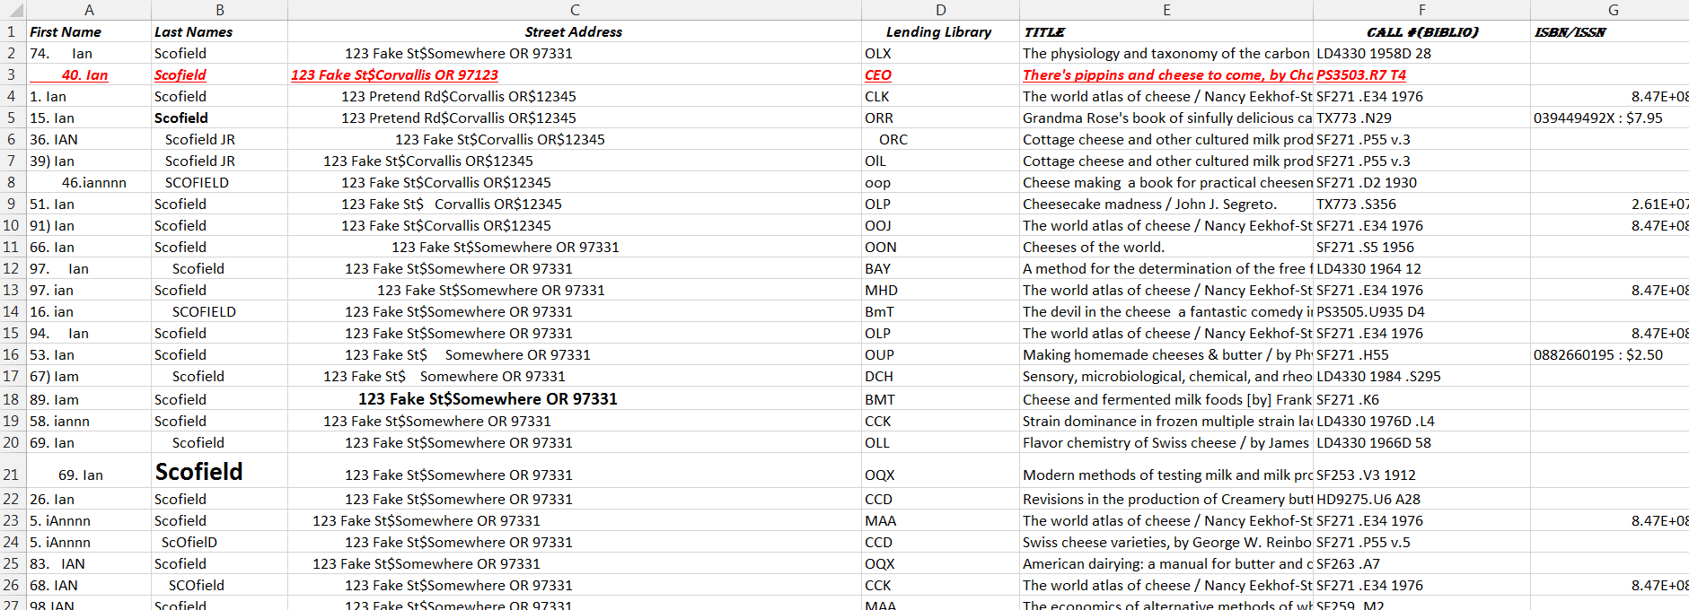
EXCEL CHALLENGES
Notes:
Who here uses Excel on a regular basis? Who here feels they are an excel expert yet? Throughout my time at OSU, we have made many changes in our collections. There were many Print to Electronic conversions, cuts, additions, and publisher platform changes. Over my first 4 years, I had many chances to discover how little I knew about Excel. Simple tasks like sorting and formatting were a struggle. It was like only knowing how to type with one finger- painfully slow. I realized I needed to know more - at least for my own sanity.

Slide 8
THE EXCEL SEMINAR “A-HA!”
Notes:
In Fall 2011, I went to a 1-hour Excel workshop at an OSU Training Days event. I was amazed at how easily the instructors navigated their spreadsheets and selected ranges, how they could sort and filter cells and rows, and how simple it was to learn and use basic formulas and conditional formatting operations to do huge tasks in seconds that would take me hours. It was like watching a magic show. But unlike any good magic show, the secrets were up for grabs. I was ready to become an excel magician.

Slide 9
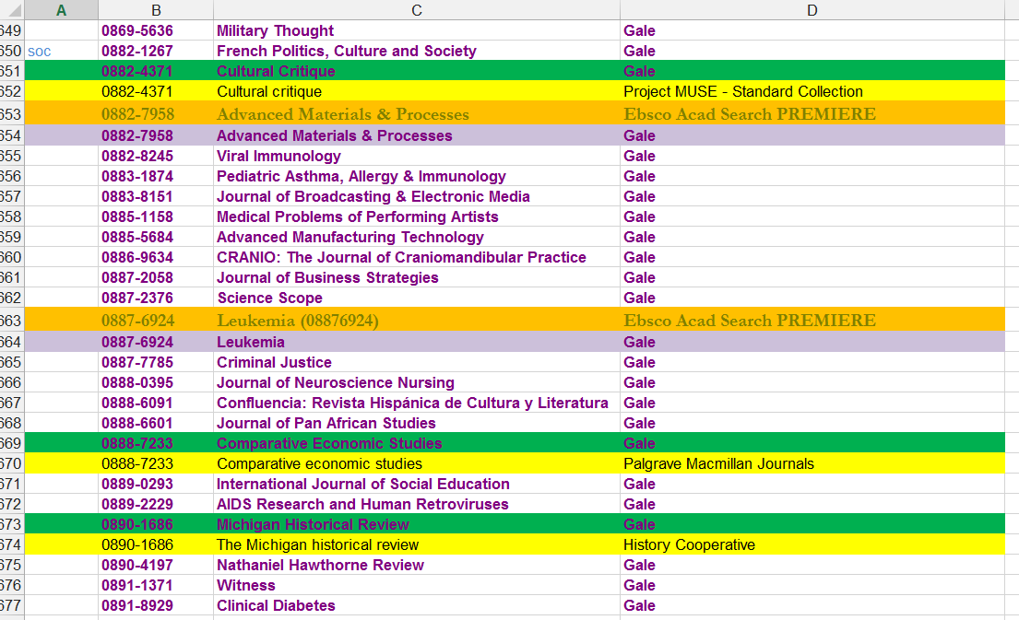
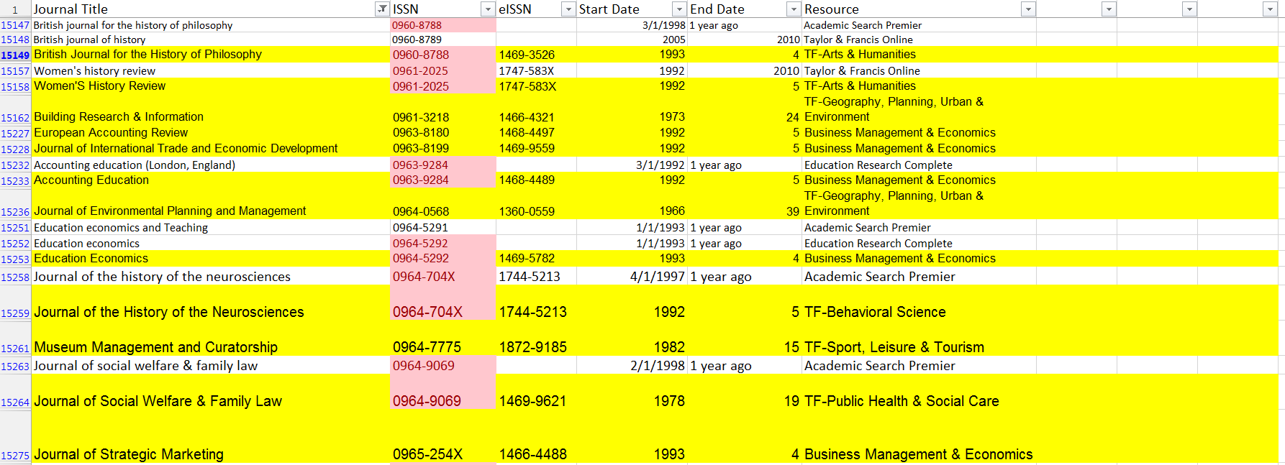
“EXCEL”ENT OPPORTUNITIES TO LEARN
Notes:
Becoming an Excel magician was not always easy, but it has been worth it. Let me encourage you, if you need to know how to use Excel better, but have been reluctant to take on the challenge, don’t hesitate any longer. It will change your life. Relationships with co-workers will improve, you’ll sleep better at night, and yes, of course, you will get so much more done. Immediately after that class I had an overlap analysis project that I had been working on for weeks with little progress. After stumbling through my new learnings, I cut my remaining time from many more weeks to just a few more hours. From there, I learned new skills as needed. Messy spreadsheets - no problem. Huge amounts of data to sort and weed through - no problem. Here’s something you can do more efficiently with a VLOOKUP table - now enjoy the rest of your week off. These skills helped with other acquisitions work, e-resource tasks (url/coverage date cleanup, proxy log analysis, coverage load of Serials Solutions to Millennium).

Slide 10
Leadership is choosing to make a difference
Leadership involves utilizing our strengths
Anyone can be a Leader
Logo: “Lead the Change”, North Carolina Library Association
Photo: “Rowing on the Willamette River, Portland, Oregon” by Kris, used under CC BY 2.0
Notes:
A couple years later, the library had a new strategic plan in place that was calling for a lot of changes over the next 5 years. One of the initiatives involved migrating to a new catalog system along with 37 other libraries in the ORBIS Cascade Alliance. Another called for everyone in the Libraries to take advantage of more Professional Development Opportunities. When I was asked to go to Portland with almost a dozen other OSU Libraries Staff and Faculty to attend the Lead the Change conference, I knew it was an opportunity I couldn’t turn down. I had slowly been becoming more involved in the Migration Project, and I had a feeling I was going to learn something that could help me prepare for my future.
While much of the event was geared towards inspiring public libraries to make an impact in their communities, there was some useful discussion on Leadership that has stuck with me ever since. They talked a lot about how Leadership is a choice we make to make a difference. It involves making an active, ongoing effort to look for the possibilities in whatever change is coming rather than being scared away by the limitations. They told us that leadership would be a test of our courage, and that it was the most rewarding when we found ways to empower others to achieve the impossible.
They also talked about the importance of knowing and utilizing our own strengths to make the best impact for our organizations. We were given a Leadership Orientation survey to assess ourselves. I wasn’t surprised to find that my orientation was heavily Structural (“has good analytical skills and can design structures/systems that get the job done”) and secondly Human Resource (“Good at teamwork, interpersonal relations, can support/empower others”) more so than Symbolic (Visionary and Inspirational) or Political (Organizer and Group Mobilizer). What struck me the most was the way this information, was presented so differently than what my internal dialogue kept telling me: Anyone can be a leader. Of all 4 orientations, none was picked as THE leader orientation needed for success. They all had their strengths, they were all needed. There wasn’t even mention of whether or not your public speaking ability makes you a better leader or not. They all gave the same answer: Anyone can be a leader. - Not even you, but Especially YOU! So I stopped worrying about my weaknesses so much (like public speaking and leading groups) and started focusing on my strengths instead.

Slide 11
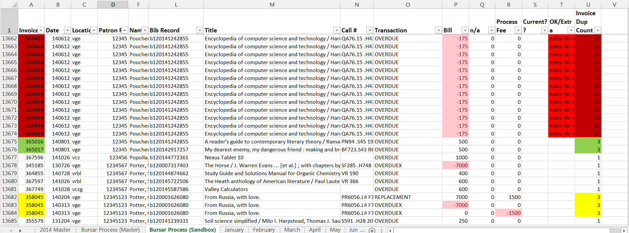
MAKING AN “EXCEL”ENT DIFFERENCE
Notes:
One of my first impactful leadership examples after Lead the Change involved the fines and fees from our old catalog. About a year before we were scheduled to migrate to the new SILS, Circulation asked me, as the catalog Admin, for help with a bug in their Fines & Fees processing. It was creating many extra credits when patrons accrued overdue fees. It was essentially going to look like we were rewarding patrons for returning their loans late. After much discussion with iii and iii peers, we were told the only easy fix would be to upgrade - but it would cost too much, taken staff resources we didn’t have, and the upgrade process is notorious for breaking other things. I talked one-on-one with Circulation staff who processed the file, and discovered that there was a way to find and erase the erroneous credits - it would just take hours and hours of manual examination (and cross examination of previous month’s activities too). As I understood the process better, I realized I could use some fancy Excel functions to create a report that would find most of the problems for us. So, with a little help from my friends sort, filter, conditional formatting, and the COUNTIF formula, I was able to create a monthly excel routine to process the new charges, and find the mistakes so they could easily be weeded out before we sent the final file to OSU’s accounting office. As a result, we saved $100’s monthly in 2014 from having to be painfully reversed after credit would have been issued to patron accounts. Circulation was thrilled not to need to have those awkward conversations with patrons.

Slide 12
ANYONE CAN BE A LEADER – CATALOG MIGRATION
Logo: “Alma”
Logo: “ExLibris”
Logo: “Millennium”
Logo: “Primo”
Notes:
My initial notions of being on a big, cross-library 8 person team project were that I would be expected to have big ideas and make grand efforts to be a successful member. While this was somewhat true, in reality all I had to do was utilize my strengths. Thanks “Lead the Change.” In between weekly team meetings with other unit representatives in Circulation, Cataloging, Web Display, Library Teaching, and quite a few multi-day off-campus workshop and training sessions, I was spending much time with my co-workers in serials, electronic resources, and acquisitions, working to make sure all of our information would get migrated properly. This meant a lot of one-on-one conversations about concerns, wishes, and potential realities. We worked through a few of the many field mapping forms for the project, to make sure all the information (that my unit was concerned with) in the old catalog would appear in the right places in the new catalog. This meant trying to learn together how the new system would operate - what were its enhancements and limitations. I don’t know if I made a huge difference in staff perceptions and opinions of the new system (there are mixed opinions on how good or terrible it is), but I have been told that the personal time I took was much appreciated.

Slide 13
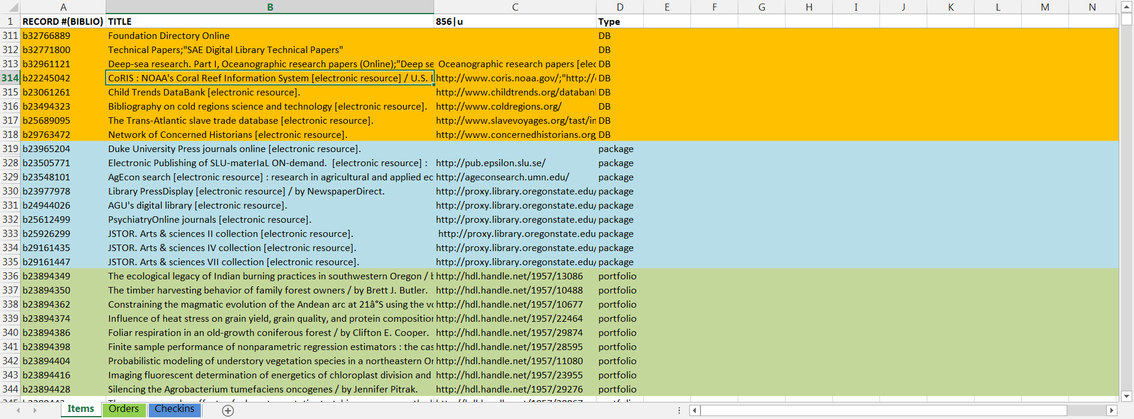
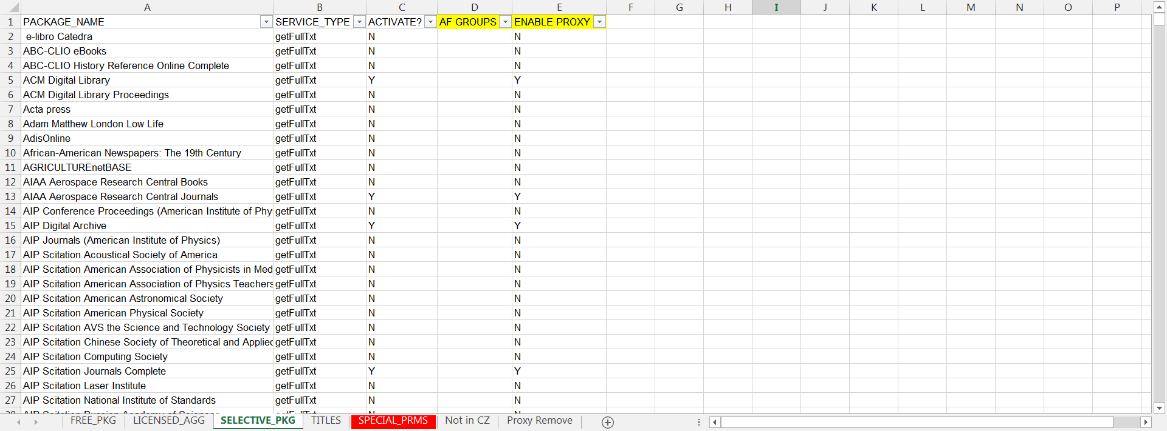
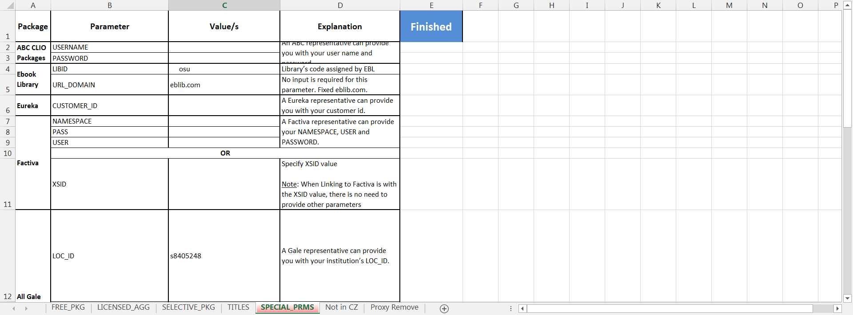
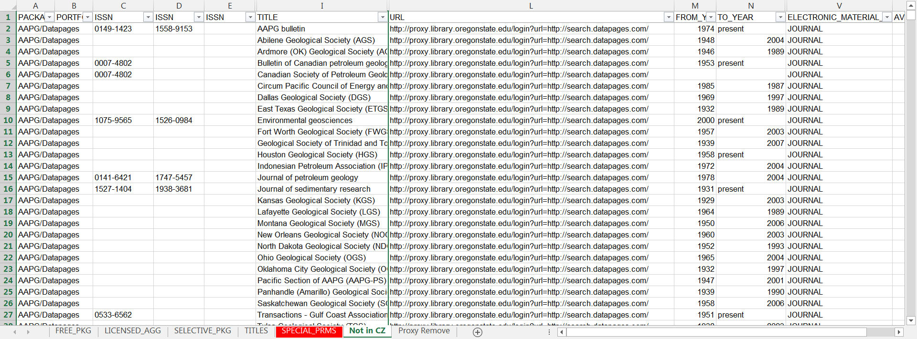
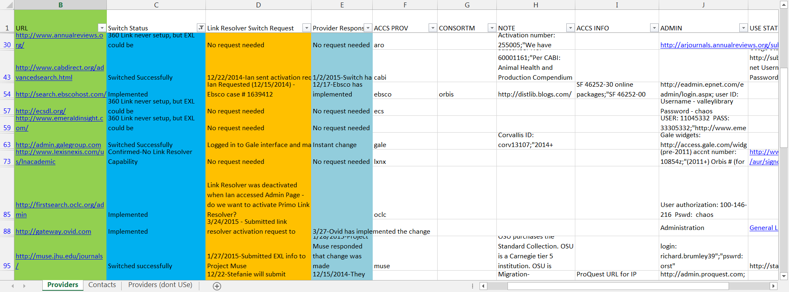
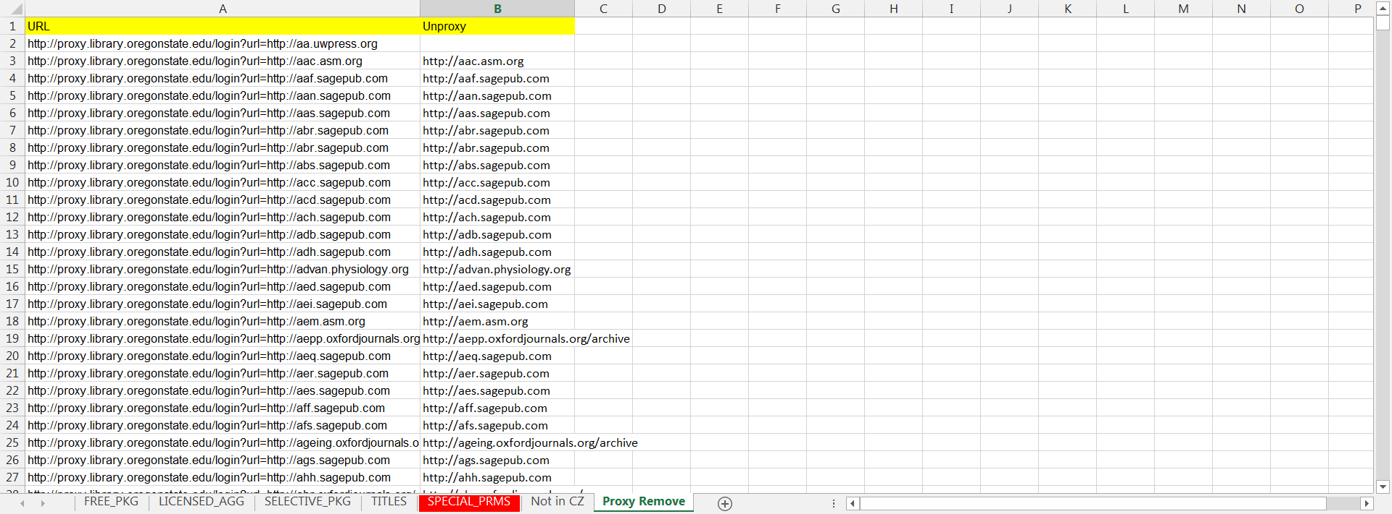
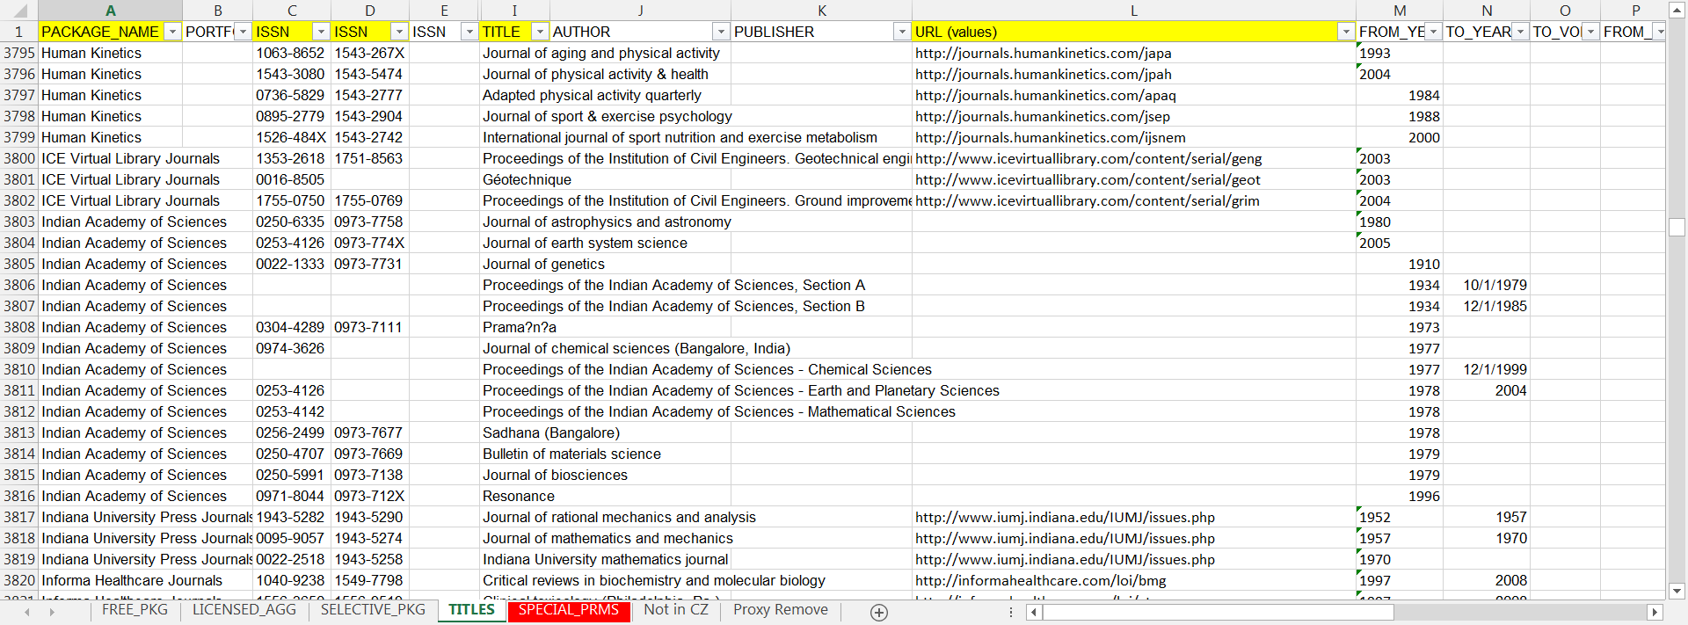
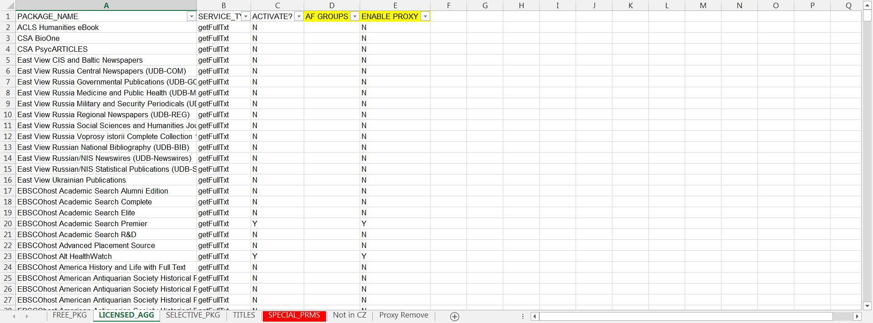
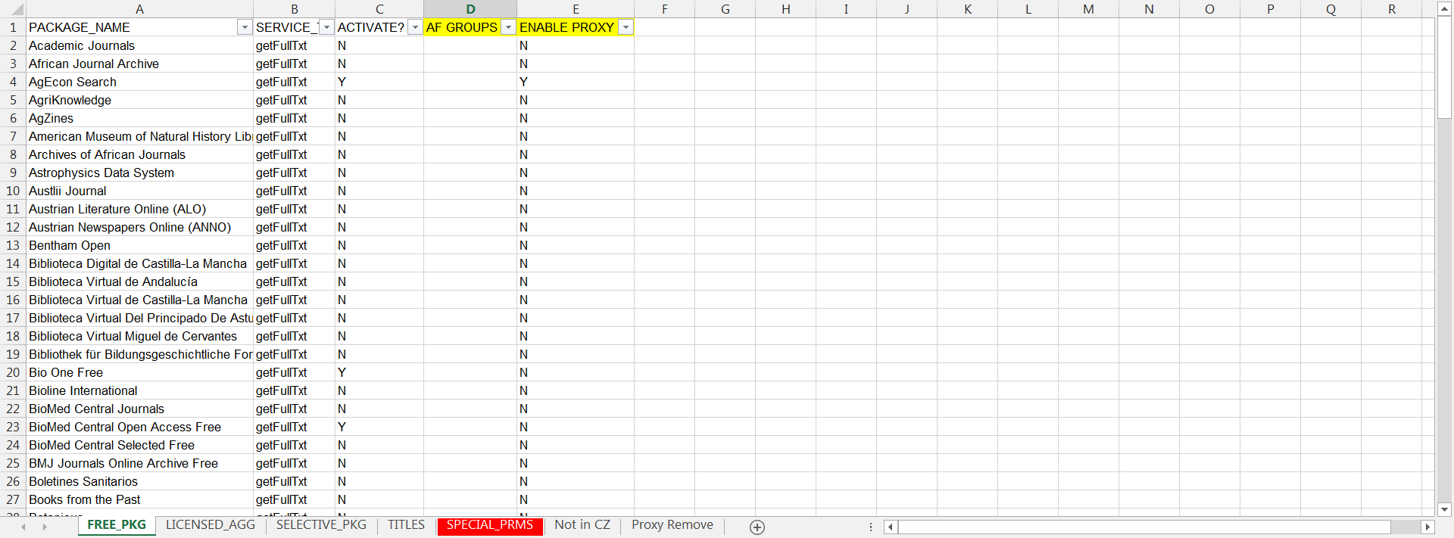
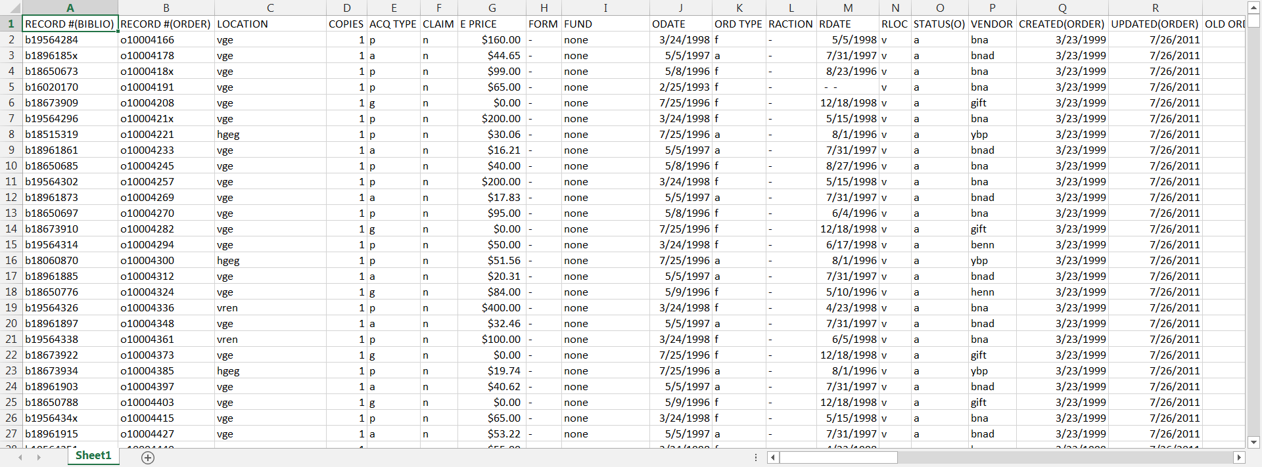
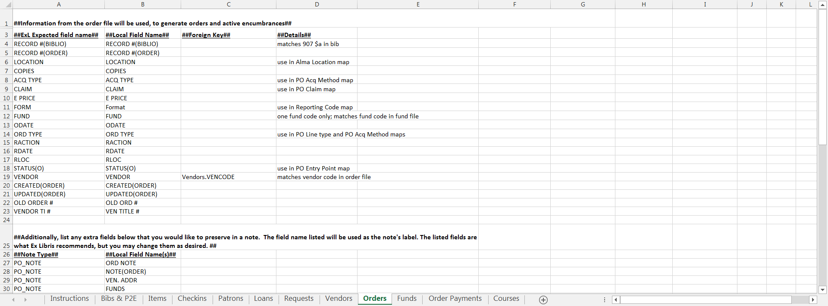
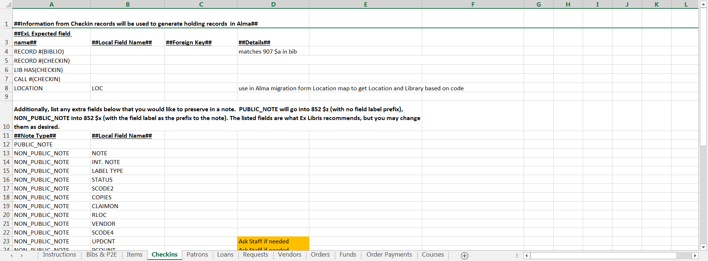
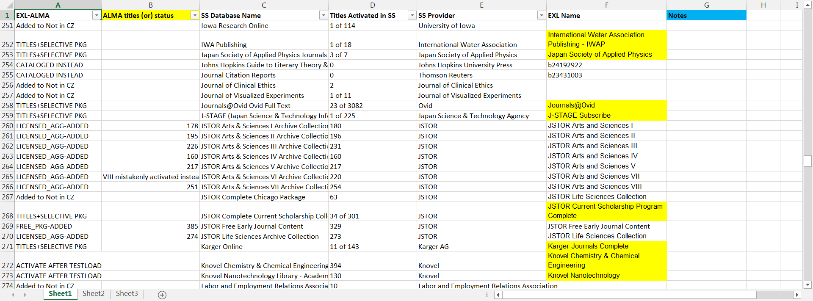
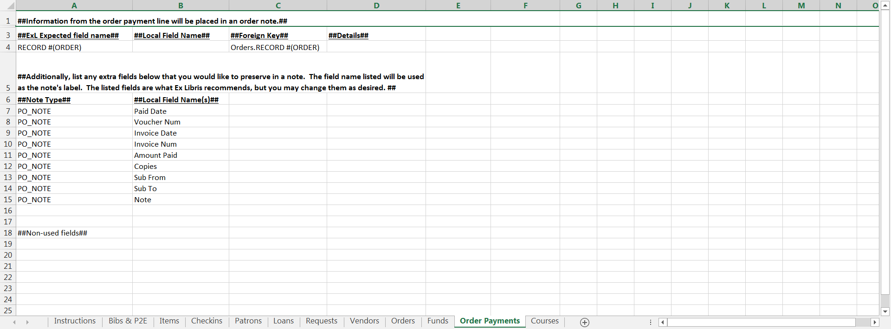
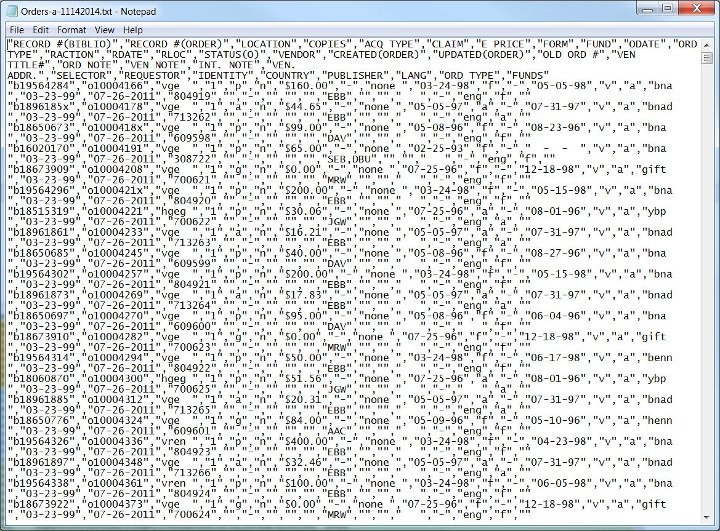
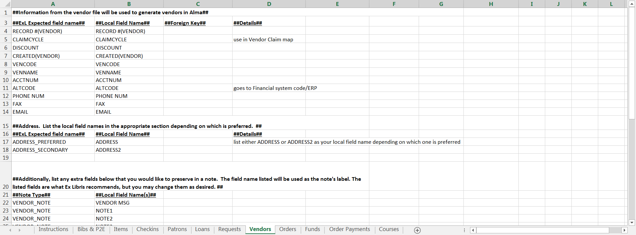
USING “EXCEL”ENT STRENGTHS
Notes:
With any great (or not so great) data migration, there is bound to be some Excel work. Or a few excel projects. Or too many. There were checklists and more checklists. All of the raw data we had to give to Ex Libris was in Txt/Marc format, but there were many excel forms to fill out, excel was useful to sort through the data, cleanup bad/inconsistent formatting for the new system and eliminate unwanted data that Millennium couldn’t eliminate for us. While I wasn’t the only person on the Team doing Excel work, there were plenty of chances for me to use advanced excel in my work just to move 120,000+ e-resource titles from 400 different packages as well as helping others who were short on time or were having excel problems. It was also a great chance to learn that you can break Excel. I broke excel on a couple of occasions. Sometimes Excel just can’t handle too much fancy filtering and sorting and conditional formatting on a 400,000+ line file that you are trying to find unneeded lines to reduce to a 200,000 line file.

Slide 14
ELUNA Conference Minneapolis, Minnesota May 2015
Photo and logo: ELUNA 2015 Meeting, Minneapolis
Notes:
4 months after the migration, there was still much to learn about the new system and much data cleanup to finish. I was 1 of 3 migration team members who were sent to ELUNA (Ex Libris Users of North America) in Minneapolis for 3 days. I was surprised because I had always thought that usually only faculty were sent to these conferences, but it didn’t matter since I was so heavily involved with the migration project. While there, we all learned more about the system, the company, met colleagues from all over (faculty and staff attended from other institutions), and brought back information that helped each of us with our Unit work in Cataloging, ERM/Admin, and Circulation. I was able to use information from a couple sessions to co-present to Library Staff/Faculty with other OSU migration experts on how the system worked, and I was able to utilize some learnings to make some of our E-resources a bit easier for our patrons to find and use. But there was one session that sparked my interest and provided an impactful and successful project when I returned.

Slide 15
ELUNA “A-HA!” – RAPID ILL LOAD
Anyone Can Be A Leader
Logo: “Rapid ILL”
Photo: “Picture-94”, Guin Library (OSU)
Notes:
I knew of a problem that the ILL department was having with monthly loading of 1 million+ of our holdings into the RAPIDILL catalog. We needed to do this to fulfill resource sharing obligations. The process was painfully slow, and unreliable. They could spend over 10 hours working on the export just to have it fail or for RAPID to reject the data. I attended a session by a well-known ELUNA Systems Admin on a function called Publishing Profiles. She was showing us how to use some of Alma's lesser understood features to export data with an automated process that bypassed the common, clunky methods. She mentioned the method could probably be used for RAPID too, but it would take some tinkering. She gave us instructions for setting up automated publishing profiles that would use some custom Alma marc editing rules called Norm Rules to strip all the unnecessary data then export ready-to-send zip files. After I returned, I was excited to inform ILL staff, but they seemed a bit skeptical at first. Over the next 4-5 months, I spent a few hours each week collaborating with ILL staff and some ELUNA contacts, configuring, testing, configuring, testing - I was eventually able to get the process to work. Now, the job in Alma is all automated. Staff only needs to spend 5 minutes (instead of over 8 frustrating hours a month) to gather and upload the files into RAPID’s upload site. I was excited to be able to accomplish this, and I feel strongly that it was the attending the session in person and networking afterwards with others at the session that made the difference for me. I was able to utilize my strengths to find a solution.

Slide 16
THE PATH FORWARD
Attending ELUNA again this year
Future leadership opportunities
We can always learn new skills
We should reflect on our growth often
Anyone can be a leader
Notes:
After ELUNA, a Discovery Librarian position was created to help with the ALMA/PRIMO implementation. I have been invited, along with just the Discovery Librarian, to attend ELUNA again this year in Oklahoma. I hope to return with something that can make a difference for OSU Libraries - whether it is a project or maybe a new colleague connection or some better understanding of the system. We are in the process of replacing a retiring Acquisitions staff member whom my position works very closely with. There will be many opportunities for training, refining processes, exploring new projects for making our new SILS system even better for us and for our users.
I have had numerous Professional Development experiences that I couldn’t even mention. I think there is just about always some benefit to take away from even the most mundane/non-job related sessions, even if it is just getting the experience of reporting/presenting your encounters back to someone or some group of people. I appreciate this Leadership Panel as an opportunity for me to review, reflect on, and share my own professional growth and the impact I have been able to make at OSU libraries. It helped me reaffirm that you don’t have to be at the top of the ladder to make a difference. You don’t have to be strongly inclined toward any one leadership orientation. We can all make a difference with a little willingness to learn, adapt, and grow. If you leave with nothing else from my talk at today’s panel, at least remember this one thing: Anyone can be a Leader.

Slide 17
Suzanne Sager
Monograph Cataloging Assistant
Portland State University Library

Slide 18
MY CAREER IN THE LIBRARY FIELD
August 7, 1986 – started working in the library at Portland State University as a clerical assistant
June 2000 – graduated from Portland State University with a BA in History and a miner in International Studies
June 2005 – graduated from the University of Illinois at Urbana-Champaign with an MS in Library and Information Science

Slide 19
PROFESSIONAL ACTIVITIES PRIOR TO PNLA LEADS
Estacada Public Library Board, 1999-2006
OLA Support Staff Division, (chair-elect/chair/past-chair, member-at-large, recorder and member of the conference committee), 2000-2008
OLA Board, Treasurer, 2001-2005

Slide 20
PROFESSIONAL ACTIVITIES SINCE PNLA LEADS
ALA Chapter Relations Committee, 2014-2016
ALA Salaries & Status of Library Employees Committee, 2010-2011, 2015-2016
Estacada Public Library Board, 2012-Present
OLA Representative to ALA, 2007-2010 & 2013-2016
OLA Conference Committee, 2009, 2011, 2013, 2014, 2015

Slide 21
PNLA LEADS, 2006
October 22-27, 2006 (Sunday-Friday)
Tamarack Resort, Donnelly, Idaho
Facilitators: Becky Schreiber & John Shannon, Schreiber Shannon Associates
32 participants and 8 mentors
Open to both support and professional library employees from the Pacific Northwest who have exhibited leadership potential, a successful work experience, and dedication to the profession

Slide 22
RECOMMENDED READING
Chaleff, Ira. The Courageous Follower : standing up to and for our leaders. San Francisco, CA: Barrett-Koehler Publishers, 1995.
Highly recommended as “a powerful motivator for good leadership practices”.
I was surprised to find this book on the list until I started reading it.
Email me if you would like a copy of the full bibliography, but remember it is 10 years old

Slide 23
FIVE DIMENSIONS OF COURAGEOUS FOLLOWERSHIP
The courage to assume responsibility
The courage to serve
The courage to challenge
The courage to participate in transformation
The courage to leave

Slide 24
The Courage to Assume Responsibility
“Courageous followers assume responsibility for themselves and the organization. They do not hold a paternalistic image of the leader or organization; they do not expect the leader or organization to provide for their security and growth, or to give them permission to act. Courageous followers discover or create opportunities to fulfill their potential and maximize their value to the organization. They initiate values-based action to improve the organization’s external activities and its internal processes. The “authority” to initiate comes from the courageous follower’s understanding and ownership of the common purpose, and from the needs of those the organization serves.”
- Ira Chaleff, The Courageous Follower

Slide 25
The Courage to Serve
“Courageous followers are not afraid of the hard work required to serve a leader. They assume new or additional responsibilities to unburden the leader and serve the organization. They stay alert for areas in which their strengths complement the leader’s and assert themselves in these areas. Courageous followers stand up for their leader and the tough decisions a leader must make if the organization is to achieve its purpose. They are as passionate as the leader in pursuing the common purpose.”
- Ira Chaleff, The Courageous Follower

Slide 26
The Courage to Challenge
“Courageous followers give voice to the discomfort they feel when the behaviors or policies of the leader or group conflict with their sense of what is right. They are willing to stand up, to stand out, to risk rejection, to initiate conflict in order to examine the actions of the leader and group when appropriate. They are willing to deal with the emotions their challenge evokes in the leader and group. Courageous followers value organizational harmony and their relationship with the leader, but not at the expense of the common purpose and their integrity.”
- Ira Chaleff, The Courageous Follower

Slide 27
The Courage to Participate in Transformation
“When behavior that jeopardizes the common purpose remains unchanged, courageous followers recognize the need for transformation. They champion the need for change and stay with the leader and group while they mutually struggle with the difficulty of real change. They examine their own need for transformation and become full participants in the change process as appropriate.”
- Ira Chaleff, The Courageous Follower

Slide 28
The Courage to Leave
“Courageous followers know when it is time to separate from a leader and group. Self-growth or organizational growth may require a courageous follower to eventually leave even the most enlightened and effective of leaders. When leaders are ineffective or their actions are detrimental to the common purpose and they are not open to transformation, the need for separation becomes more compelling. Courageous followers are prepared to withdraw support from, even to disavow or oppose destructive leaders, despite high personal risk.”
- Ira Chaleff, The Courageous Follower

Slide 29
RECOMMENDED TESTS TO TAKE BEFORE PNLA LEADS
www.personalityonline.com (Personality tests are very useful in showing you how you act and react to certain situations)
Myers Briggs Type Indicator, www.humanmetric.com/cgi-win/JTypes2.asp (This free test is based on Carl Jung’s and Isabel Briggs Myers typological approach to personality)

Slide 30
MAIN TAKEAWAYS
From PNLA LEADS
I learned more about my style of leadership
It helped me to become more confident as both a leader and a follower
Anyone can be a leader
Every member of a team is important and brings a unique point of view
You should treat others the way that you want to be treated
A good way to learn how to be a leader is to observe others who are good leaders

Slide 31
MY THOUGHTS
Don’t say yes to every opportunity! Sometimes it’s hard to say no, but I need to be sure that it fits into my schedule and that it is something that I am capable of doing.
Make time for myself and my family! It’s really important to me to have some time to relax.
The best part of volunteering is the great people I am able to work with.
Never stop learning!

Slide 32
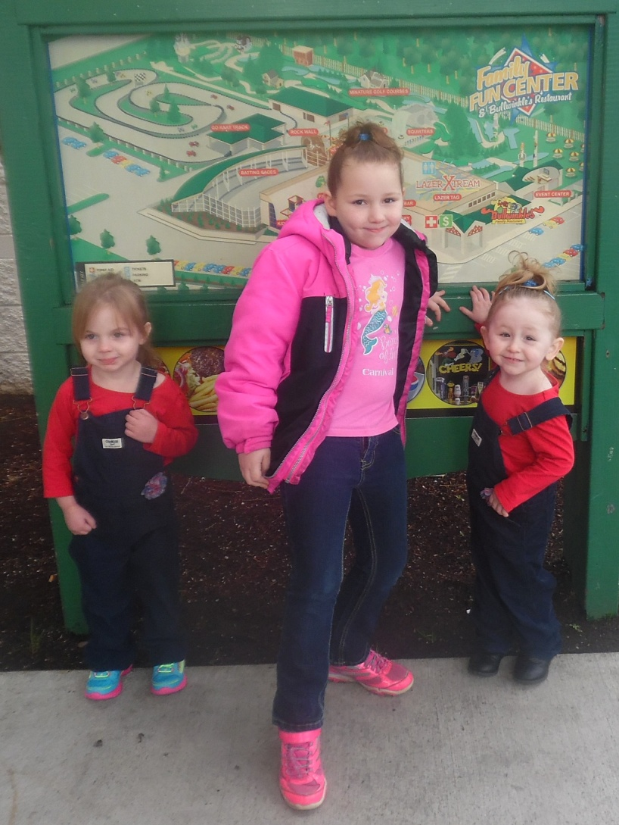
NUMBER 1 COMMITMENT
Photo: Suzanne Sager

Slide 33
Elaine Gass Hirsch
Associate Director
Watzek Library, Lewis & Clark College

Slide 34
Going up to the Balcony:
Leadership Institute for Academic Librarians

Slide 35
WHAT IS LIAL?
ACRL/Harvard Institutes for Higher Education collaboration
Intensive 5 day immersion program founded in 1999
Program Objectives:
How well positioned is your organization to meet current and future challenges?
How effective is your own leadership?

Slide 36
FOUR FRAME APPROACH TO UNDERSTANDING ORGANIZATIONS
Structural
Human Resources
Political
Symbolic
Developed by Lee Bolman and Terrence Deal (1984). Adapted to academic leadership by Lee Bolman and Joan Gallos (2011).

Slide 37
STRUCTURAL FRAME
Image of Organization: Machine, Factory
Frame Emphasis: Rationality, analysis, logic, facts, data, formal roles and relationships
Photo: “Gears” by Mustang Joe, used under CC0

Slide 38
HUMAN RESOURCES FRAME
Image of Organization: Family
Frame Emphasis: The importance of people and the fit between the individual and the organization
Image: “People Around Circle Holding Hands” by Poppy

Slide 39
POLITICAL FRAME
Image of Organization: Jungle
Frame Emphasis: Allocation of power and scarce resources
Photo: “Jungle Waterfall” by skitterphoto

Slide 40
SYMBOLIC FRAME
Image of Organization: Theater
Frame Emphasis: Meaning, purpose, vision, inspiration, values
Photo: The PrivateBank Theater Auditorium by Kimberlyhobart, used under CC BY-SA 3.0

Slide 41
LEADERSHIP ORIENTATIONS QUESTIONNAIRE
Give the number “4” to the phrase that best describes you as a manager and leader, “3” to the item that is next best, and on down to “1” for the item that is least like you.
Compute your scores as follows:
ST = 1a + 2a + 3a + 4a + 5a + 6a
HR = 1b + 2b + 3b + 4b + 5b + 6b
PL = 1c + 2c + 3c + 4c + 5c + 6c
SY = 1d + 2d + 3d + 4d + 5d + 6d

Slide 42
CONSIDERING THE RESULTS
Which orientation is your natural tendency?
Which would you like to strengthen?
Do the results seem right?
Do the results reflect your sense of the kind of leader you want to be?

Slide 43
BIBLIOGRAPHY
Bolman, L.G. and T.E. Deal. Leadership Orientations Questionnaire, 1988
Bolman, L.G. and J.V. Gallos. Reframing Academic Leadership Jossey-Bass, 2011
Casey, A.M. Leadership Institute for Academic Librarians in Creating Leaders: An Examination of Academic and Research Library Leadership Institutes. ACRL, 2015 p. 11-31

Slide 44
Steve Silver
Library Director
Kellenberger Library, Northwest Christian University

Slide 45
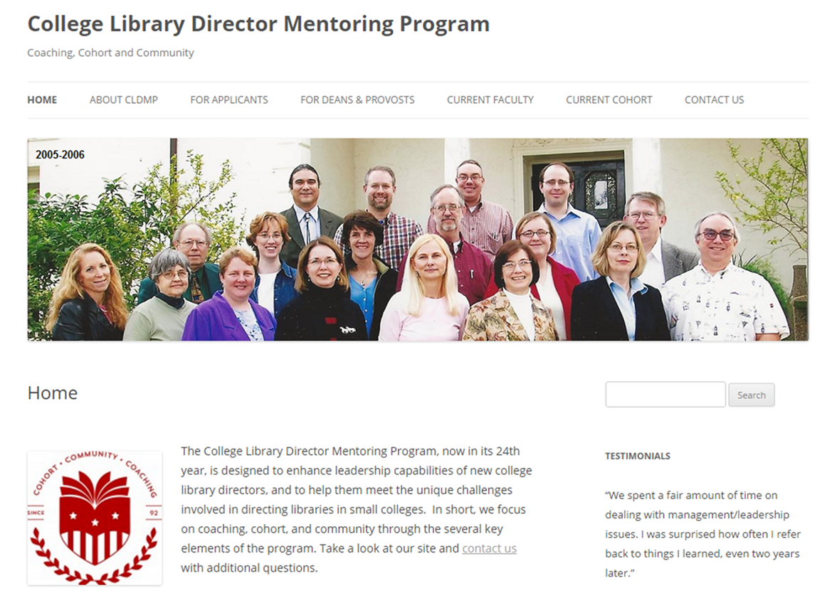
Photo: “CDLMP 2005-2006” by CDLMP
Notes:
For brand new small college library directors
ACRL program
Since late 80s.
Mentor, seminar, email list

Slide 46
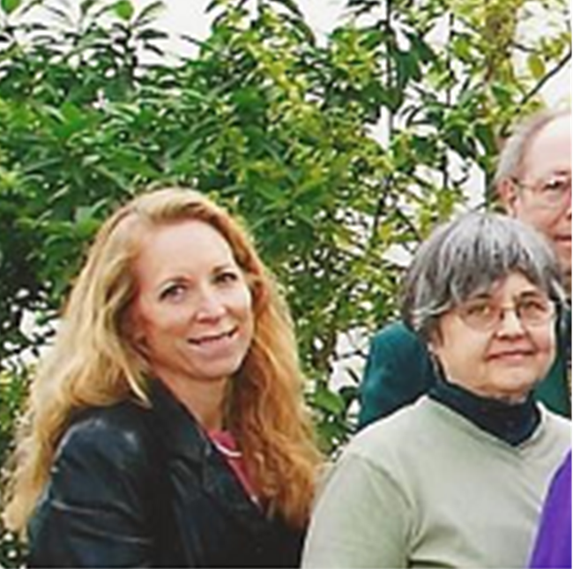
Photo: “CDLMP 2005-2006” by CDLMP
Notes:
Got into this program because my previous director had also participated—[close-up pic of Mo Cole]

Slide 47
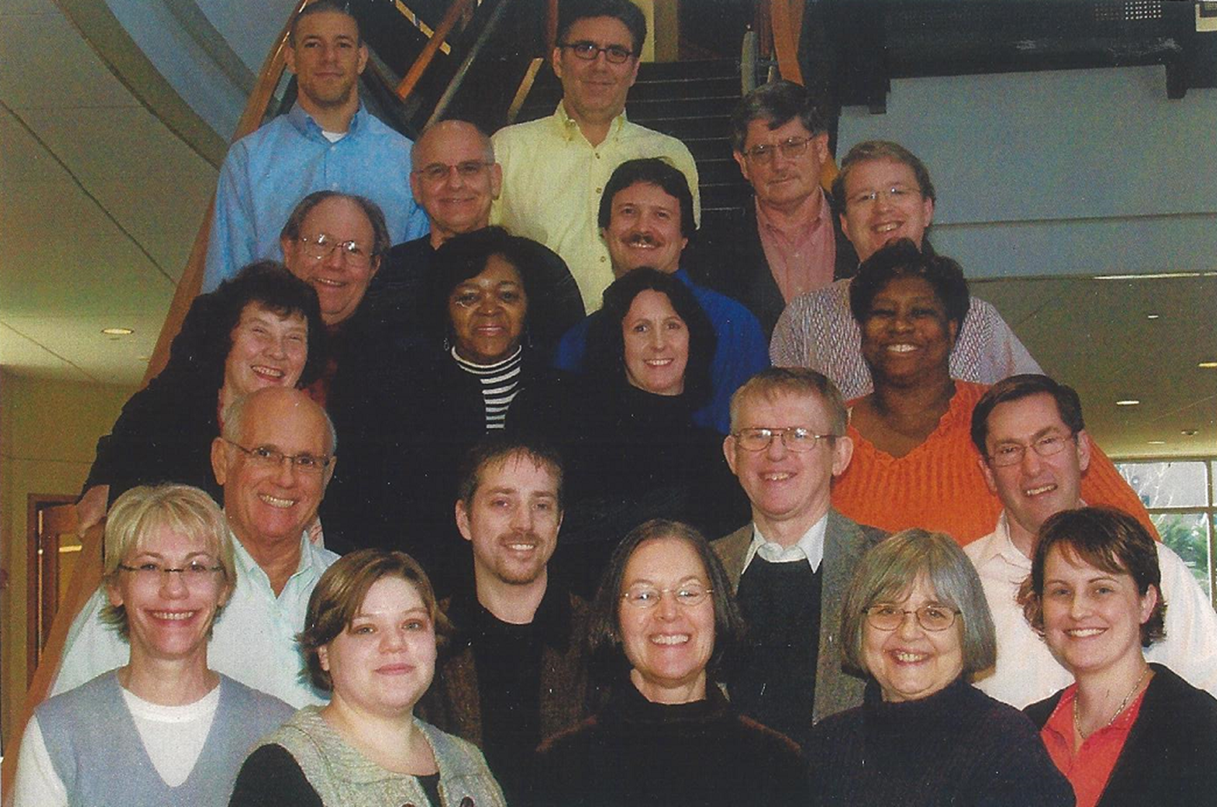
2007-2008 COHORT
Photo: “CDLMP 2007-2008” by CDLMP
Notes:
Only fair I show you my cohort picture [slide with 2007-08 cohort]

Slide 48
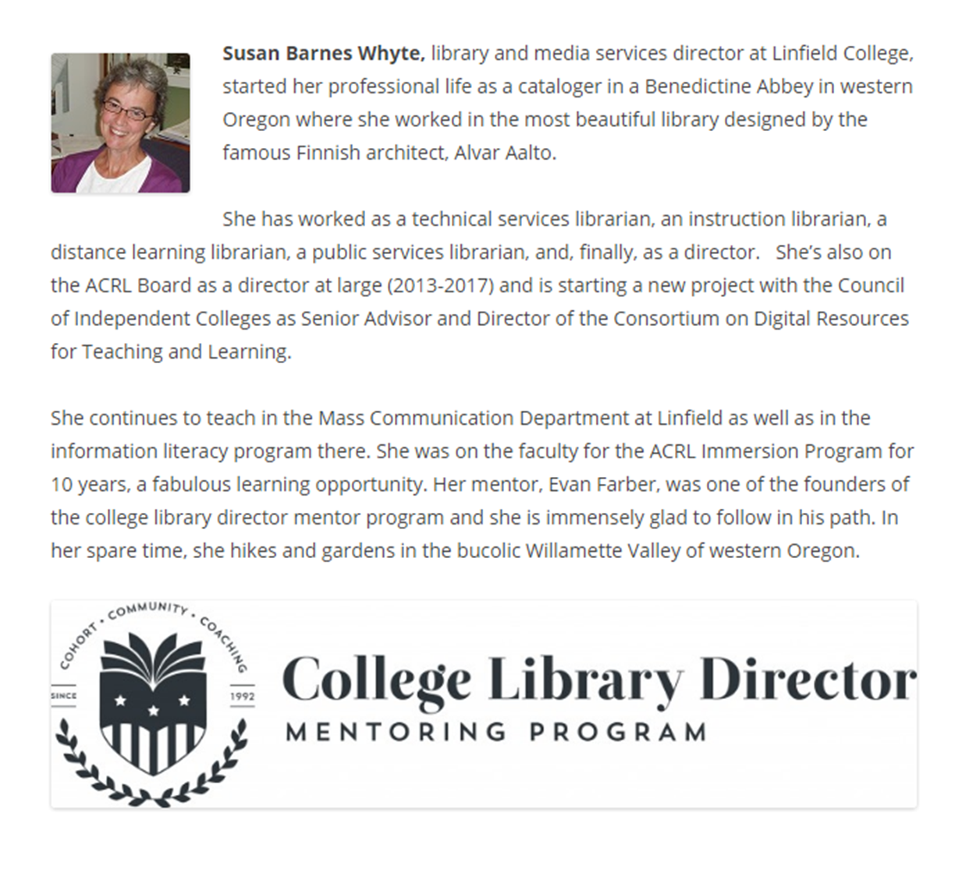
2007-2008 COHORT
Notes:
Our own Susan Barnes Whyte currently on the faculty [slide of Susan’s CLDMP page]

Slide 49
LESSONS LEARNED
from the College Library Director Mentoring Program
I CAN do this
Notes:
Director
I was very wet behind the ears, brand new librarian when I was thrust into role of library director
Felt completely overwhelmed. Through CLDMP gained needed skills and learned that, with support, encouragement, training, I could do this job.
Old cliché to 'believe in yourself.' For me it was 'believe what others believe about me.'
Conference chair
Conference chair last year, first time in Eugene in quite some time
No experience with OLA board, no experience with OLA conference planning, no experience leading such a complex and important committee
Applied lesson learned: I CAN do this with support, encouragement, training;
believe what others believe about me
Don't think I'm being prideful to say conference came off very well
Not all me, others could have done it, but I was able to do it due in part to lessons learned from CLDMP

Slide 50
LESSONS LEARNED
from the College Library Director Mentoring Program
I CAN do this
I can’t do it all
Notes:
Conversely one big lesson is that I cannot do it all, and that's okay. Let some things go. Do what you can, prioritize well, then go home and leave it at work.
One typically thinks of a high-profile administrative position as requiring 60 hour weeks and total commitment to the job above all else. I have found, in fact, the opposite to be generally true of small college library directors. There are extra hours, absolutely, but most directors I interact with have a healthy sense of a good work/life balance, and have learned the lesson of doing what they can, but then going home and enjoying life outside of their job. There is ALWAYS more work to do, especially for a director. Trying to get it all done will only stress you out and leave you less effective overall.
This work is important to us. Not just to us, it is important. But, If something doesn't get done it's not the end of the world. And it is not who we are, but only what we do.
But easy to get caught up in our own stuff and stress.--Only makes us less effective.
This year implementing Alma. May be all that I need to say
Have to let some things go:
Strategic planning
Collection development activities reduced
Interactions with faculty and campus severely reduced
Assessment plan crawling forward
OLA involvement
2 components:
Strategic—know what the priorities are or are going to be, focus on those, and realize what will not get done
Daily: when things pile up, when I leave my desk a mess, take a deep breath and go home. Life goes on, it's okay.
Balancing act and a lesson I am continually learning and improving on. Far from perfect

Slide 51
LESSONS LEARNED
from the College Library Director Mentoring Program
I CAN do this
I can’t do it all
Manage relationships
Notes:
Came into profession through Tech Services. You know the type: task oriented, logically not emotionally driven, internal processor, rather deal with "things" or systems than people. To this day I am the world's worst at remembering names and faces , but I can scan a technical document and recall most of what it says in an instant.
In many ways a poor personality match to being a library director
One big lesson from CLDMP, and another one I'm constantly learning and trying to get better at, is that all that fuzzy, touchy-feely, emotional drama crap is actually really, really important.
It's the people that do the work, and after the particular task or project is complete, the people will still be there to do the next task or project. You can achieve short-term results by focusing on the task, but better long-term results by focusing on the people.A couple of the areas where this plays out:
Supervisees
Each of us supervises someone, even if just a student worker
Each staff I supervise is unique, with their own strength areas and weak areas, own personalities, own triggers, own motivations.
Understanding their personalities and think intentionally about my relationship helps me manage them better. What will motivate or excite this person? How early do I need to set a deadline for that person? How can we best achieve together the library's goals and mission?
And here's a shocker to no one: Us mild-mannered, friendly, collaborative librarians can and do experience interpersonal conflict. Managing conflict among staff can be a real gut-check moment - waaay outside my comfort zone, but the long-term rewards of a workplace relatively free of simmering resentment and employees who know that I will be firm but fair is so, so worth those anxious moments of stepping into conflict to seek a better solution. I could share stories, but confidentiality is important. Just trust me, this is real.
Dean
One needs to manage relationships "up" as much as "down," and this was a big lesson for me from the CLDMP. I'm very fortunate to have a fantastically supportive and effective Dean. I know not all in this room can say that. But even so, consciously managing my relationship with my dean, my supervisor, is vitally important.
How does my supervisor like to communicate? What's important to keep him informed of, and how? What is going on in other areas of his work that I or the library can help with? What issues is he dealing with in his family/personal life? Building trust takes time and conscious effort, but gets my and the library's needs heard in better light when they come up.
A few years ago NCU hired a new president. This person just happened to be the son-in-law of a former long-time library director at NCU, and requested specifically to meet with me, tour the building, and see our collections shortly after he arrived on campus that summer.
Wow, what an opportunity to establish a great connection, get the very real and significant library needs in front of someone who could do something about them, someone who could be a strong library advocate. The tour went great, he loved seeing the Rare Bible collection, conversation was easy.
Then we got back to my office and I hit him with the long list of what the library needed. It was too much, too soon. You could feel the positive energy that had been developed drain from the room. I was focused on MY library and MY needs, and not on building the relationship I needed with this person. I'm still working to overcome that rough beginning.
Some lessons are learned the hard way, and again (a theme?), this is an area I'm obviously still working on
Manage the relationships, and the needed work and decisions will come much easier in the end.

Slide 52
LESSONS LEARNED
from the College Library Director Mentoring Program
I CAN do this
I can’t do it all
Manage relationships
Leaders are people just like me and you
Notes:
One final lesson from the CLDMP. Not a formal lesson, but learned from observation and reflection: Leaders are real people too.
I remember sitting in that seminar with people who were brand new library directors, yes, but many who were heavily involved in ALA and ACRL committees and similar work, who had published, who had worked in academic libraries for years, and being very intimidated. But by the end of the seminar, and through our interactions online, realized they were people just like me, with hopes, dreams, fears, quirks, strengths and weaknesses.
When I first began to get involved with OLA in various ways I felt intimidated. Here are Oregon library movers and shakers, people who've published, who've worked in libraries for many years, people who really know their stuff.
What I found, of course, is that they're people too, figuring it out as they go just like the rest of us. They are amazing people who do amazing things, that also have families, and really interesting stories, and shortcomings, and anxieties, and fears, and hopes and dreams.
If they can be the kind of leaders I look up to, then maybe I can be one too. And if I can be a leader, wherever I happen to be placed, then each of you can be one too, wherever you are placed, with whatever hopes, dreams, anxieties, fears, and interesting stories you carry with you.

Slide 53
THANKS!
Discussion & Questions

Slide 54
SOURCES/CREDITS
Bolman, L.G. and T.E. Deal. Leadership Orientations Questionnaire, 1988.
Bolman, L.G. and J.V. Gallos. Reframing Academic Leadership. Jossey-Bass, 2011.
Casey, A.M. Leadership Institute for Academic Librarians in Creating Leaders: An Examination of Academic and Research Library Leadership Institutes. ACRL, 2015. p. 11-31.
Chaleff, Ira. The Courageous Follower : Standing Up To and For Our Leaders. San Francisco, CA: Barrett-Koehler Publishers, 1995. p. 6-8.
Kruse, Kevin. What is Leadership? Forbes.com. 9 April 2013. http://www.forbes.com/sites/kevinkruse/2013/04/09/what-is-leadership/#30ff1811713e
Special thanks to all the people who made and released these awesome resources for free:
Presentation template by SlidesCarnival

