Slide 1
For the win!
Customer Service Victories
Angela Weyrens and Jennifer Steward

Slide 2
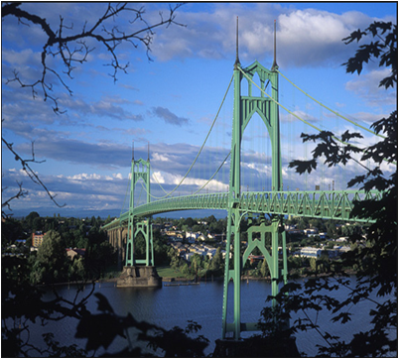
A bit about Jennifer

Slide 3
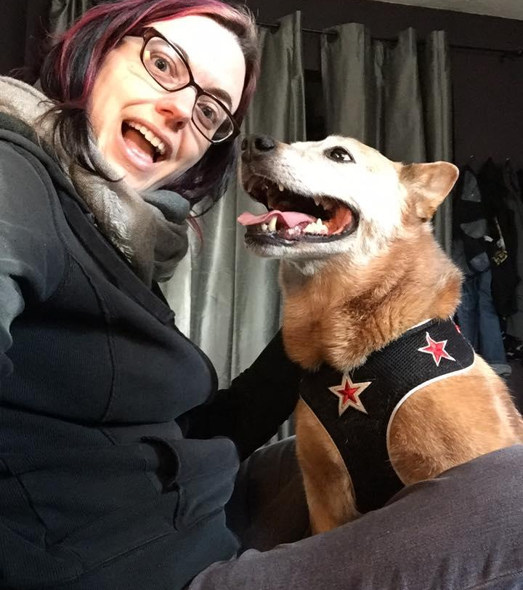
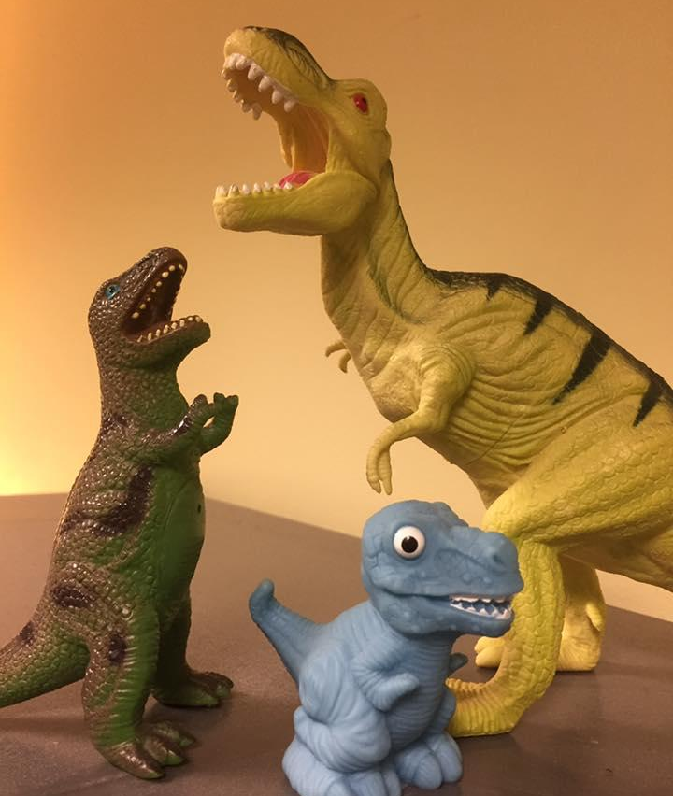
A bit about Angela

Slide 4
A bit about both of us

Slide 5
We are not perfect
We are learning

Slide 6
The Plan
1. We talk (just a little)
2. You talk in groups
3. You talk more

Slide 7
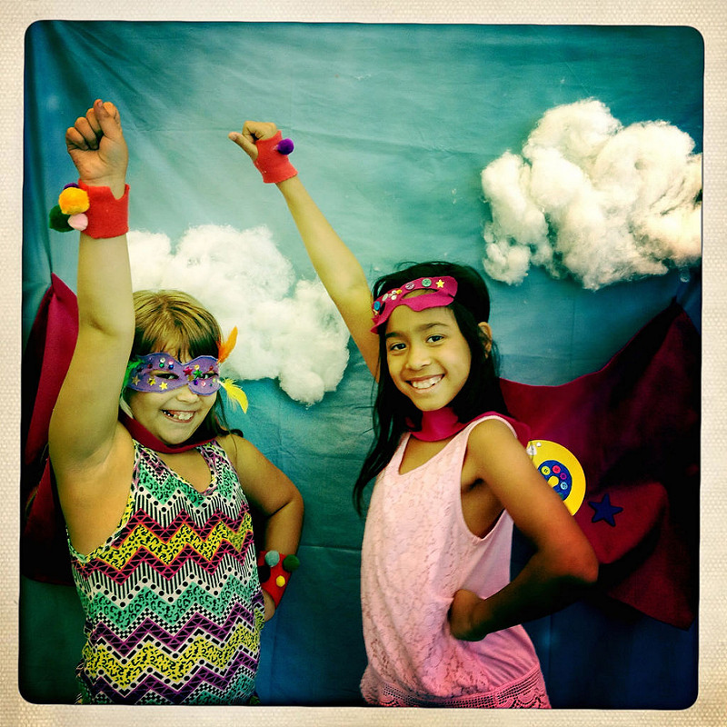
What
is a
victory?

Slide 8
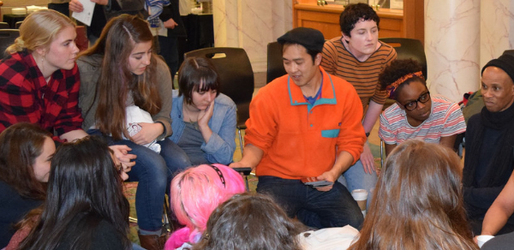
Discuss

Slide 9
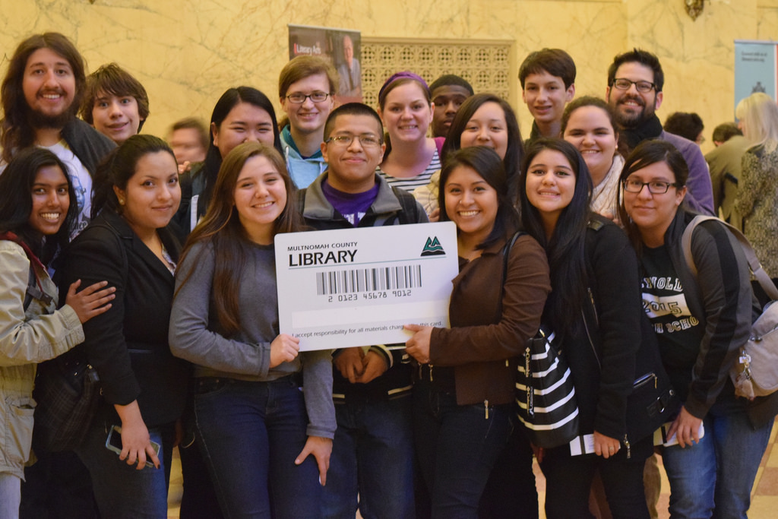
Community and connection

Slide 10
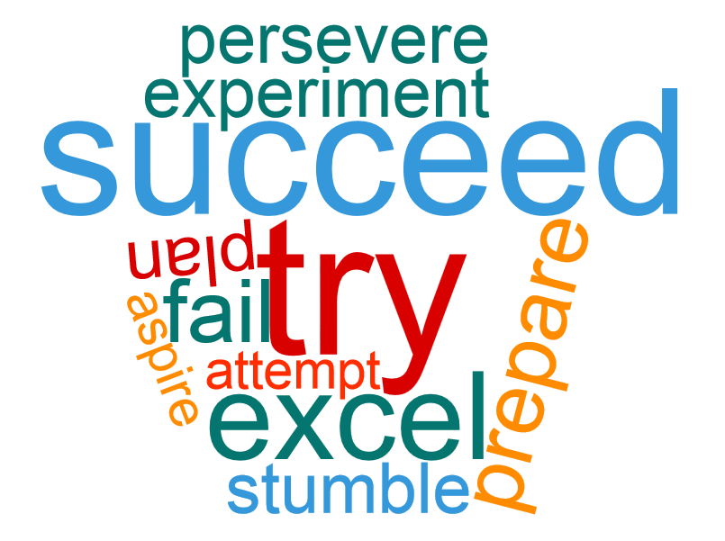
Practice

Slide 11
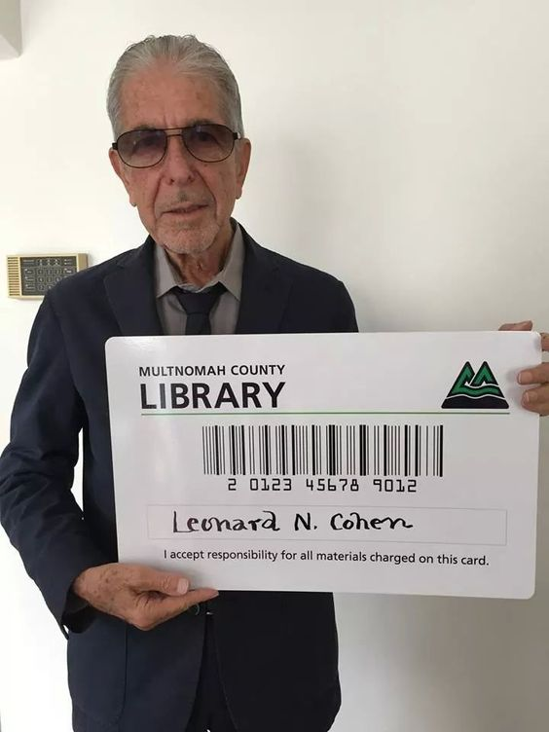
Thank you!
Contact us:
Angela Weyrens
angelaw@multcolib.org
Jennifer Steward
jennifes@multcolib.org

