Slide 1
Tips of the Trade:
Extra Techniques for Communicating with staff and volunteers
Suzy Coleman
Tualatin Public Library

Slide 2
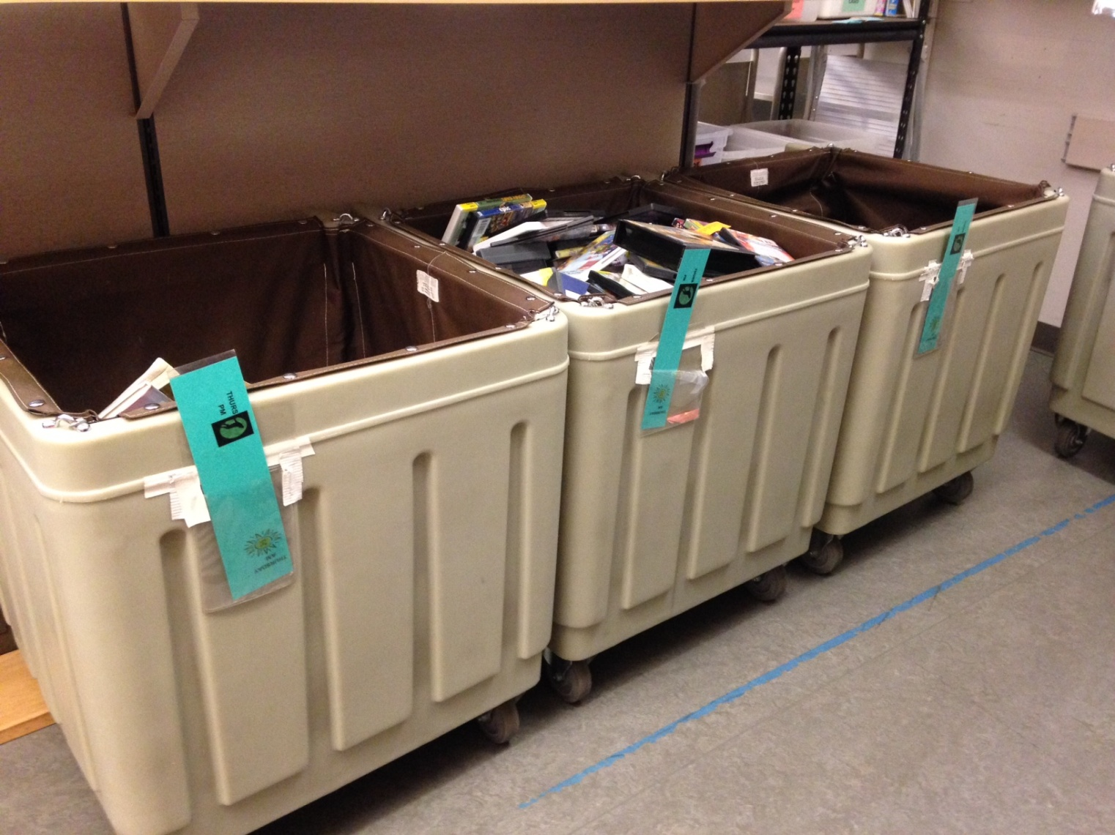
Bin and cart flags
Day of week flags tell check-in workers how many days to backdate.

Slide 3
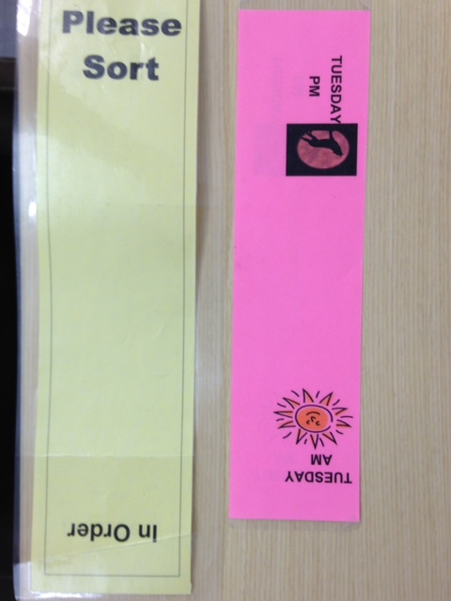
Flip flags to change message.
Double sided and laminated.
Make them long enough to be seen about the tallest books.
Flag Details

Slide 4
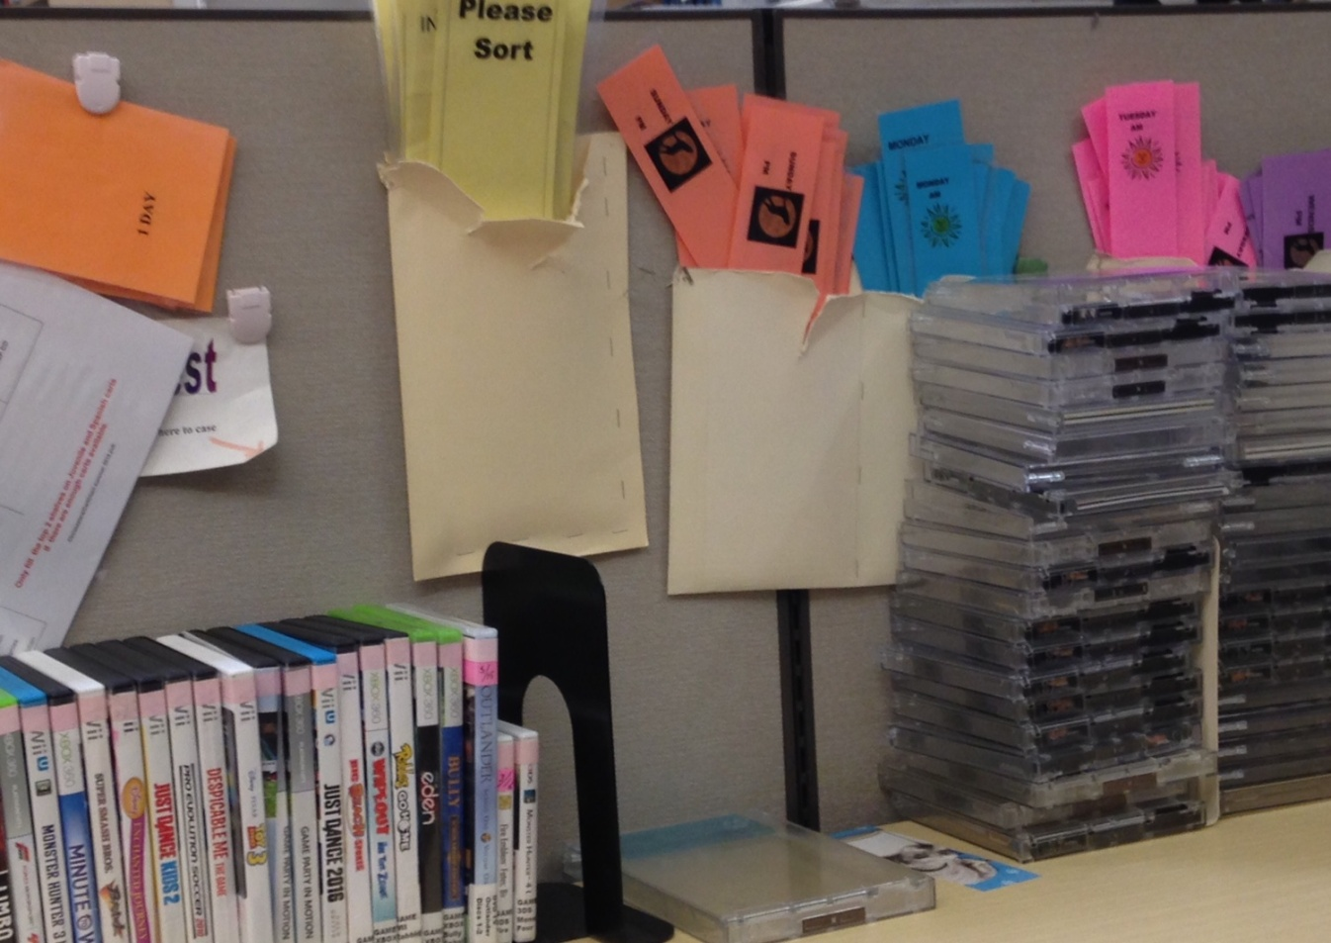
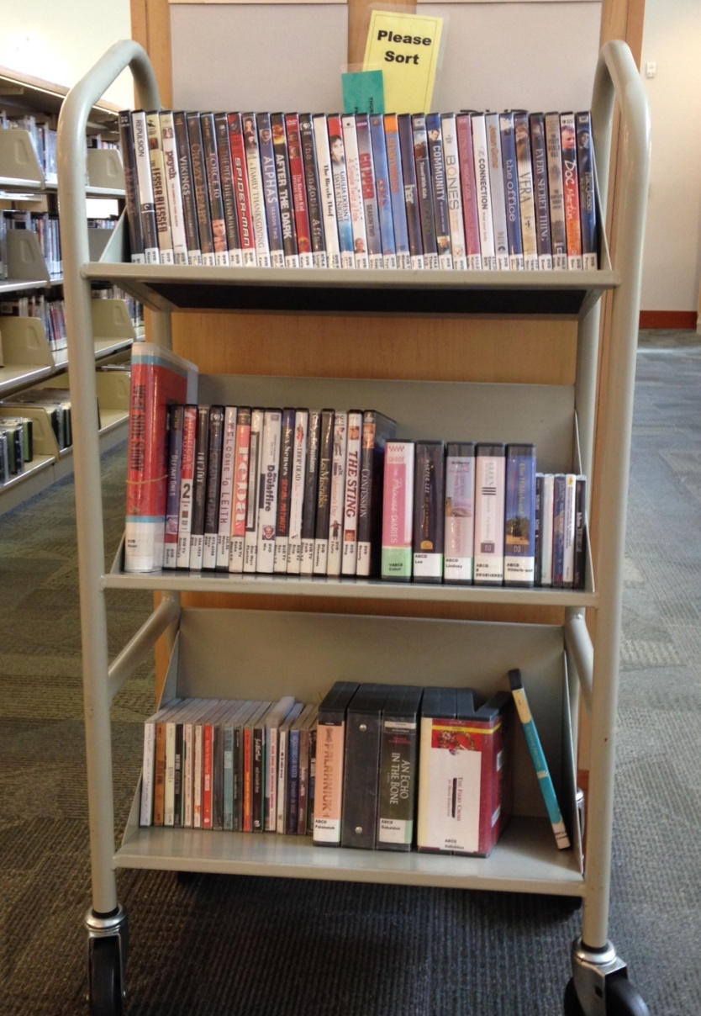
Cart flags
Day flag gets older carts shelved first.
Please Sort & In Order flag directs shelvers to a sorted cart fast.

Slide 5
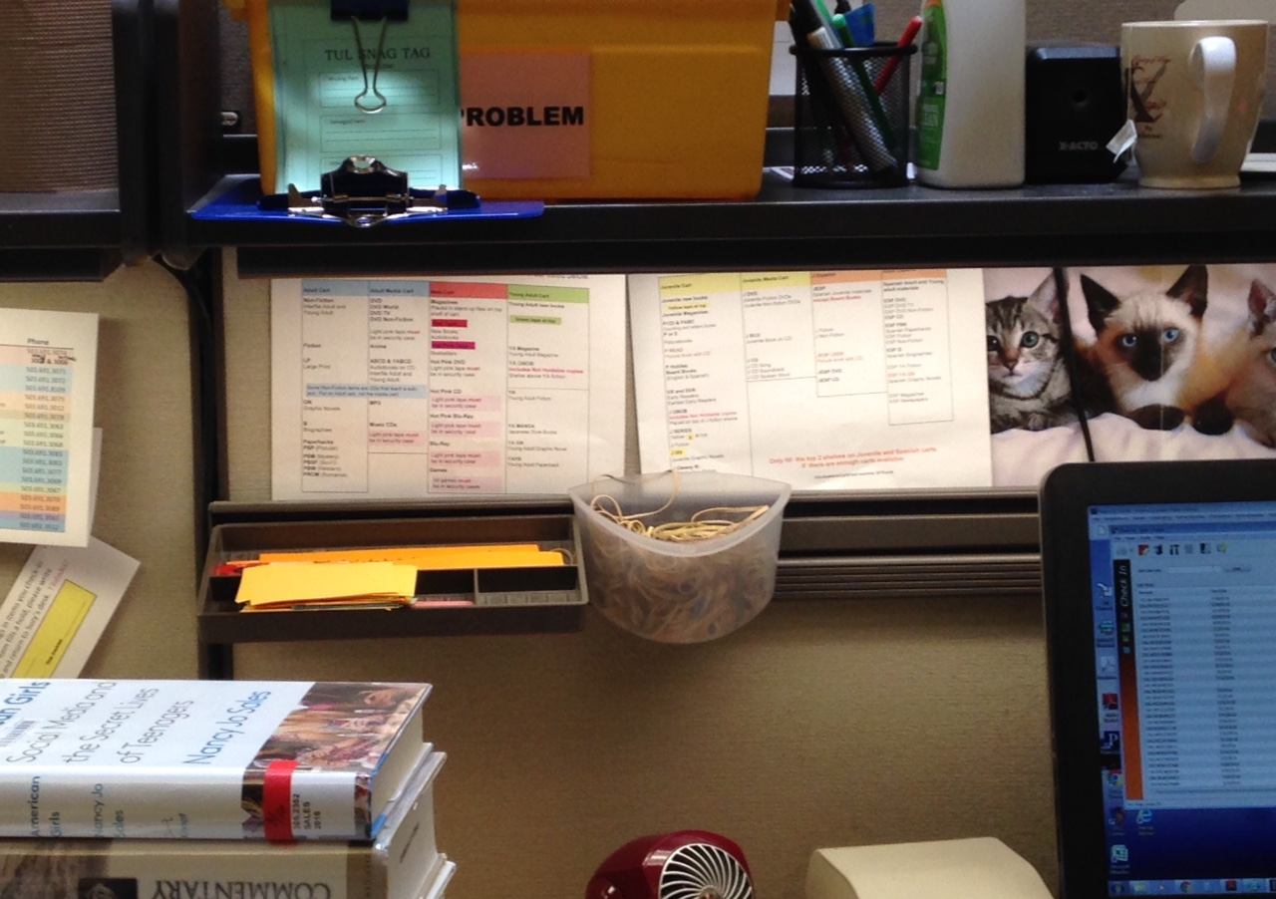
Point of need
Collections assigned to carts posted at Check-in stations and
put on carts to assist new shelvers.

Slide 6
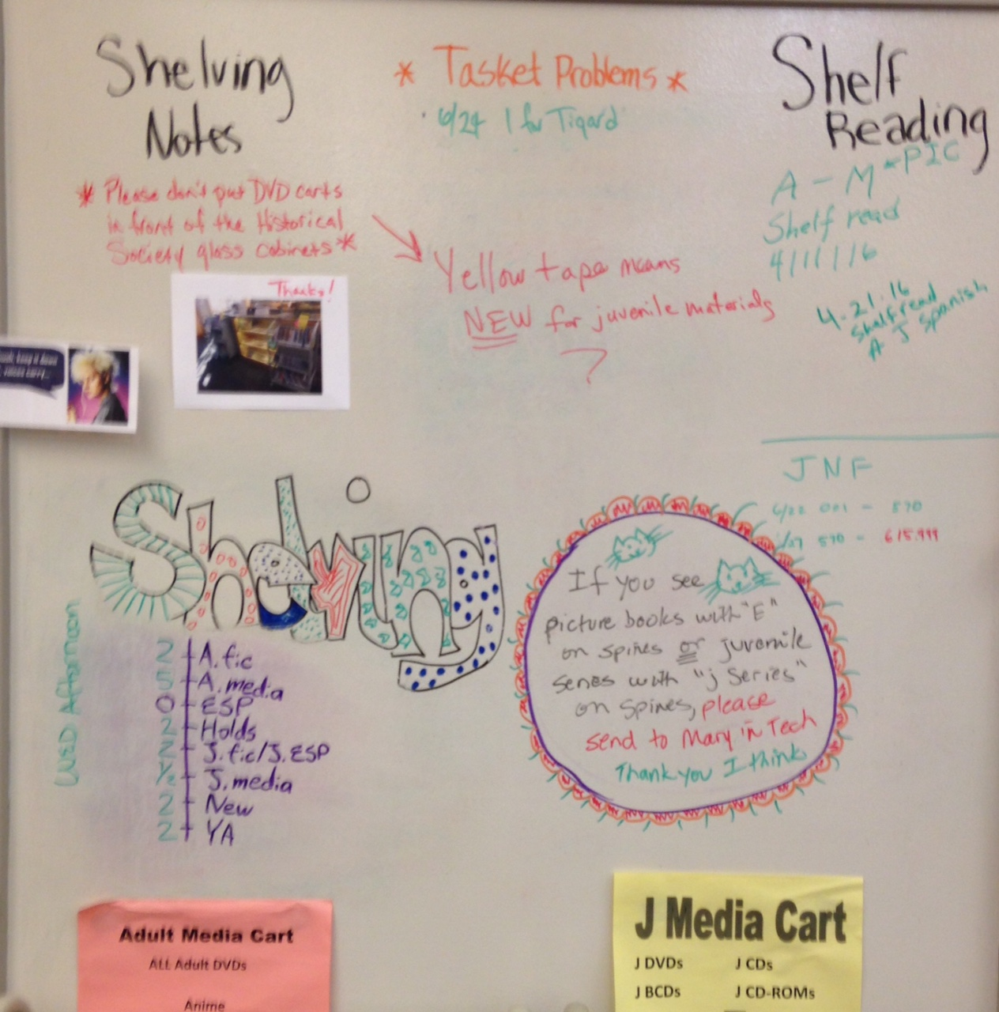
Write on the wall!
Walls painted with Idea Paint turns them into message boards for staff and volunteers.

