Slide 1
Tips of the Trade: Training Guides and Techniques for Libraries
Successful practices in a medium-sized Public Library
Suzy Coleman
Tualatin Public Library

Slide 2
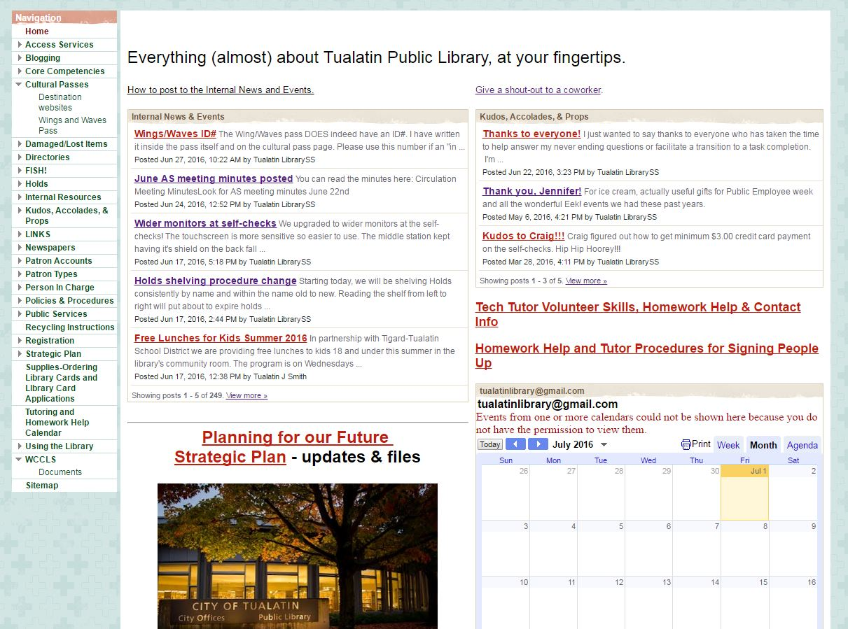
Our Wiki For All Staff

Slide 3
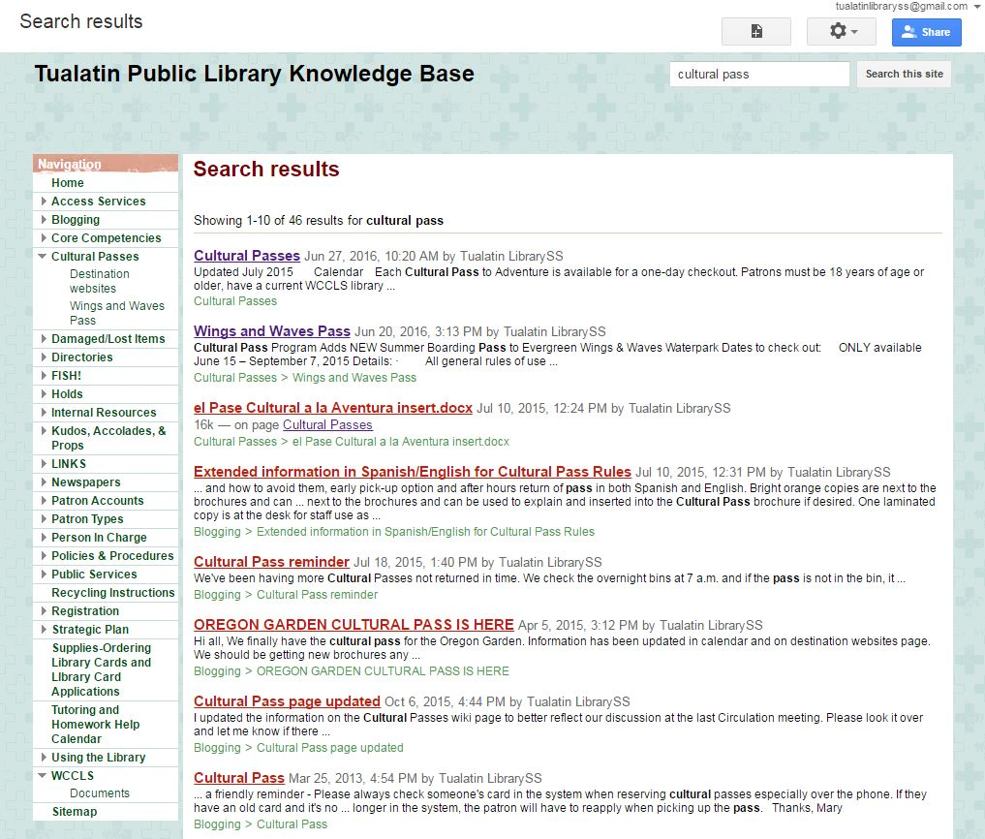
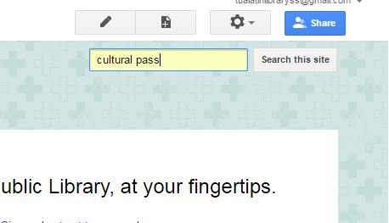
The search box is the favorite way to find what is need.

Slide 4
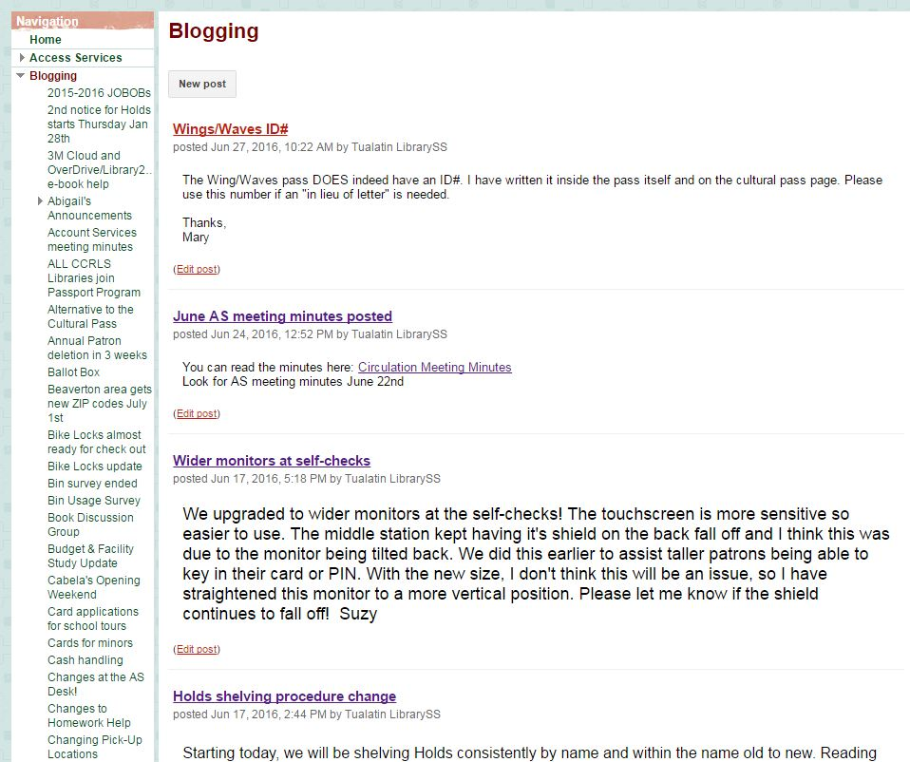
Select Blogging and you can read postings in reverse chronological order or create a new post. It is helpful to announce new pages in the Wiki.

Slide 5
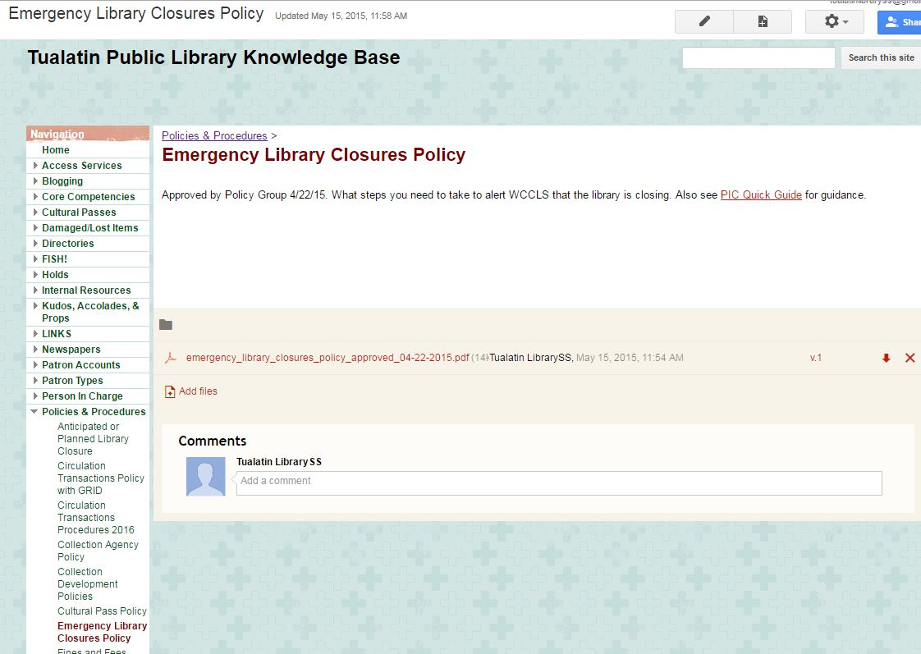
Easily add & remove documents.

Slide 6
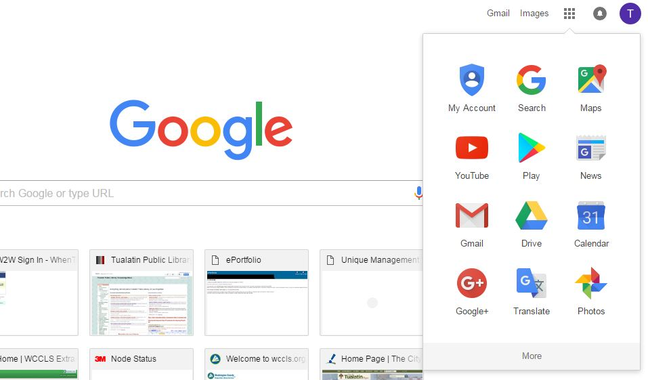
To create a Wiki you need to have a Google account.
Go to the Google apps icon, select “More”, then “Even more from Google”.

Slide 7
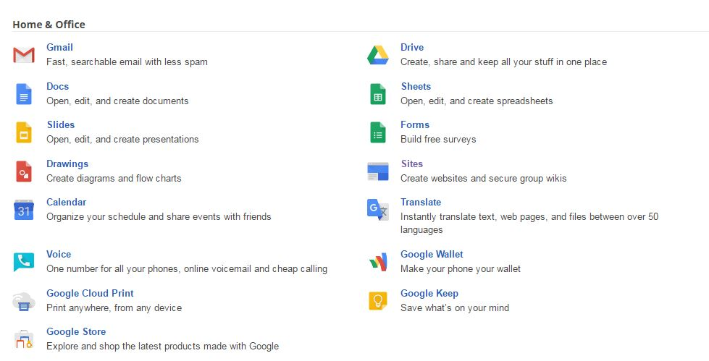
Keep scrolling down to Home & Office. Select Sites. They really bury this!

Slide 8
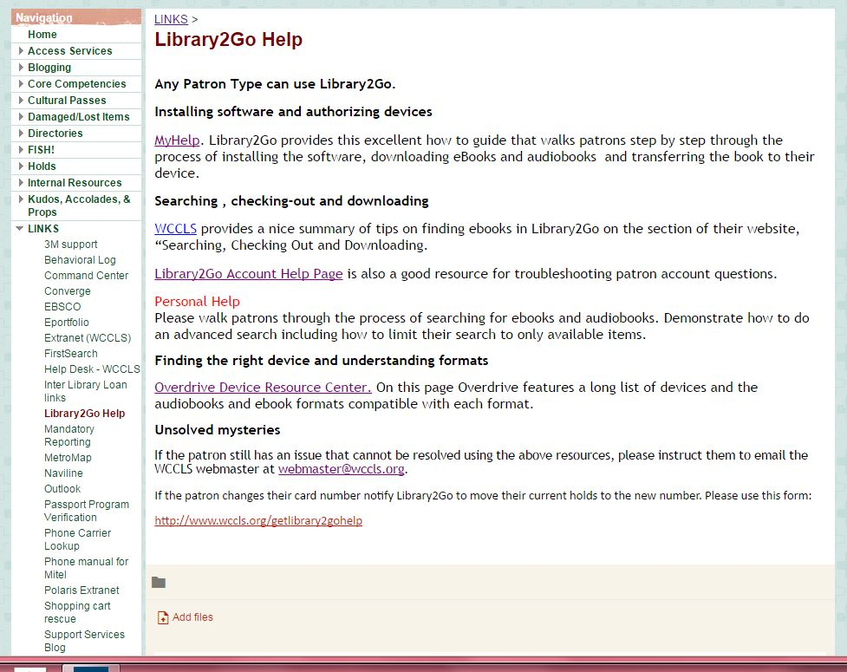
LINKS to most used sites.
Useful when setting up a new computer or when you work from multiple computers.

Slide 9
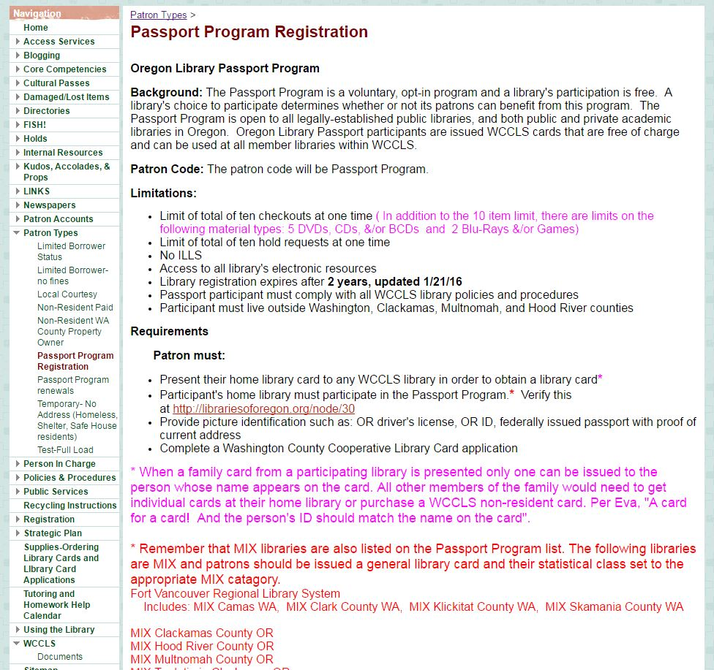
For those occasional procedures that are complex!
Keep them at your fingertips.

Slide 10
Help your staff work like pros!
Start small.
Empower staff to edit and update.
Motivate staff, let them suggest what would be helpful.

