Slide 1
Cataloging Bones: Models and Realia
Katie Lockwood, MSLIS Metadata & Systems Librarian
University of Western States
klockwood@uws.edu

Slide 2
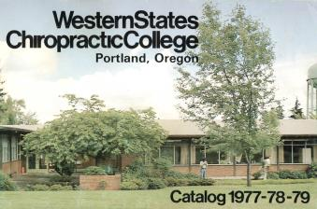
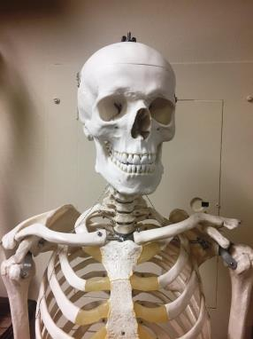
University of Western States
Founded in 1904 as a
chiropractic college
Anatomy focus

Slide 3
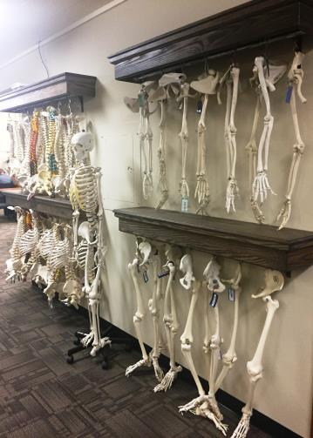
Library Bone Collection
126 bone models
(35 different bones)
1 day checkout
177 real human bones (28 different bones)
In library use only

Slide 4
On the Fly Records: Just Get it in the Catalog!
245 00 Femur
Both plastic and real bone on same record
Can I check it out?
Copied from other records, so incorrect coding
LDR Type “a” (books)
Language eng
Strange dates

Slide 5
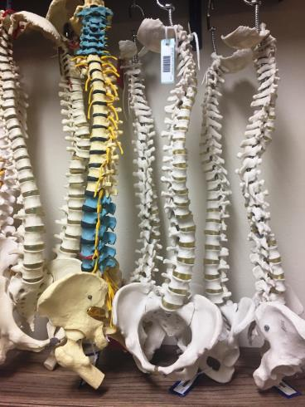
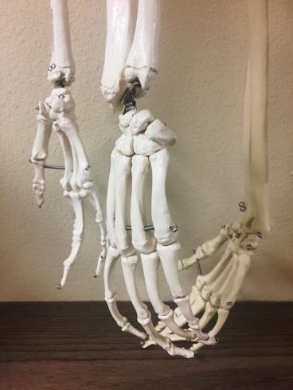
Improve Discoverability?

Slide 6
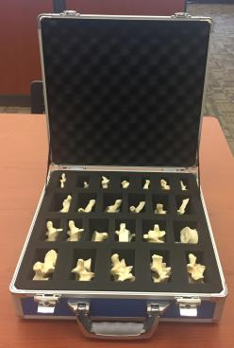
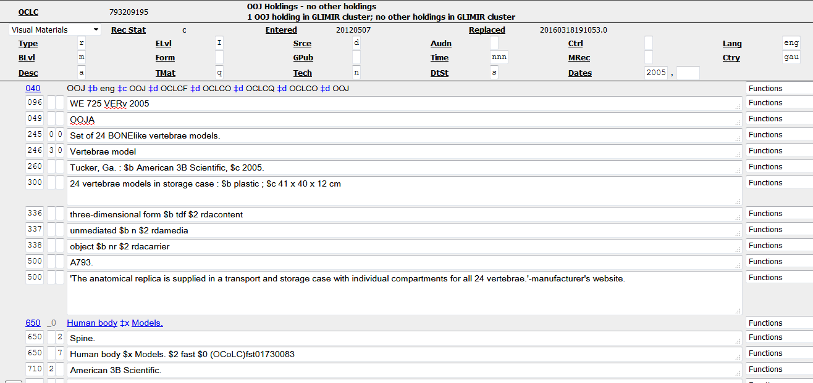
When Title and Distributor is Known

Slide 7
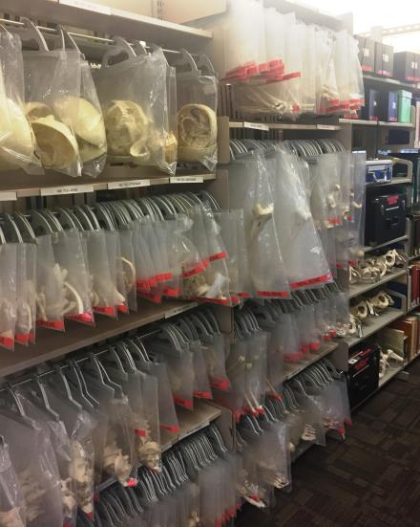
For the 150+ Other Items
Separate records for realia and models
Correct coding and subject headings

Slide 8
Fixed Field Elements: LDR –Visual Materials
Type “r”: Three-dimensional artifact or naturally occurring object
TMat
“q”: model
“r”: realia

Slide 9
Fixed Field Elements: 008
Lang: “zxx” – no linguistic content
DtSt: “n” dates unknown (“use for naturally occurring objects” – OCLC)
Dates: uuuu uuuu

Slide 10
245: [Title]?
245 00 Femur model
245 00 Femur bone
“Exception: Do not indicate that the information was taken from a source outside the manifestation itself if the manifestation is of a type that does not normally carry identifying information (e.g., a photograph, a naturally occurring object, a collection).”(RDA 2.2.4)

Slide 11
260: Publication
[Place of publication not identified…]?
“As a minimum, a resource description for a work, expression, manifestation, or item should include all the core elements that are applicable and readily ascertainable.”(RDA 0.6.4)

Slide 12
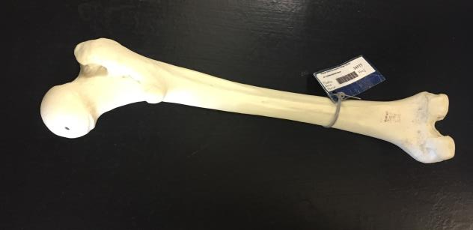
300: Physical Description
245 00 Femur model.
300 1 model : $b plastic ; $c 39 cm x 8 cm x 8 cm
245 00 Femur bone.
300 1 specimen : $b organic ; $c 39 cm x 8 cm x 8 cm

Slide 13
RDA Content, Media, Carrier
245 00 Femur model.
300 1 model : $b plastic ; $c 39 cm x 8 cm x 8cm
336 three-dimensional form $b tdf $2 rdacontent
337 unmediated $b n $2 rdamedia
338 object $b nr $2 rdacarrier
245 00 Femur bone.
300 1 specimen : $b organic ; $c 39 cm x 8 cm x 8cm
336 three-dimensional form $b tdf $2 rdacontent
337 unmediated $b n $2 rdamedia
338 object $b nr $2 rdacarrier

Slide 14
Subjects – MeSH and Local
245 00 Femur model.
300 1 model : $b plastic ; $c 39 cm x 8 cm x 8 cm
336 three-dimensional form $b tdf $2 rdacontent
337 unmediated $b n $2 rdamedia
338 object $b nr $2 rdacarrier
650 2 Femur.
650 7 Plastic Bone. $2 local
245 00 Femur bone.
300 1 specimen : $b organic ; $c 39 cm x 8 cm x 8 cm
336 three-dimensional form $b tdf $2 rdacontent
337 unmediated $b n $2 rdamedia
338 object $b nr $2 rdacarrier
650 2 Femur.
650 7 Real Human Bone. $2 local

Slide 15
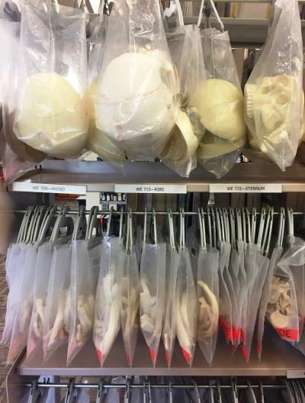
NLM Call Numbers
096 WE 865 FEM
Individual item accession letters
WE 865 FEMa
WE 865 FEMb

Slide 16
245 00 Femur model.
300 1 model : $b plastic ; $c 39 cm x 8 cm x 8 cm.
336 three-dimensional form $b tdf $2 rdacontent
337 unmediated $b n $2 rdamedia
338 object $b nr $2 rdacarrier
650 2 Femur.
650 7 Plastic Bone. $2 local
245 00 Femur bone.
300 1 specimen : $b organic ; $c 39 cm x 8 cm x 8 cm.
336 three-dimensional form $b tdf $2 rdacontent
337 unmediated $b n $2 rdamedia
338 object $b nr $2 rdacarrier
650 2 Femur.
650 7 Real Human Bone. $2 local

Slide 17
Staff Interface

Slide 18
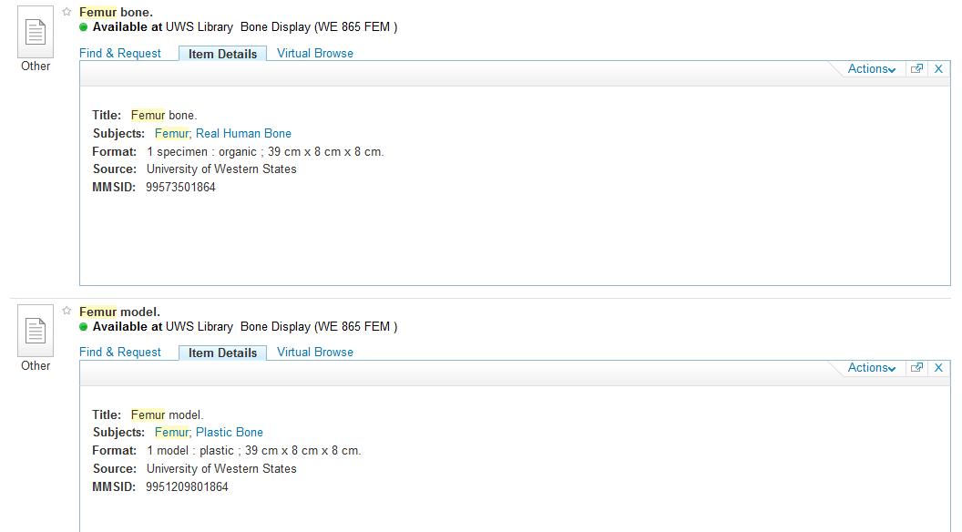
Patron Display

Slide 19
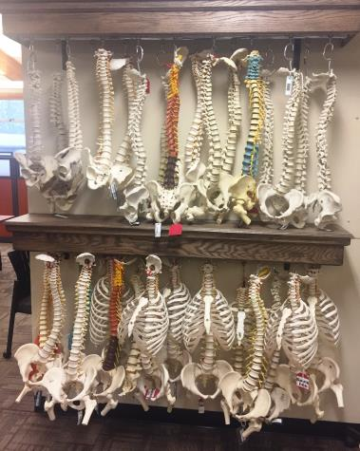
Checkout: Don’t Adjust the Spines!
Bone models
1 day checkout
Real human bones
In library use only

Slide 20
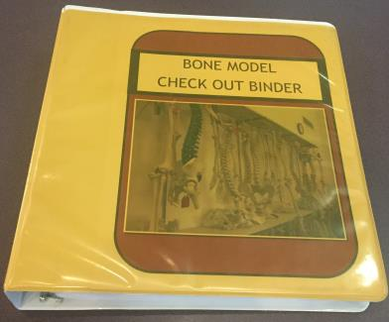
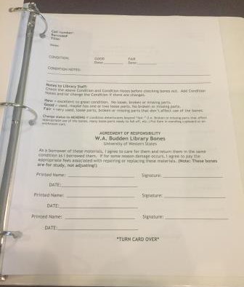
Bone Contracts

Slide 21
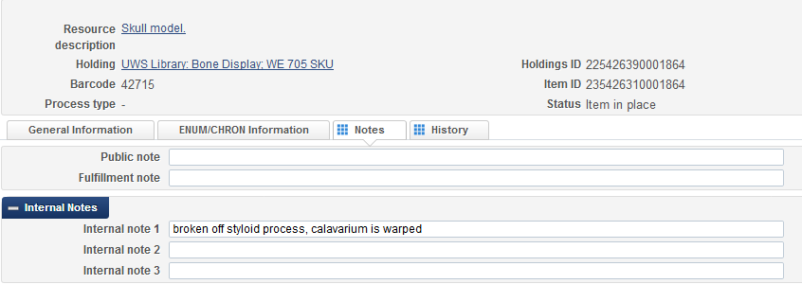
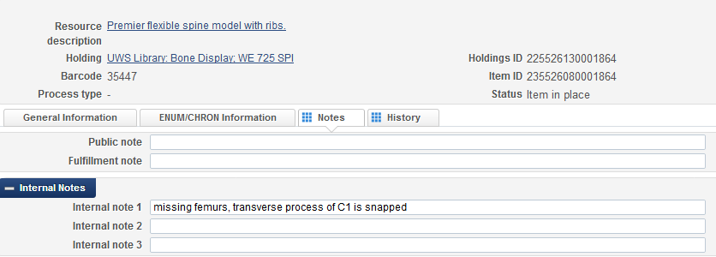
Bone Condition Inventory

Slide 22
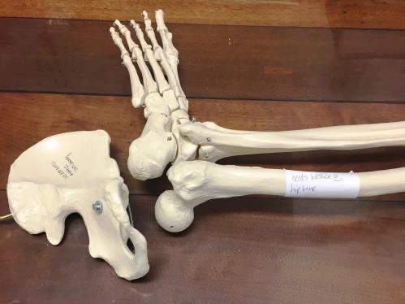
Repairs

Slide 23
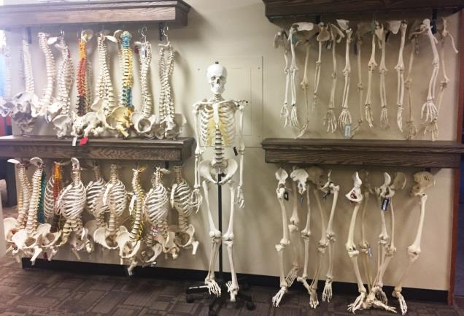
Thank you!

