Slide 1
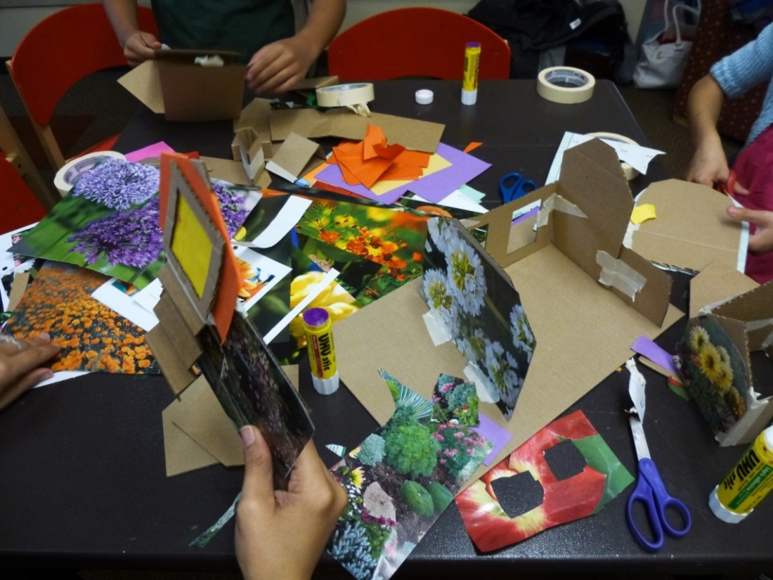
Creative Construction
inspiring thinking skills with open-ended, project-based programming for all ages
Amber Bell, Youth Services Supervisor, Tigard Public Library amber@tigard-or.gov

Slide 2
STEM sprouts Teaching Guide
http://www.bostonchildrensmuseum.org/sites/default/files/pdfs/STEMGuide.pdf

Slide 3
Engaging Young Engineers: Teaching problem-solving skills through STEM
Curious thinking
Persistent thinking
Flexible thinking
Reflective thinking
Collaborative thinking
Stone-MacDonald, A., Wendell, K., and Douglass, A. Engaging Young Engineers: Teaching problem-solving skills through STEM.

Slide 4
CCSS Standards for Mathematical Practice:
1. Make sense of problems and persevere in solving them
www.ode.state.or.us/wma/teachlearn/commoncore/ccssmath.pdf

Slide 5
Elements of a Successful Open-ended Program
Materials
Theme
Tools & Techniques
Signage

Slide 6
Materials
Cardboard
Fabric & Fibers
Paper
Wood
Recycled materials & loose parts
Natural Materials
Art media
Construction toys

Slide 8
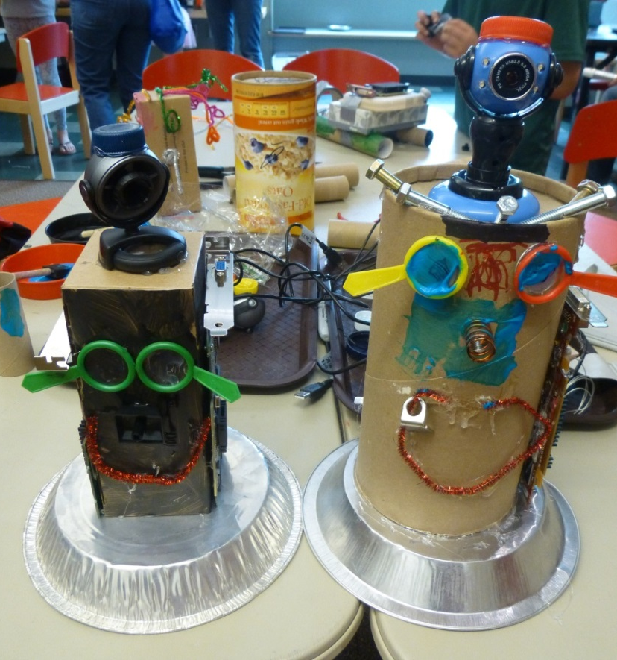
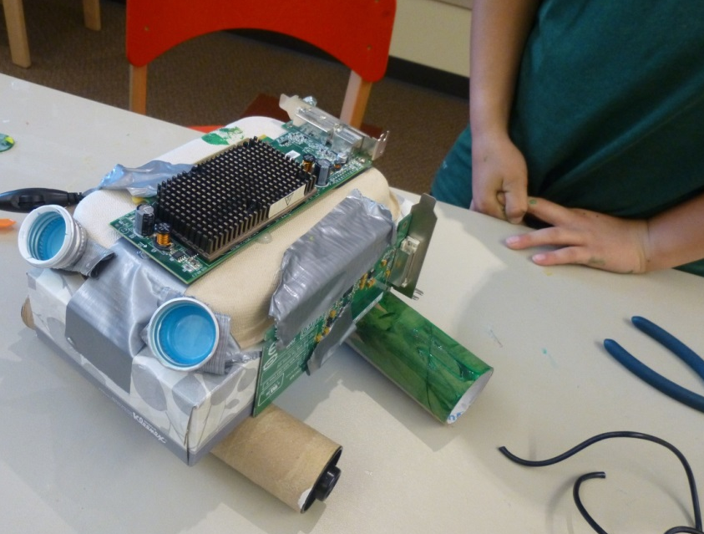

Slide 9
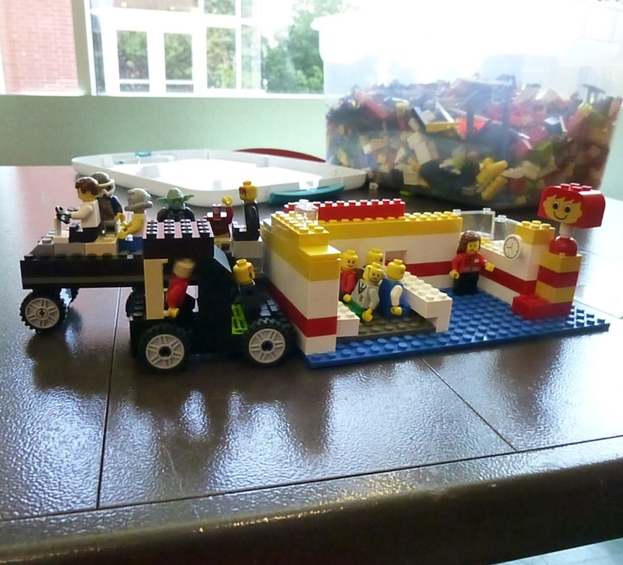

Slide 10
Themes
Robots
Puppets
Castles
All sorts of vehicles: superhero, airplanes, boats, cars, trains, etc…
Rooms, houses, and buildings
Towns & Cities
Finders Keepers (making projects to hide and discover)
Valentines
Snuggle up (soft creations)
Magnets
Simple machines

Slide 11
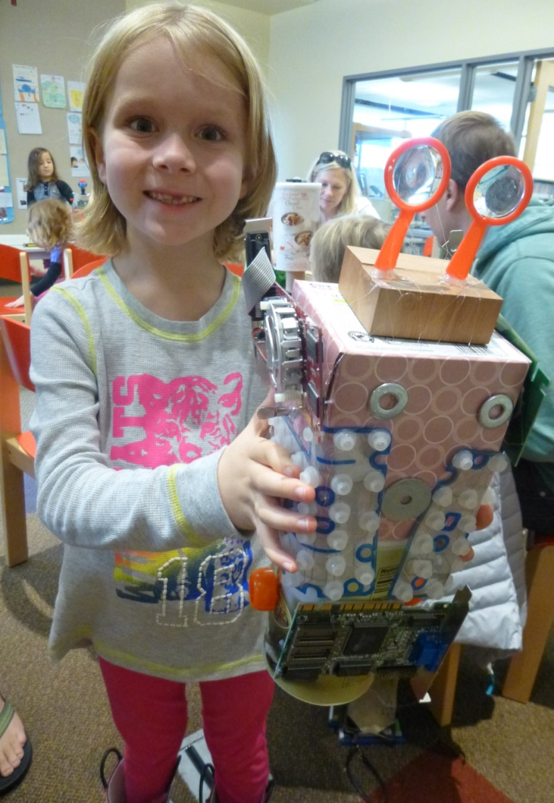
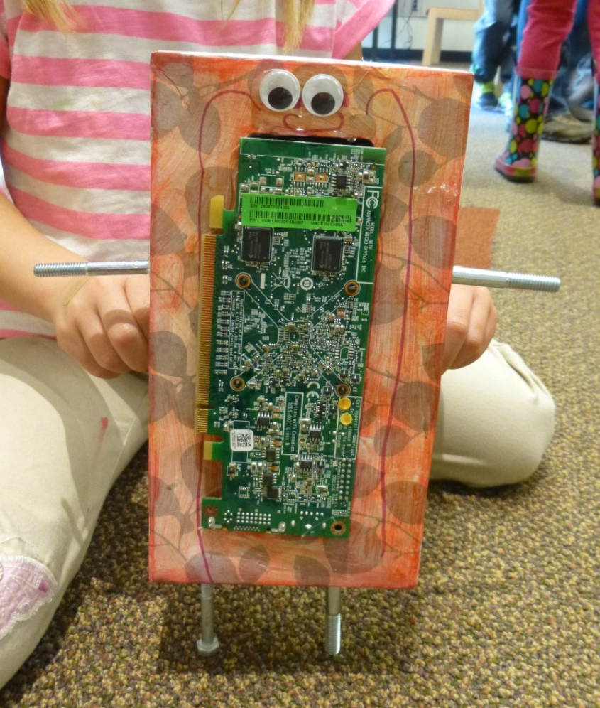

Slide 13
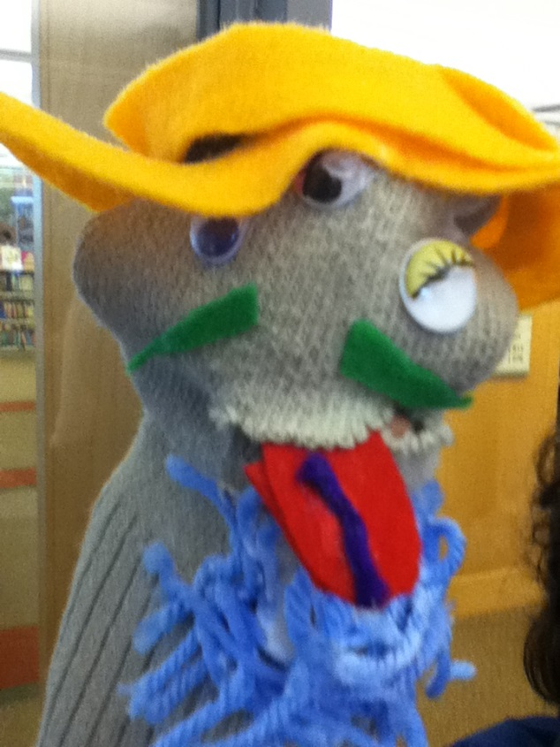

Slide 14
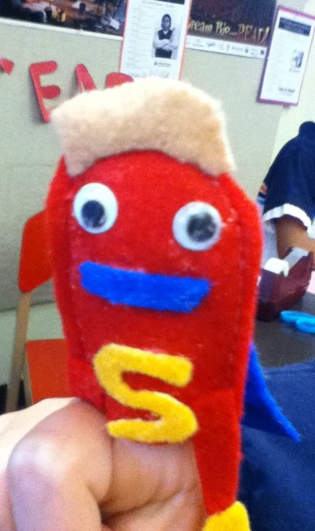
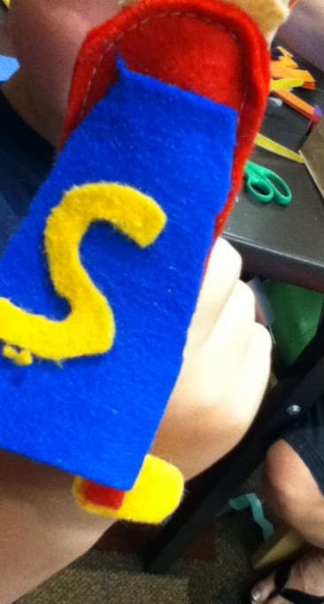

Slide 15
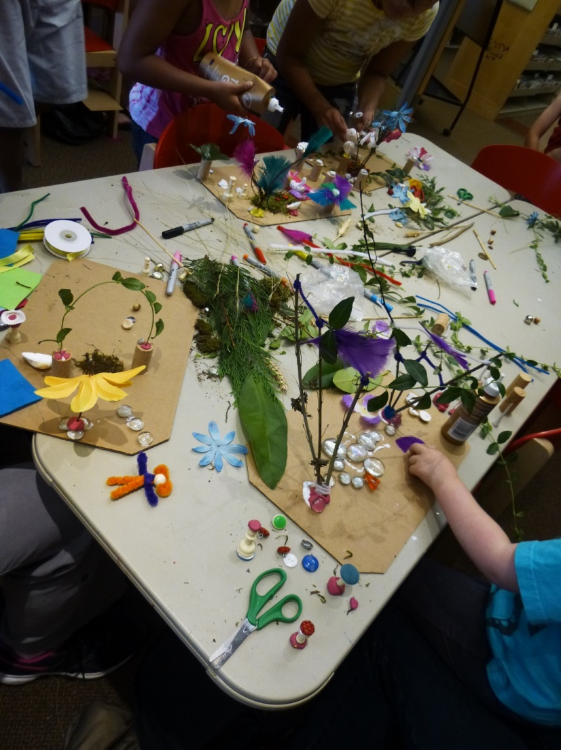
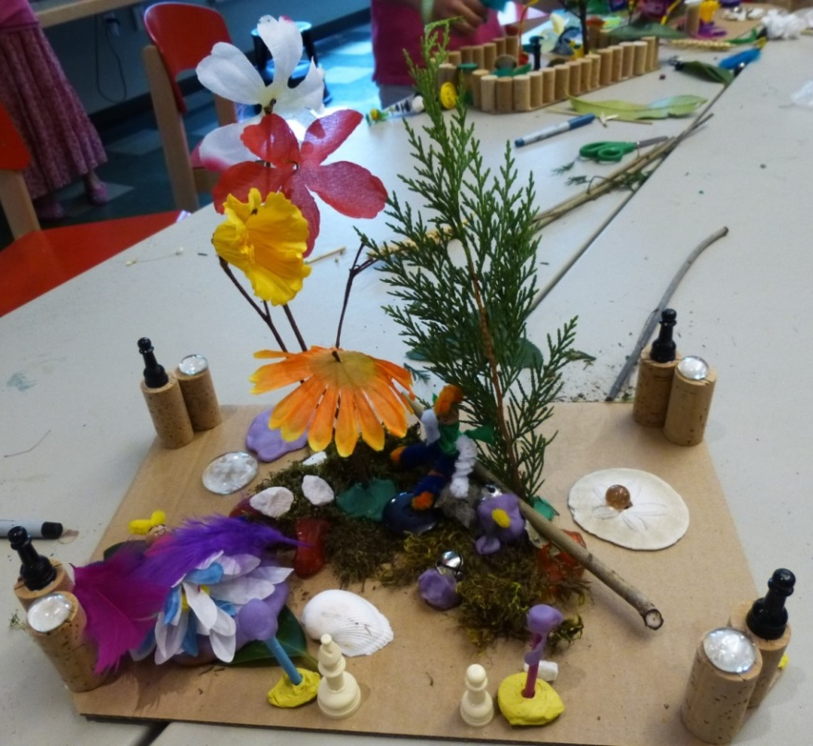

Slide 16
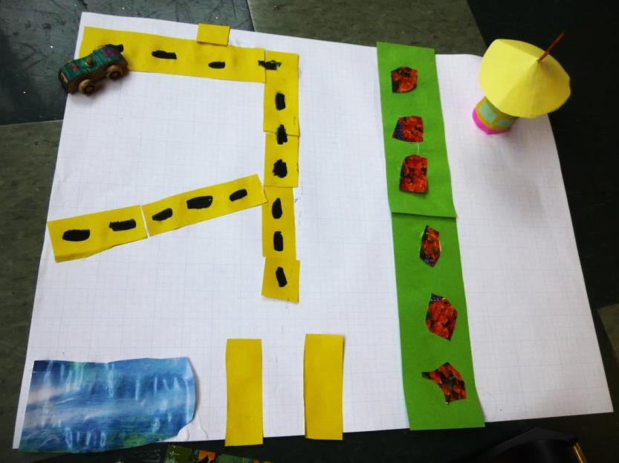
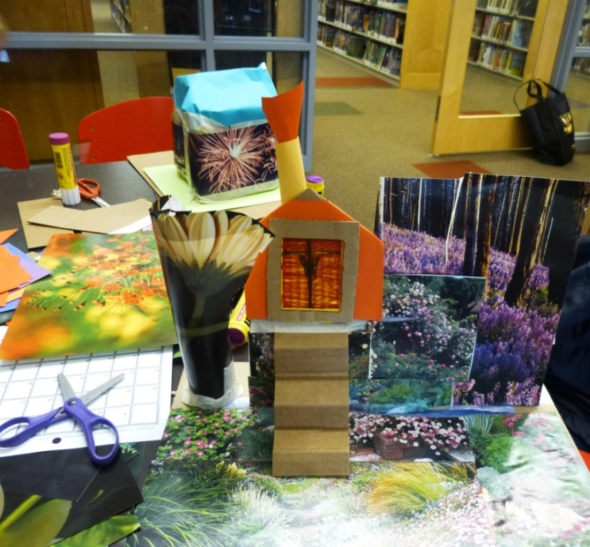

Slide 17
Tools & Techniques
Tools
Adhesives
Construction techniques

Slide 18
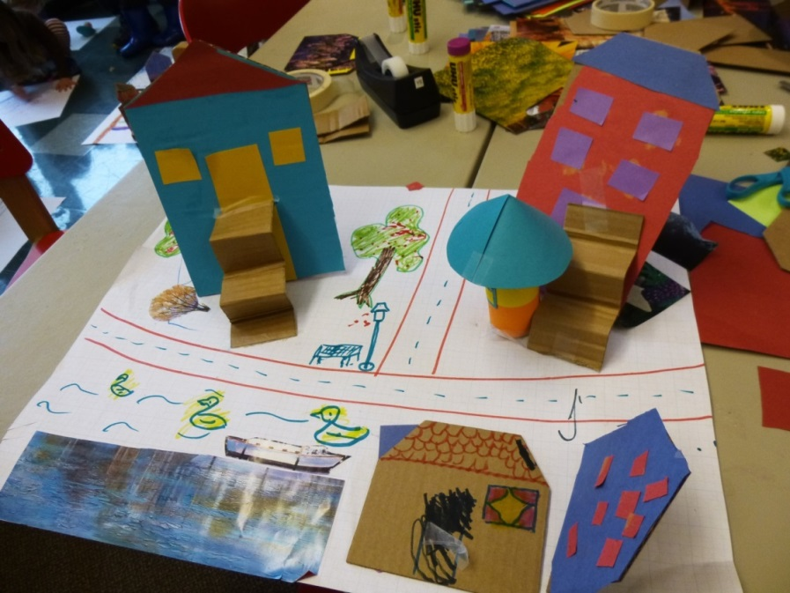
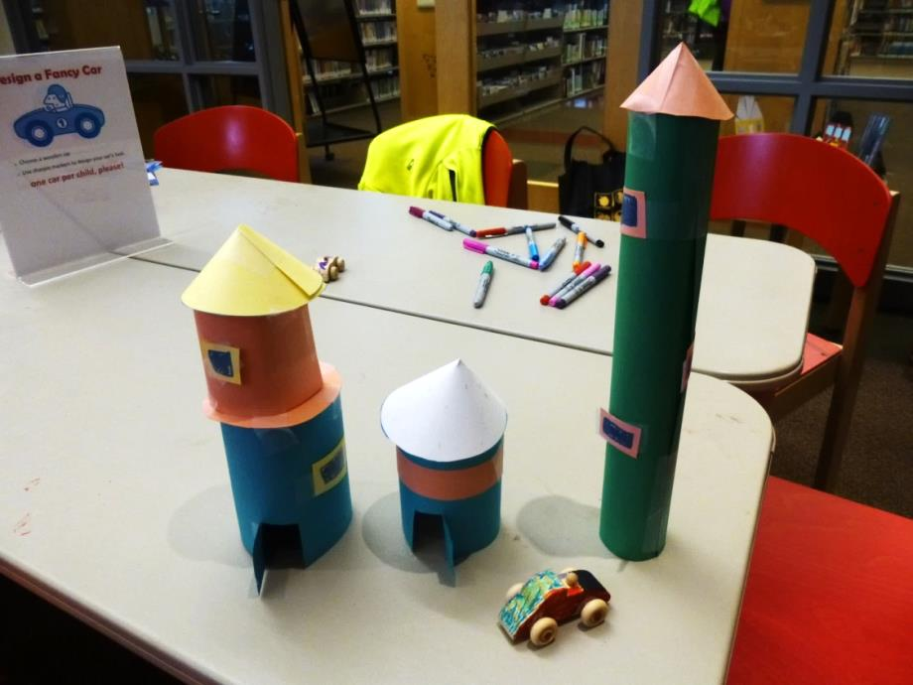

Slide 19
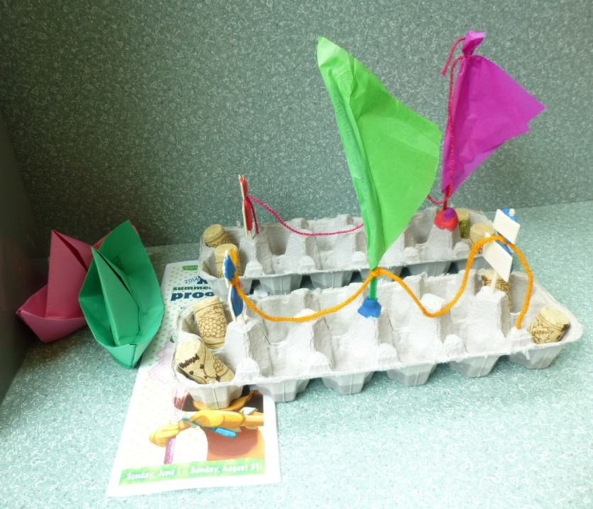

Slide 20
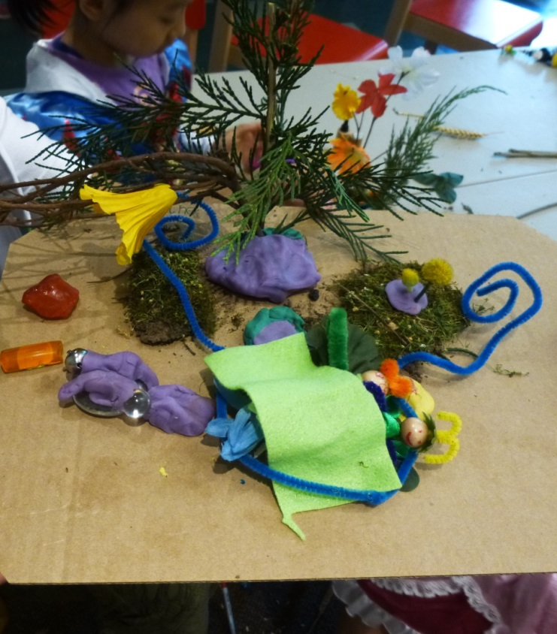
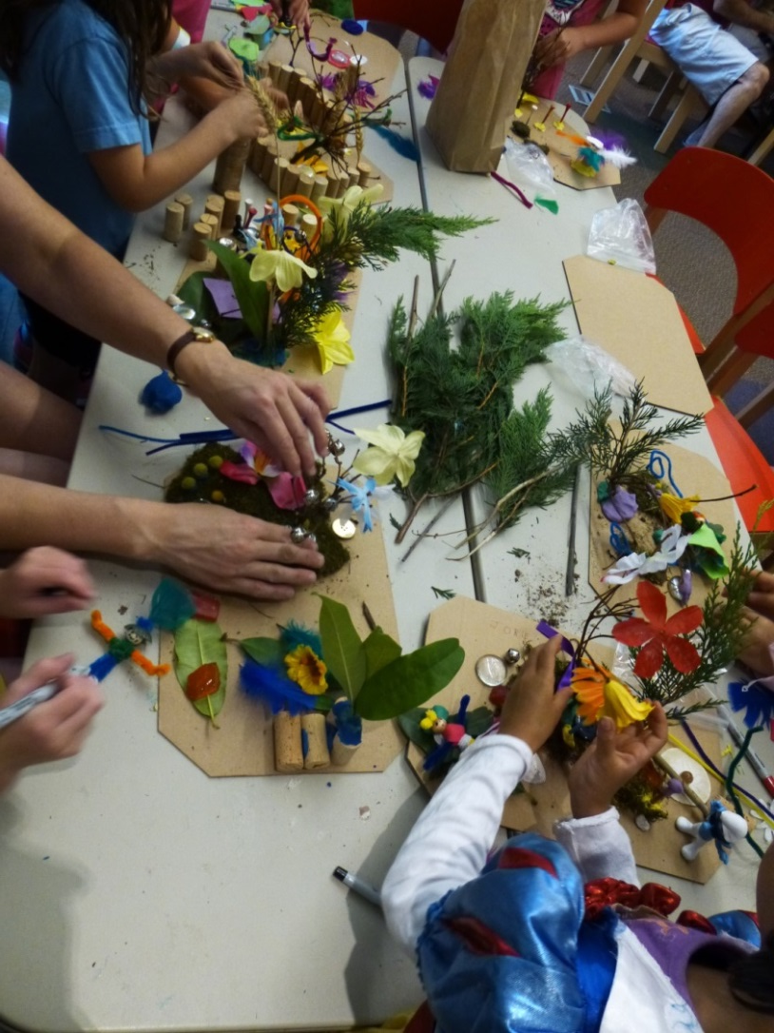

Slide 22
Signage
Sparse directions
Inspiring images
Open-ended questions
Tips!
Extension ideas

Slide 26
from STEM sprouts Teaching Guide:
http://www.bostonchildrensmuseum.org/sites/default/files/pdfs/STEMGuide.pdf

Slide 27
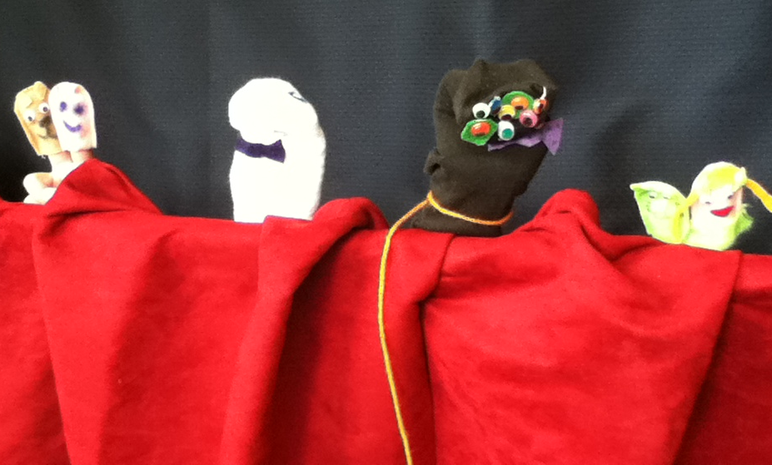

Slide 28
Recycled Materials General Request List
Fabric flowers
Polished rocks or small, smooth rocks
Shells
Ribbon
Yarn
Styrofoam craft balls (not packing material!)
Stamps
Non-holiday wrapping paper
(specific items requested depending on the program)

