Slide 1
Oddball Cataloging-- Puppets, Bones and Other Realia:
Discoverability for Fun, Practice, Research, Study or Cultural Experience

Slide 2
From AACR2 through RDA
Challenges in cataloging three-dimensional objects and realia requiring cataloger judgment
What is the library trying to do for patrons by offering 3-D/realia?
How much information, and what is the metadata source?
How can a 3-D/realia record work with the ILS for discoverability?
What should display to patrons?
How can a 3-D/realia record work with the ILS for circulation?

Slide 3
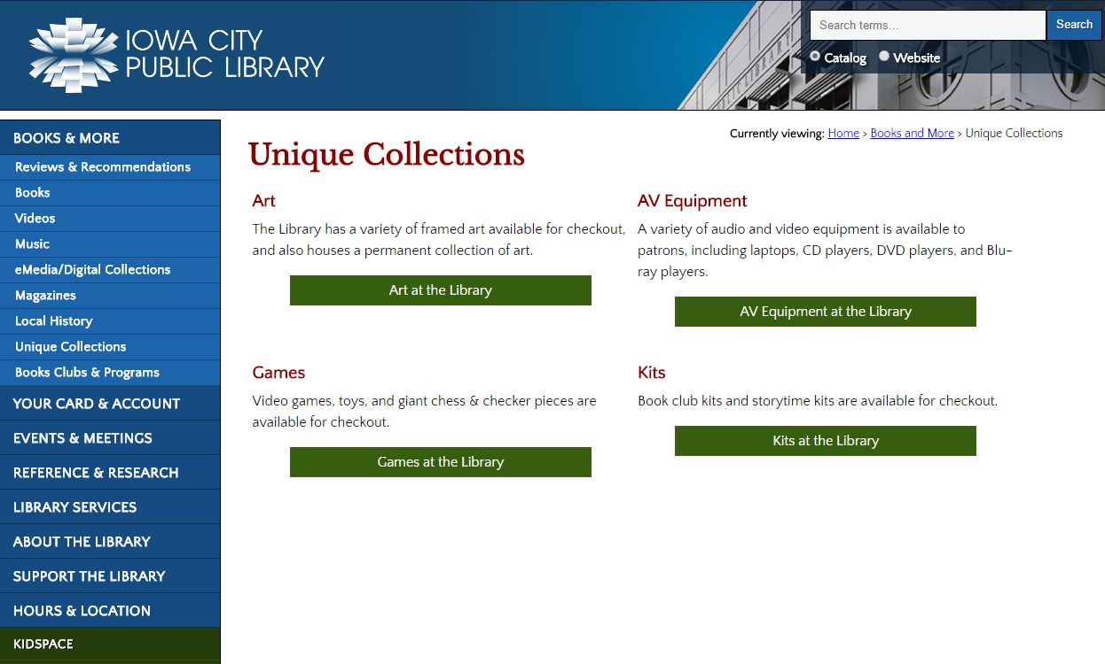

Slide 4
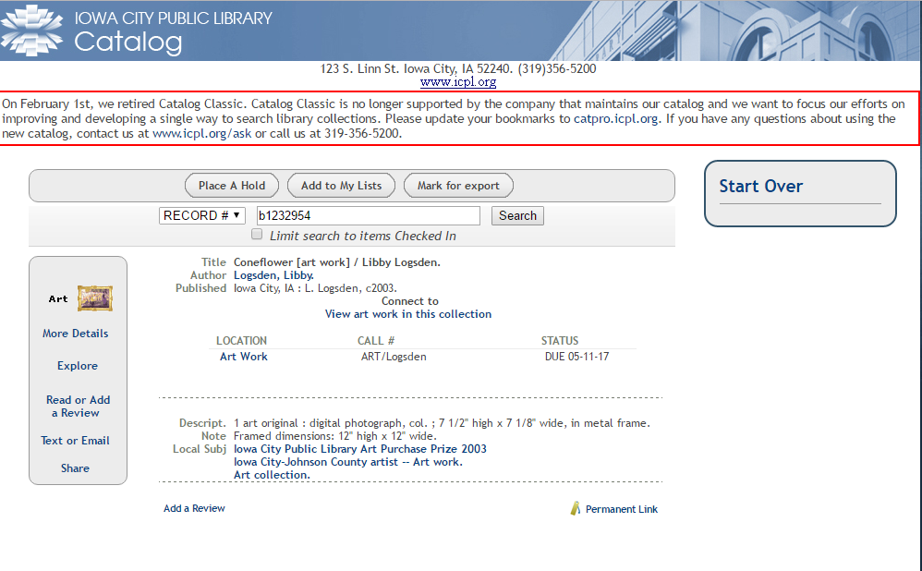

Slide 5
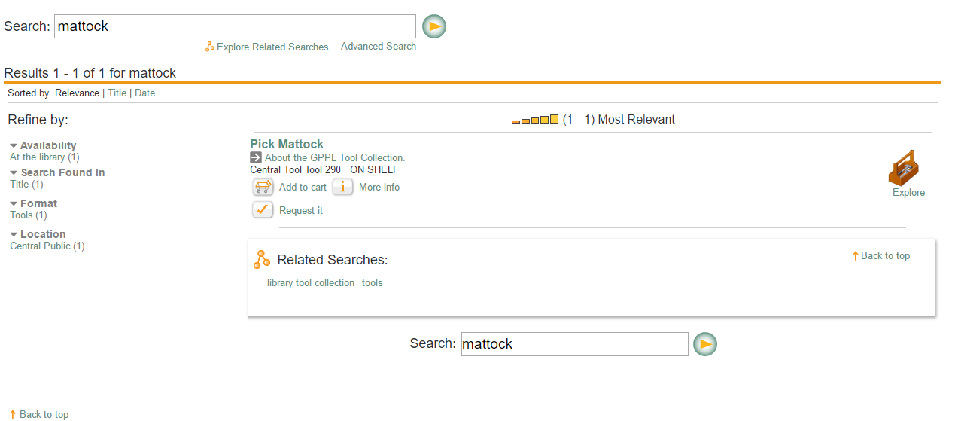
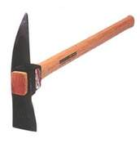

Slide 6
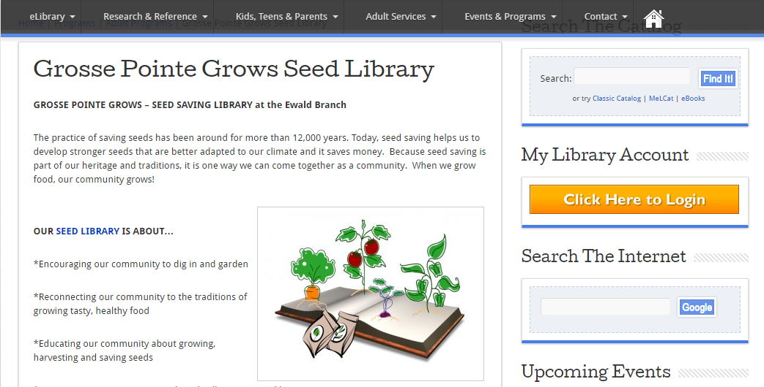

Slide 7
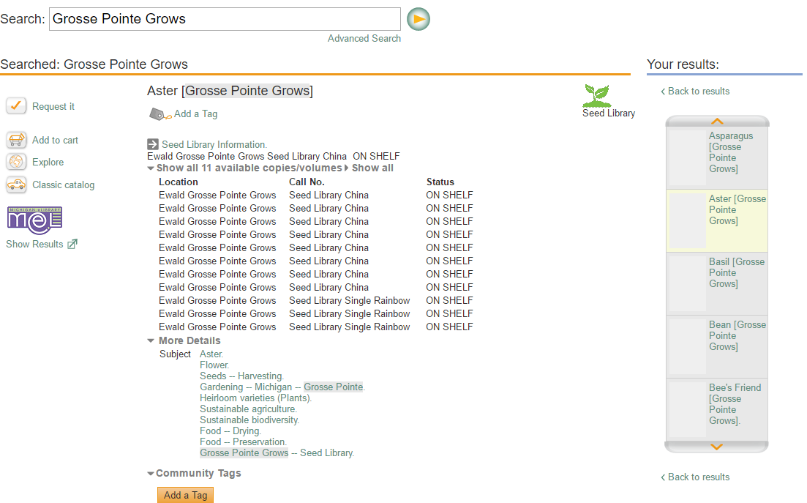

Slide 8
Presenters
Jane Cothron
Cataloger
Lincoln County Library
District
Bob Renfro
Cataloging Librarian
Multnomah County
Library
PJ Bentley
Librarian I
West Slope Community
Library, Portland
Katie Lockwood
Metadata and Systems
Librarian
University of Western States

