Slide 1
Oregon Department of Transportation Library
Lessons of the Barlow Road
Photo: Travel Oregon
Oregon Library Association Annual Conference
Presented by:
Laura Wilt, Librarian
ODOT Library
April 21, 2017

Slide 2
Early travelers often didn’t find a warm welcome as they made their way through the last leg of their journey to the fertile Willamette Valley
Notes:
Most visitors coming into Oregon are greeted by some type of welcome sign.

Slide 3
Finding a Better Way
As wagon trains reached The Dalles, settlers had to face the treacherous trip down the Columbia River in rafts. This often proved to be the most difficult portion of their entire trek across the country, frequently resulting in loss of stock, supplies and even life.
Notes:
So with their final goal almost in sight, the travel-weary emigrants had to overcome this last dangerous hurdle. Samuel Barlow came to the Oregon Country with his own family, so he was very much aware of the value of an overland route to complete the trip to the Willamette Valley.

Slide 4
The Barlow Road sought to improve the safety and efficiency of travel to the Willamette Valley
While the Barlow Road offered its own challenges, most considered it a vast improvement over the river route. Opened for traffic in 1846, it operated as a private toll road. In 1852, the toll station saw:
673 wagons
2448 male immigrants
825 female immigrants
$3660.85 collected in tolls
Notes:
Barlow and partner Joel Palmer located and marked a route; Barlow went to the Provisional Govt Dec. 1845 and applied for charter to build wagon road, which he would operate as a toll road.
One of what we call the “Beaver Boards” – part of historic sign programs. Laurel Hill was a portion of the Barlow Rd – not able to create grade to drive wagons down, and had to winch them with ropes.

Slide 5
By the time the Oregon Highway Commission was formed by legislative action in 1913, private toll roads were pretty much a thing of the past, and territorial road laws had evolved to establish a state-wide system of highways. The slogan, “Get Oregon out of the mud!” showed the need to move from primitive wagon and farm roads to all-season, surfaced highways capable of supporting automobile travel.
Notes:
Last tolls collected on the Barlow Road 1918. You can see from this photo of the Mt. Hood Loop Hwy that early state construction didn’t always mean a paved road – in this case, it was surfaced with an oil binder. Often, the grading and surfacing would be done under one contract, and sometime later (could be years), the actual paving would be done under another contract. Although they seem primitive today, they were a huge step forward from the primitive wagon roads that would often wash out to a unpassable quagmire with the winter rains. Information in my files that talked about having to basically rebuild the Barlow Rd every spring in the early years.

Slide 6
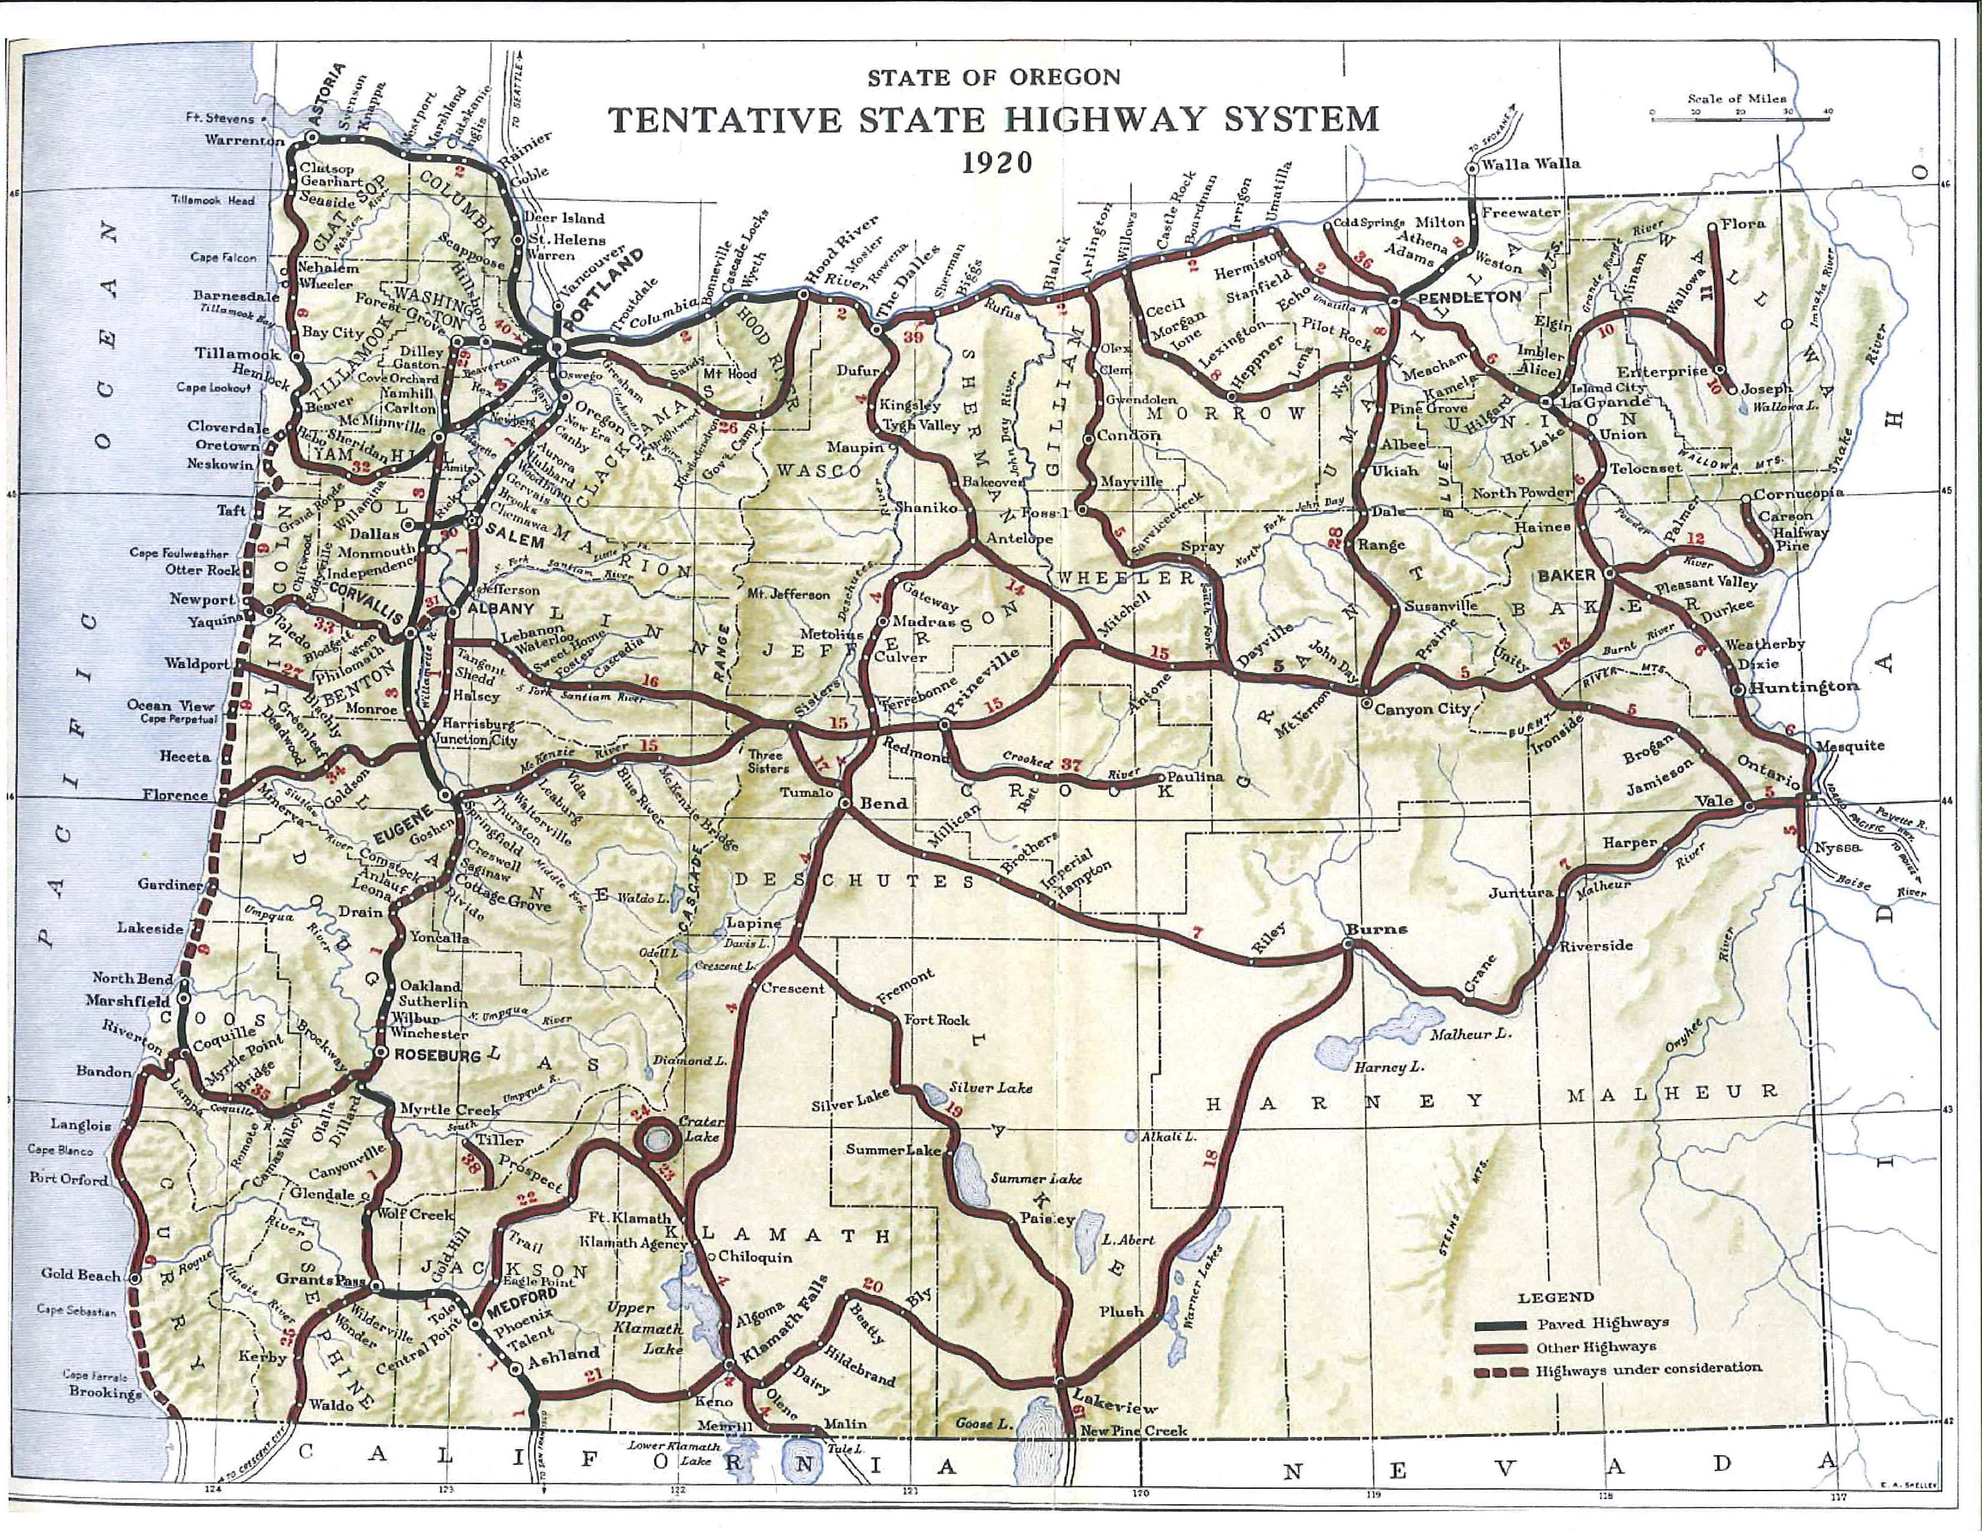
Notes:
Map from 1920 Biennial report shows just how few roads were actually paved with a macadam or concrete surface.

Slide 7
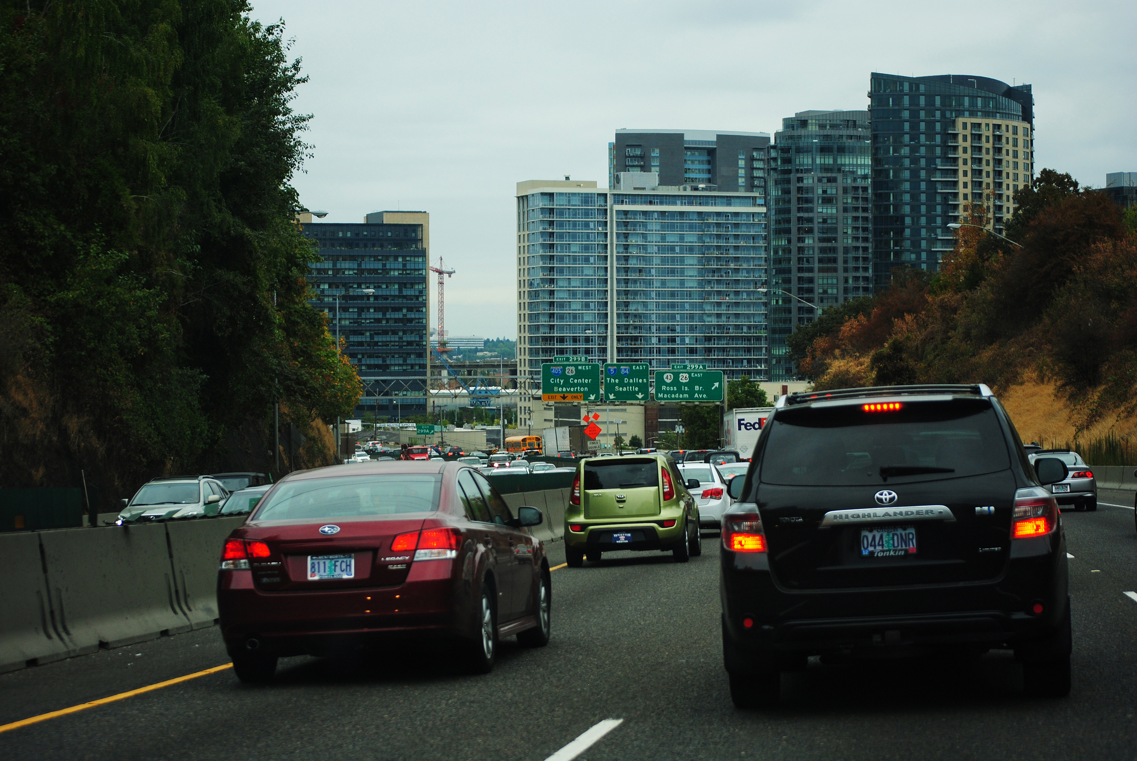
Today’s traffic is vastly different from the covered wagon trains that came through the Barlow Road, but we are still dealing with the need to find ways to transport travelers more safely and efficiently.

Slide 8
So what does this mean for ODOT Library users?

Slide 9
ODOT Library
Formed by the Highway Department in 1939
Solo library, attached to the ODOT Research Section
Serves ODOT, other agencies and the public
Notes:
Many surprised DOTs are huge consumers of information so most have dedicated library services, either as an agency-sponsored library, such as ODOT, or contracted through universities, transportation centers, state libraries.
As solo librarian, rely heavily on networking. I’m very grateful for the relationship we have between the state agency libraries – rely on them for information don’t have at my library, and try to make myself available for information and resources that I may be able to furnish for them. Also work transportation librarians across the country, and beyond. Transportation Division, Special Libraries Assoc., pooled fund studies that allow states to contribute to carry out research and projects that individually couldn’t do. DOTs are huge consumers of information so most have dedicated library services, either as an agency-sponsored library, such as ODOT, or contracted through universities, transportation centers, state libraries.

Slide 10
The ODOT Library offers resources for researching:
Agency information and history
Transportation laws
Construction / project specifications
Transportation research
Historical background for transportation projects
Notes:
Records from the beginning of the agency. Biennial reports
Transportation research – state wide and beyond
R/W maps, intergovernmental agreements

Slide 11
Collection includes:
ODOT reports and publications, including historic Biennial Reports and statistical reports through time (traffic volume, crash data, etc.)
Transportation Research Board (TRB) publications
American Association of State Transportation and Highway Officials (AASHTO) publications
Federal Highway Administration (FHWA) publications
Other transportation and engineering-related materials
Historic photos, documents and correspondence
Notes:
2 organizations that all state DOTs are members of, supply employees to serve on committees, provide peer reviews, etc.

Slide 12
Having access to historic photos and documents helps to trace the evolution of traffic safety over time, in terms of both equipment and practices.

Slide 13
And speaking of transportation safety -
The ODOT Library can help find current information on the topic.
Transportation and traffic safety are generally measured through statistics. ODOT gathers and compiles this information and disseminates it through the agency website and library catalog. There are many other sources for this type of information, some of which can be accessed through a LibGuide on the library homepage.

Slide 14
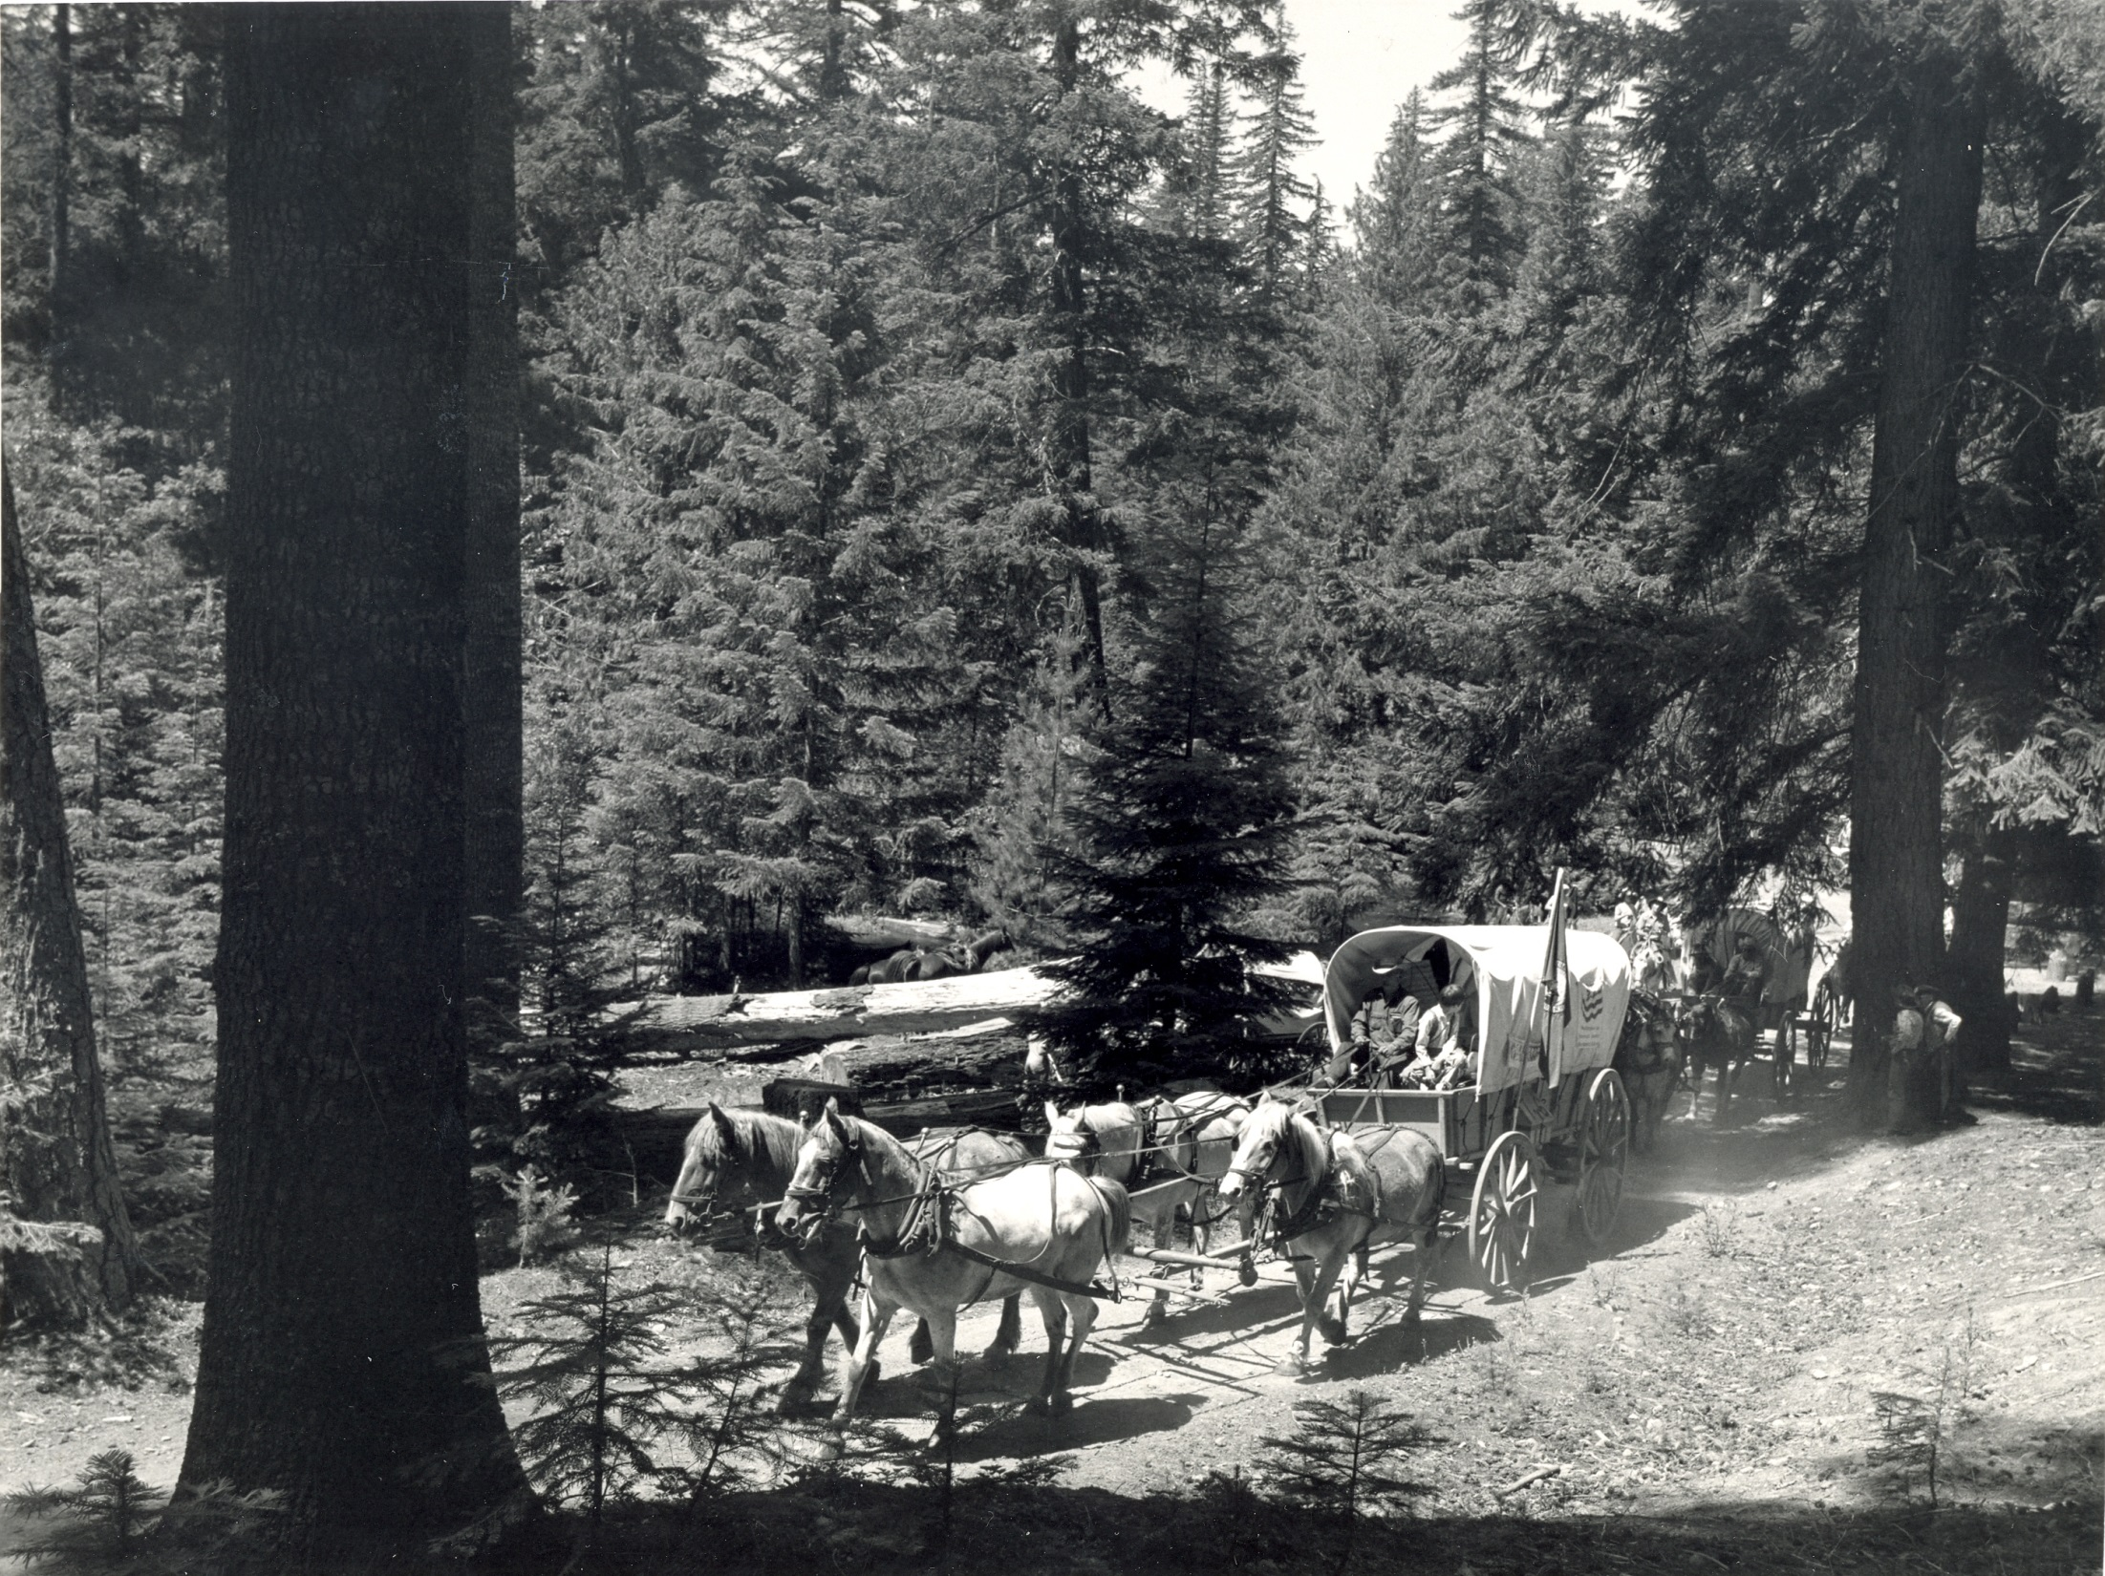
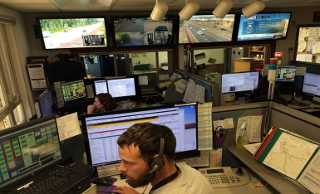
And speaking of transportation safety:
Much like the spirit of innovation that found a way to develop the Barlow Road, DOT engineers, planners, researchers and maintenance crews are constantly searching for new technology and ways of doing things that will increase safety and ease of travel on our highways.
Senate Bill 810
Oregon Per-Mile Road Use Charge Law
Safety is generally measured through statistics and performance measures. US DOT and state DOTs collect and compile data, making most of it available to the public. A few examples:
Hidden Treasures: Finding the Transportation Information You Need
National Work Zone Safety Information Clearinghouse – maintained by librarians at the Texas Transportation Institute (TTI)
Notes:
Barlow and Palmer saw a need, and found a way to fill that need.
National programs like “Vision Zero”, which seeks to find ways to completely eliminate traffic deaths, as well as emerging research and policy that will shortly allow the operation of autonomous vehicles on our roadways will again change the traveling landscape in ways that might remind us of the Jetsons. Might seem a bit scary, but if we consider approaching this from the pioneering point of view of our forefathers, we can continue to work towards innovations that will continue to increase safety and efficiency.

Slide 15
The last 170 years have seen a tremendous change in where and why we travel, and the means we use to get there.
One goal remains the same, however – to arrive at our destination safely.
Laura Wilt, Librarian
Oregon Department of Transportation Library
555 13th St. NE
Salem, OR 97301
Laura.e.wilt@odot.state.or.us
503-986-3280

