Slide 1
Experiments with BIBFRAME
Lori Robare
Oregon Library Association Conference
April 20, 2017

Slide 2
Overview of a few experiments
LC’s 1st BIBFRAME pilot
BIBFRAME Editor
UC Davis’ BIBFLOW project
Scribe Editor
LD4P project
Casalini SHARE Virtual Discovery Environment

Slide 3
Caveats
These are not fully developed, fully functional systems or tools – they are experiments intended to test
All of the experiments are based on BIBFRAME 1.0
What follows is the perspective of an interested observer, not a knowledgeable participant

Slide 4
Recommended viewing: ALCTS webinar series
“From MARC to BIBFRAME”: Linked Data on the Ground
Library of Congress BIBFRAME Developments (free now)
Putting the Link in Linked Data
Embedded URI in MARC: An Essential for Linked Data
How to Get From Here to BIBFRAME
Modeling and Encoding Serials in BIBFRAME
Linked Data Cataloging Workflows
Originally presented Oct.-Nov. 2016 ($$); free after six months
ALCTS webinar archive: http://www.ala.org/alcts/confevents/past/webinar

Slide 5
LC’s 1st pilot: October 2015-March 2016
To test the efficacy of BIBFRAME and the ability of catalogers to create bibliographic data in BIBFRAME structure
About 45 staff participated
Mix of languages, formats, publication types
Cataloged same resources in both MARC21 and BIBFRAME
Initially, created MARC records first; switched later to BIBFRAME first
Training developed at LC (freely available, next slide)
Editor developed for inputting data
13.5 million MARC records converted to BIBFRAME for searching

Slide 7
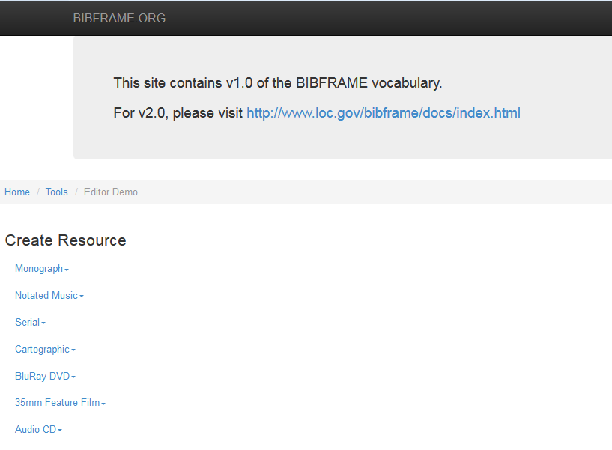
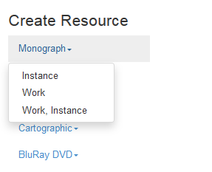
Live Demo:
Creating descriptions
for Work and Instance

Slide 8
Results/conclusions
Participants created about 2500 descriptions
Understanding of RDA was important
Labels and RDA instruction links were very helpful
Detailed knowledge of BIBFRAME was not essential
Participants understood modeling of Works and Instances
Treatment of Expressions in BIBFRAME model needed additional explanation
Dropdowns and lookups were popular features
Searching was adequate but could be improved
Pilot was considered a success
Input from catalogers helped shape development of 2.0 model & vocabulary

Slide 9
LC 2nd pilot
To begin in June 2017, last at least six months
45 participants from 1st pilot will be involved
Refresher training in May
30 additional staff will be trained to expand participation later in the summer
Training materials being revised, will be shared
Editor:
Ability to retrieve and edit descriptions
Authority control will be more robust

Slide 10
Resources
BIBFRAME Editor (1.0)
http://bibframe.org/tools/editor/
Moving-Away-from-MARC-a-thon (Manual has exercises for Editor)
https://www.loc.gov/catworkshop/bibframe/moving-away-from-marc.html
“BIBFRAME on the Move” (recorded talk to LC staff, Sept. 2016)
https://www.loc.gov/today/cyberlc/feature_wdesc.php?rec=7571
Beacher Wiggins, “The Library of Congress BIBFRAME Initiative” (talk at Linked Data Summit, Midwest Collaborative for Library Services)
https://www.mcls.org/index.php/download_file/view/1311/620/

Slide 11
BIBFLOW project, UC Davis (slide from ALCTS webinar)
Highly recommended viewing! (free beginning mid-May)

Slide 12
Xiaoli Li, Linked Data Cataloging Workflows (ALCTS webinar)

Slide 13
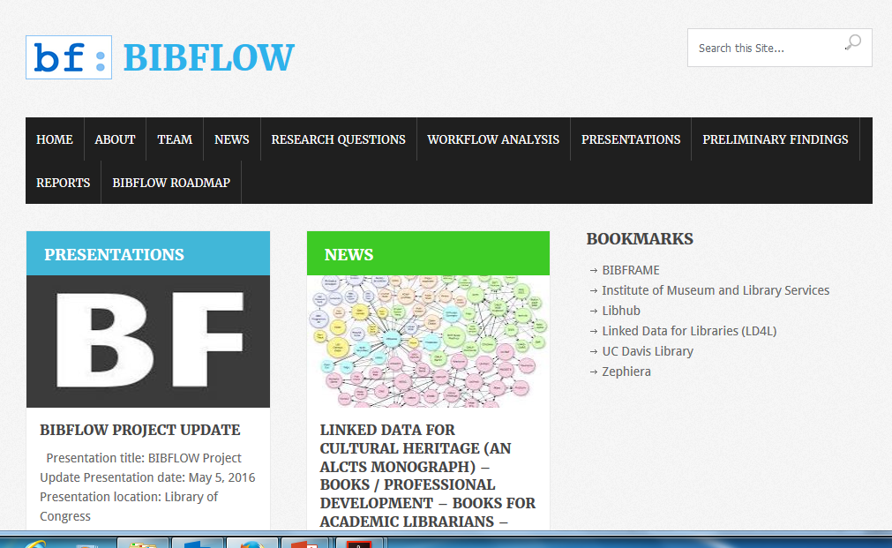
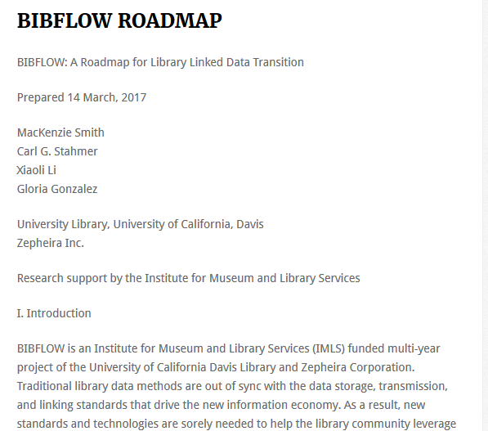
https://bibflow.library.ucdavis.edu/
Notes:
Roadmap is a 60 page document available on the BIBFLOW web page and also in pdf format

Slide 14
Roadmap and webinar address:
Cataloging workflows with BIBFRAME
Copy cataloging
Original cataloging
Creation of authority data and minting URIs
How catalog data supports numerous library operations
Recommendations for how to approach the transition to linked data

Slide 15
Xiaoli Li, Linked Data Cataloging Workflows (ALCTS webinar)

Slide 16
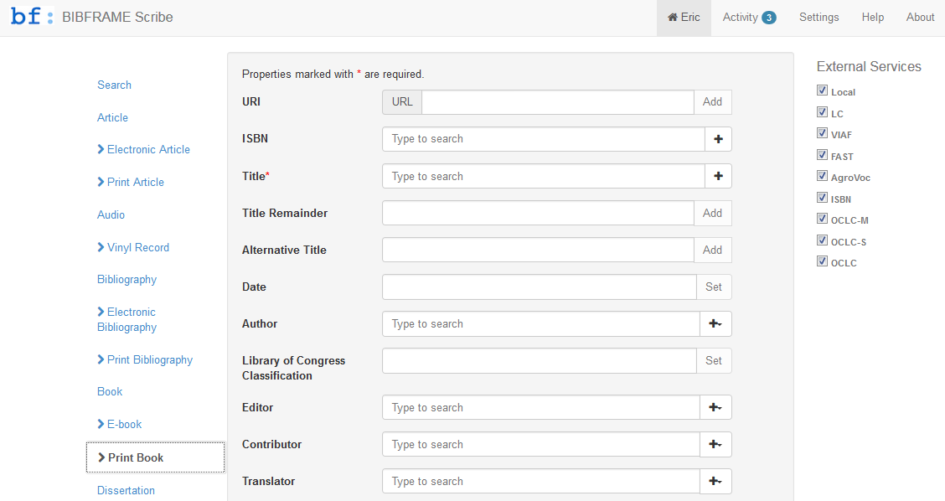
http://jarjar.lib.ucdavis.edu:8888/static/

Slide 17
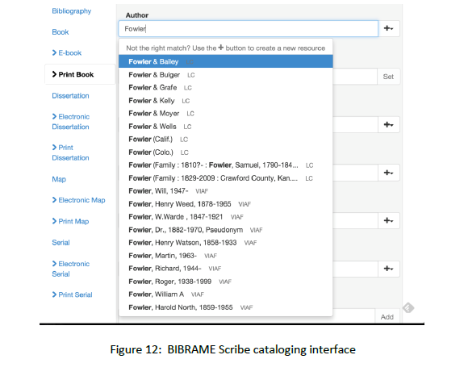
From Roadmap, demonstrating look-ups

Slide 18
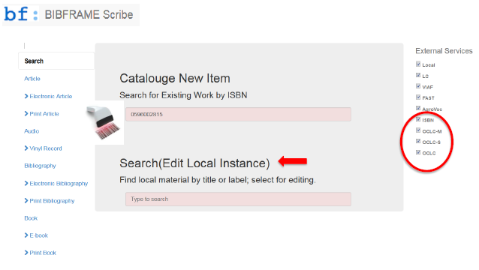
Xiaoli Li, Linked Data Cataloging Workflows (ALCTS webinar)

Slide 19
Some findings from the BIBFLOW project (from Roadmap)
Recommends a phased transition approach to minimize costs and maximize efficiency and benefits
Libraries are better positioned than most believe to transition to linked data
Generally speaking, catalogers had little difficulty transitioning to a Linked Data ecosystem
Catalogers did not need a comprehensive knowledge of the technical details of Linked Data or of the BIBFRAME model to work successfully in the new environment
Serials presented challenges: current state of BIBFRAME does not address changes over time, enumeration and chronology

Slide 20
Phased approach (from Roadmap)
Phase 1: situates libraries to function in a Linked Data library ecosystem
Step 1: establish a system for capturing and inserting URIs into newly created/edited MARC records
Step 2: batch insertion of URIs in MARC records
Step 3: Linked Data import/export API
Phase 2: transition to a native Linked Data ecosystem
Step 1: iterative transition to Linked Data native cataloging interface
Step 2: batch conversion of legacy MARC records
Step 3: iterative conversion of non-catalog library systems

Slide 21
BIBFLOW resources
Home page (includes Roadmap)
https://bibflow.library.ucdavis.edu/
UC Davis’ editor, BIBFRAME Scribe:
http://jarjar.lib.ucdavis.edu:8888/static/
Three webinars in the ALCTS series (should be free by mid-May):
http://www.ala.org/alcts/confevents/past/webinar
How to Get From Here to BIBFRAME – Carl Stahmer
Modeling and Encoding Serials in BIBFRAME – Gloria Gonzalez
Linked Data Cataloging Workflows – Xiaoli Li

Slide 22
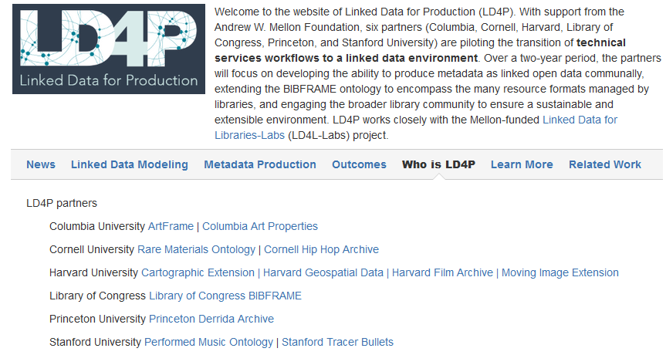

Slide 23
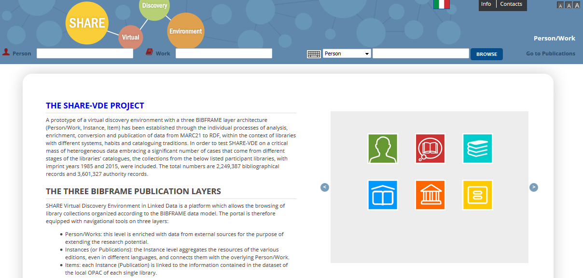
Casalini SHARE Virtual Discovery Environment
http://www.share-vde.org/sharevde/clusters?l=en

Slide 24
Three BIBFRAME publication layers
Person/Works
Enriched with data from external sources to extend research potential
Instances (Publications)
Aggregates resources of various editions, even in different languages, and connects them with the overlying Person/Work
Items
Each Instance (Publication) is linked to information in the dataset of the local OPAC of each individual library

Slide 25
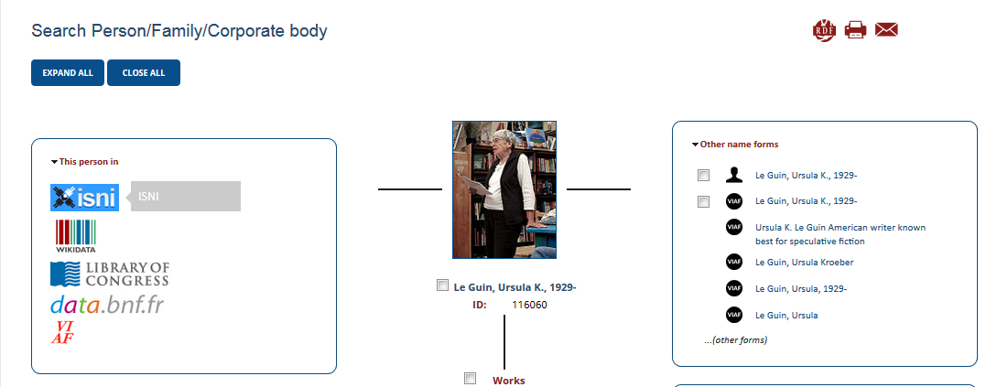
Live Demo:
Searching Person, Work
Browsing by Person

Slide 26
Casalini Share-VDE and LD4P
http://www.share-vde.org/sharevde/clusters?l=en
User Guide:
http://www.share-vde.org/sharevde/files/Guida_Utente_en.pdf
Linked Data for Production (LD4P) public page:
https://wiki.duraspace.org/pages/viewpage.action?pageId=74515029

Slide 27
Thank you!
Lori Robare
University of Oregon Libraries
lrobare@uoregon.edu

