Slide 1
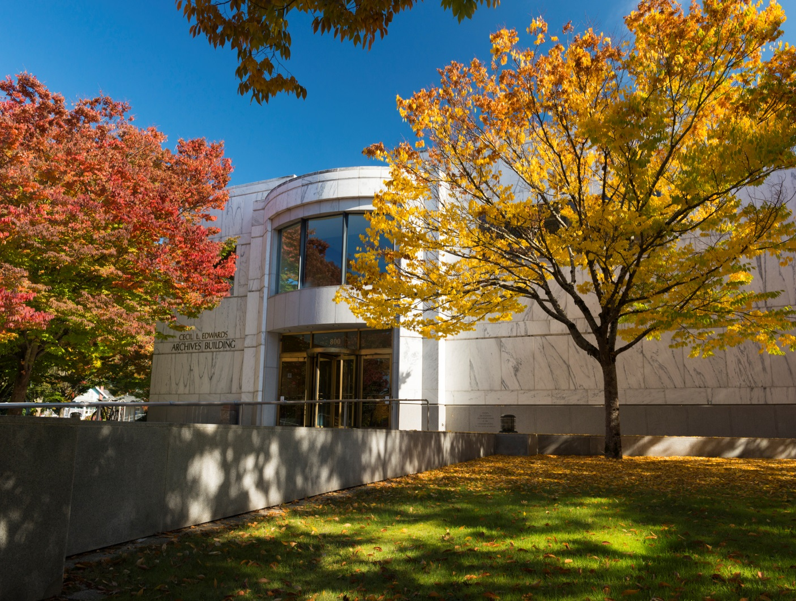
Oregon State Archives

Slide 2
What is the State Archives?
History of the Division
Repository for Oregon Public Records (Information Broker)
Manager of Public Records (Information Manager)
Administrative Rules
Oregon Blue Book
Official Documents

Slide 3
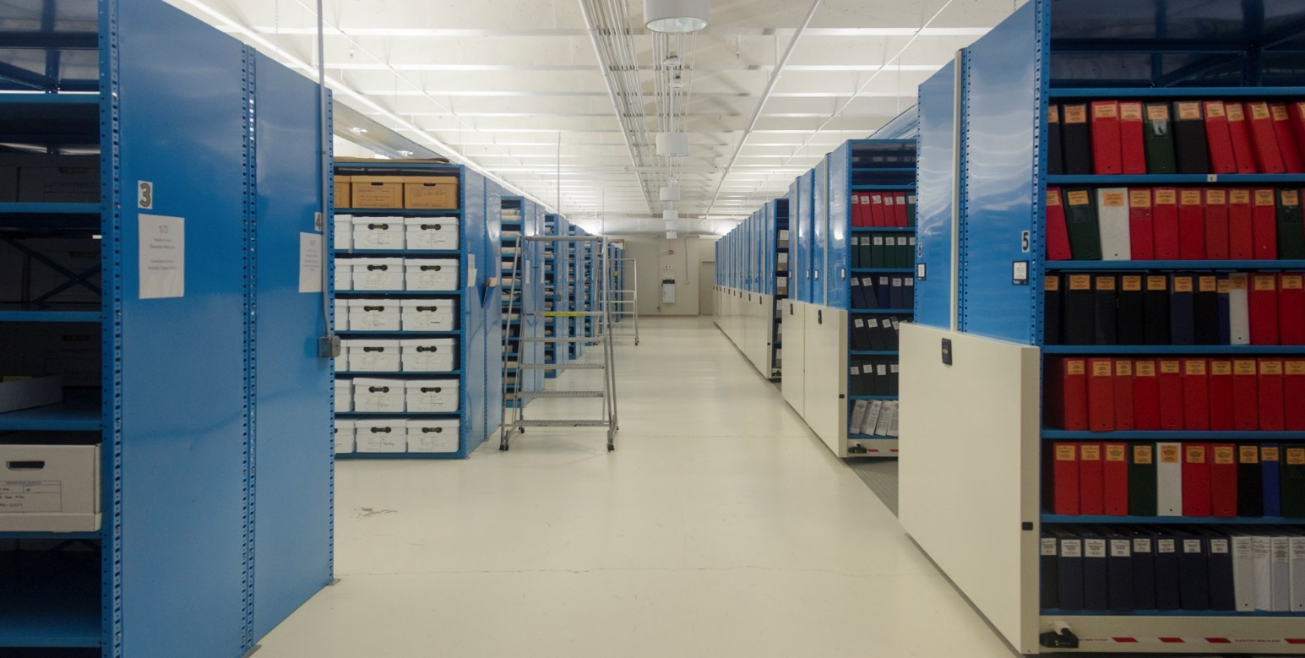
Researching Archival Records
Be prepared because Archives are not like libraries. The more you know the better off you will be, so organize your research beforehand.

Slide 4
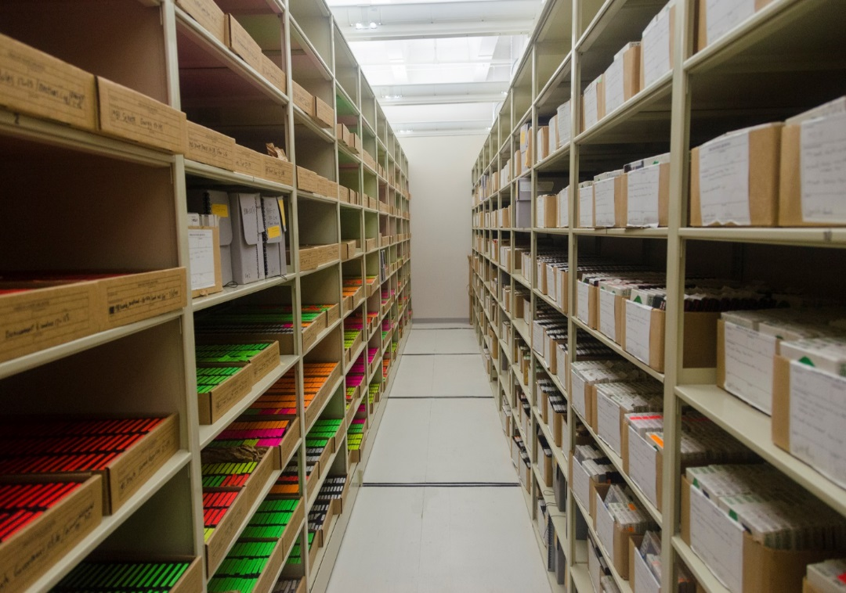
Why isn’t everything available on the internet?

Slide 5
Accessing the Archives in Person
Hours of operation:
M-F 8:00 to 12:00 and
1:00 to 4:45
Registration and Rules of Use
Closed stacks, records are brought to you
Self Service copying

Slide 6
Accessing the Archives Remotely
How – phone, email, mail
Requests normally answered within 5 working days
Include all pertinent facts as you know them
Include your contact information so staff can contact you if clarification is needed.

Slide 7
Fees
Self service copying -- 25 cents per page
Copying by staff – 75 cents per page
Research labor -- $40 per hour, billed in 10 minute increments
(maximum of 4 hours research for a request)
For more information about fees see: OAR 166-010-0010

Slide 8
Research Tools available from the Archives
Home page
http://sos.oregon
.gov/archives/Pages
/default.aspx

Slide 9
Elected Officials
Governors’ records
http://sos.oregon.gov/archives/Pages/records/governors_guides.aspx

Slide 10
State Agency Records
State Agency Records Guides
http://sos.oregon.gov/
archives/Pages/records
/state_records_guides
.aspx
ODOT finding aid
Administrative overview
Scope and Content
Series Description
Selected images
http://arcweb.sos.state.or.us/pages/records/state/odot/index.html

Slide 11
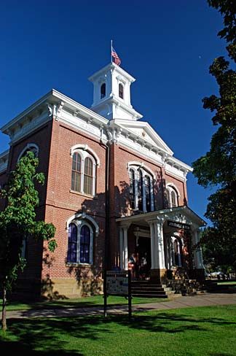
Local Government Records
Oregon Historical County
Records Guide
http://sos.oregon.gov/archives/
Pages/records/county_records
_guide.aspx
More than 70 records series described
for all 36 counties

Slide 12
Legislative Records
Researching Legislative Records
http://sos.oregon.gov/archives/Pages/records/legislative-research.aspx
Listing of Legislative Records http://sos.oregon.gov/archives/Pages/records/legislative_records_guide.aspx
Audio recordings from 1957-present
Committee records from 1945-present
Original Bill files from 1860-present
Legislative Committee Records and recordings
http://sos.oregon.gov/archives/Pages/records/legislative_minutes.aspx
Legislative Bill Tracings
http://sos.oregon.gov/archives/Pages/records/legislative_tracings.aspx

Slide 13
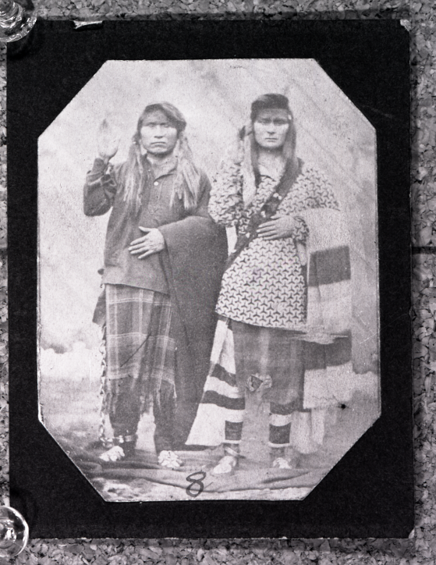
Genealogical Resources
Early Oregonians https://secure.sos.state.or.us/prs/personProfileSearch.do?earlyOregonian=true&searchReset=true
More than 102,000 profiles for
individuals living in Oregon prior
to statehood.
Oregon Historical Records Index
http://genealogy.state.or.us/
Name index with than
650,000 entries.

Slide 14
Records Management Services
Advice, assistance and training regarding public
records
Retention and Disposition Schedules
Records Center
Security Microfilm Depository
Oregon Records Management Solution
Social Media, Cloud Computing, Technology, etc.

Slide 15
Records Management Services
Advice, assistance and training regarding public records
http://sos.oregon.gov/archives/Pages/records_management_training.aspx
General Schedules (OAR 166)
http://sos.oregon.gov/archives/Pages/records_retention_schedule.aspx
Special Schedules for State Agencies
http://sos.oregon.gov/archives/Pages/state_admin_schedules.aspx

Slide 16
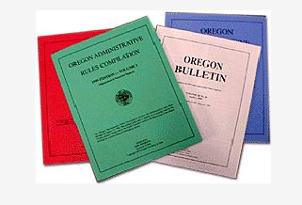
Oregon Administrative Rules
A "rule" is "any agency directive, standard, regulation or statement of general applicability that implements, interprets or prescribes law or policy, or describes the procedure or practice requirements of any agency."
The Administrative Rules Unit assists agencies with the notification, filing and publication requirements of the rulemaking process.
The Administrative Rules Unit of the Archives Division, Office of the Secretary of State, publishes the Oregon Administrative Rules Compilation and the online Oregon Bulletin.

Slide 17
Oregon Administrative Rules Resources
Accessing OARs
http://sos.oregon.gov/archives/Pages/records/local/scenic-images.aspx
Researching OARs
Contact the reference staff at reference.archives@state.or.us
Administrative Orders, 1939- present
Past Bulletins, 1958- present
Compilations of Administrative Rules, 1997-present

Slide 18
More resources
Virtual tour of the State Archives
http://sos.oregon.gov/archives/records/tour/Pages/default.aspx
Exhibits
http://sos.oregon.gov/archives/Pages/exhibits.aspx
Scenic Images of Oregon
http://sos.oregon.gov/archives/Pages/records/local/scenic-images.aspx
Historical Trademarks
https://secure.sos.state.or.us/prs/search.do

Slide 19
For More Information…
Archives Division -
Reference Unit: archives.reference@state.or.us
Webpage: http://sos.oregon.gov/archives/Pages/default.aspx
Phone: (503) 378-5198
E-mail: layne.g.sawyer@state.or.us

