Slide 1
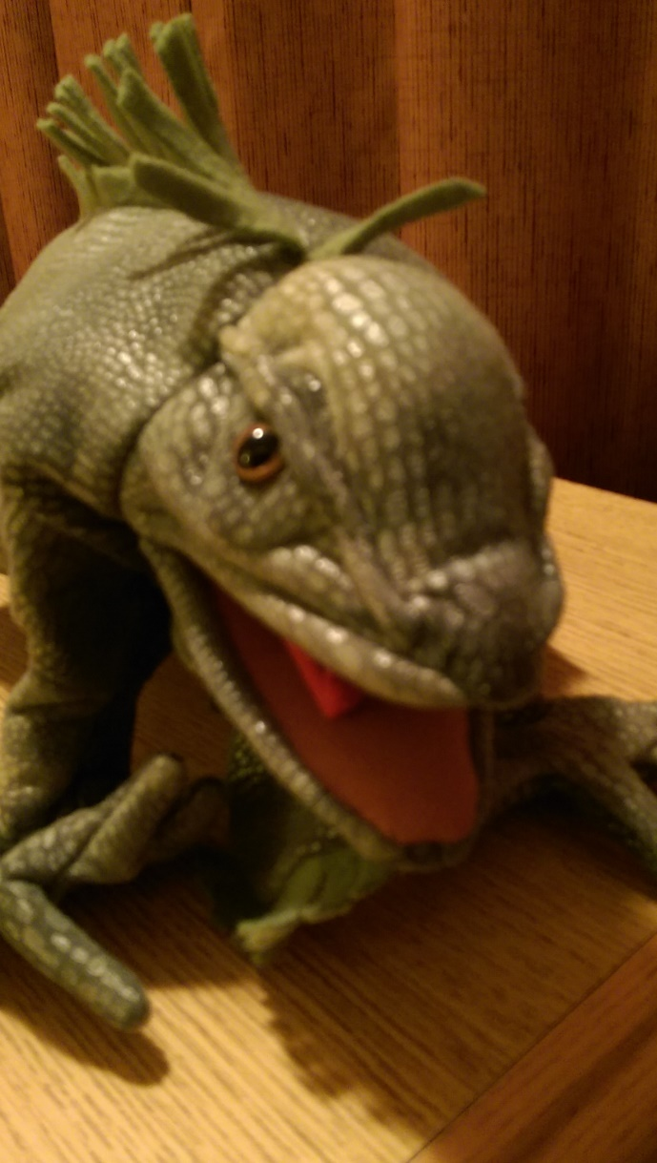
Oddball Cataloging: Puppets and Story Kits
Oregon Library Association Conference April 21, 2017 Salem, Oregon
Jane Cothron
Lincoln County Library District
Chinook Library Network
jcothron@lincolncolibrarydist.org

Slide 2
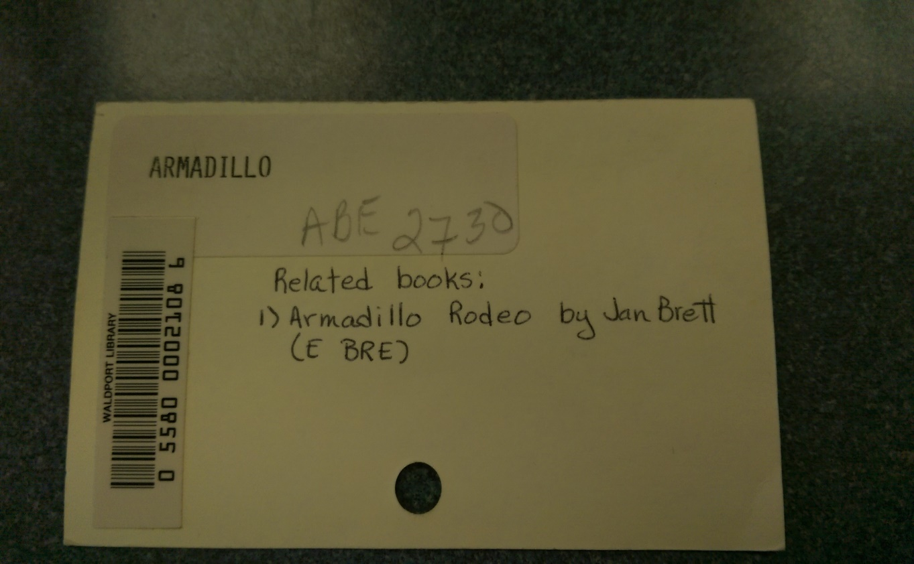
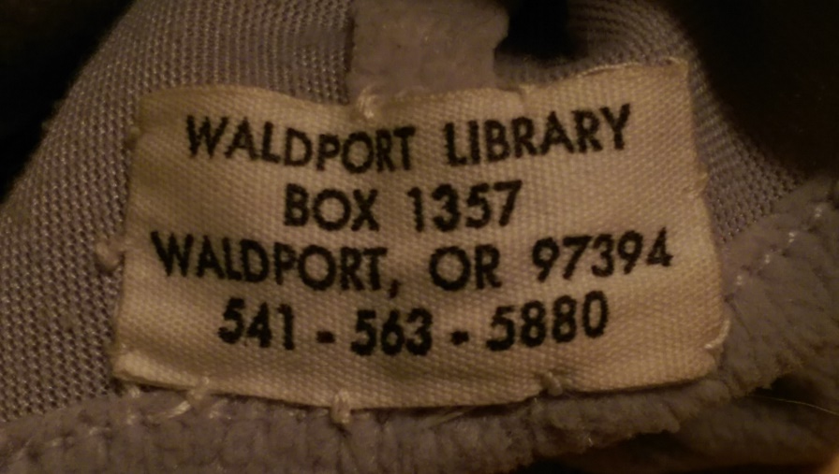
Notes:
Waldport Library has a puppet collection used by both library staff and patrons. The puppets are cataloged, mostly only with brief records. Processing includes sewing in a fabric tag with the library address and phone number and creating a card with barcode and notes on related texts. In this case, the gray armadillo puppet came with the Jan Brett book, Armadillo Rodeo.

Slide 3
Notes:
This is an attempted RDA record for the armadillo puppet with accompanying book. I am open to discussion about using “tactile three-dimensional form” as rda content descriptor. It is three dimensional and one can touch it, but for puppets, watching the movements is probably more important than the tactile qualities. Please see Kelley McGrath’s 2012 presentation on Cataloging Three-Dimensional Objects with RDA for a really good discussion of this (and much more).

Slide 4
Folkmanis Iguana Puppet

Slide 5
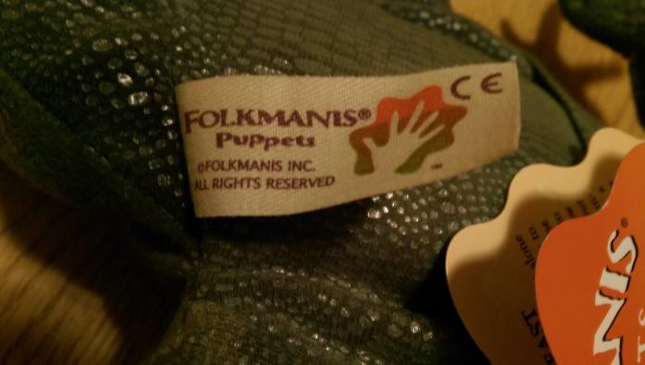
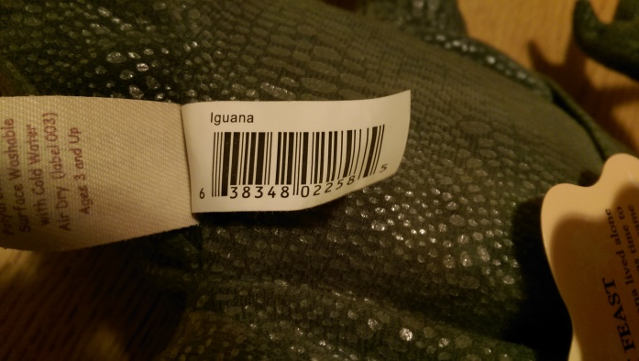
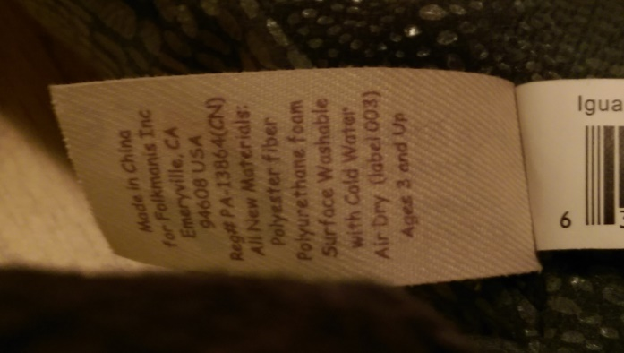
Tagging the usual suspects
Notes:
For those of us fortunate enough to have puppets from Folkmanis, Inc., the title information is on the tag—as is the manufacturer, publisher, and often, a story about the puppet animal. The iguana puppet tag includes both a “Facts of Interest” list and a story. In addition, there is a fabric tag sewn in with washing instructions and various standard numbers.

Slide 6
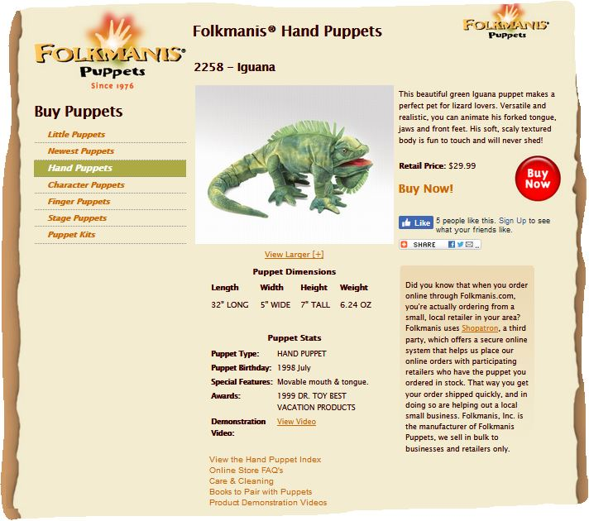
Notes:
More information can be found on the Folkmanis web page, including the date introduced, the dimensions, and a description.

Slide 7
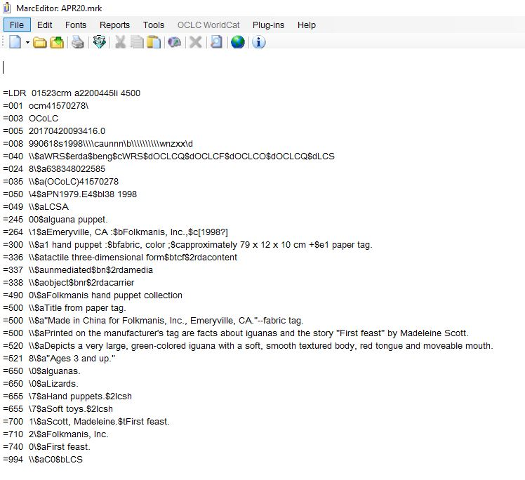
Notes:
I did not find a subdivision that brought out that this is a toy iguana. I do want the keyword access to iguanas and lizards, but the unmodified heading is not right. In the meantime…I’ll have to cope with the ambiguity. Any suggestions?

Slide 8
Story to Go Kits
A while back the library district received an LSTA grant to create story to go kits—a backpack with books, toys, activities, games, and often music or videocassettes for caregivers to use with children ages 1-7.

Slide 9
Notes:
New records for Stories to Go kits can use RDA, but we are still including a gmd in the 245 field for non-text materials. We also include a contents note for multipart items. The kit I happened to pick up is missing audio and video materials. When those are replaced, we’ll add that information to the notes and physical description fields and add 006 and 007 fields as appropriate.

Slide 10
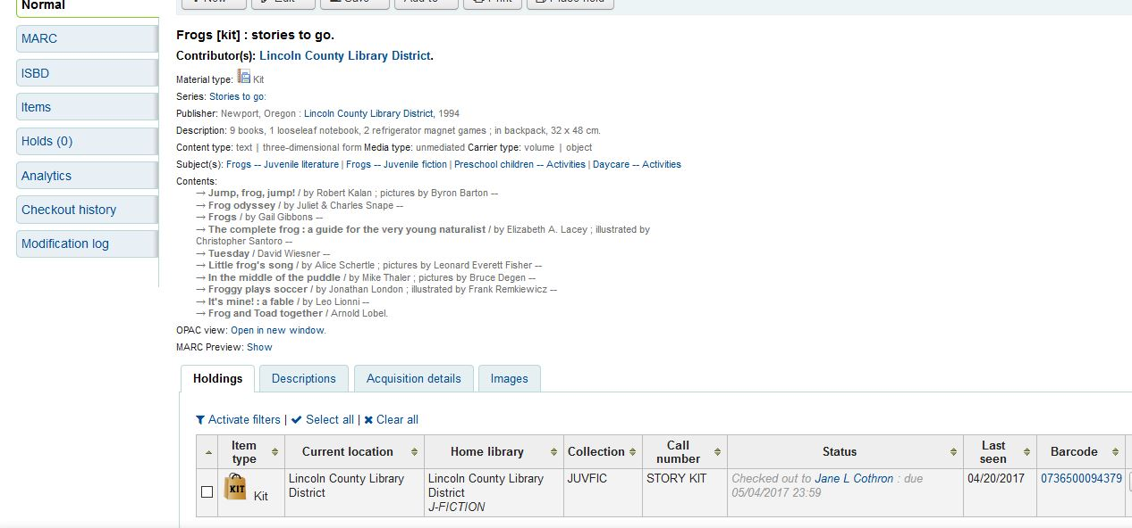
The same record in Koha staff view:

Slide 11
Things to consider
OCLC Guidelines for Type instruct catalogers to code realia as VISUAL MATERIAL
and assign the TYPE code r for Three-dimensional artifact or naturally occurring object
….
which works, except that OPACs often use icons interpreting VISUAL MATERIAL to mean films, movies, and stuff like that. The icon in our OPAC pictures a few frames from a filmstrip. Archaic, yes, and confusing.

Slide 12
A couple of resources
OCLC Bibliographic Formats and Standards
http://www.oclc.org/bibformats/en.html
Cataloging Three-Dimensional Objects with RDA, by Kelley McGrath (with links to slides, YouTube, and wmv recording)
http://www.ala.org/alcts/confevents/upcoming/webinar/cat/032812

