Slide 1
The Wizard Behind the Curtain: Technical Services Demystified
Emily O’Neal
Technical Services Managers
Deschutes Public Library
emilyo@deschuteslibrary.org

Slide 2
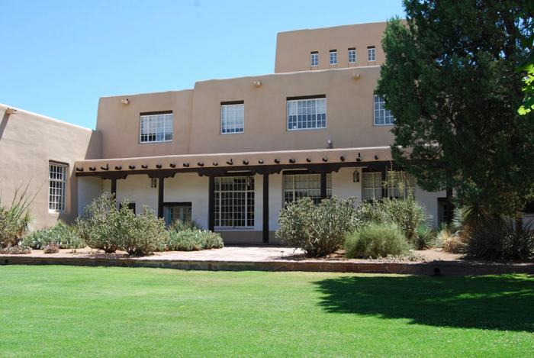
INTRODUCTION
Upper Left: UNM – Zimmerman Library
Albuquerque, NM
Upper Right – Bud Werner Memorial Library
Steamboat Springs, CO
Bottom Center – Deschutes Public Library
Bend, OR
Photos: Google Images
Notes:
I have been working in library technical services since I was in high school!
Professionally, I have managed aspects of Technical Services for 9 years!
Originally I was in an academic library as the ‘Operations Manager of Collections’ which basically means do everything! Huge system, large consortium
I then moved to CO, Head of Technical Services, single branch but in a large consortium
Now the Manager of Technical Services, serves all of Deschutes Co. w/ lending agreements with Jeff and Crook

Slide 3
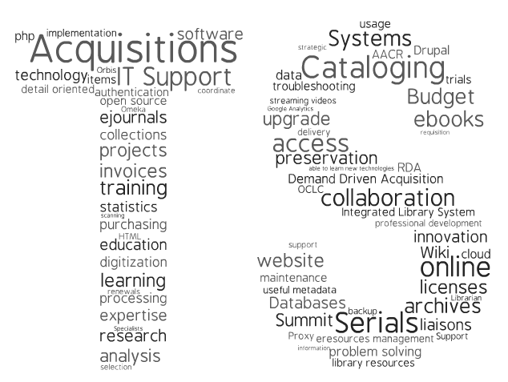
Technical Services is the foundation of the library
http://library.clark.edu/content/technical-services
Notes:
We select and purchase all library materials
We make sure all of those library materials are discoverable
We maintain those materials so that they are relevant and desirable
We make sure patrons can find what they are looking for and buy what we might not already have
We make it possible to place holds on the materials
We make it possible to find similar items through their searching

Slide 4
Elements of Technical Services
Technical Services, a.k.a. adding materials to the library!
Collection Development/Selection
Acquisitions
Cataloging
Processing
Collection Management/maintenance and weeding
Add on options: Periodicals and ILL – where do they go?
Notes:
This includes BOTH physical and electronic. Some libraries split these up but technically the process is the same. Someone needs to select it, buy it, make it discoverable, and then decide whether or not to keep it.
Periodicals have traditionally been in Technical Services
ILL…

Slide 5
Definitions please!
Selection – choosing what to buy
Acquisitions – the purchase and payment process
Cataloging – adding information about the newly purchased materials to the library’s software system so that patrons can access the materials
Processing – adding library specified labels, stamps, etc. for the circulation and use of the item.

Slide 6
Selection/Collection Development
Selectors and/or Collection Development Librarians decide what to buy.
Sources:
Book Reviews – Booklist, Library Journal
Best of and Recommendation Lists - New York Times
Publisher Catalogs
Patron Requests

Slide 7
Acquisitions
Orders are collected from the Selectors and given to Acquisitions to buy
A number of steps typically occur before the order is placed:
Duplicate checking
Bibliographic Information
Price
Notes:
Duplicate checking - verify that the item isn’t already owned by the library or on order.
Bibliographic Information - verify that the information on the order matches the materials about to be ordered
Price – verify that the item is within purchasing guidelines according to the price of the item and where to buy from.

Slide 8
Ordering and Receiving
ORDERING
Elements of an order:
Quantity
Price and discount
Fund
Location
Shelf-ready options:
Processing specifications
Call Number
Special instructions
Brief Bibliographic record
For DISCOVERY!
RECEIVING
Items arrive, open the box and verify the order:
Quantity
Price
Bibliographic
Invoicing and Payment
Receive in ILS
Notes:
Quantity – how many copies to buy
Price and discount – for budget and tracking
Fund – which “bucket” of money this item will be paid for out of
Location – which building this goes to, or which department within a single library system

Slide 9
Acquisitions Definitions
Primary Vendor – the company from which the library buys the majority of their materials. Often these are jobbers.
Jobber – a wholesaler, buys materials from publishers at discount, relaying that discount on to the library
Encumbered – when you initially place the order, the amount of money you plan to spend from the fund. It is a guestimate
Expended – the actual amount of money spent on an item
Firm order – a regular purchase
Approval Plan – materials the primary vendor sends automatically based off an approved profile from the library for which the library can keep and pay for or return
Leased Plan – materials that are essentially rented and will be returned to the vendor
Standing Order – materials the library automatically buys and are automatically shipped based off a profile

Slide 10
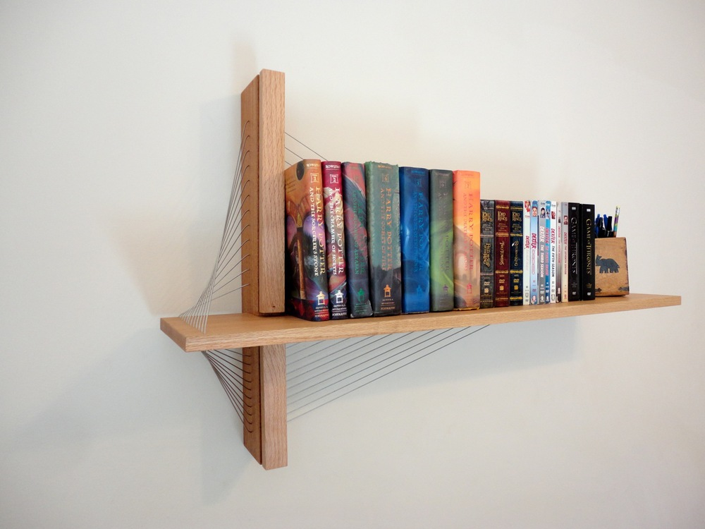
On to Cataloging…
Once the item has been received and invoiced, it goes to cataloging.
Goal #1 – DISCOVERY!
Notes:
The basics: The material needs a storage place (think ILS) to put the information about the material so it can later be found by those seeking the information.
Elements of a cataloging record
Description of the material – Title, Author, ISBN, Publication
Often obtained from another source and brought in to the library catalog.
Description of the item – call #, location, barcode, status

Slide 11
Cataloging – Bibliographic Data
Standard elements to the bibliographic data in a cataloging record:
Title
Author
ISBN
Publication information
Size
Format
Pages
Content description
Call Number
Subject headings!
Subjects
People
Corporations
Locations

Slide 12
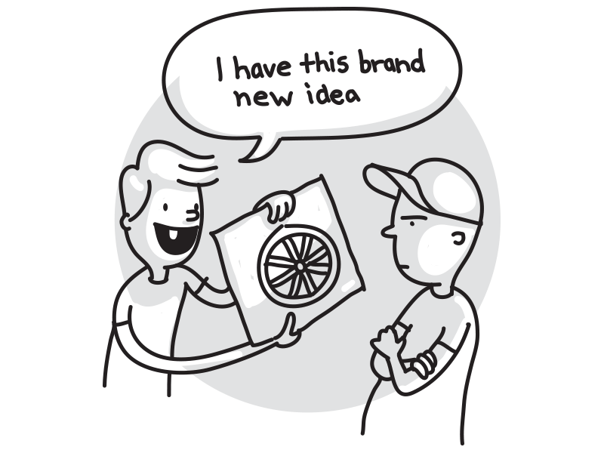
Typical Cataloging Workflow
Why reinvent the wheel if you don’t have to!?
OCLC
Find Record
Export
Item
Notes:
Why reinvent the wheel if you don’t have to!?
Most libraries go to OCLC to retrieve the bibliographic record and bring it into their system.
This is called Copy Cataloging.
Go to OCLC Connexion or WorldShare → Find Record → Export into ILS → Add item record
Libraries can add local data to the OCLC record either before or after export
Local data changes include local subject headings, enhancing the record, removing elements not needed, adding local notes.
This often overlays the brief order bibliographic record.
Original Cataloging is when a cataloger builds the bibliographic record from scratch, without the aid of other pre-existing records.
Descriptive cataloging deals with the physical nature of the book, author, pages, etc.
Subject analysis deals with the intellectual nature of the work, what it is about, how we want it linked to other similar items.

Slide 13
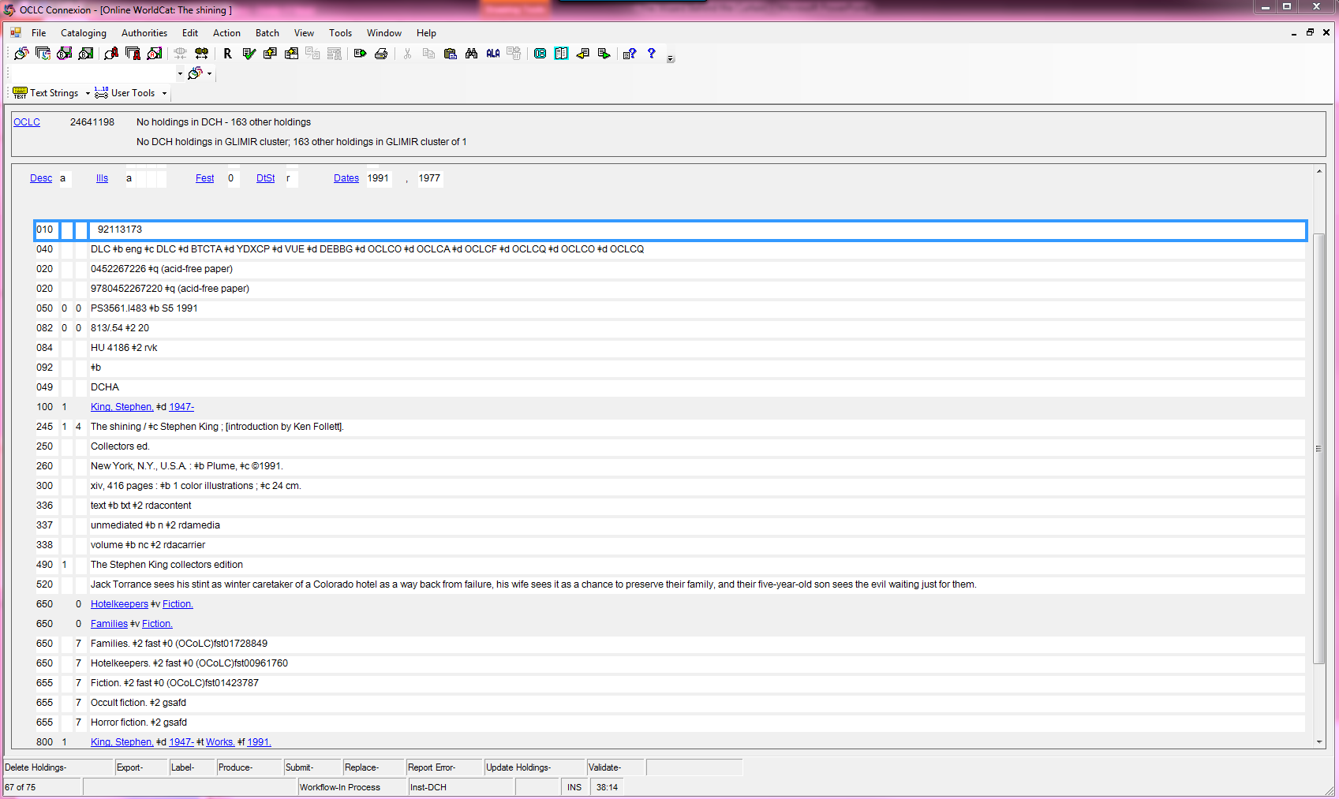
Notes:
This is a MARC record, stands for Machine Readable Cataloging. Tells the computers to talk to each other and to display the info a certain way.

Slide 14
Why cataloging matters?
THE CATALOG IS THE FOUNDATION AND KEY TO DISCOVERY OF ALL LIBRARY RESOURCES! TAKE CARE OF IT, MAINTAIN IT, AND IT WILL PAY OFF IN THAT IT WILL BE EASIER TO FIND INFORMATION!
http://www.robinfay.net/training/cataloging_basics.ppt

Slide 15
Cataloging Definitions
AACR/AACR2 – Anglo-American Cataloguing Rules, a library created set of rules to determine how to catalog rules. Has recently been replaced by RDA
RDA – Resource Description and Access, new cataloging Standard
Authority Control – organizes bibliographic data by using a single, distinct spelling of a name (people, place, thing or concept).
Subject Heading – a specified term used to assign a topic to the record for information retrieval.
Holdings – The library owns this item
MARC – Machine-Readable Cataloging. Tells the computers to talk to each other and to display the info a certain way.

Slide 16
Processing
Physical processing –
Barcode
Call number spine label
Property stamps
Other specialized stickers
Book covers – mylar and kapco
Book tape
Other elements of processing:
Changing item locations or status
Checking materials in
Mending and repairs
Special projects
Displays

Slide 17
Collection Maintenance
To remove books that are not being used
To remove books with outdated or obsolete information/philosophies (that have no historical use)
To identify books that are damaged or in poor condition
To identify gaps in the collection and make new purchases
To align the collection with the library’s goals and vision
Limited space for the collection
Notes:
Now that we put all this stuff in the library, we need to take something out. It is a living collection, needs constant maintenance.

Slide 18
Periodicals
'periodical', 'serial' and 'journal' are often used interchangeably in the library though they are slightly different!
Periodical is a broad term, meaning anything that is published periodically. It could be newspapers, magazines, newsletters or journals.
Serial is also a broad term, meaning anything that is published serially, or in a series.
A journal is a publication which comes out on a regular basis and contains articles.
http://canberra.libanswers.com/a.php?qid=501250

Slide 19
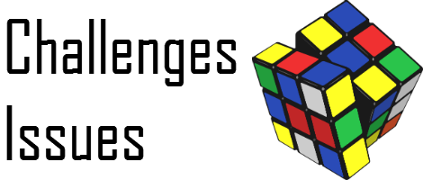
Periodical Issues
Notes:
Check-in – Per issue! Checking is key!
Physical processing of each issue
Add each issue to the library catalog for DISCOVERY!
Issues the make periodicals special:
Constant maintenance
Constant shelving
Constant check-in
Constant weeding
Title changes
Cessations

Slide 20
Interlibrary Loan
ILL Request
Library Doesn’t Own it
Library wants to buy it
Library does not want to buy it
Library Owns it
Place a hold
Acquisitions Process
ILL
Notes:
When an item is needed, the library doesn’t own it and won’t buy it
Often purchasing decisions include the date of the item, future desirability of the item and if the item is out of print
Sometimes the ILL is something the library will buy and it then goes through the acquisitions process which is why this often goes in tech
BUT, if it is straight ILL, it is often more a materials handling responsibility. Often divided between the two departments, no real home in the public library world.

Slide 21
Full Circle
Selection
Acquisitions
Cataloging
Processing
Maintenance

Slide 22
Essentially, we create this:

Slide 24
Citations
Google Images
http://slideplayer.com/slide/7528151/
http://canberra.libanswers.com/a.php?qid=501250
http://www.robinfay.net/training/cataloging_basics.ppt

