Slide 1
2017 Winners
2018 Nominations
Melanie Hetrick, Tillamook County Library Kiva Liljequist, Metropolitan Learning Center (Portland) MacKenzie Ross, Beaverton City Library

Slide 2
What is ORCA?
Founded in 2010
Fun and exciting way for Oregon youth in grades 3-12 to become enthusiastic and discriminating readers
Students choose their favorite book in a real-life democratic process

Slide 3
How are the books chosen?
Oregon students, teachers, and librarians may nominate titles
Copyright date must be two years prior to when the list is announced
Nominations are reviewed by a committee of Oregon librarians, educators, and booksellers
Committee creates the final list!
Notes:
Copyright date 2 years prior in order to make sure affordable paperbacks available

Slide 4
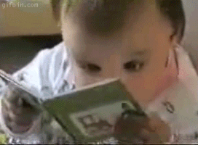
Committee Members
Chair: Kiva Liljequist (Metropolitan Learning Center, Portland)
Jen Blair (Beaverton School District) Billie Bloebaum (Third Street Books, McMinnville) Anna Bruce (Happy Valley Library) Grace Butler (Whitman Elementary School, Portland) Melanie Hetrick (Tillamook County Library) Elizabeth Johnson (Corvallis-Benton County Public Library) Beth LaForce (George Fox University, Newberg) Jessica Marie (Salem Public Library) Laurie Nordahl (North Bend High School) MacKenzie Ross (Beaverton City Library) Karren Timmermans (Pacific University, Eugene) Rebekah Westmark (Coos Bay Public Library)
Source: GIPHY, https://tinyurl.com/laxhrjh

Slide 5
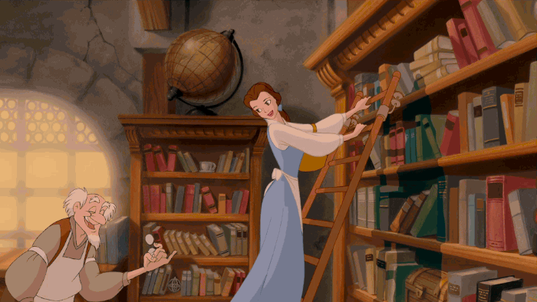
And the 2017 winners are...
Source: GIPHY, https://tinyurl.com/kclw8jv

Slide 6
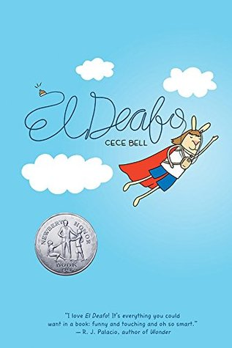
2017 ORCA Upper Elementary Winner
El Deafo Cece Bell
⧫ Will Eisner Award for Best Publication for Kids ⧫ Kirkus Prize Nominee for Young Readers’ Literature ⧫ Goodreads Choice Award Nominee for Middle Grade and Children’s
Read-alikes: Wonder (Palacio), Roller Girl (Jamieson), Smile (Telgemeier)
Author’s website: https://cecebell.wordpress.com/
Notes:
Booktalk: Imagine if you couldn’t hear anything (pause). No voices, music, sounds of any kind. When she was only 4 years old, Cece contracts a terrible case of Meningitis, and loses her hearing. During her first year of school, she goes to a school for the deaf where all her other classmates are also hearing impaired. Before she begins first grade, however, her family moves to a new town where there is no class for hearing impaired students. She is equipped with a “super-powerful, just-for-school hearing aid, called the Phonic Ear, which will help her hear the teacher. But it turns out that the Phonic Ear also gives her a secret super power. Not only can she hear her teacher when she’s in the classroom, but also when her teacher is in other parts of the school - the teacher’s lounge, the hallway, and even the bathroom! Even with her super powers, Cece feels very conspicuous and embarrassed by her disability and the huge contraption she has to wear to help her hear. All she really wants is to fit in, and make friends. Could it be possible that what makes her different could also make her cool?

Slide 7
2017 ORCA Middle School Winner
The Crossover Kwame Alexander
⧫ Newbery Medal ⧫ Coretta Scott King Award for Author Honor ⧫ Goodreads Choice Award Nominee for Middle Grade and Children’s ⧫ 2016-2017 Oregon Battle of the Books
Read-alikes: Brown Girl Dreaming (Woodson), Serafina’s Promise (Burg), Full Cicada Moon (Hilton)
Author’s website: http://kwamealexander.com/
Notes:
Booktalk: "With a bolt of lightning on my kicks …The court is SIZZLING. My sweat is DRIZZLING. Stop all that quivering. Cuz tonight I’m delivering." Josh Bell is awesome on the basketball court as a player, and off the court as a poet. But as good as he is at both, he has a lot to learn about growing up, brotherhood, and the importance of family. Like basketball, in the game of life, you have to follow your heart AND play by the rules.

Slide 8
2017 ORCA High School Winner
I’ll Give You the Sun Jandy Nelson
⧫ Printz Award ⧫ Stonewall Honor Book for Young Adult Literature ⧫ Goodreads Choice Award Nominee for Young Adult Fiction ⧫ 2016-2017 Oregon Battle of the Books
Read-alikes: Fangirl (Rowell), Two Boys Kissing (Levithan), More Happy Than Not (Silvera)
Author’s website: http://jandynelson.com/
Notes:
Booktalk: “I gave up practically the whole world for you,” I tell him. “The sun, stars, ocean, trees, everything, I gave it all up for you.” Polar opposites, twins, Noah and Jude, love each other so much they express it by offering each other impossible gifts - the sun and the stars, and protect each other above all else. But when a devastating tragedy comes to their family, their grief takes precedence over loyalty and love. Betrayal and anger take over. Will Noah and Jude be able to forgive each other and find their way back to the love and trust that they once knew?

Slide 9
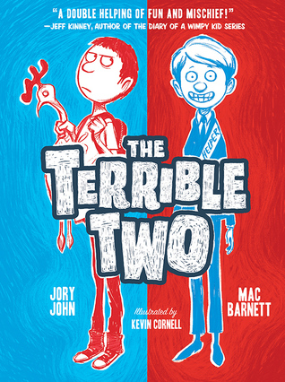
2018 ORCA Upper Elementary Nominees
The Terrible Two Mac Barnett
⧫ E.B. White Read Aloud Award Honor ⧫ Great Stone Face Book Award Nominee
Author website: https://www.macbarnett.com/
Sequel: The Terrible Two Get Worse
Read-alikes: Diary of a Wimpy Kid series (Kinney), The Misadventures of the Family Fletcher (Levy), PIckle: The (Formerly) Anonymous Prank Club of Fountain Point Middle School (Baker), Unusual Chickens for the Exceptional Poultry Farmer (Jones)
Notes:
Miles Murphy is not happy to be moving to Yawnee Valley, a sleepy town that’s famous for one thing and one thing only: cows. In his old school, everyone knew him as the town’s best prankster, but Miles quickly discovers that Yawnee Valley already has a prankster, and a great one. If Miles is going to take the title from this mystery kid, he is going to have to raise his game. It’s prankster against prankster in an epic war of trickery, until the two finally decide to join forces and pull off the biggest prank ever seen: a prank so huge that it would make the members of the International Order of Disorder proud.

Slide 10
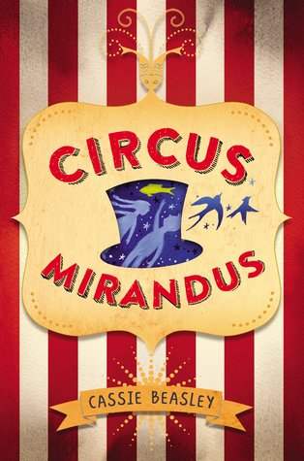
2018 ORCA Upper Elementary Nominees
Circus Mirandus Cassie Beasley
Author website: http://cassiebeasley.com/
Read-alikes: Unusual Chickens for the Exceptional Poultry Farmer (Jones), Gabriel Finley and the Raven’s Riddle (Hagen), Ophelia and the Marvelous Boy (Foxlee), Nightingale’s Nest (Loftin)
Educator’s guide: http://www.penguin.com/wp-content/uploads/2016/04/CircusMirandus_EducatorsGuide_16_4p_FORWEB.pdf
Next book: Tumble & Blue (August 2017)
Notes:
Do you believe in magic? Micah Tuttle does. Even though his awful Great-Aunt Gertrudis doesn’t approve, Micah believes in the stories his dying Grandpa Ephraim tells him of the magical Circus Mirandus: the invisible tiger guarding the gates, the beautiful flying birdwoman, and the magician more powerful than any other—the Man Who Bends Light. Finally, Grandpa Ephraim offers proof. The Circus is real. And the Lightbender owes Ephraim a miracle. With his friend Jenny Mendoza in tow, Micah sets out to find the Circus and the man he believes will save his grandfather. The only problem is, the Lightbender doesn't want to keep his promise. And now it's up to Micah to get the miracle he came for.

Slide 11
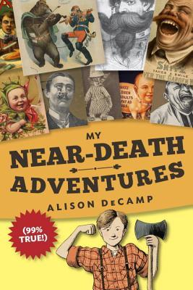
2018 ORCA Upper Elementary Nominees
My Near-Death Adventures (99% True!) Alison DeCamp
Author website: http://www.alisondecamp.com/
Sequel: My Near-Death Adventures: I Almost Died. Again.
Read-alikes: Fake Mustache (Angleberger), The Willoughbys (Lowry), The Mysterious Howling (Wood)
Discussion guide: https://www.randomhouse.com/teachers/wp-content/uploads/2016/05/MNDA_TeachersGuide.pdf
Notes:
There are many things that 11-year-old Stanley Slater would like to have in life—most of all, a father. But what if Stan’s missing dad isn’t “dearly departed” after all? Armed with his stupendous scrapbook, full of black-and-white 19th-century advertisements and photos, Stan’s attempt to locate his long-lost hero/cowboy/outlaw dad is a near-death adventure fraught with pesky relatives, killer lumberjacks, and poisonous pies! His tale will leave readers in stitches, but not the kind that require medical attention.

Slide 12
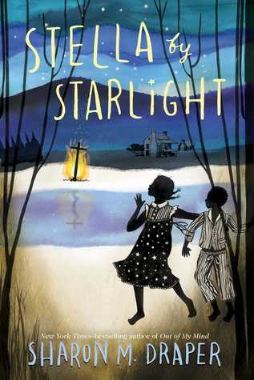
2018 ORCA Upper Elementary Nominees
Stella by Starlight Sharon M. Draper
⧫ Charlotte Huck Award Winner for Outstanding Fiction for Children ⧫ Parents Choice Awards Silver Medal Winner
Author website: http://sharondraper.com/
Read-alikes: Sugar (Rhodes), The Madman of Piney Woods (Curtis), Gone Crazy in Alabama (Williams-Garcia), Full Cicada Moon (Hilton)
Study guide: http://sharondraper.com/guides.asp?id=74
Notes:
When the Ku Klux Klan's unwelcome reappearance rattles Stella's segregated southern town, bravery battles prejudice in this Depression-era tour de force from Sharon Draper, the New York Times bestselling author of Out of My Mind. Stella lives in the segregated South; in Bumblebee, North Carolina, to be exact about it. Some stores she can go into. Some stores she can't. Some folks are right pleasant. Others are a lot less so. To Stella, it sort of evens out, and heck, the Klan hasn't bothered them for years. But one late night, later than she should ever be up, much less wandering around outside, Stella and her little brother see something they're never supposed to see, something that is the first flicker of change to come, unwelcome change by any stretch of the imagination. As Stella's community - her world - is upended, she decides to fight fire with fire. And she learns that ashes don't necessarily signify an end.

Slide 13
2018 ORCA Upper Elementary Nominees
George Alex Gino
⧫ Stonewall Book Award for Children’s ⧫ Goodreads Choice Award Nominee for Middle Grade and Children’s ⧫ Charlotte Huck Award for Outstanding Fiction for Children
Author website: http://www.alexgino.com/
Read-alikes: Gracefully Grayson (Polonsky), Better Nate Than Ever (Federle)
Human Rights Campaign: Transgender Children and Youth: http://www.hrc.org/explore/topic/transgender-children-youth
Notes:
When people look at George, they think they see a boy. But she knows she's not a boy. She knows she's a girl.
George thinks she'll have to keep this a secret forever. Then her teacher announces that their class play is going to be Charlotte's Web. George really, really, REALLY wants to play Charlotte. But the teacher says she can't even try out for the part . . . because she's a boy.
With the help of her best friend, Kelly, George comes up with a plan. Not just so she can be Charlotte -- but so everyone can know who she is, once and for all.

Slide 14
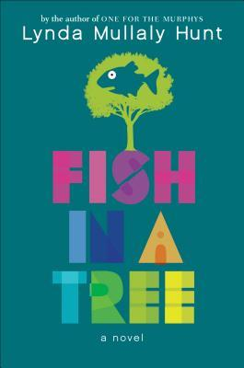
2018 ORCA Upper Elementary Nominees
Fish in a Tree Lynda Mullaly Hunt
⧫ Schneider Family Book Award for Middle School
Author website: http://www.lyndamullalyhunt.com/
Read-alikes: Absolutely Almost (Graff), Stella By Starlight (Draper), A Handful of Stars (Lord)
Educator’s guide: http://www.penguin.com/static/images/yr/pdf/FishInATree_lessonplans_Final_LR.pdf
Next book: Out of Order (2018)
Notes:
“Everybody is smart in different ways. But if you judge a fish by its ability to climb a tree, it will live its life believing it is stupid.”
Ally has been smart enough to fool a lot of smart people. Every time she lands in a new school, she is able to hide her inability to read by creating clever yet disruptive distractions. She is afraid to ask for help; after all, how can you cure dumb? However, her newest teacher Mr. Daniels sees the bright, creative kid underneath the trouble maker. With his help, Ally learns not to be so hard on herself and that dyslexia is nothing to be ashamed of. As her confidence grows, Ally feels free to be herself and the world starts opening up with possibilities. She discovers that there’s a lot more to her—and to everyone—than a label, and that great minds don’t always think alike.

Slide 15
2018 ORCA Upper Elementary Nominees
Roller Girl Victoria Jamieson
⧫ Newbery Honor ⧫ Oregon Spirit Book Award for Graphic Novel
Author website: http://www.victoriajamieson.com/
Read-alikes: Sunny Side Up (Holm), El Deafo (Bell), Smile and Sisters (Telgemeier)
Next book: All’s Faire in Middle School (September 2017)
Fun fact: Local author who lives in Portland!
Notes:
For most of her twelve years, Astrid has done everything with her best friend Nicole. But after Astrid falls in love with roller derby and signs up for derby camp, Nicole decides to go to dance camp instead. And so begins the most difficult summer of Astrid's life as she struggles to keep up with the older girls at camp, hang on to the friend she feels slipping away, and cautiously embark on a new friendship. As the end of summer nears and her first roller derby bout (and junior high!) draws closer, Astrid realizes that maybe she is strong enough to handle the bout, a lost friendship, and middle school… in short, strong enough to be a roller girl.

Slide 16
2018 ORCA Upper Elementary Nominees
Unusual Chickens for the Exceptional Poultry Farmer Kelly Jones
⧫ Dorothy Canfield Fisher Book Award Nominee ⧫ Georgia Children’s Book Award Finalist
Author website: http://curiosityjones.net/
Read-alikes: Everything on a Waffle (Horvath), Fantastic Mr. Fox and Matilda (Dahl), The Star of Kazan (Ibbotson)
Notes:
Twelve-year-old Sophie Brown feels like a fish out of water when she and her parents move from Los Angeles to the farm they’ve inherited from a great-uncle. But farm life gets more interesting when a cranky chicken appears and Sophie discovers the hen can move objects with the power of her little chicken brain: jam jars, the latch to her henhouse, the entire henhouse.... And then more of her great-uncle’s unusual chickens come home to roost. Determined, resourceful Sophie learns to care for her flock, earning money for chicken feed, collecting eggs. But when a respected local farmer tries to steal them, Sophie must find a way to keep them (and their superpowers) safe. Told in letters to Sophie’s abuela, quizzes, a chicken-care correspondence course, to-do lists, and more, Unusual Chickens is a quirky, clucky classic in the making.

Slide 17
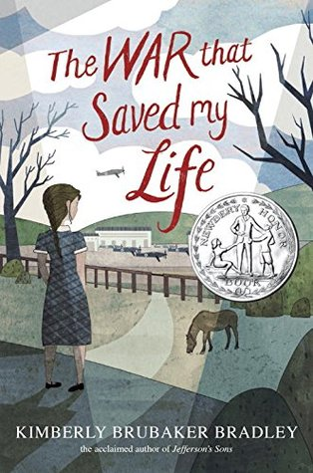
2018 ORCA Middle School Nominees
The War That Saved My Life Kimberly Brubaker Bradley
⧫ Newbery Medal Honor ⧫ E.B. White Read Aloud Award Honor ⧫ 2017-2018 Oregon Battle of the Books
Author website: http://www.kimberlybrubakerbradley.com/
Read-alikes: Number the Stars (Lowry), Wolf Hollow (Wolk), Chasing Secrets (Choldenko)
Rumored sequel: The War I Finally Won
Educator’s guide: http://www.penguin.com/wp-content/uploads/2015/03/WarThatSavedMyLife_Guide_15_4p_LR.pdf

Slide 18
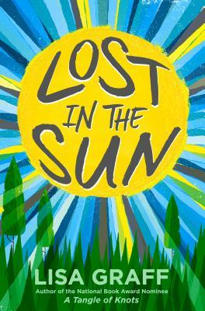
2018 ORCA Middle School Nominees
Lost in the Sun Lisa Graff
⧫ Dorothy Canfield Fisher Children’s Book Award Nominee ⧫ Texas Lone Star Reading List ⧫ 2017-2018 Oregon Battle of the Books
Author website: http://www.lisagraff.com/
Read-alikes: The Thing About Georgie (Graff), Wonder (Palacio)
Educator’s guide: http://www.lisagraff.com/LisaGraff_StudyGuide_FNL-revise-lo.pdf
Next book: The Great Treehouse War (May 2017)

Slide 19
2018 ORCA Middle School Nominees
Full Cicada Moon Marilyn Hilton
⧫ Jane Addams Children’s Book Award Nominee for Older Children ⧫ Asian/Pacific American Award for Literature for Children ⧫ Cybils Finalist for Poetry
Author website: http://www.marilynhilton.com/
Read-alikes: Listen, Slowly (Lai), Countdown (Wiles), Brown Girl Dreaming (Woodson)
Book group guide: http://www.marilynhilton.com/cmsdocuments/Full_Cicada_Moon_Book_Group_Guide.pdf

Slide 20
2018 ORCA Middle School Nominees
The Boys Who Challenged Hitler Phillip M. Hoose
⧫ Boston Globe-Horn Book Award Honor ⧫ Sibert Informational Book Award Honor
⧫ YALSA Award Nominee for Excellence in Nonfiction
Author website: http://www.philliphoose.com/
Read-alikes: Courage & Defiance (Hopkinson), Beyond Courage (Rappaport)
Teacher’s guide: http://www.philliphoose.com/wp-content/uploads/2015/05/The-Boys-Who-Challenged-Hitler-FINAL.pdf

Slide 21
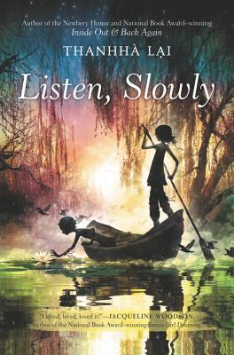
2018 ORCA Middle School Nominees
Listen, Slowly Thanhha Lai
⧫ Cybils Finalist for Middle Grade Fiction
Author website: https://www.thanhhalai.com/
Read-alikes: Full Cicada Moon (Hilton), Inside Out & Back Again (Lai), One Crazy Summer (Williams-Garcia)
NPR interview with Lai: http://www.npr.org/2015/02/12/385793936/listen-slowly-about-connecting-to-a-heritage-you-dont-know
Fun fact: Lai started a non-profit (Viet Kids, Inc.) to “buy bicycles for poor students in Vietnam.”

Slide 22
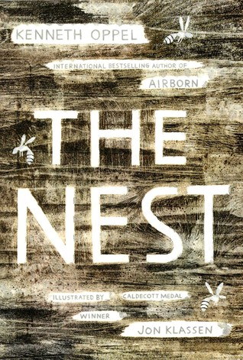
2018 ORCA Middle School Nominees
The Nest Kenneth Oppel
⧫ Dorothy Canfield Fisher Children’s Book Award Nominee
Author website: http://www.kennethoppel.ca/
Read-alikes: The Night Gardener (Auxier), Circus Mirandus (Beasley), A Path Begins [Thickety] (White)
Reading group guide: http://www.simonandschuster.com/books/The-Nest/Kenneth-Oppel/9781481432337/reading_group_guide
Next book: Inkling (2018)

Slide 23
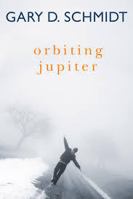
2018 ORCA Middle School Nominees
Orbiting Jupiter Gary Schmidt
⧫ALA Notable Book for Children, Older Readers
⧫YALSA 2017 Best Fiction for Young Adults
⧫VOYA’s Perfect Tens; 2015
Author website: http://www.hmhbooks.com/schmidt/
Read-alike: The Crossover (Alexander), House Arrest (Holt), The Seventh Most Important Thing (Pearsall)
BookPage interview: https://bookpage.com/interviews/18869-gary-d-schmidt#.WPkvjLi1uUk

Slide 24
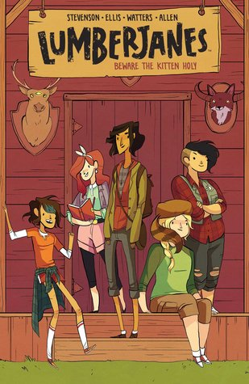
2018 ORCA Middle School Nominees
Lumberjanes, Vol. 1: Beware the Kitten Holy Noelle Stevenson
⧫ Will Eisner Comic Industry Award for Best New Series
Author website: http://www.gingerhaze.com/
Read-alikes: Ms. Marvel (Wilson), The Unbeatable Squirrel Girl (North)
Sequels: Vol. 2: Friendship to the Max, Vol. 3: A Terrible Plan, Vol. 4: Out of Time, Vol. 5: Band Together, Vol. 6: Sink or Swim
Mini Wonder Woman comic: http://www.dccomics.com/blog/2015/02/11/exclusive-preview-sensation-comics-featuring-wonder-woman-chap-24

Slide 25
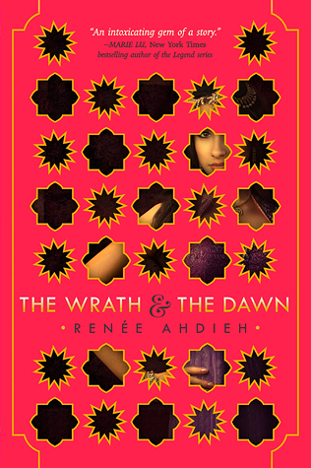
2018 ORCA High School Nominees
The Wrath and the Dawn Renée Ahdieh
⧫ Goodreads Choice Award Nominee for Young Adult Fantasy and Science Fiction ⧫ 2017-2018 Oregon Battle of the Books
Author website: http://www.reneeahdieh.com/
Sequel: The Rose and the Dagger
Read-alikes: Red Queen (Aveyard), An Ember in the Ashes (Tahir), Illuminae (Kaufman), The Scorpion Rules (Bow), A Thousand Nights (Johnston), The Arabian Nights
Next book: Flame in the Mist (May 2017)
Notes:
Booktalk: Khalid rules the land and Shahrzad is looking for revenge. Shahrzad’s best friend was Khalid’s most recently murdered bride, so Shahrzad volunteers to be his next bride in order to make Khalid pay. Every night, Shahrzad tells a fantastical story, leaving Khalid wanting more, and preventing him from ordering her death each morning. Her plan is working out well except for the tiny inconvenience of her learning more about Khalid’s circumstances and...is she falling in love with him?? To make it even more problematic, Shahrzad doesn’t realize that her brothers are hatching a plan to rescue their sister from Khalid. And, after so many days of Shahrzad acting as Khalid’s queen, what disaster will strike Khalid’s kingdom?

Slide 26
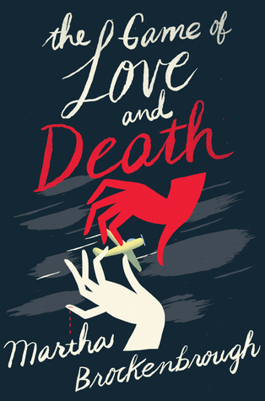
2018 ORCA High School Nominees
The Game of Love and Death Martha Brockenbrough
⧫ Kirkus Prize Nominee for Young Readers’ Literature ⧫ Pacific Northwest Booksellers Association Award Winner ⧫ YALSA Teens Top Ten
Author website: http://martha-brockenbrough.squarespace.com/
Read-alikes: Walk on Earth a Stranger (Carson), The Book Thief (Zusak), Symphony for the City of the Dead (Anderson)
Next book: Alexander Hamilton, Revolutionary (September 2017)
Fun fact: Local-ish author who lives in Seattle!
Notes:
Booktalk: Set in Seattle in 1937, Martha Brockenbrough's The Game of Love and Death tells the story of Flora and Henry, two teenagers who could not be more different, but have one very unique thing in common: They have been chosen as the objects of a bet between Love and Death. Though Brockenbrough uses the story of Flora and Henry to explore issues of race and class and sexuality, the book is, at its heart, a story about fighting for what you love against any obstacle, even if that obstacle is Death Herself.

Slide 27
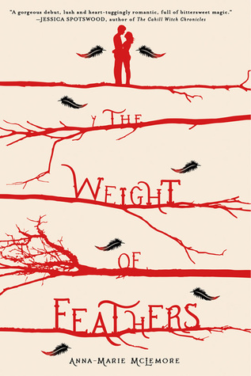
2018 ORCA High School Nominees
The Weight of Feathers Anna-Marie McLemore
⧫ Morris Award Nominee
Author website: http://author.annamariemclemore.com/
Read-alikes: Bone Gap (Ruby), The Accident Season (Fowley-Doyle), The Strange and Beautiful Sorrows of Ava Lavender (Walton)
Discussion guide: http://images.macmillan.com/folio-assets/discusion-guides/9781250058652DG.pdf
Next book: Wild Beauty (October 2017)
Notes:
Booktalk: Lace Paloma belongs to a family of show-stopping mermaids, whereas Cluck Corbeau belongs to a family of bird-like tightrope walkers. However, just because both families travel to show off their amazing skills, they have a fraught history full of deceit, magic, danger, and love. The family rivalry is further complicated when disaster strikes the town where both families are performing, and Cluck saves Lace’s life. To be expected, Lace falls for Cluck, Cluck falls for Lace, and they slowly unravel some of the truth behind the rivalry’s history. The author’s breathtaking writing will make you wish you were a scaled Paloma or feathered Corbeau.

Slide 28
2018 ORCA High School Nominees
Dumplin’ Julie Murphy
⧫ Amelia Bloomer Project ⧫ Goodreads Choice Award Nominee for Young Adult Fiction
Author website: http://juliemurphywrites.com/
Read-alikes: Gabi, a Girl in Pieces (Quintero), Not Otherwise Specified (Moskowitz), I Was Here (Forman), The Boy in the Black Suit (Reynolds)
Next book: Ramona Blue (May 2017)
Fun fact: Wrote her first novel during NaNoWriMo while working as a librarian!
Notes:
Booktalk: Will (real name: Willowdean, nickname Dumplin) isn’t ashamed of her body. In fact, high school is going pretty smoothly until she makes friends with her coworker “Private School Bo,” expects him to reject her romantic feelings for him, and instead it seems that he likes her back. Crazy, right? That seems to flip her whole world around, and she decides to enter the Miss Clover City beauty pageant--the one her mom has been involved in for years. And it doesn’t help that her mom has a history of pressuring Will to lose weight. Does Will go through with the pageant all the way to the end? And what happens with Bo?

Slide 29
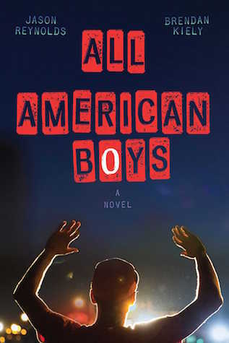
2018 ORCA High School Nominees
All American Boys Jason Reynolds and Brendan Kiely
⧫ Coretta Scott King Honor
Author website: http://www.jasonwritesbooks.com/
Read-alikes: How It Went Down (Magoon), X (Shabazz), This Side of Home (Watson), Between the World and Me (Coates)
Reading group guide: http://www.simonandschuster.com/books/All-American-Boys/Jason-Reynolds/9781481463331/reading_group_guide
Keynote address at ABC Children’s Institute: http://www.shelf-awareness.com/issue.html?issue=2976#m36112
Notes:
Booktalk: “Rashad is absent again today.” This is written on the sidewalk at Rashad and Quinn’s school, all over their city, and it’s even a hashtag on social media. Rashad was just trying to buy some chips and help a woman whose groceries had fallen around him at Jerry’s Corner Mart. However, the police officer was sure that Rashad was bothering the woman and trying to steal the chips. Told through alternating points of view--Rashad, the black kid who was just trying to get some chips; and Quinn, the white kid who’s unsure what to believe--and spanning a mere eight days, All American Boys will get you thinking about what you might do if or when something like this were to happen in your community.

Slide 30
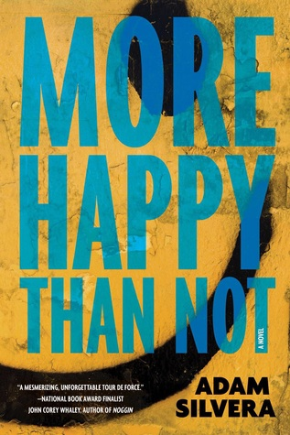
2018 ORCA High School Nominees
More Happy Than Not Adam Silvera
⧫ Goodreads Choice Award Nominee for Young Adult Fiction
Author website: http://www.adamsilvera.com/
Read-alikes: Simon vs. the Homo Sapiens Agenda (Albertalli), The Rest of Us Just Live Here (Ness), None of the Above (Gregorio), Honor Girl (Thrash), We Are the Ants (Hutchinson)
Next book: They Both Die at the End (September 2017)
Fun fact: Silvera published this book (his first) before turning 25, which was a goal of his!
Fun fact #2: Interviewed Ahdieh! https://youtu.be/BLiW6M044n0
Notes:
Booktalk: Adam has a supportive girlfriend and a great group of friends--two things that help get him through his father’s suicide. However, this all changes over the summer when Adam befriends Thomas. They celebrate each other’s birthdays, enjoy inside jokes, don’t want to be involved in fistfights, and have deep, real, meaningful conversations. Over time, Adam thinks he likes Thomas as more than a friend and is confused and upset when he confronts Thomas, only to be rejected. That’s where the science fiction comes in: after dealing with this confusion and his dad’s suicide, Adam turns to the Leteo Institute, which promises a “memory relief procedure” that can you make you forget all those pesky hurtful memories. And aside from the fact that Adam’s mom certainly can’t afford the cost of the procedure, Adam’s past turns out to be even more complicated than he thought.

Slide 31
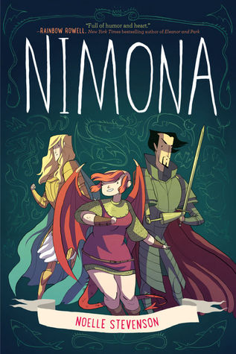
2018 ORCA High School Nominees
Nimona Noelle Stevenson
⧫ National Book Award Finalist ⧫ Will Eisner Comic Award for Best Graphic Album Reprint ⧫ Goodreads Choice Award Nominee for Graphic Novels and Comics
Author website: http://www.gingerhaze.com/
Read-alikes: Carry On (Rowell), Uprooted (Novik), The Unbeatable Squirrel Girl, Vol. 1 (North), Six of Crows (Bardugo)
Fun fact: Stevenson used the webcomic as her senior thesis at the Maryland Institute College of Art
Notes:
Booktalk: Nimona is a young shape-shifter who all but forces the "villainous" Lord Ballister Blackheart to take her on as a sidekick to assist in his battle against the "heroic" Sir Ambrosius Goldenloin and the Institution of Law Enforcement and Heroics. But Nimona isn't fully in control of her emotions or her powers and the feud between Blackheart and Goldenloin has depths she doesn't expect. Funny and heartfelt, smart and snarky, Noelle Stevenson's Nimona is the subversive fantasy graphic novel you didn't know you needed.

Slide 32
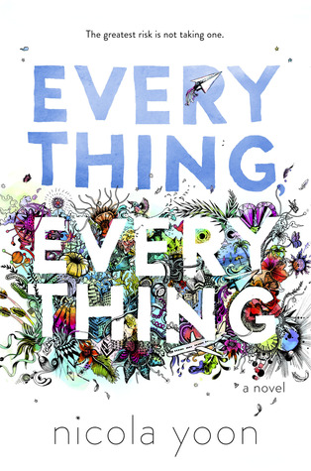
2018 ORCA High School Nominees
Everything, Everything Nicola Yoon
⧫ Goodreads Choice Award Nominee for Debut Author ⧫ Goodreads Choice Award Nominee for Young Adult Fiction
Author website: http://www.nicolayoon.com/
Read-alikes: The Fault in Our Stars (Green), Highly Illogical Behavior (Whaley), One (Crossan), All the Bright Places (Niven)
Discussion guide: http://www.randomhouse.com/teachers/resource/everything-everything-discussion-guide/
Movie trailer: https://youtu.be/42KNwQ6u42U
Notes:
Booktalk: Madeline doesn’t leave her house--ever. She only sees her mom and her nurse, Carla, and the front door to the house has an air lock because she is allergic to the world. And that means that when a new family moves in across the street and tries to give Madeline and her mom a bundt cake, Madeline is forced to refuse the gift. However, Madeline can’t refuse Olly’s attentions for long. The two teens communicate through their bedroom windows, email, instant messaging, and finally in person. Having Olly as a friend changes Madeline’s entire world, and they end up breaking all the rules by traveling to Hawaii, and it’s thanks to this exciting and frightening trip that Madeline learns the truth about her condition.

Slide 33
For ORCA Resources, Visit the Blog...
https://oregonreaderschoiceaward.wordpress.com/
If you are interested in being involved with the ORCA Committee, contact the Chair (Kiva) at orca@olaweb.org
Thank you!

