Slide 1
Open Oregon Digital: Building Digital Collections with Linked Data
Julia Simic, Metadata and Digital Production Librarian, University of Oregon Libraries
Sarah Seymore, Digital Collections Metadata Librarian,
University of Oregon Libraries
Notes:
Julia- to slide 18

Slide 2
History of Digital Collections at UO
UO only
CONTENTdm and DSpace Collections
Qualified Dublin Core with many local fields
Collection curators came from all over the Libraries
Non-professional catalogers
2009 began hosting OSU collections
2012 beginning of Hydra collaboration
Notes:
For the purposes of this talk, I will be speaking broadly about the collaboration between the University of Oregon and Oregon State University and our shared digital collections, using examples from UO’s work migrating from CONTENTdm to Hydra and the metadata transformation we did to include linked data in all our records.
So first some background. Originally UO’s digital collections were in two systems: CONTENTdm and Dspace, which we continue to use for our Institutional Repository. Our records were mostly Dublin Core with many local fields of data, but still substantially DC. Most of the content was image collections: historic photographs or teaching collections like Building Oregon and Art and Architecture Images.
The curators of our digital collections came from all over the Libraries: Special collections librarians, Archivists, Subjects Specialists and faculty. And many of our collections were cataloged by non-professionals, which lead to some interesting problems.
In 2009 we entered into a joint project with OSU to host their collections in a shared instance of CONTENTdm. As CDM aged and its limits began to cause problems in system stability and usability, we began to look at alternatives, again as a joint project.

Slide 3
82 collections, ca. 290,000 objects
Notes:
At the time of migration we had 82 collections between the two institutions with about 290,000 objects mostly using their own loose schema, though there was substantial overlap in fields across collections.
This slide reflects the original timeline for migration that turned out to be highly optimistic. It was to begin in April of 2014 and be finished by the end of August. That didn’t happen for many reasons that I will not be going into right now.
Today we have: 99 Total collections and 345,000 objects
ITIS=Integrated Taxonomic Information System (US, Canada, Mexico agencies, Species 2000, Global Biodiversity Information Facility)
UBIO=uBio (Marine Biological Laboratory)
MeSH=Medical Subject Headings (National Library of Medicine)

Slide 4
Migration
Dedication to Open Source
Un-silo our content
User Interface improvements
Search capabilities increased
OSU technical expertise
UO project management and metadata expertise
Notes:
So Why Hydra?
I mentioned earlier that CDM had some problems in system stability and usability. Specifically we had issues with advanced/cross collection searches yielding mixed results; large collections crashing; too many Controlled Vocabularies in individual collections crashing the entire system; and access management difficulties that were never successfully addressed.
Instead we developed work arounds: Cross collection searching was done via collection landing page search boxes; We split large collections like AAI into 3 discrete collections which naturally limited searching and discovery; and we limiting the number of CVs for each collections, again limiting discovery.
The limited configuration of CDM’s User Interface sparked patron complaints, especially when sorting search results, downloading multiple files, and the disconnect between the filename and metadata after downloading.
So in looking for a replacement system, we wanted to be sure that it was stable, flexible and scalable. We have a dedication to open source solutions at both institutions and more importantly we wanted to un-silo our content. We also wanted to make the user’s experience better and make our searching and browsing easier and more reliable.
OSU had the technical expertise and depth needed to implement an Open Source system, while UO had the project management and metadata expertise, so it was decided that Hydra would be hosted and maintained at OSU, though both institutions would contribute developer time.

Slide 5
Communication
Stakeholders
21 people across 2 institutions
Platforms:
Google drive
Github: https://github.com/OregonDigital
Slack
Email
Waffle and Trello
Weekly WebX check-ins
Face-to-face in monthly day-long meetings
Notes:
Good communication was key during the implementation of Hydra and the migration.
Stakeholders included Special Collections and Archives units, Digital collection curators, Faculty researchers and departments, and outside entities such as Emerald Media, the Oregon Arts Commission, PCUN: Pineros y Campesinos Unidos del Noroeste, and GWLA.
At the time we had 21 people across both institutions involved so communication strategies were very important.
Google- Project management documents, timelines/schedules, metadata documentss
Github- app, gems, opaquenamespace, and a wiki, also we used the Issues functionality to document technical problems and discussion
Slack- daily conversation, because it archived conversations and could be linked with Github notifcations- useful for tagging people/messages
Email- For larger group notifications
Waffle- technical staff use for sprints
Trello- Used at UO for project management
WebEx- Weekly check-in calls where people reported to the full group what they were actively working in order to remove any impediments and to address the Issue statuses. We tended to be very productive on Friday afternoons, so by having the meetings on Monday, ideally, we could clear impediments, and work through the week
We started out having monthly meetings at UO or OSU during development of Hydra and the migration, but now that Oregon Digital is live, we meet face-to-face quarterly - These meetings are time for discussion of major issues, larger feature prioritization, project planning, training, and sometimes co-developing if time permits

Slide 6
Oregon Digital Metadata Principles
You should not be constrained by your schema.
You are not that special.
You do not know everything.
If your data isn’t reusable, shareable, and machine readable, then you’re not doing good enough.
Use exemplary behavior and reuse from others so that they may also reuse from you.
https://github.com/OregonDigital/oregondigital/wiki/Add-New-Linked-Data-Terms
Notes:
To begin with here are the metadata principles that guided our decision making.

Slide 7
Create mapping (crosswalk) for each collection
Determine LOD fields
Export data from CDM into spreadsheet
Create and publish local LOD URIs
Find LOD URIs
Normalize/cleanup
Ingest
Notes:
The metadata professionals were brought in after Oregon Digital development was underway and the first pilot was complete, with short timeline for cleaning up and adding linked data. I wish that we had been brought in earlier--we could have headed off some trouble spots and contributed more to the system architecture if we had been.
Here’s a the general workflow we used in our metadata transformation. The first step was to create mappings for each collection’s metadata fields to a shared pool of linked data predicates that would be used across all collections; Then we determined what fields would contain URIs as object values; Exported the CDM metadata into spreadsheets for examination and clean-up; Found URIs to replace text strings in the fields we determined would be LOD fields using a combination of scraping and by-hand look-up; If we couldn’t find the URIs we needed, we published them ourselves in JSON-LD; then we ingested the digital objects and new metadata into Hydra.

Slide 8
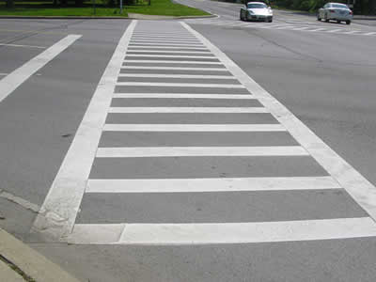
Crosswalking
Dublin Core used as often as possible
If DC didn’t suit, we found something else, often more precise
Linked Open Vocabularies (LOV)
RDA Registry
Many others
If there was nothing to use, we created and published our own (opaquenamespace.org)
Created a Metadata Crosswalk and Dictionary for consistency
https://www.dot.ny.gov/programs/adamanagement/ada-transition-plan/appendices/rating-scale
Notes:
The first step was looking at the existing fields in each of our collections and determining what Linked Data Predicate would be used in it place. In general, we used Dublin Core whenever possible, but if that did work we looked for other already-available predicates. Often this was because we wanted to use predicates that were as precise as possible.
If we still couldn’t find anything that described the field contents accurately, we published new predicates ourselves in our Controlled Vocabulary Manager (opaquenamespace.org). This often happened when we had highly localized information fields such as Watershed, Military Service Location, or Tribal Notes.
At the same time we were looking at all the collections as a whole and trying to determine which predicates could be use across multiple collections. To this end we created a giant Metadata Crosswalk and a Metadata DIctionary to document our decisions.

Slide 9
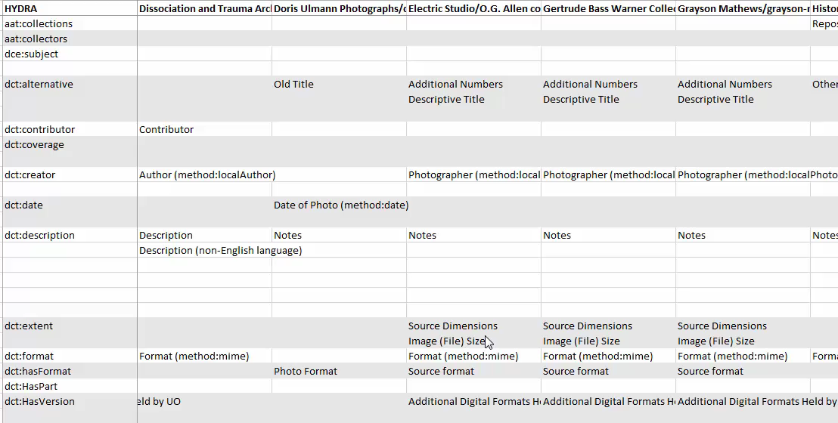
Metadata Crosswalk
Notes:
Here’s just a snippet of our Corsswalk. We saw lots of patterns in our fields, even though the field names were inconsistent across collections.

Slide 10
Metadata Dictionary
https://drive.google.com/open?id=1nnJz49oqstQLF2PFBn5ZvWfWdF-8PVl5TFL1EMotQrA&authuser=0
Notes:
The Metadata Dictionary is a living document. New predicates can be added on the fly after a discussion by the metadata people at both Institutions. We use a lot of MARC Relators and Dublin Core predicates.

Slide 11
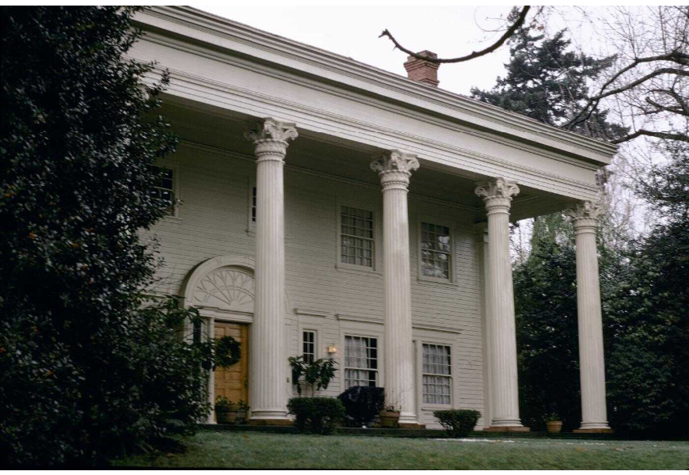
LOD in Hydra CDM records -> Hydra linked data
Title: Honeyman, David T., and Nan Wood House (Portland, Oregon)
View: exterior
Alternate Title: David T. Honeyman and Nan Wood House (Portland, Oregon)
Creator Display: David Chambers Lewis (architect, 1867-1918)
Creator: Lewis, David C.
Date: 1907-1908
City: Portland County: Multnomah
Notes:
The migration gave us an unprecedented opportunity to examine the metadata in all our collections and integrate Linked Data, but it required a huge amount of prep time.
This is a record as it appeared in CDM for the David Honeyman house in Portland from our Building Oregon collection. All the data is in text strings.

Slide 12
<Subject><Predicate><Object>
<http://oregondigital.org/resource/oregondigital:df671z09b> <http://purl.org/dc/terms/title> "Honeyman, David T., and Nan Wood House (Portland, Oregon)" .
<http://oregondigital.org/resource/oregondigital:df671z09b> <http://purl.org/dc/terms/alternative> "David T. Honeyman and Nan Wood House (Portland, Oregon)" .
<http://oregondigital.org/resource/oregondigital:df671z09b> <http://id.loc.gov/vocabulary/relators/pht> <http://id.loc.gov/authorities/names/n82202764> .
<http://oregondigital.org/resource/oregondigital:df671z09b> <http://opaquenamespace.org/ns/cco/creatorDisplay> "David Chambers Lewis (architect, 1867-1918)" .
<http://oregondigital.org/resource/oregondigital:df671f55b> <http://purl.org/dc/terms/spatial> <http://sws.geonames.org/5746545/> . <http://oregondigital.org/resource/oregondigital:df671z09b> <http://purl.org/dc/terms/temporal> "1900-1909" .
…
http://oregondigital.library.oregonstate.edu/catalog/oregondigital:df671f55b
Notes:
This is the same record using n-triples, which uses the Subject-Predicate-Object notation with spaces and periods between elements. As you can see the Subjects are always the same in this record and refer to the digital object, the photograph of the house. The Predicates represent the field names and the Object data can be either strings or URIs.
The Objects that contain URIs are controlled vocabularies: Photographer and Spatial. In Hydra, the fields with Controlled Vocabularies become facets that assist with searching and browsing.

Slide 13
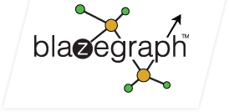
opaquenamespace.org
Repository for linked open data that isn’t available elsewhere
No institutional affiliation
Blazegraph triple store
LOD predicates and terms from Oregon Digital
Open to anyone
Increasing interest in expanding the usage beyond Oregon for the Hydra Community at large
https://blazegraph.com/
Notes:
I’ve mentioned a couple of times that we published our own Predicates and Object URIs when necessary. At first we published these as huge JSON-LD files on Github. Every time an item records was opened, Hydra would call to several of these text files to get the appropriate label for display. This slowed our system down considerably. For instance the Creators file on GitHub at the time of the migration was 149,641 lines long and reloaded with every hit from Hydra. So it became very clear we needed a repository for our linked data records that was faster and more efficient. The Controlled Vocabulary Manager is a Ruby gem connected to Blazegraph (a graph database). We branded it opaquenamespace.org to reflect no institutional affiliation in the hope that it might become a resource for others who needed to publish linked open data. It is open and free to download and use on our GitHub site, and is one of several tools under consideration by the Hydra community as a whole for the implementation of a shared linked data resource.
I’m going to hand off to Sarah now, who will be talking about some of the specific challenges we had with our linked data implementation.

Slide 14
Data cleanup and normalization
What we did
Export data from CDM
Sort and clean up
Exported CDM data
Normalized/cleaned the data to LOD standards
Created URIs
Add LOD URIs for data values
Publish our own LOD URIs
Notes:
Sarah starts here

Slide 15
Why this matters
Better data = better collaborative opportunities
Mountain West Digital Library (MWDL)
LOD helped (and will continue to help) with data normalization!

Slide 16
Export data from CDM to Excel spreadsheets
Sort and clean up
Add LOD URIs for data values
Publish our own LOD URIs
Notes:
Process

Slide 17
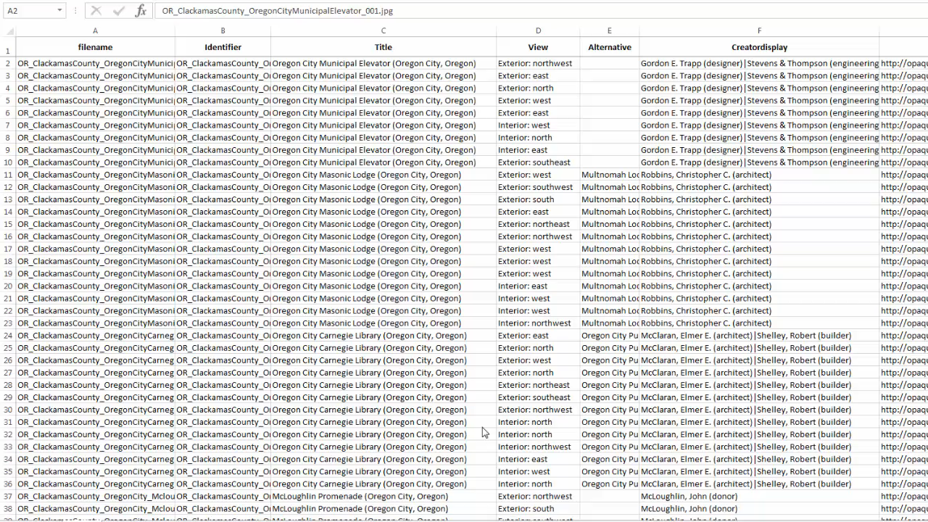

Slide 18
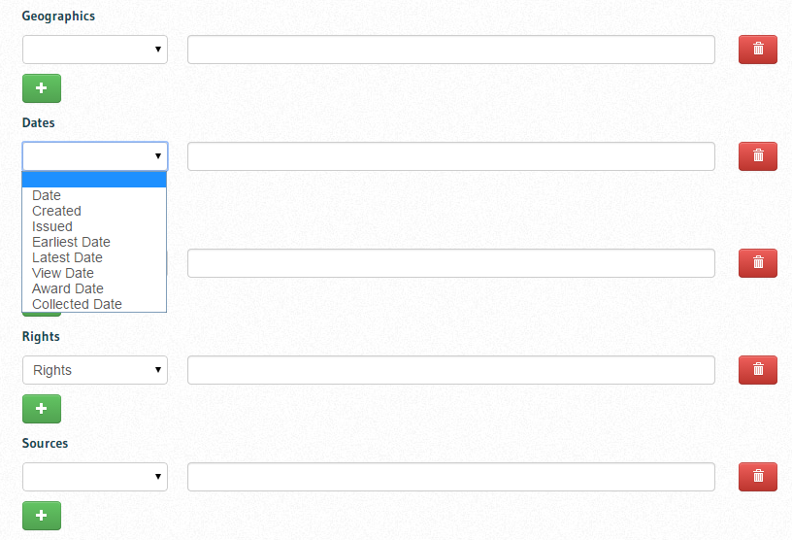
Predicates
Predicates = field names
Greatly reduced the number of fields
What data fields are controllable (decided in crosswalking step)

Slide 19
Dates
date
awardDate
Date
Date in Photo
Artwork Creation Date
Award Date(s)
dateDigitized
issued
Date Published
Installation Date
Capture Date
Digital Capture Date
Date Digital
Date of Digitization
vra/earliestDate and vra/latestDate
Earliest Date and Latest Date
cco/viewDate
Date Photographed
Photo Date
Date of Photo
Photograph Date
temporal
Decades

Slide 20
Geographics
spatial
City
County
Country
Site/Province
Place
Place Names
Artwork Site
Location and Locations
City, State/Province
Primary Drainage and Secondary Drainage
streetAddress
Site Detail
coverage
Site Detail
Notes:
Don’t need this many fields >> geonames imbedded hierarchy
Site detail > both used differently in collections

Slide 21
geonames.org
Notes:
MAIC- Ester Jacobson-Tepfer and Julia, so these are geo-located in Mongolia
Easy to create- got scholar involved

Slide 22
Faculty and curator involvement

Slide 23
Objects
Objects = data values
What data is local vs. what data is from (or can use) external controlled vocabularies
Web scraping LOD vocabularies
Time consuming and work intensive!

Slide 24
Controlled vocabularies
Library of Congress: Subject Headings, Name Authority File, Thesaurus of Graphic Materials, Ethnographic Thesaurus
Getty Vocabularies: Thesaurus of Geographic Names, Art and Architecture Thesaurus, Union List of Artist Names
British Museum
DBPedia for institutions
Geonames for places
Rights: Creative Commons, Europeana Rights Statements: http://oregondigital.org/copyright
Language: ISO-639-2
Type: DCMI Types
Format: Internet MIME Types
Notes:
*not in LOD yet

Slide 25
LOD controlled fields
In CDM:
Values do not always match external controlled vocabularies
Room for human error
Interesting subjects like “Oatmeal in Art” and complex subjects
Bradish, Bill. Oats: A non-narrated participatory narrative. Ca. 1988. University of Oregon Libraries. Aritsts’ Books.
Notes:
DCT not required
Somewhat controlled
Open to human error

Slide 26
In Hydra:
URIs resolve spelling and other normalization errors
“Oatmeal in art” becomes http://id.loc.gov/authorities/subjects/sh85093605|http://id.loc.gov/authorities/subjects/sh85007461
OregonDigital field names match schema names
Notes:
Old subject terms
Compound terms
Exhibitions- France- 20th Century

Slide 27
opaquenamespace.org
Creating local LOD URIs for terms, subjects, names, etc. not in external controlled vocabularies
Some of our vocabularies: Creator, Culture, localCollectionName, Predicates, Organizations, People, Publisher, Repository, Rights, SeriesName, Style Period, Subject, Technique, WorkType
Notes:
Marmotta- triplestore and CV manager gem- easier on the back-end – not loading entire file, etc.
Beginnings of wishful thinking for creation of ingest form for local LOD vocab

Slide 28
{
"@id": "http://opaquenamespace.org/ns/creator/RookwoodPottery",
"@type": "CorporateName",
"comment": "Haskell, Barbara; American Century: Art and Culture 1900-1950, 1st ed, New York: Whitney Museum of American Art , 1999. ",
"date": "ca. 1880-1960",
"definedBy": {
"@id": "http://opaquenamespace.org/VOCAB_PLACEHOLDER.nt"
},
"issued": {
"@type": "date",
"@value": "2014-07-10"
},
"label": "Rookwood Pottery",
"modified": {
"@type": "date",
"@value": "2014-07-10"
}
},
Notes:
Creator
Personalname and corpnames
Now create URIs in the webform

Slide 29
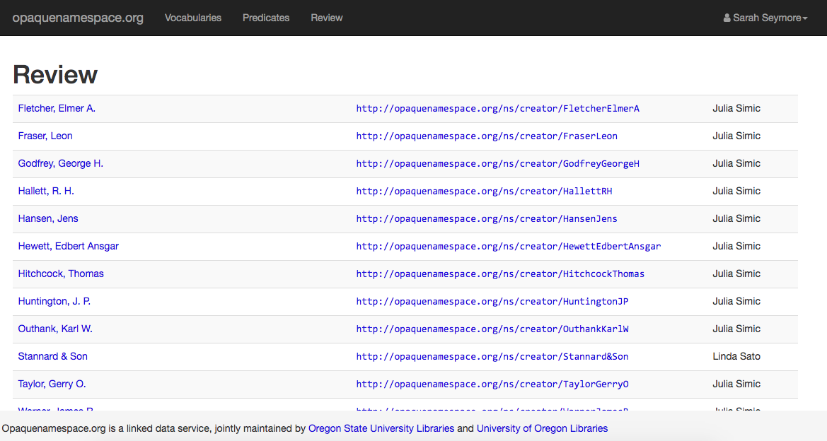
opaquenamespace.org web interface and review queue

Slide 30
Ingest process
Spreadsheet of data
Digital items
crosswalk
Run BagIt script
ssh and edit permissions for OD
Ingest in OD
Review
Approve
Notes:
No GUI for it- command line- good sorry no graphics

Slide 31
Cataloging in Hydra
Administrator (admin):
Manage roles
Review ingested objects
Ingest new objects
Update existing objects
Manage templates
Archivist/Cataloger (archivist):
Review ingested objects
Ingest new objects
Update existing objects
Manage templates
Submitter (submitter):
Ingest new objects
Notes:
Permissions and roles- admin, archivists, submitter- check on Github OD/OD wiki- roles page. We define and control. Go through breakdown.
Still using spreadsheets for bulk cataloging – with URIs
Show template- good for adding a few items or editing a few items
Metadata guides and training curators

Slide 32
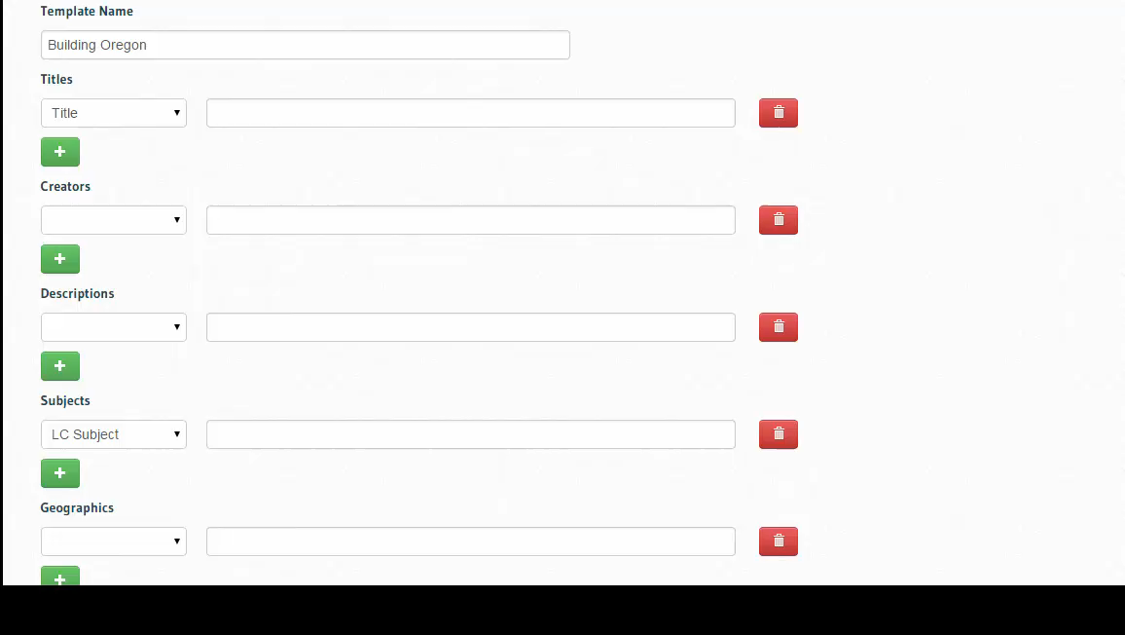
Notes:
The field names are the same as the predicate names > clarity

Slide 33
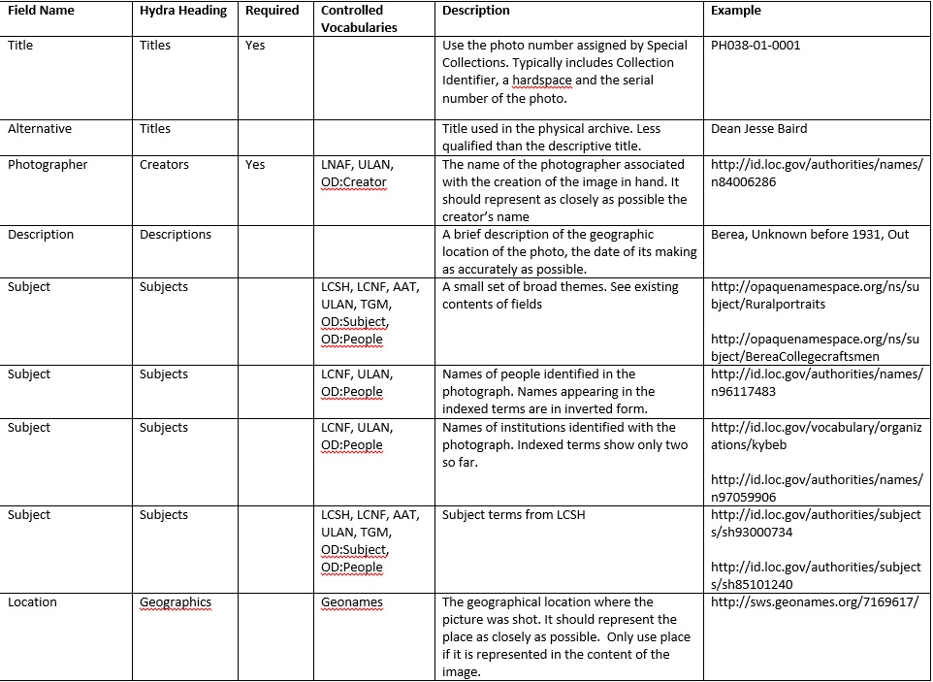
Notes:
Documentation for training for people who aren’t professional catalogers

Slide 34
Looking back and ahead…
Issues and lessons learned
Expectations and next steps
Long (and continuous) development
Metadata decisions impact system architecture
Start early- you cannot underestimate the time you will need!
There will be roadblocks when building your own system
Learn to speak “programmer”
Find the best means and tools for cross-institutional collaboration and stick with them
Developing batch editor
MWDL and DPLA
Adding more description to local LOD URIs and publishing in other LOD resources
IR head in Hydra
Exhibit integration like Spotlight and/or Omeka in Hydra
Adding new content and promoting our URIs!
Notes:
Exhibits
IR head – Sufia by OSU – but we are waiting
Other media
Marmotta- SPARQL endpoint soon and skos

Slide 35
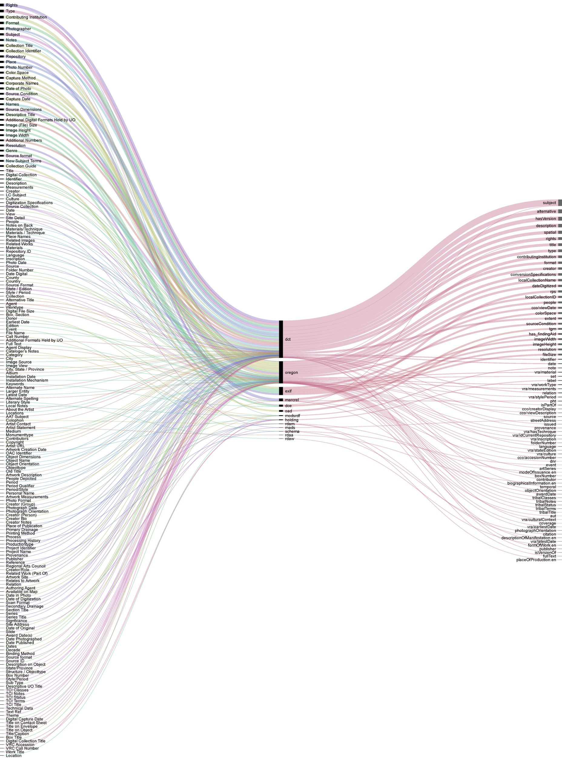

Slide 36
Information:
OregonDigital: http://oregondigital.library.oregonstate.edu/catalog
GitHub: https://github.com/OregonDigital
Metadata Dictionary: https://docs.google.com/spreadsheets/d/1nnJz49oqstQLF2PFBn5ZvWfWdF-8PVl5TFL1EMotQrA
Digital Scholarship Center, University of Oregon: http://library.uoregon.edu/digitalscholarship
Julia Simic, jsimic@uoregon.edu
Sarah Seymore, sseymore@uoregon.edu

