Slide 1
Serving patrons experiencing homelessness

Slide 2
Who am I and what do I do?
Kate Schwab - kates@multco.us
Information Services Librarian at Multnomah County's Central Library. Special focus on serving patrons experiencing homelessness and people in poverty in downtown Portland
Past SSD member. Served on conference committee 3 years
Enthusiastic but not very experienced gardener

Slide 3
Who am I and what do I do?
Develop and implement a plan for programming and outreach for people experiencing or at risk of homelessness.
Outreach: to day shelter, street newspaper drop-in office, cafe that serves unhoused and people in poverty, night shelter, service fair, presenting to meetings of staff at service orgs.
Programming: Coffee and Conversation based on Dallas Public Library (TX) program, tours for groups, writing workshops, future programs to include film series.
Attend the Multnomah County HUD Continuum of Care meetings as a community member.

Slide 4
Why do we do this?
"The American Library Association promotes equal access to information for all persons, and recognizes the urgent need to respond to the increasing number of poor children, adults, and families in America. These people are affected by a combination of limitations, including illiteracy, illness, social isolation, homelessness, hunger, and discrimination, which hamper the effectiveness of traditional library services. Therefore it is crucial that libraries recognize their role in enabling poor people to participate fully in a democratic society, by utilizing a wide variety of available resources and strategies."
ALA Policy Statement: Library Services to the Poor

Slide 5
Why do we do this?
In your community, who else is doing what we do?
Free computer access and training; jobs/career assistance; referrals to local community resources; free activities and space for socializing; quiet, safe, and free space to exist.
People experiencing homelessness are heavy users of the same services that we promote to housed users.
Reading!
Using the computer to search for jobs, housing or social services
Entertainment
Access to information
Without the library, many people would be denied access to basic information that supports them as a citizen and community member

Slide 6
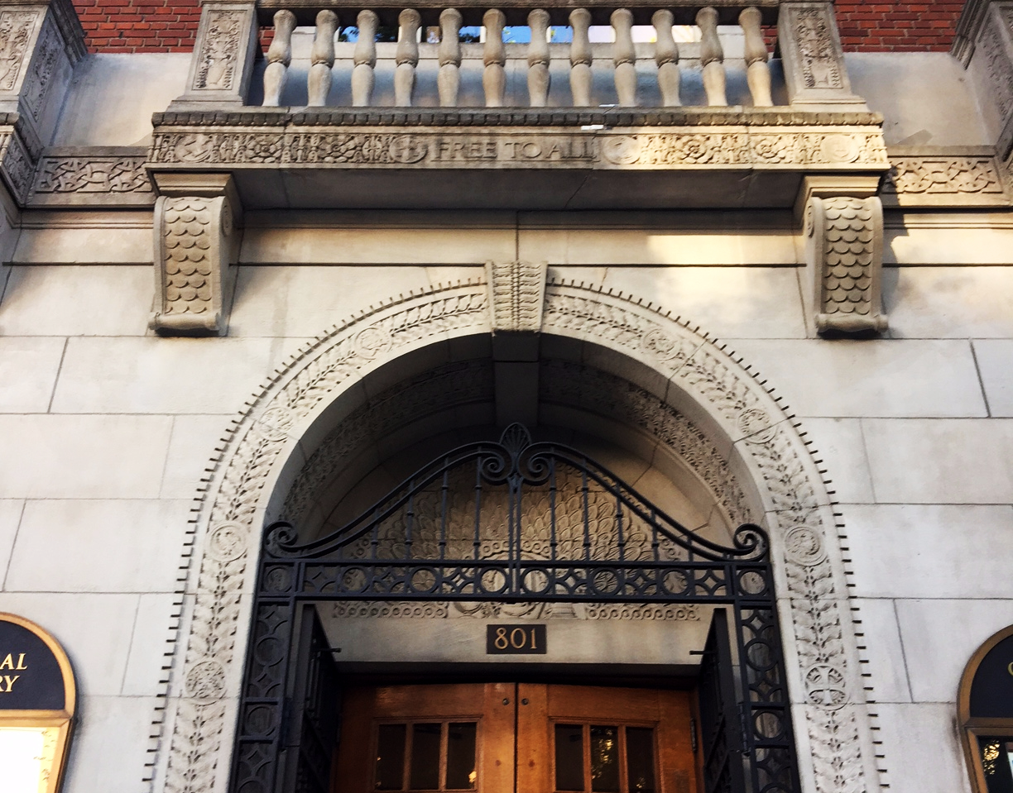
Welcoming people experiencing homelessness

Slide 7
Welcoming people experiencing homelessness
Ways to welcome people experiencing homelessness:
Seek to understand homelessness and trauma
Develop policies that reflect an understanding of the reality of homelessness and poverty
Build relationships with organizations in your community that serve people who are unhoused

Slide 8
Understanding homelessness and trauma
28% of people unhoused in Oregon are in families (2015 Point-in-Time count).
“Couldn’t afford rent” and unemployment were the top two barriers to finding housing reported by respondents to the 2017 Point-in-Time Count in Central Oregon.
Families or individuals living with friends or family don't have stable housing and are at high risk of becoming unhoused.
Homelessness and trauma are bound together. The more trauma experienced as a child, the more likely an adult is to experience homelessness and other negative health outcomes. Experiencing homelessness can lead to trauma and is itself traumatic for most.

Slide 9
Policies
What are some of the barriers for someone who is unhoused in your community trying to get a library card or access your library?
No ID; no permanent address; no proof of address; shelter address; lack of way to communicate with library; lack of ways to manage account; prohibitive fines; fines that stay even after exiting homelessness; stolen materials; water-damaged materials; large bags; policies that aren't applied equally (odor, noise, use of restrooms); lack of transportation; computer policies that limit use; having an animal; mental illness or past trauma that presents in "problem" behavior; attitudes of other patrons or staff that are unwelcoming; lack of childcare to do "adult work" with kids in tow; lost everything they had due to sweep of campsite, domestic violence, or moving into foster care; staff lack of knowledge of community resources.

Slide 10
Policies
Start with compassion. You may be the first person who has treated that patron with respect today.
Focus on what you can do for someone as opposed to what you can't.
If you feel brave, question policies that exclude people who are unhoused or in transition. Small changes in the way we apply and create policy can have a huge impact on unhoused patrons.
Find examples of other libraries that have policies that support rather than exclude and share those policies with decision-makers.

Slide 11
Build relationships
Learn how your community frames and defines homelessness and how they are working to address it. What are the factions? Who is taking action?
Make connections with individuals and organizations serving people experiencing homelessness. Start by highlighting library services you already have--raise awareness.
Listen to the challenges of individuals and organizations and think about how the library can help.
Think about how serving people experiencing homelessness fits into your library's mission or strategic plan and start expressing this work in those terms. Homelessness is an equity issue.

Slide 12
Resources for learning more
Homelessness in America website from the National Coalition for the Homeless
Extending Our Reach: Reducing Homelessness Through Library Engagement ALA toolkit
A Librarian's Guide to Homelessness Social service provider on homelessness and libraries, video. Now an online training.
Understanding and Serving People Experiencing Homelessness: A Trauma-Informed Approach to Library Service PLA webinar
Whole person librarianship: Fostering Empathy in Challenging Times webinar and website

Slide 13
Resources for learning more
Oregon Point-In-Time Homeless Counts website
Local Point-In-Time Homeless Counts - usually performed by partners in that region's Continuum of Care coalition. List of Oregon's CoCs
Homeless Students in Oregon (2015-16). More info at the Oregon Dept of Ed McKinney-Vento Act website
Our Lives: Surviving the Streets of Fresno Interviews with people experiencing homelessness, directed by a librarian.
Through Our Lens: Photovoice Project from Sisters of the Road
Dallas Public Library's Homeless Engagement Initiative

Slide 14
Thank you!

