Slide 1
But we aren’t scientists!
Get your hands on steAm programs for kids and teens
Beaverton City Library, Youth Services:
Sandy Carson-Fitzgerald
Ian Duncanson
Jessica Miele
MacKenzie Ross

Slide 2
poll question
Why is STEM important for libraries?
We use a ‘focus on fun’ approach
We tailor activities to the level of the kids/teens we serve
It’s relevant to the lives of kids/teens
It’s hands-on
It’s skills-based
Source: https://www.tsc.nsw.edu.au/tscnews/5-reasons-why-stem-is-important-in-early-years-education

Slide 3
Also…
In 2009, the National Research Council concluded that learning experiences across informal environments positively influence science learning in school, attitudes toward science, and pursuit of science-related occupations.
Source: https://www.starnetlibraries.org/stem-in-libraries/why-stem/

Slide 4
Stem sTORYTIME
Highlight STEM concepts in stories
Include fun factual book
Use STEM-related questions, such as: What do you think will happen next?
Patterns, size, shapes, matching, categorizing
Talk through observations
Graphing and matching activities
Include STEM-information related to games and crafts
STEM-concept treasure hunts

Slide 5
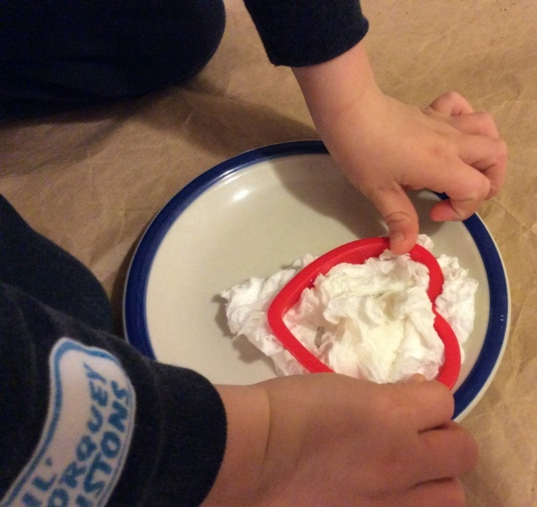
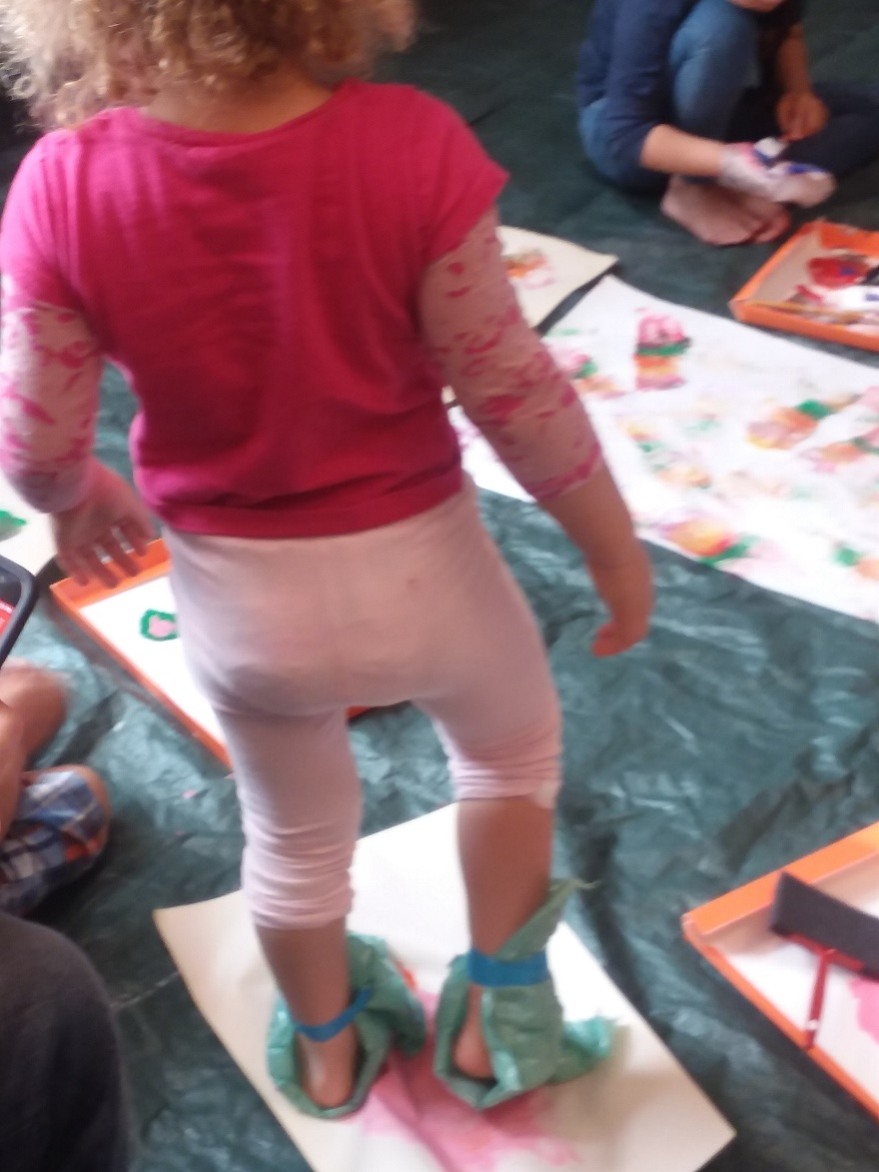
Messy art
Shaving cream paper marbling
Bubblewrap stomp painting
Bubble art
Race car painting
Indoor snow
Homemade sidewalk chalk
Ivory soap in the microwave

Slide 6
Kid engineers
Paper airplanes
Toothpick/marshmallow structures
Egg drop challenge
Popsicle stick catapults
Balloon towers
Earthquake test
Sail cars

Slide 7
Tween Messy science
Ice cream in a bag
Magnetic slime
Balloon-powered cars
Egg parachutes
Pop rocks and balloons
Solar s’more ovens

Slide 8
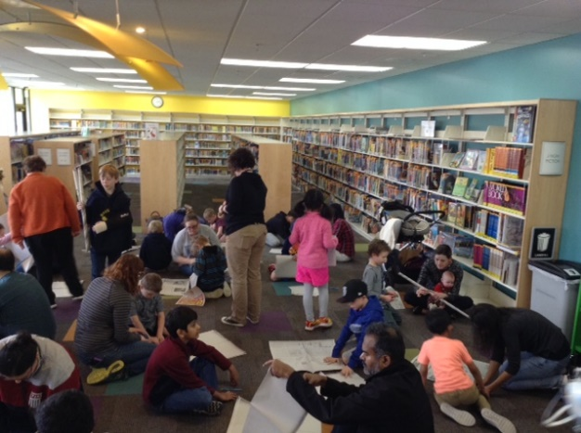
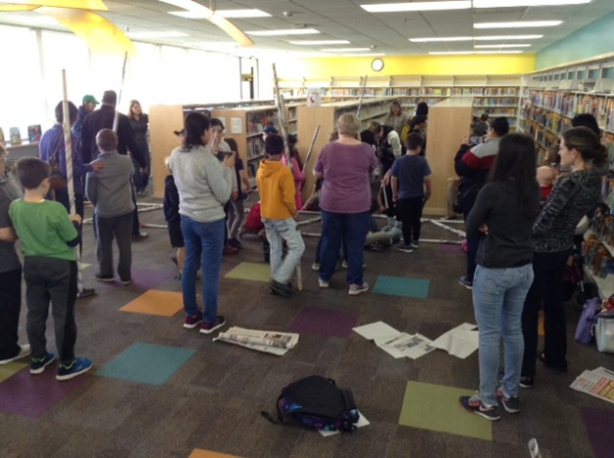
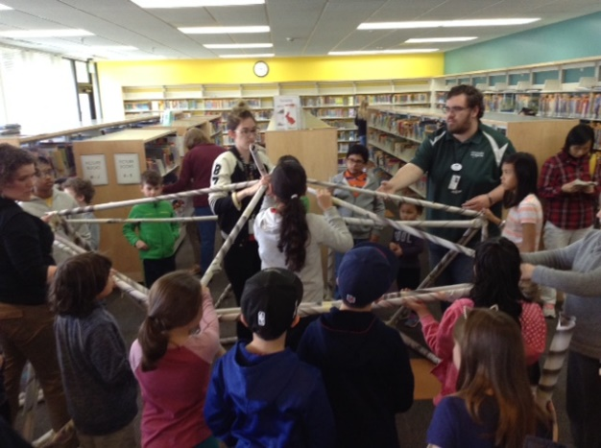
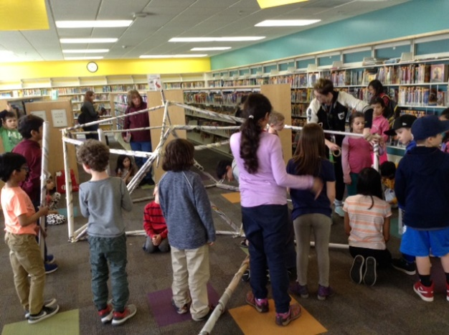
Bonus: Moon habitat challenge
Space Spring Break @ BCL
Program led by Evergreen Aviation staff
They offer additional outreach programs! And their menu of options changes!
Or you can make the moon habitat with staff and volunteers!
NASA offers instructions
More NASA Space Place Activities

Slide 9
Re-using for multiple programs
“Outreach” STEM Toys
Bee-Bot
Cubelets
Snap Circuits
Ozobots
LittleBits
Force and Motion Activity Set
Laser Maze

Slide 10
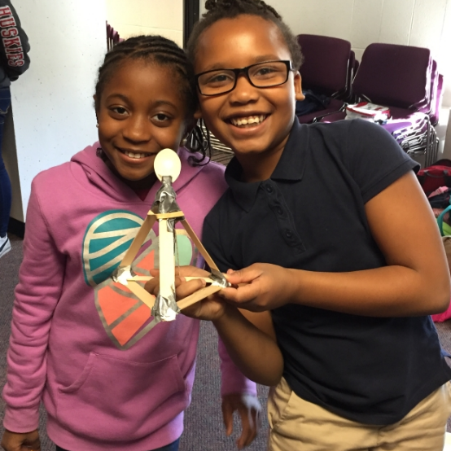
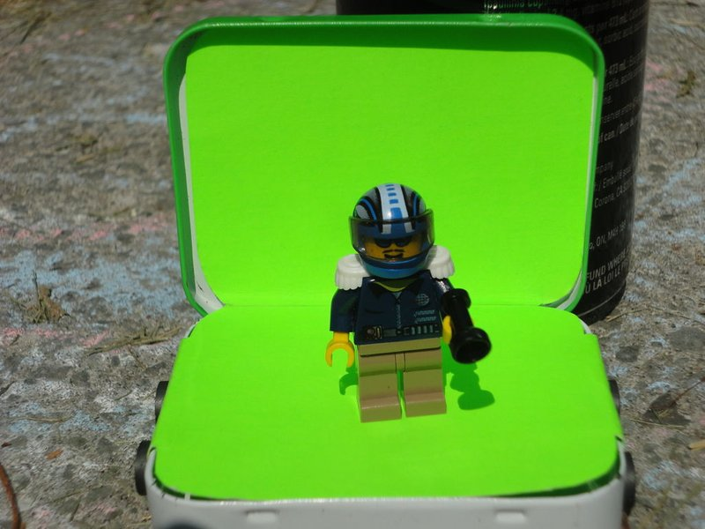
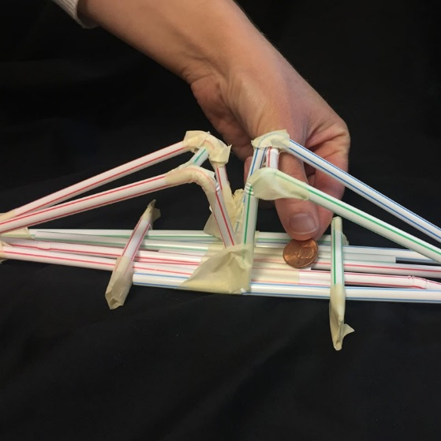
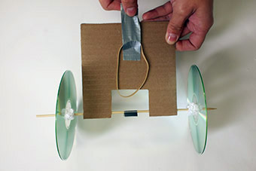
Stem programming Resources
Museum of Science and Industry Chicago: Hands-On Science Activities
STAR_net: STEM Activities
Instructables: Maker Projects
Northeastern University Center for STEM Education: STEM Activities
PBS Kids Design Squad: “Build” Activities
National Geographic: Education Activities

Slide 11
Questions?
Contact Us:
Sandy Carson-Fitzgerald | scarson@beavertonoregon.gov
Ian Duncanson | iduncanson@beavertonoregon.gov
Jessica Miele | jmiele@beavertonoregon.gov
MacKenzie Ross | mross@beavertonoregon.gov

