Slide 1
Using Grey Literature for Government Information Reference Research
Some fast examples of grey literature resources you can use to answer government information reference queries
Natalie Brant
State Library of Oregon

Slide 2
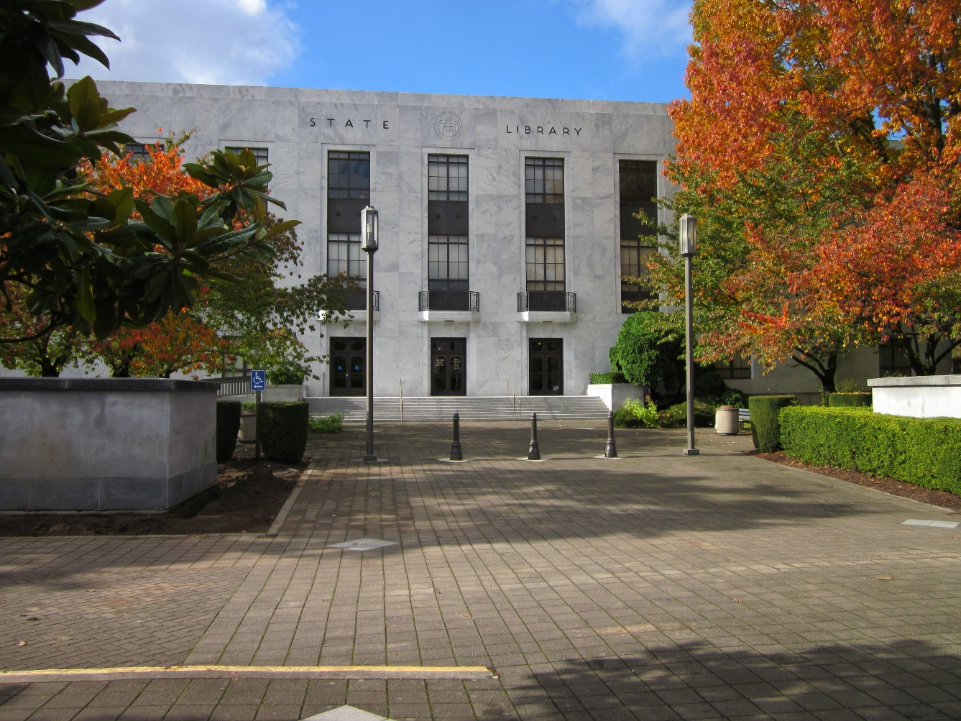
State Library of Oregon Resources
Oregon Government Publications collection
Oregon State Library – official archive of Oregon Government documents
Other Oregon depository libraries
Eastern Oregon University Library
Oregon Institute of Technology Library (Klamath Falls)
Multnomah County Library
Oregon State University Libraries
Portland State University Library​
Southern Oregon University Library
University of Oregon Library
Federal Government Information
Since 2007, OSL has overseen the transition of Oregon’s Regional Federal
Depository Collection from being housed at a single library, to a distributed
housing arrangement among four partner libraries:
Portland State University
University of Oregon
Oregon State University
Oregon State Library
http://www.oregon.gov/OSL/pages/oregonians.aspx

Slide 3
Oregon Blue Book
Is there a State Agency for that?
http://bluebook.state.or.us/

Slide 4
Nonprofit agencies’ publications
Is there a nonprofit organization researching this issue?
Many nonprofits do policy research on behalf of federal and state government
Foundation Center’s Catalog of Nonprofit Literature – helps discover what research is being done by which nonprofits
Foundation Directory Online – even more helpful, but not free ☹
http://catalog.foundationcenter.org/

Slide 5
Census Publications
Is there expert analysis of the vast amount of statistical data produced by the U.S. Census?
Census Library
and
American FactFinder
https://census.gov/library/publications.html

Slide 6
Congressional Research Service (CRS)
Is there a place to find research being done around current federal legislation and policy issues?
CRS provides comprehensive public policy research exclusively for members of Congress, their committees, and staff
https://www.everycrsreport.com/

