Slide 1
Oregon Reader’s Choice Awards
2018 Winners and 2019 Nominations
Melanie Hetrick, Tillamook County Library
Kiva Liljequist, Metropolitan Learning Center (Portland)
MacKenzie Ross, Beaverton City Library

Slide 2
What is ORCA?
Founded in 2010.
Fun and exciting way for Oregon youth in grades 3-12 to become enthusiastic and discriminating readers.
Students choose their favorite book in a real-life democratic process.

Slide 3
How are the books chosen?
Oregon students, teachers, and librarians may nominate titles.
Copyright date must be three years prior to when the winners are announced.
Nominations are reviewed by a committee of Oregon librarians, educators, and booksellers.
Committee creates the final list!

Slide 4
Committee Members
Chair: Kiva Liljequist (Metropolitan Learning Center, Portland)
Jen Blair (Beaverton School District) Billie Bloebaum (Third Street Books, McMinnville) Anna Bruce (Happy Valley Library) Grace Butler (Whitman Elementary School, Portland) Melanie Hetrick (Tillamook County Library) Elizabeth Johnson (Corvallis-Benton County Public Library) Beth LaForce (George Fox University, Newberg) Lori Lieberman (West Sylvan Middle School, Portland) Jessica Marie (Salem Public Library) Laurie Nordahl (North Bend High School) MacKenzie Ross (Beaverton City Library) Bekah Westmark (Coos Bay Public Library)
Notes:
Send email to check name and workplace - done 4/10
Emailed back: Billie, Beth, Elizabeth, Grace, Jen, Bekah
Anna on vacation until OLA (came from Happy Valley Library)

Slide 5
And the winners are...

Slide 6
2018 Upper Elementary Winner
Roller Girl by Victoria Jamieson
Newbery Honor
Oregon Spirit Book Award for Graphic Novel
Also by Author: All’s Faire in Middle School
Readalikes:
Sunny Side Up by Jennifer L. Holm
El Deafo by Cece Bell
Smile and Sisters by Raina Telgemeier
Author Website: http://www.victoriajamieson.com/
Notes:
Booktalk: Astrid and Nicole have always been best friend and have always enjoyed doing everything together. Then Astrid’s mom takes them to see the Rose City Rollers roller derby team at Oaks Park in Portland. They look fierce! They have crazy names like The Blast Unicorn and Scald Eagle. They have weird hair, tattoos, strange outfits, and creepy makeup. When the derby starts, the skaters are laughing and having a great time. The jammer Rainbow Bite looks like a superhero. Astrid can’t take her eyes off of the game. Nicole is looking for cute boys. When Astrid signs up for roller derby camp, she assumes that Nicole will, too. But Nicole would rather go to dance camp. Roller derby is tough. Astrid is exhausted, bruised, and frustrated on the first day of camp, but she is determined to keep trying. She gets better, tougher, stronger, and dyes her hair a cool shade of blue. Trying to stay friends with Nicole, who is loving ballet, boys, and her new friend at dance camp, is tough, too. This graphic novel is by Portland author Victoria Jamieson, who is a Rose City Roller herself, and it’s a great book about determination, dealing with the changes life throws at you when you’re growing up and away from who you used to be, and finding the one thing that you want to do more than anything else. Oh yes, and it’s also about lots of skating action, cool socks, and a bunch of characters that everyone can relate to.

Slide 7
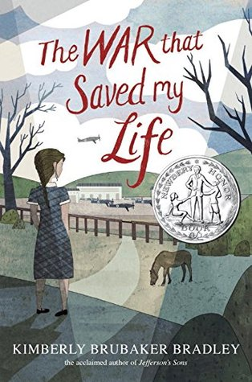
2018 Middle School Winner
The War That Saved My Life by Kimberly Brubaker Bradley
Newbery Medal Honor
E.B. White Read Aloud Award Honor
Sequel: The War I Finally Won
Readalikes:
Number the Stars by Lois Lowry
Wolf Hollow by Lauren Wolk
Chasing Secrets by Gennifer Choldenko
Author Website: https://kimberlybrubakerbradleycom.wordpress.com/
Educator’s Guide: www.penguin.com/wp-content/uploads/2015/03/WarThatSavedMyLife_Guide_15_4p_LR.pdf
Notes:
Booktalk: Ten-year old Ada has spent her whole life trapped in a miserable little apartment in London, sometimes shoved in a cupboard and starving, with her abusive mother and little brother, Jamie. Ada has a clubfoot, and her mother is ashamed of her “crippled” daughter and doesn’t want anybody to know about her disability, so she never lets Ada out. Ada’s only interaction with other people is waving out of the apartment’s tiny, dirty window. When Jamie brings home news from school about the war and about London possibly being bombed, Ada decides to finally take action. Children are being sent out of London to live with families in the country, where it’s safer. If her mother won’t care for her own children, Ada will have to do it herself. But Ada can’t walk without being in pain, so she scoots and crawls most of the way, but the two children finally make it to the train station and to a new house in the country…and Ada’s life changes forever. As Ada begins to realize her own self-worth and all of the things she is capable of, it becomes harder and harder to imagine returning to life in London with her mother. She is not worthless, she is not repulsive, she is not shameful—and she will no longer be willing to be labeled as such. But when her mother shows up to take Ada and Jamie back to London, how can Ada hold on to her new life?

Slide 8
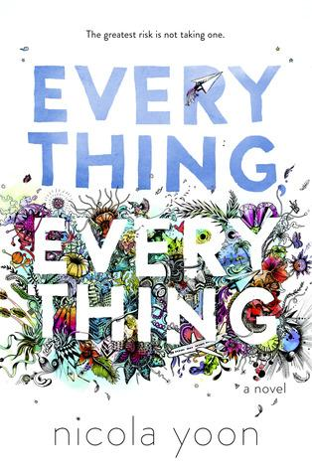
2018 High School Winner
Everything, Everything by Nicola Yoon
Goodreads Choice Award Nominee for Debut Author and for Young Adult Fiction
Also by Author: The Sun Is Also a Star
Readalikes:
The Fault in Our Stars by John Green
Highly Illogical Behavior by John Corey Whaley
One by Sarah Crossan
Author Website: http://www.nicolayoon.com/
Notes:
Booktalk: Maddy doesn’t leave her house—ever. She only sees her mom and her nurse, Carla, and the front door to the house has an air lock because she is literally allergic to the world. Maddy is content with her life until Olly and his family move in across the street and disappointment in her situation begins when Olly and his sister bring over a bundt cake and Maddy has to refuse the gift. However, Maddy can’t refuse Olly’s attentions for long. They get to know each other by communicating through their bedroom windows, email, instant messaging, and finally in person. Having Olly as a friend changes Maddy’s entire world, and she ends up risking everything by traveling with Olly to Hawaii. It’s only thanks to this exciting the frightening trip that Maddy learns the truth about her condition.

Slide 9
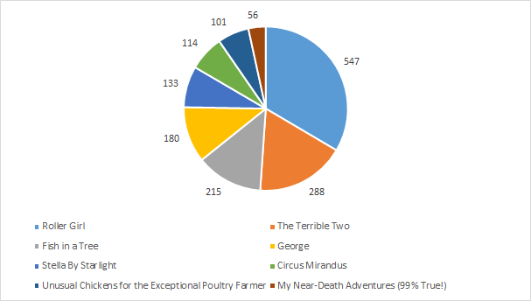
2018 Upper Elementary Voting
Notes:
graphs!

Slide 10
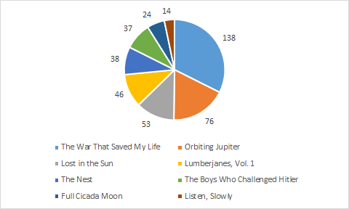
2018 Middle School Voting
Notes:
graphs

Slide 11
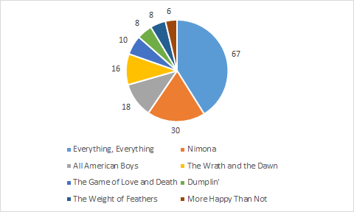
2018 High School Voting
Notes:
graphs

Slide 12
2019 Upper Elementary Nominations

Slide 13
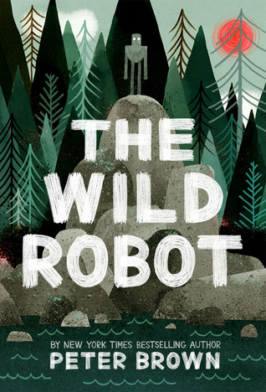
The Wild Robot by Peter Brown
Awards and Lists:
NCTE Charlotte Huck Award for Outstanding Fiction for Children
Starred Reviews: Publisher’s Weekly, Booklist, School Library Journal
Next in Series: The Wild Robot Escapes
Other books by the author: My Teacher Is a Monster! (No, I Am Not), Children Make Terrible Pets, Creepy Carrots, The Curious Garden, Flight of the Dodo
Readalikes:
Nuts to You by Lynne Rae Perkins
Unusual Chickens for the Exceptional Poultry Farmer by Kelly Jones
Hatchet by Gary Paulsen
The Iron Giant by Ted Hughes
Author Website: http://www.peterbrownstudio.com/

Slide 14
Some Kind of Courage by Dan Gemeinhart
Awards and Lists:
Texas Bluebonnet Award 2017-2018
Starred Reviews: Booklist
Also by author: The Honest Truth, Scar Island
Readalikes:
All Rise for the Honorable Perry T. Cook by Leslie Connor
Wolf Hollow by Lauren Wolk
When the Sea Turned To Silver by Grace Lin
Wildwood by Colin Meloy
One Dog and His Boy by Eva Ibbotson
Author Website: http://dangemeinhart.com/
Fun fact: Dan is a school librarian in Wenatchee, Washington!

Slide 15
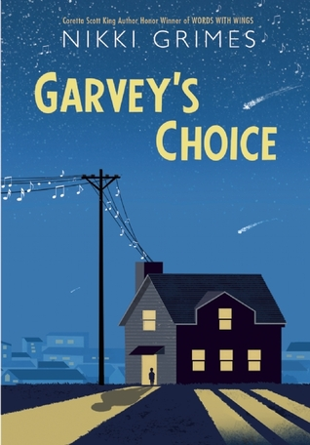
Garvey’s Choice by Nikki Grimes
Awards and Lists:
ALA Notable Children’s Book
Bank Street College of Education Best Books of the Year list
Booklist: Top 10 Diverse Fiction List
Starred Reviews: School Library Journal, School Library Connection, Booklist, Kirkus Reviews, Library Media Connection
Also by author: Bronx Masquerade, Barack Obama: Son of Promise, Child of Hope, Dark Sons, Poems in the Attic, Words With Wings, Meet Danitra Brown, The Road to Paris, Jasmin’s Notebook, Talkin’ About Bessie, and many more.
Readalikes:
Beanball by Gene Fehler
Love That Dog by Sharon Creech
Locomotion by Jacqueline Woodson
Brown Girl Dreaming by Jacqueline Woodson
Author Website: https://www.nikkigrimes.com/

Slide 16
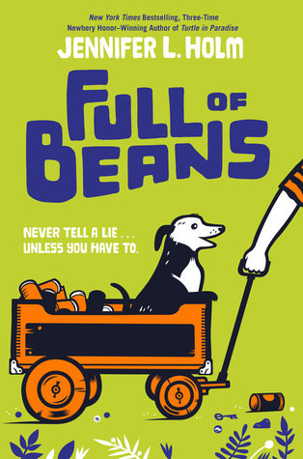
Full of Beans by Jennifer Holm
Awards and Lists:
2017 Scott O’Dell Historical Fiction Award
A New York Public Library Best Book for Kids, 2016
Starred reviews: Shelf Awareness, Horn Book, Booklist, Kirkus Reviews, Publishers Weekly
Other books by author: The Fourteenth Goldfish, Our Only May Amelia, The Trouble With May Amelia, Turtle in Paradise, Boston Jane series, Babymouse series, Squish series, The Creek, Middle School is Worse Than Meatloaf, Sunny Side Up, Swing It Sunny, Penny From Heaven
Readalikes:
Turtle in Paradise by Jennifer Holm
Wish by Barbara O’Connor
The Terrible Two by Mac Barnett
Author Website: http://www.jenniferholm.com/

Slide 17
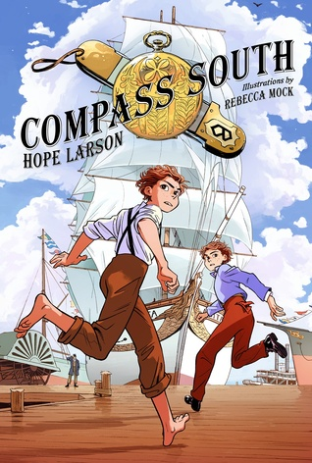
Compass South: A Graphic Novel by Hope Larson
Awards and Lists:
Starred Reviews: Booklist, School Library Journal
Next in Series: Knife’s Edge
Other books by author: A Wrinkle In Time, Gray Horses, Salamander Dream, Chiggers, Goldie Vance
Readalikes:
Gregor the Overlander by Suzanne Collins
The Thief by Megan Whalen Turner
Lumberjanes by Noelle Stevenson
Author Website: https://twitter.com/hopelarson

Slide 18
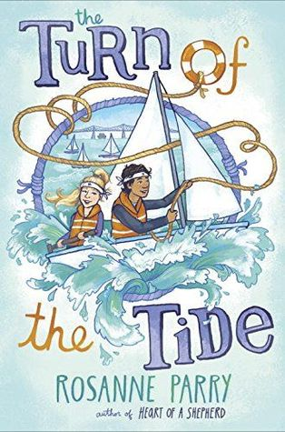
The Turn of the Tide by Rosanne Parry
Awards and Lists:
Starred reviews: Booklist, School Library Journal
Other books by author: Heart of a Shepherd, Second Fiddle, Written in Stone
Readalikes:
The Lightning Queen by Laura Resau
The Seventh Most Important Thing by Shelley Pearsall
Wild Wings by Gill Lewis
Author Website: http://rosanneparry.com/
Fun facts: Rosanne lives in Portland, OR! She also hosts The League of Exceptional Writers at Powell’s Books on Cedar Hills Blvd in Beaverton, “a monthly workshop where authors and illustrators share their writing knowledge with kids, ages 8-18 years old, who are interested in creating books.” (from author’s website)

Slide 19
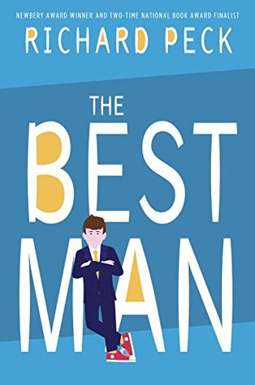
The Best Man by Richard Peck
Awards and Lists:
Starred Reviews: School Library Journal, Booklist, Horn Book Guide, Horn Book Magazine, Kirkus Reviews, Publishers Weekly
Peck has won the Newbery Award, the Margaret A. Edwards Award, the NCTE/Alan Award, and the Edgar Allan Poe Award, among other accolades.
Other books by author: A Year Down Yonder, A Long Way From Chicago, The River Between Us, The Teacher’s Funeral: A Comedy in Three Parts, Here Lies the Librarian, and many others
Readalikes:
Wednesday Wars by Gary Schmidt
As Brave As You by Jason Reynolds
Save Me A Seat by Sarah Weeks
Author Website: www.scholastic.com/teachers/authors/richard-peck/

Slide 20
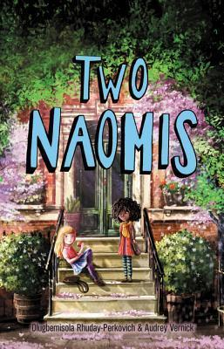
Two Naomis by Olugbemisola Rhuday-Perkovich and Audrey Vernick
Awards and Lists:
Starred reviews: Booklist, Kirkus Reviews,
Other books by Olugbemisola Rhuday-Perkovich: Eighth-Grade Superzero, Open Mic (contributor)
Other books by Audrey Vernick: Water Balloon, Screaming at the Ump, Brothers at Bat
Readalikes:
One Crazy Summer by Rita Williams-Garcia
The Great Treehouse War by Lisa Graff
Summer of the Gypsy Moths by Sara Pennypacker
Author Websites: https://olugbemisolabooks.com/ and www.audreyvernick.com/

Slide 21
2019 Middle School Nominations

Slide 22
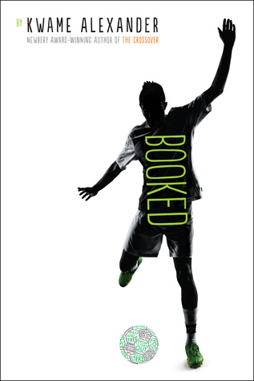
Booked by Kwame Alexander
Awards and Lists:
New York Times Bestseller
National Book Award long list
ALA Notable Children’s Book
ALA Quick Pick for Reluctant Young Adult Readers
Also by author: The Crossover, Rebound
Readalikes:
Words With Wings by Nikki Grimes
Word Nerd by Susin Nielsen-Fernlund
Brown Girl Dreaming by Jacqueline Woodson
Author Website: www.kwamealexander.com
Twitter: @kwamealexander

Slide 23
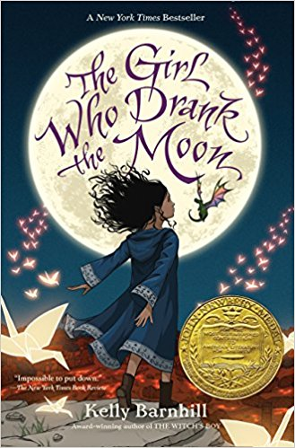
The Girl Who Drank the Moon by Kelly Regan Barnhill
Awards and Lists:
Newbery Medal
Dorothy Canfield Fisher Children’s Book Award Nominee
Andre Norton Award Nominee for YA Science Fiction & Fantasy
New York Public Library Best Book
Also by author: The Witch’s Boy, Iron Hearted Violet, The Mostly True Story of Jack
Read Alikes:
Ravenous by MarcyKate Connolly
Thickety: A Path Begins by J.A. White
Readers Guide
https://d17lzgq6gc2tox.cloudfront.net/downloadable/asset/original/9781616205676_rg.pdf?1505137549
Author Website: www.kellybarnhill.wordpress.com
Twitter: @kellybarnhill

Slide 24
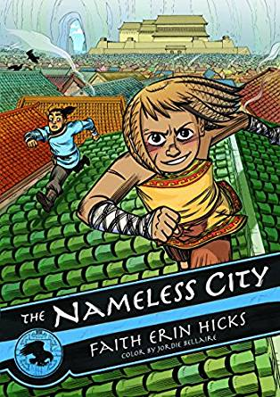
Nameless City by Faith Erin Hicks
Also by Author: The Bigfoot Boy, Friends With Boys
First in a trilogy: 2) The Stone Heart 3) The Divided Earth
Read alikes:
Cleopatra In Space by Mike Maihack
Zita the Spacegirl by Ben Hatke
The Sand Warrior by Mark Siegel
Author Website: www.faitherinhicks.com
Twitter: @FaithErinHicks
Interesting info: Hicks has a section for “mini comics” on her webpage. One available mini comic: “The Hunger Games movie - what did I think?”
Reading Guide:
https://images.macmillan.com/folio-assets/teachers-guides/9781626721562TG.pdf

Slide 25
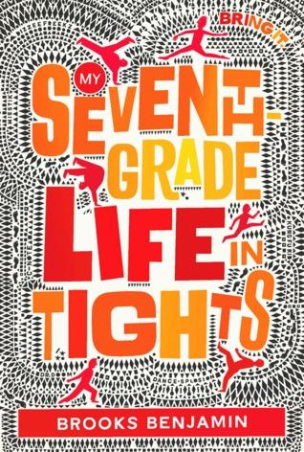
My Seventh-Grade Life in Tights by Brooks Benjamin
Book Trailer: http://www.brooksbenjamin.com/books
“Equal parts jazz hands and karate chop, with a dash of football and a pirouette of pure heart. Dillon and the Dizzee Freekz are en pointe. This book will rock you! “–Kristin O’Donnell Tubb, author of The 13th Sign
Read Alikes:
Better Nate Than Ever by Tim Federle
How to Stage a Catastrophe by Rebecca Donnelly
Educator Guide: http://docs.wixstatic.com/ugd/46fc7c_c747045459e04ef99fe824b4acf2d5a0.pdf
Author Website: http://www.brooksbenjamin.com/
Twitter: @brooksbenjamin

Slide 26
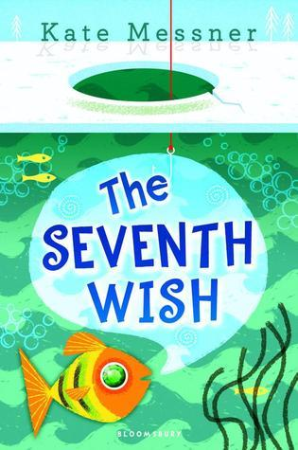
The Seventh Wish by Kate Messner
Also by Author: Ranger in Time series, The Silver Jaguar Society Mysteries, Marty McGuire series
Read Alikes:
Wishing Day by Lauren Myracle
Genuine Sweet by Faith Harkey
“An empathetic, beautiful, magical fiercely necessary book that stares unflinchingly at the the very real challenges contemporary kids face and gently assures them they are not alone. Kate Messner gives her readers a story to cherish.”
~Anne Ursu, author of The Real Boy and Breadcrumbs
Educator’s Guide:
https://media.bloomsbury.com/rep/files/TheSeventhWishK.MessnerEducatorsGuide.pdf
Author Website: www.katemessner.com
Twitter: @KateMessner

Slide 27
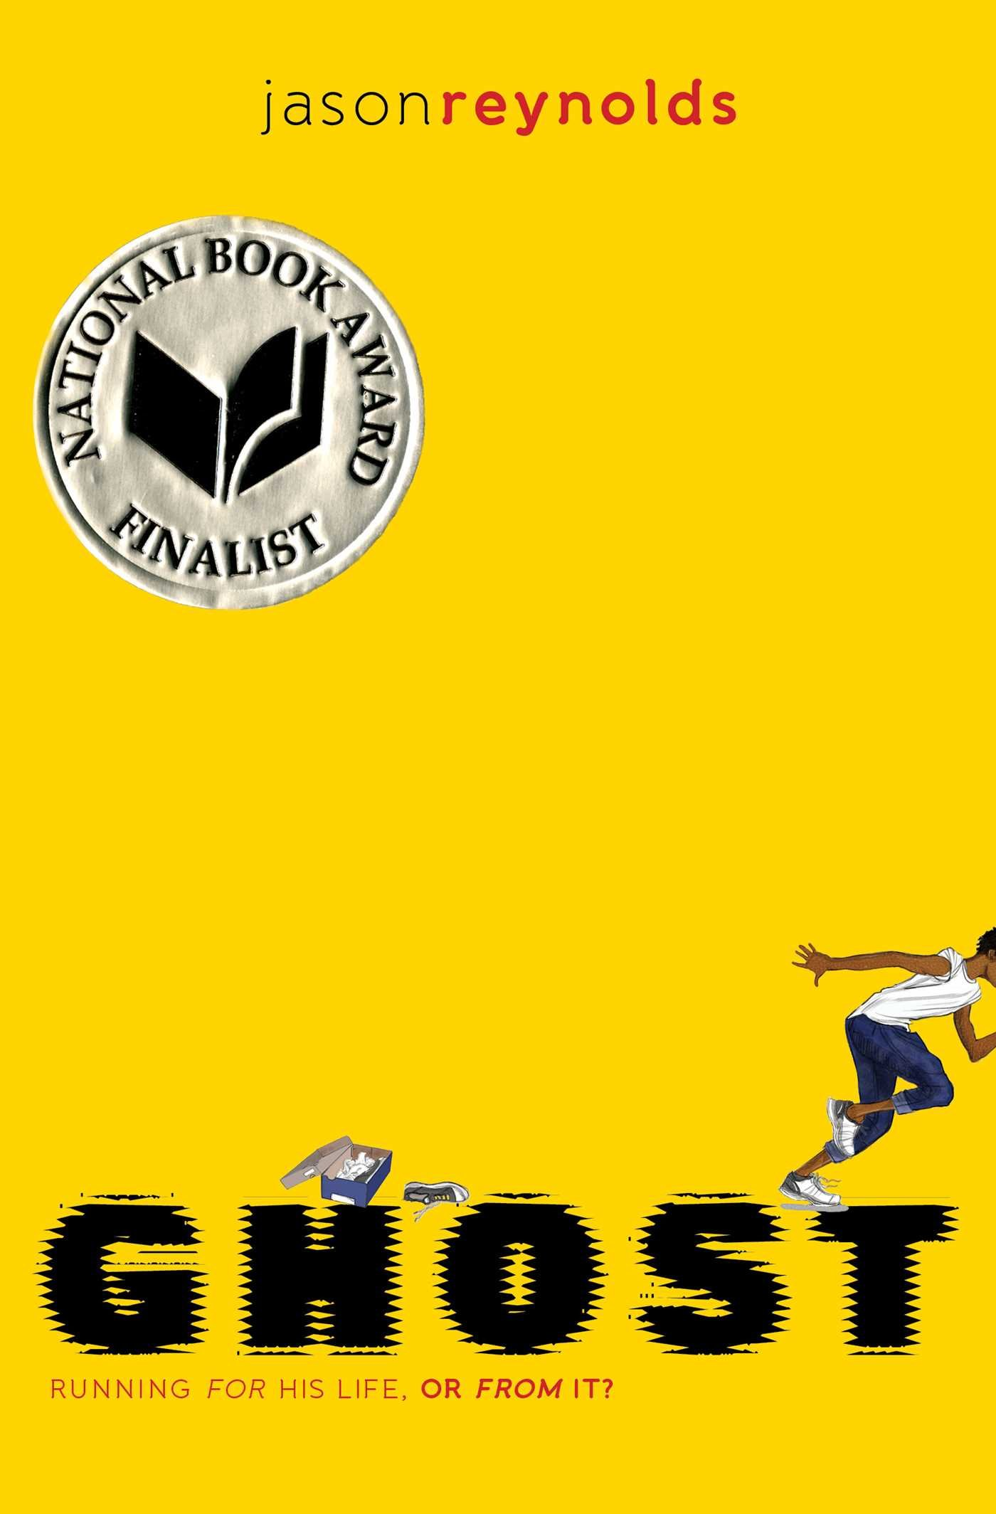
Ghost by Jason Reynolds
Awards and Lists:
National Book Award Finalist
Odyssey Award Nominee
Rebecca Caudill Young Readers
Dorothy Canfield Fisher Children's Book award Nominee
NAIBA Book of the Year for Middle Readers
NCTE Charlotte Huck Award
First in a trilogy: 2) Patina 3) Sunny
Also by author: All American Boys, Long Way Down
Read alikes
One Crazy Summer by Rita Williams-Garcia
Orbiting Jupiter by Gary D. Schmidt
Reading group guide:
http://www.simonandschuster.com/books/Ghost/Jason-Reynolds/Track/9781481450164/reading_group_guide
Website: www.jasonwritesbooks.com
Twitter: @JasonReynolds83

Slide 28
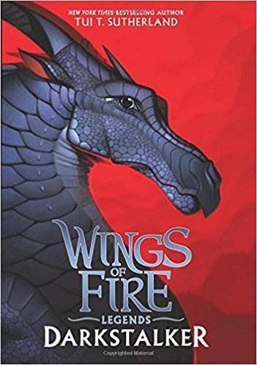
Darkstalker by Tui Sutherland
Also by the author: Wings of Fire series, The Menagerie series
Read alikes:
The original Wings of Fire series
The Last Dragon Chronicles by Chris D’Lacey
Septimus Heap by Angie Sage
Author’s Webpage: http://tuibooks.com/wordpress/
Facebook: https://www.facebook.com/Tui-T-Sutherland-101732837959/
Publisher page dedicated to the series:
http://wingsoffire.scholastic.com/
Also published as...Erin Hunter?! (and others)

Slide 29
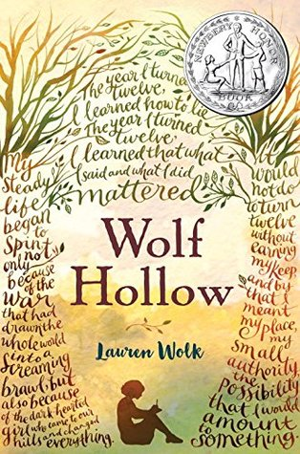
Wolf Hollow by Lauren Wolk
Awards and Lists:
2017 Newbery Honor Book
New York Times Bestseller
An NPR Best Book of the Year
A Booklist Best Book of the Year
A Kirkus Reviews Best Book of the Year
A Shelf Awareness Best Book of the Year
A School Library Journal Best Book of the Year
An ALA Notable Children's Book
Also by Author: Beyond the Bright Sea
Read Alikes:
The War That Saved My Life by Kimberly Brubaker Bradley
Number the Stars by Lois Lowry
Discussion Guide: http://www.penguin.com/wp-content/uploads/2017/05/25690-BeyondBrightSea_DiscGuide1.pdf
Author Website: www.laurenwolk.com
Twitter: @LaurenWolkBooks

Slide 30
2019 High School Nominations

Slide 31
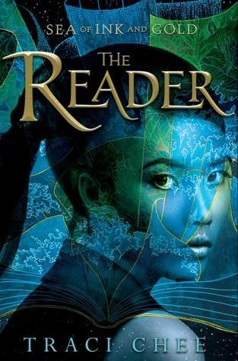
The Reader by Traci Chee
#ownvoices
Awards and Lists:
Kirkus Award Finalist
Goodreads Choice Award Nominee for Debut Goodreads Author
NPR Best Book of the Year
Bustle Best YA Book of the Year
Next in Series: The Speaker and The Storyteller (November 2018)
Readalikes:
Ink and Bone by Rachel Caine
The Girl From Everywhere by Heidi Heilig
Carry On and Fangirl by Rainbow Rowell
Author Website: http://tracichee.com/
Traci Chee’s Fan Art Contest: http://tracichee.com/fanartcontest

Slide 32
Burn Baby Burn by Meg Medina
#ownvoices
Awards and Lists:
Kirkus Award Finalist
Amelia Bloomer Top Ten
OBOB 2018-19 List
Also by Author: Yaqui Delgado Wants to Kick Your Ass and The Girl Who Could Silence the Wind
Readalikes:
Girl in the Blue Coat by Monica Hesse
The Smell of Other People’s Houses by Bonnie-Sue Hitchcock
Author Website: https://megmedina.com/
Discussion Guide: http://www.candlewick.com/book_files/0763674672.bdg.1.pdf

Slide 33
If I Was Your Girl by Meredith Russo
#ownvoices
Awards and Lists:
Stonewell Book Award
Goodreads Choice Award Nominee for Young Adult Fiction
IndieNext Top 10 List
Bustle Best YA Books of the Year
Starred reviews from Publisher’s Weekly and Kirkus
Also by Author: Meet Cute: Some People Are Destined to Meet (contributor)
Readalikes:
When the Moon Was Ours by Anna-Marie McLemore
Beautiful Music for Ugly Children by Kirstin Cronn-Mills
The Art of Being Normal by Lisa Williamson
Author on Twitter: @Mer_Squared

Slide 34
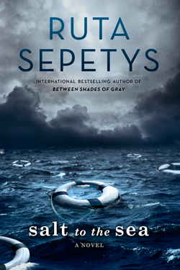
Salt to the Sea by Ruta Sepetys
Awards and Lists:
CILIP Carnegie Medal Winner
SCBWI Golden Kite Award Winner for Fiction
OBOB 2018-19 List
Also by Author: Between Shades of Gray and Out of the Easy
Readalikes:
The Passion of Dolssa by Julie Berry
Every Falling Star by Sungju Lee
IMDB says movie is “in development”
Author Website: http://rutasepetys.com/
Discussion Guide: http://rutasepetys.com/wp-content/uploads/2016/06/SalttotheSea_DG1.pdf

Slide 35
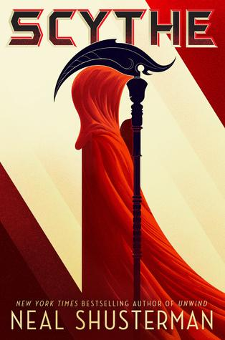
Scythe by Neal Shusterman
Awards and Lists:
Printz Honor
OBOB 2018-19 List
Next in Series: Thunderhead
Readalikes:
Graceling by Kristin Cashore
The Scorpion Rules by Erin Bow
Monstress, Vol. 1 by Marjorie Liu
IMDB says movie is “in development”
Author Website: http://www.storyman.com/
Reading Group Guide: http://www.simonandschuster.com/books/Scythe/Neal-Shusterman/Arc-of-a-Scythe/9781442472433/reading_group_guide

Slide 36
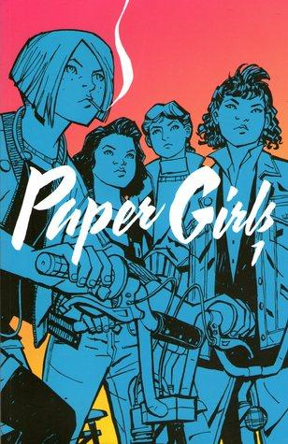
Paper Girls, Vol. 1 by Brian K. Vaughan
Awards:
Will Eisner Comic Industry Award
Goodreads Choice Award Nominee for Graphic Novels & Comics
Next in Series: Paper Girls, Vol. 2-4
Also by Author: Runaways, We Stand on Guard, Saga
Book Readalikes and Media Watch-alikes:
Lumberjanes by Noelle Stevenson
Ready Player One by Ernest Cline
Netflix: Stranger Things and Dark and The OA
Author Website: http://bkvcomics.com/
Illustrator Website: http://www.cliffchiang.com/
Hot Tip: Image Comics has their HQ in Portland, and they host an Expo event!

Slide 37
The Sun Is Also a Star by Nicola Yoon
#ownvoices
Awards and Lists:
Printz honor
Coretta Scott King New Talent Award
Goodreads Choice Award Nominee for Young Adult Fiction
Also by Author: Everything, Everything and Meet Cute: Some People Are Destined to Meet (contributor)
Yara Shahidi in Negotiations to Star in [...] Movie Adaptation
Readalikes:
Eleanor and Park by Rainbow Rowell
You Bring the Distant Near by Mitali Perkins
Author Website: http://www.nicolayoon.com/

Slide 38
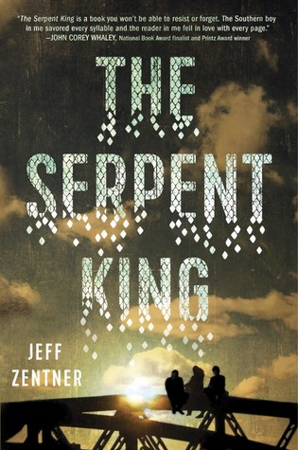
The Serpent King by Jeff Zentner
Awards and Lists:
Morris Award
Goodreads Choice Award Nominee for Debut Goodreads Author & for Young Adult Fiction
OBOB 2018-19 List
Also by Author: Goodbye Days
Readalikes:
Radio Silence by Alice Oseman
This Is the Part Where You Laugh by Peter Brown Hoffmeister
IMDB says movie is “in development”
Author Website: http://www.jeffzentnerbooks.com/
Listen to Zentner’s Music: https://jeffzentner.bandcamp.com/

Slide 39
How to ORCA Like a Boss!
Notes:
Add slides for: spine stickers, ballot boxes, March Madness, book club, displays, outreach, advertising on website, invite author for event, SRP giveaways (or other giveaways), ILS record set

Slide 40
Basic Information
Kids and teens must read at least 2 titles in their division in order to vote. To read a book means to either read it yourself or listen to someone else read it (audiobooks, friends, grownups, etc.).
Voting happens in March.
Winning titles are announced...now! In April! At the OLA conference!

Slide 41
Fall Months: September - November
Order, catalog, and process the books! Use Scholastic Dollars or funds from PTA or Friends group. Put spine labels on cataloged copies to help identify the books.
Make special bookshelves just for ORCA nominees so they’re easier to find.
Print bookmarks so kids and teens can keep track of what they’ve read.
Print brochures--these include book covers and descriptions for titles in all three divisions.
Create a blog where kids and teens can share their thoughts, book trailers, etc.

Slide 42
Winter Months: December - February
Encourage kids and teens to read the books over winter break! Make it part of a Winter Reading Challenge. Show them how to borrow ebooks and freeze their holds.
Tie in to a Read-a-Thon fundraiser.
Have kids and teens give mini-booktalks and make recommendations for each other based on what they’ve liked reading. (It’s good for kids and teens to hear about books from their peers!)
Create displays to ask kids and teens for their nominations for the committee to consider for the following year.

Slide 43
Voting: March
Kids and teens can vote March 1 - 31.
Enter votes in the official ORCA voting Google form, but consider creating a Google form just for your students. That way you can see the voting breakdown for your kids and teens, then you can enter the stats from there to the official Google form.
Create displays!
Have a countdown sign!
Create ballot boxes!
Display your school- or library-wide voting results!
Have a local bakery make a cake, writing the 3 winning titles in frosting, and serve at a party.
Tournament bracket! (Though this isn’t ideal for capturing votes to put in the Google form.)

Slide 44
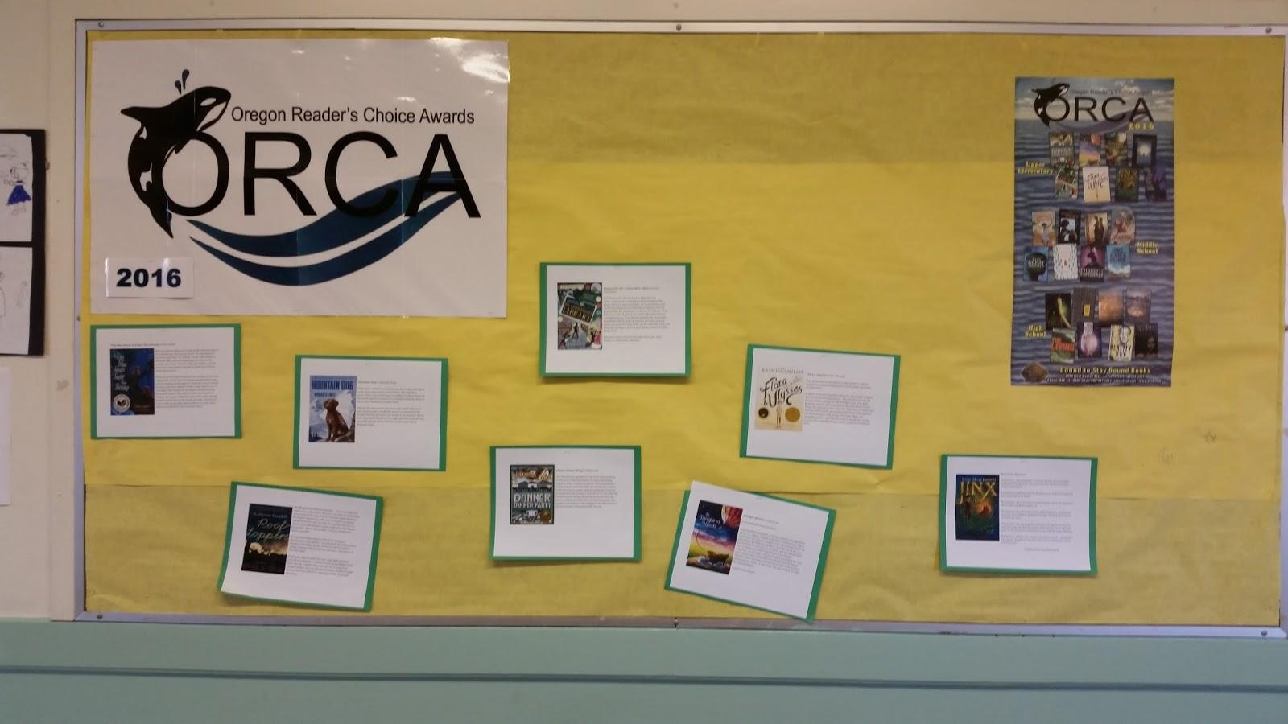
Bulletin Board Displays

Slide 45
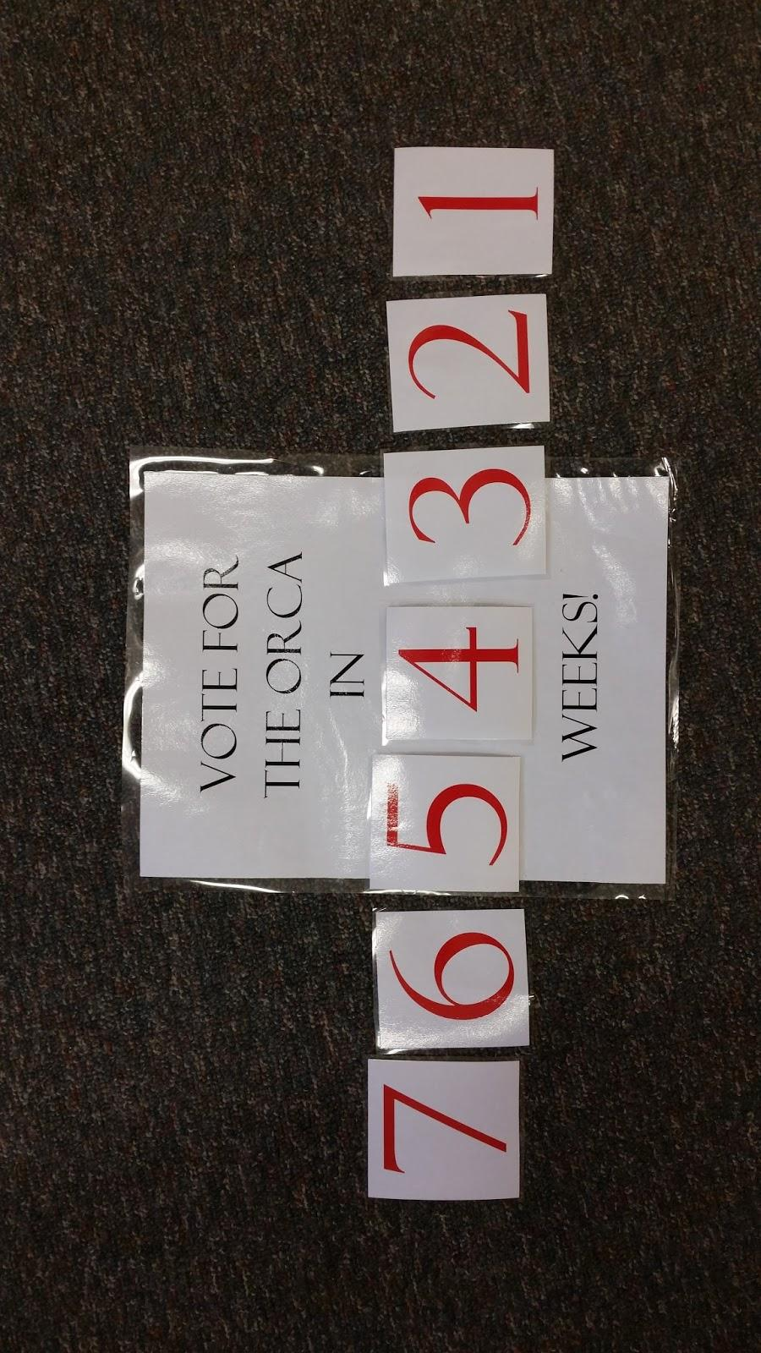
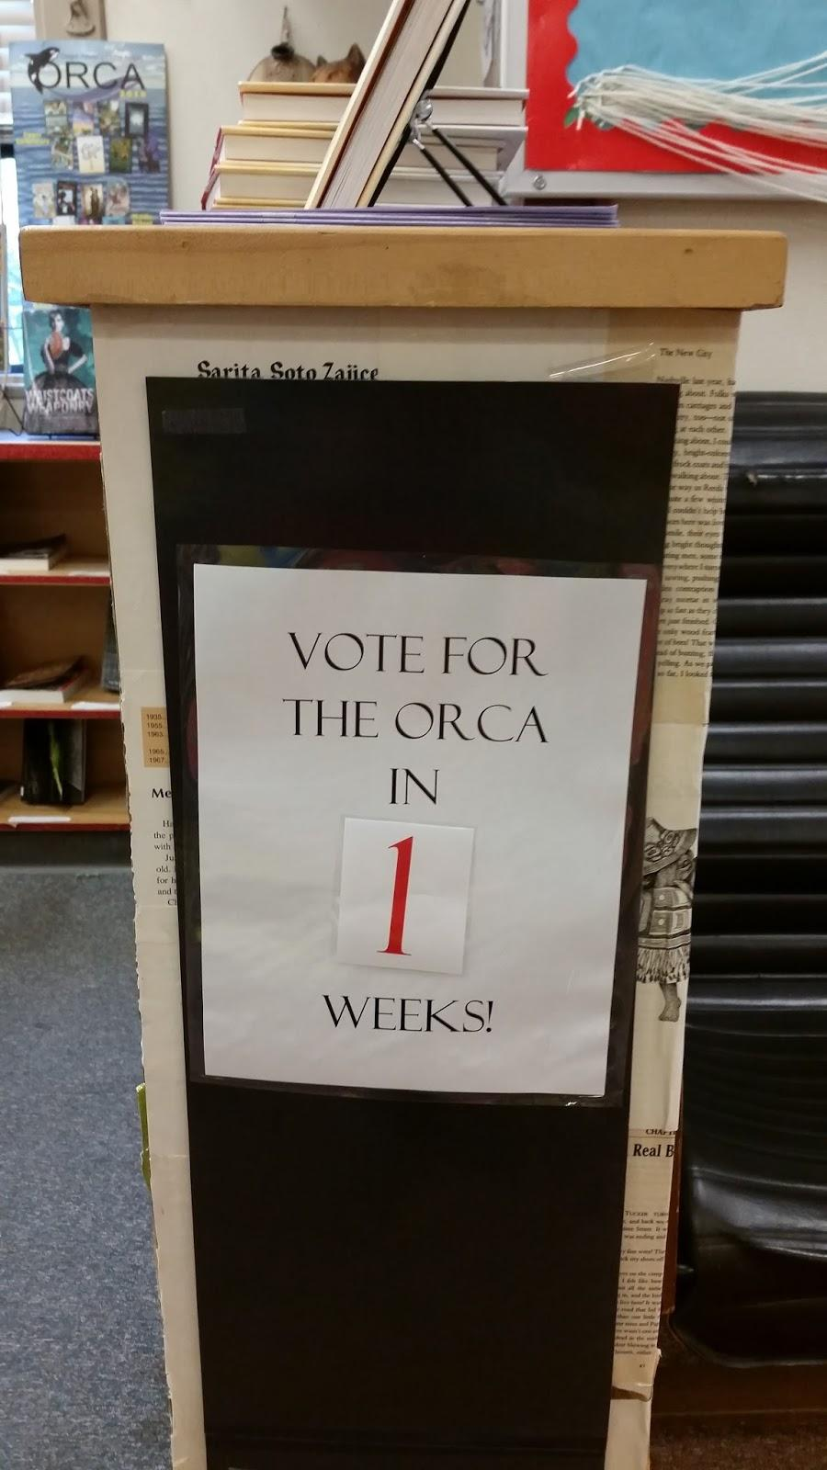
Voting Countdown Sign

Slide 46
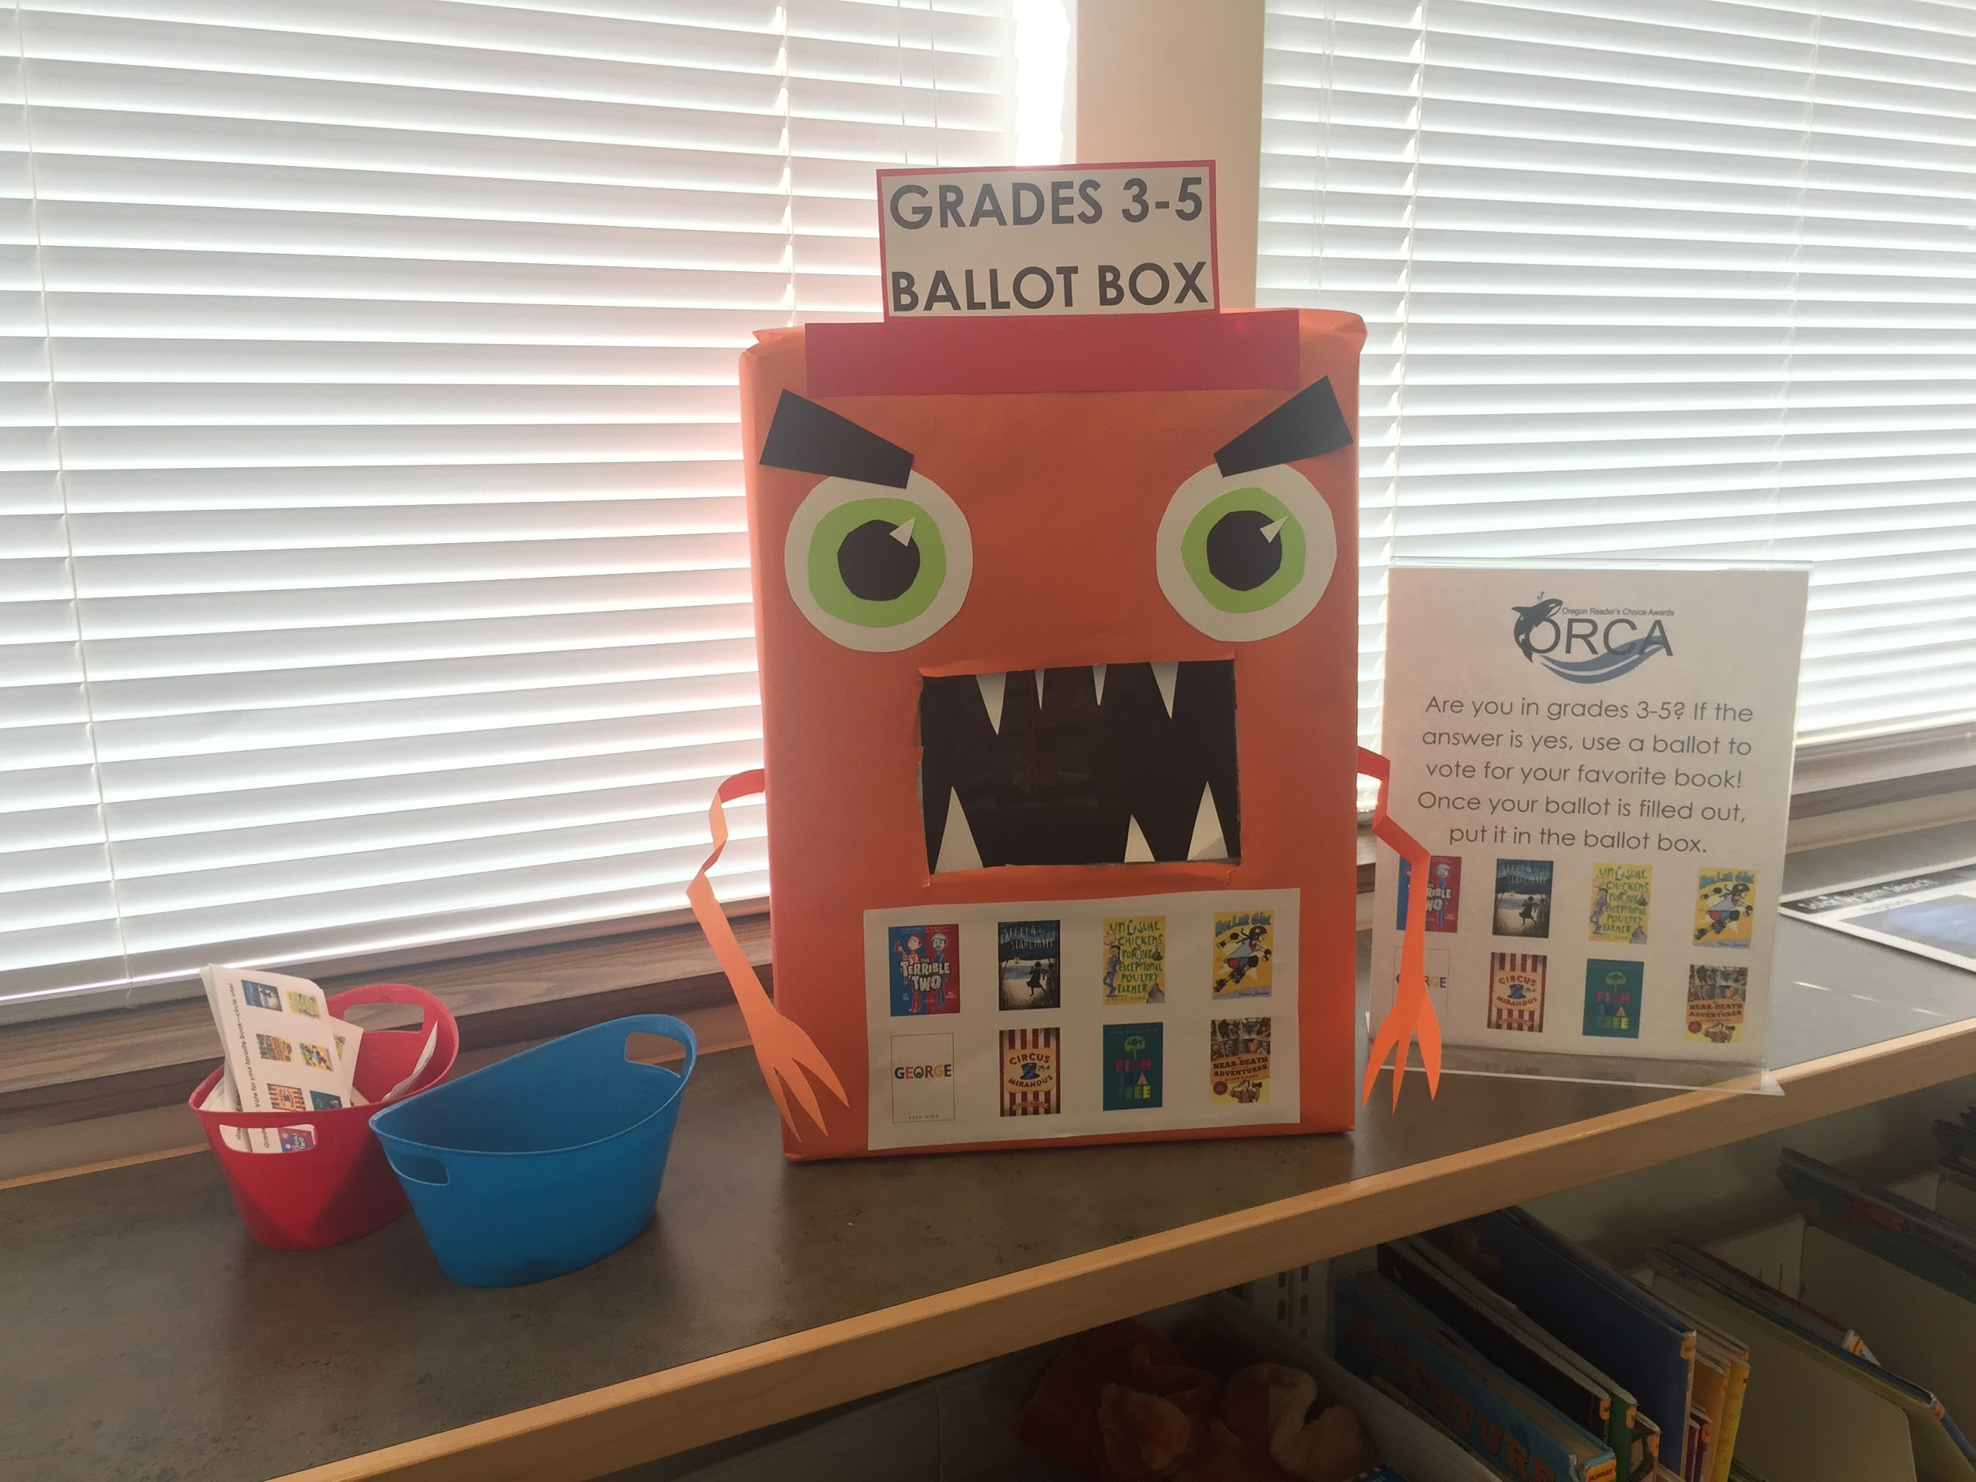
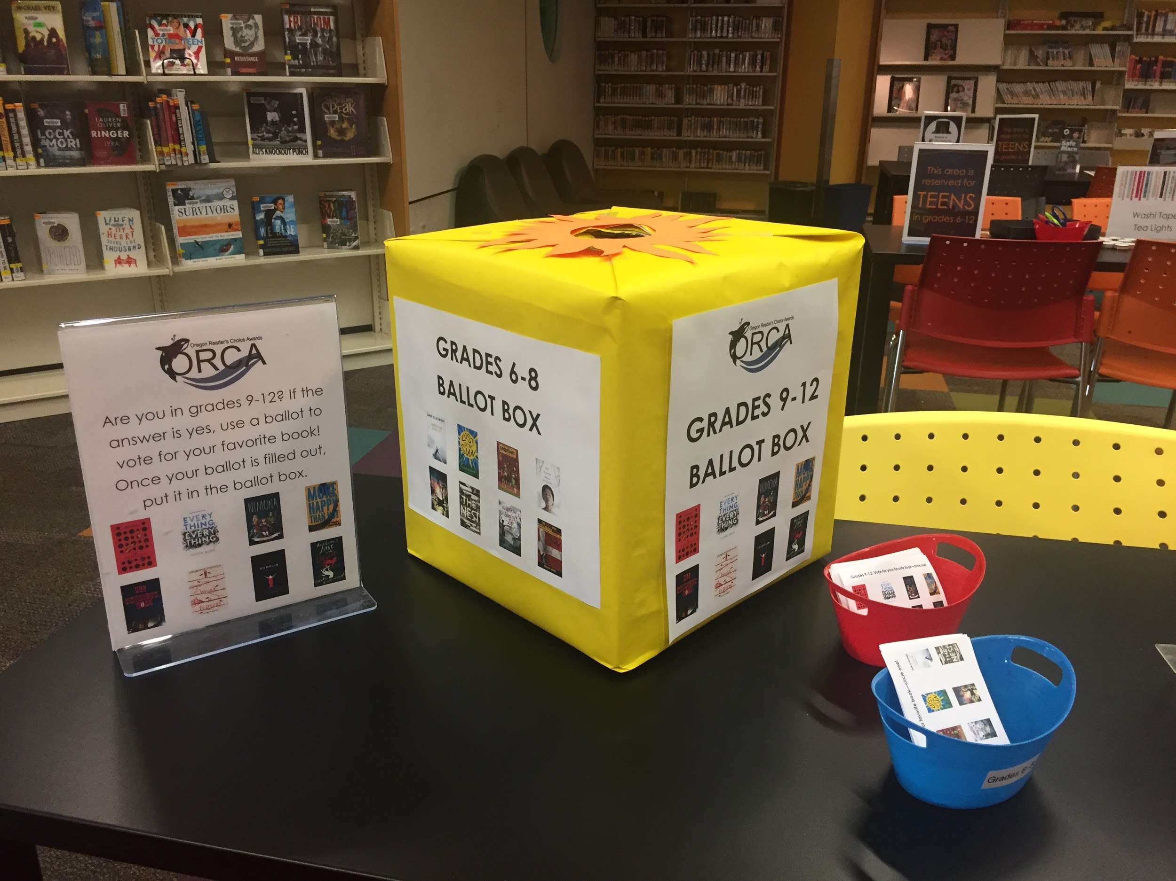
Ballot Boxes
Voting slips and signs can be found on the ORCA website.
Have a volunteer create ballot boxes!
Can count the ballots when done and include it as a passive program.
For a more involved program, Scholastic has instructions for holding a mock (presidential) election.

Slide 47
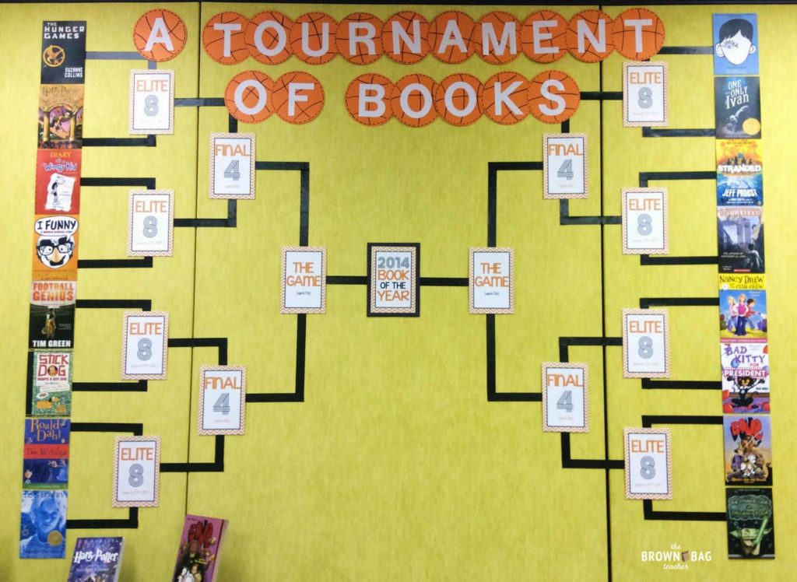
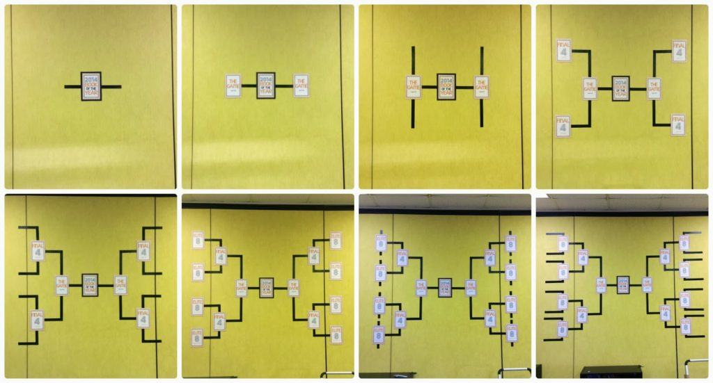
Tournament Bracket
Brown Bag Teacher website provides thorough instructions on how to create a book tournament display.
Credit: http://brownbagteacher.com/book-madness-march-book-display/

Slide 48
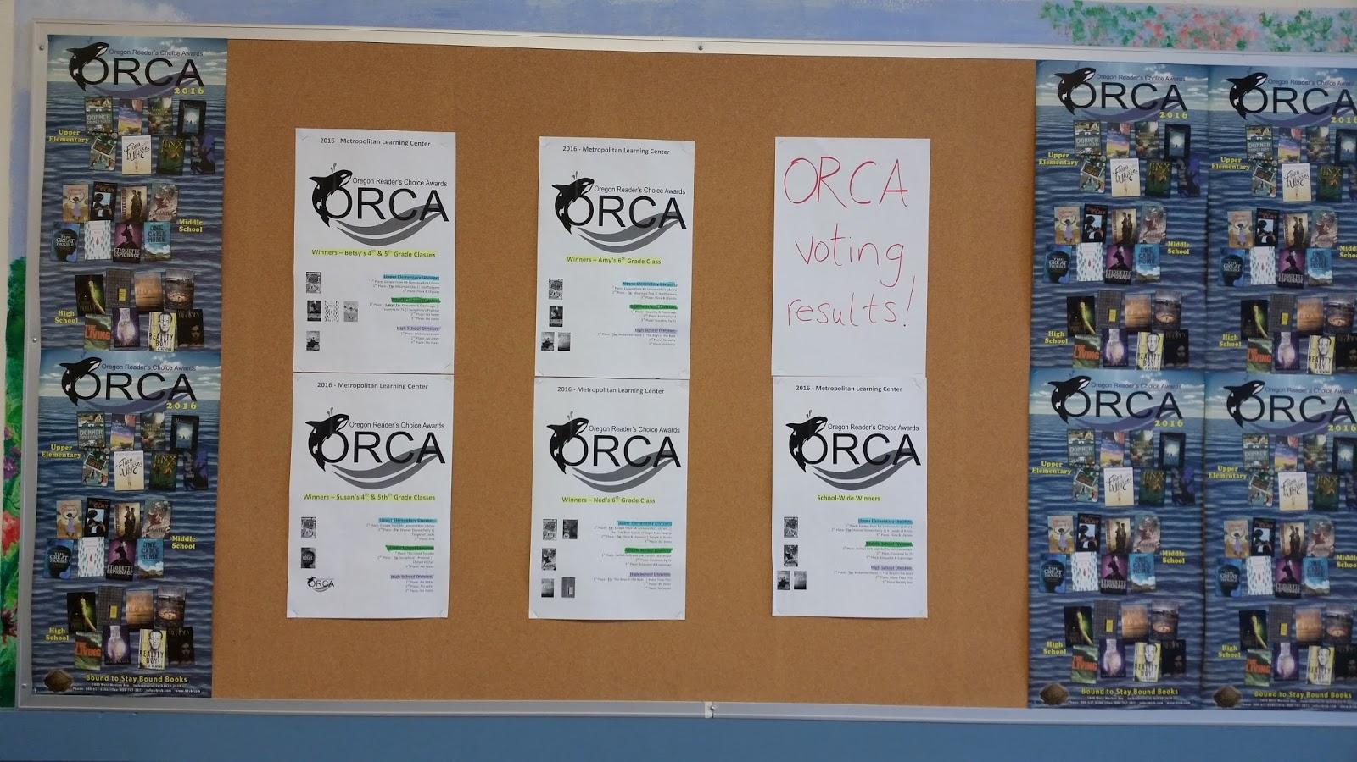
Displaying School- or Library-Wide Voting Results

Slide 49
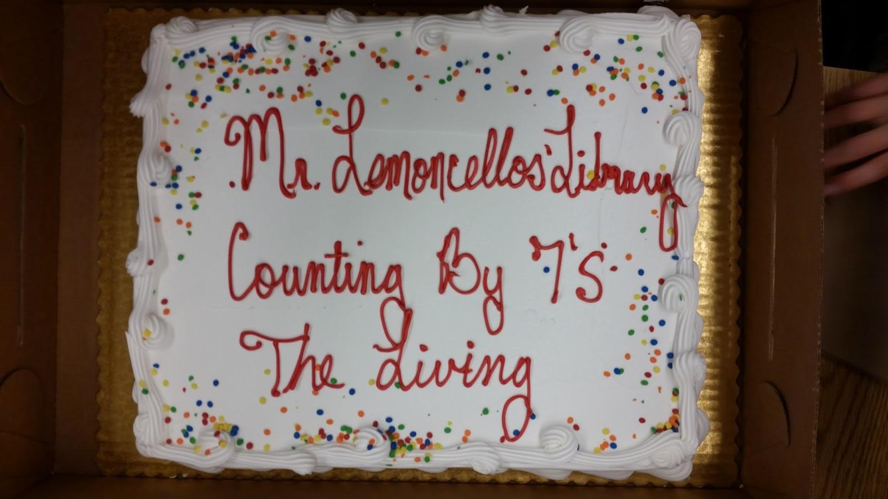
Revealing Winners Via Cake!

Slide 50
More!
Create a list or record set (Multnomah County).
Do you visit schools to give booktalks? Throw in a few ORCA titles in to your mix!
Do you give books away for Summer Reading? Order some ORCA titles!
ORCA guerilla poetry--have kids and teens write poems from the point of view of ORCA characters and post the poems around the school (anonymously, of course).
Peep Diorama Contest--have them pick a scene from an ORCA title!
Use the LEGO Movie Maker iPad app to create stop-motion animation of scenes from their favorite ORCA titles.
Create postcards--one side is an illustration of a scene related to an ORCA title, and the other side is a message from one character to another.
Tie it in to OBOB--if you like this OBOB title, you might like this ORCA title.
Create new book covers for their favorite ORCA title.
Have them write fanfiction based on an ORCA title.

Slide 51
Bonus: We Love Hearing From Authors!
Alison DeCamp (My Near Death Adventures 99% True!) thanked us for “the nicest e-mail in forever!”
Lisa Graff (Lost in the Sun): “What wonderful news! Thank you so much for letting me know. I’m so honored to have my book on the ORCA list, and in such fabulous company too. :) I don’t believe one of my books has ever made the ORCA list before, so this is an extra special treat.”
Martha Brockenbrough (The Game of Love and Death): “Well, isn’t this the most exciting news to wake up to! Thank you! As they say, it is an honor being nominated. And please let me know how I can support your readers now and going forward.”

Slide 52
For ORCA resources, visit the blog:
https://oregonreaderschoiceaward.wordpress.com/
If you are interested in being involved with the ORCA Committee, contact the Chair at orca@olaweb.org
Thank you!
Notes:
Fun things you get to do: read, write booktalks, present at OLA, meet other professionals across the state, contact authors

