Slide 1
WayFinder – The Technical Aspects
DESCHUTES PUBLIC LIBRARY RECLASSIFICATION PROJECT
Notes:
Thanks, Emily!
I’m very excited to talk about some of the technical aspects of this project with you.

Slide 2
Backstage Library Works & Reclassification
2
Notes:
In my 20+ years at Backstage I have been involved in a number of large reclassification projects. When we first started handling these projects it was strictly Dewey to LC, then it morphed into Local classification to LC. Eventually reclassifying to Dewey (or updating to the latest version of Dewey) started creeping in. A few years ago we started seeing more word-based classification projects crop up. When Emily approached us with the project she had in mind, I was intrigued and excited because it involved what I love, mapping data.

Slide 3
Agenda
RECLASSIFICATION
Planning
Production
On-Site
Lessons
3
Notes:
We’re going to be covering 3 major areas of the project itself. Planning, Production and the Onsite/Reshelving portion, and then we’ll talk a little about the lessons learned throughout the project

Slide 4
Scoping
PLANNING
4
Notes:
On January 27, 2022 Emily reached out through our general “info request” page requesting a call to discuss an upcoming reclassification project that she and her team were developing.
Initial discussions were regarding the creation of a “hybrid approach” to classification where most of the catalog would receive a newly assigned word-based “category” and subcategory. The word-based classification would better help decipher the original Dewey.
We began talking about the general scope of what was needed to be done and how it was likely going to be a mapping to the new WayFinder classification using the Dewey that was in the bib records. Emily had shared some slides that explained how they’d gotten to this point and their desire for a more browseable catalog. The library staff would be working on creating the mappings and I’d shared with them a couple of ideas of how to present that mapping based on some examples that were in the slides.

Slide 5
Timeline
PLANNING
Late January 2022: Initial request for a call
Early February 2022: First phone call
March 2022: Proposals for pricing needed
Planned by April 2022:
Creation of Categories and Subcategories by DPL staff
Hierarchy created for which Category takes priority
April/May 2022: Develop programming for mapping
July 2022: Funding approval & project start
November 2023: Start relabeling
June 2023: Reopen the first branch
5
Notes:
One of the things shared in the initial phone call was the timeline. because this project was part of a larger project that included building renovations & rebuilds, there was a set timeline in place for when items needed to start moving out of their current locations, which was the end of the year (December). It was also discussed that funds likely wouldn’t be able to be released until July, which means that all production and label printing would need to be completed in 5 months for over 200,000 items. We work with compressed timelines regularly but one complication here is that we didn’t know just how many items we’d be able to map with a script versus needing manual intervention (which we’ll talk about in a little bit)

Slide 6
Pricing
PLANNING
Questionnaire completion
Automated
Sampling
Manual Sampling
Quote development
6
Notes:
Our typical planning & pricing process for Reclassification projects involves a potential client filling out a “questionnaire” that dictates what will happen during a reclassification project and any custom requests they might have. We have standard questionnaires for both Dewey and LC reclassification project. Then we sampling the process by first taking all records that the library provides and running through them an automated matching algorithm to pull in existing classification from an external database of their choosing. Then we typically have our cataloging team work on a small sample to manually assign the classification so that they can get a feel of what’s in the collection and the complexity of assignment for each subcollection and material type.

Slide 7
Pricing
PLANNING
Phone call & Slides
Questionnaire completion
Automated
Sampling
Manual Sampling
Quote development
7
Notes:
However, with this particular project since we’re looking at a home-grown classification that was not yet fully developed, we were unable to perform any sampling ahead of any cost estimate needs. We had a general idea, at least, of what some of the mapping programming would need to look like thanks to Emily’s original slides that she shared so we could come up with pricing for that aspect. Not knowing, though, how many records we’d be able to map with this program, we set out to be conservative in regards with how many might need manual intervention. So we’d estimated around a 50% conversion rate knowing full well that it would likely be higher than that, but we wanted to make sure we had wiggle room in case something went awry. We’d put together quotes for true BISAC assignment for a couple other institutions around the same time so our Metadata department was ready to provide pricing for that aspect as well. We’d also talked in brief terms about printing labels for the project. I’ll talk a little more about this later, but one lesson we learned is that we didn’t talk enough about this at the outset.

Slide 8
Preparing for Mapping
PLANNING
Late January 2022: Initial request for a call
Early February 2022: First phone call
March 2022: Proposals for pricing needed
Planned by April 2022:
Creation of Categories and Subcategories by DPL staff
Hierarchy created for which Category takes priority
April/May 2022: Develop programming for mapping
July 2022: Funding approval & project start
November 2023: Start relabeling
June 2023: Reopen the first branch
8
Notes:
We received verbal confirmation at the end of April that the project would be moving forward, but without any manual category assignment by our catalogers. Because it was the end of the month I was a little concerned about being able to continue to meet the milestones in place since we hadn’t yet received any mappings. But all my anxieties about timeline would prove to be unfounded.

Slide 9
Mapping Fiction
Planning
HIERARCHY
Juvenile | Bridging Fiction
Juvenile | Early Readers
Juvenile | Graphic Novels
Juvenile | Scary
Juvenile | Science Fiction
Juvenile | Fantasy
Juvenile | Mystery
Juvenile | Historical Fiction
Juvenile | Adventure
Juvenile | General
Teen | Manga
Teen | Graphic Novels
Teen | Science Fiction
Teen | Fantasy
Teen | Mystery & Thriller
Teen | General
EXAMPLE MAPPING
Teen Fiction
Science Fiction
DPL Bib Record Data
MARC Tag | Bib Data | Classification Genre to Apply
655 | Science Fiction | Science Fiction
655 | Dystopian fiction | Science Fiction
655 | Alternative histories (Fiction) | Science Fiction
655 | Steampunk fiction | Science Fiction
655 or 650 | Star Wars fiction | Science Fiction
655 | Time-travel fiction | Science Fiction
650 | Time-travel | Science Fiction
9
Notes:
We received the first round of mapping at the end of May for the Kids & Teen fiction. This mapping included using subjects as opposed to the Dewey number as I originally anticipated. A specific hierarchy for preference of mapping was included. So for instance, if a record contained 2 subjects that appeared in 2 different categories of the new classification, one would be preferred over the other.
For this particular mapping, I didn’t want to give it immediately to our programmers because I needed to first figure out the logic required so that I could then explain it to them so I started developing various scripts to accomplish the work. This ended up being a very iterative process. My first round of scripts included attempting to utilize the fixed field Audience & Fiction codes correctly identify Teen vs Kids and Fiction vs NonFiction (I was using an older copy of the library’s catalog that I had as my test records).

Slide 10
Manga & Graphic Novel Mapping
PLANNING
MARC Tag | Bib Data | Classification Genre to Apply
655 | Graphic novels, Japan | Manga
655 | Comic book, strips, etc | Manga
655 or 650 | Manga | Manga
655 | Comics (Graphic works) | Manga
655 | Fantasy comics | Manga
655 | Science fiction comics | Manga
655 | Romance comics | Manga
655 | Paranormal comics | Manga
655 | Humorous comics | Manga
655 | Detective and mystery comics | Manga
MARC Tag | Bib Data | Classification Genre to Apply
655 or 650 | Graphic Novels | Graphic Novels
650 | Comic books, strips, etc | Graphic Novels
655 | Superhero comics | Graphic Novels
655 | Fantasy comics | Graphic Novels
655 | Comics (Graphic works) | Graphic Novels
655 | Science fiction comics | Graphic Novels
PREFER MANGA OVER GRAPHIC NOVELS
Use 655 $a Manga
Use 041 $h jpn
Use 546 “Translated from the Japanese”
10
Notes:
Manga & Graphic Novels needed some special consideration as well to identify them appropriately. MOST Manga had a 655 “Manga”, but that wasn’t always the case so it there was a discussion with library staff about other ways to identify Manga, such as using the 041 language code as well as a specific 546 note.
The next set of mapping we received (5 days after the Teen/Kids Fiction) was the Adult Fiction, also utilizing subjects in the mapping so similar logic could be used that I was already developing

Slide 11
Mapping Adult Nonfiction & Biography
PLANNING
Call Number | Category | Subcategory
001 | Business & Finance | Business
003 | Science & Technology | General
006.3092 | Science & Technology | General
031.092 | Society & Culture | General
069.092 | Arts & Crafts | General
070 | Politics | International Politics
070.092 | Languages & Writing | General
070.4 | Languages & Writing | General
070.4092 | Languages & Writing | General
070.449796092 | Sports & Recreation | General
Call Num (from c/099) | Category | SubCategory
001 | Business & Finance | Business
001.01 | Spirituality & Beliefs | Philosophy
001.944 | True Crime & Paranormal | Paranormal
001.95 | True Crime & Paranormal | True Crime
001.96 | Society & Culture | General
001.98 | Society & Culture | General
002 | Literature | General
002.09 | Literature | General
002.9 | Arts & Crafts | General
003 | Spirituality & Beliefs | Philosophy
003.54 | Science & Technology | General
11
Notes:
Teen/Kids Nonfiction and Adult Nonfiction/Biography arrived within a day of each other in mid-June. The Teen/Kids were still using subjects in their mapping so I began incorporating those into the rest of my script. The Adult Nonfiction/Biography, however, did utilize Dewey in the mapping, so I set those aside for a bit while I finished the remaining scripts. I was able to give the Adult Nonfiction/Biography directly to my programmer to begin building me a process to map that information. One of the difficulties there is that there was not always a Dewey call number in the record, and if there was it could have been in 3 different places, the item record, the 099 or the 082 field. We’d need to create exceptions if the desired location to use for the mapping (099) did not exist so that the others would be checked as well.
We received the DVD mapping in early July, using Subjects, so these got included into my scripting as well. There were specific hierarchical considerations here, too.

Slide 12
Sampling
PLANNING
12
Notes:
I started providing samples (and I did many, many more internally as I was trouble-shooting mapping & programming issues). The samples resulted in spreadsheets (like the one above) for Teens, Kid, Adults, and DVDs. Each spreadsheet did also include Author, Title, and Dewey so DPL staff could sort, re-sort, and verify the information present and look for any incorrect mappings based on their hierarchies.

Slide 13
Kickoff (& Label Confusion!)
PRODUCTION
13
Notes:
We knew that July was going to be our official project commencement so between various vacations among staff we planned to have our “kick of call” on July 14th. During this phone call we did talk more about labels and that TWO label sets were desired (one to reprint all the Dewey labels and one for the new WayFinder category label). My recollection was that in the initial project scoping call that only the new WayFinder label would be needed, but we had never discussed the size of that particular label either! After discussing in more detail what was required for both labels we turned to our vendor partner for a custom quote for the larger WayFinder label. One benefit of having originally quoted manual classification assignment but then that not being utilized was that there was some wiggle room in the original contract for the additional label cost (though it certainly wasn’t an ideal situation)

Slide 14
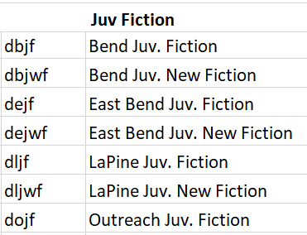
Kickoff
PRODUCTION
14
Notes:
Also during this kick-off call we talked a little about the sample results and it was suggested that since the fixed fields were not working as well as hoped identifying records to fall into particular mappings that we instead turn to using the library assigned location codes that are present in the item record. While it did require rework of the scripts already developed, it turned out to be a far superior route to go since the fixed fields were often miscoded or uncoded altogether.
We were also still seeing some Kids materials that were not being caught for some reason in the mapping so some additional troubleshooting had to be done on my end and some more assignment by library staff was needed to whittle down the number of record that were not being classified through the scripting.

Slide 15
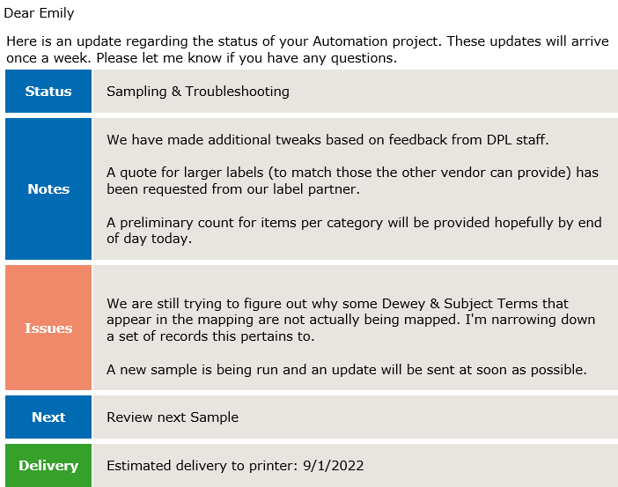
Weekly updates
production
15
Notes:
After the kick-off call we started sending weekly updates as to the status of the project, any questions not yet covered in an email, reminders of to-dos as well as estimated milestone dates (such as when we’d receive the full dataset for mapping). This is just an example of what the updates would look like. These were sent out every Friday.
We also starting having biweekly Zoom meetings that included Jacob Bastian (who is the Product Manager of the Onsite portion of the project, which we’ll talk about in a few minutes).

Slide 16
Troubleshooting
Production
16
Notes:
We continued doing some sampling and troubleshooting. By the end of the sampling there were under 2000 records (out of over 200,000) that were unclassed for one reason or another. The end was in sight!

Slide 17
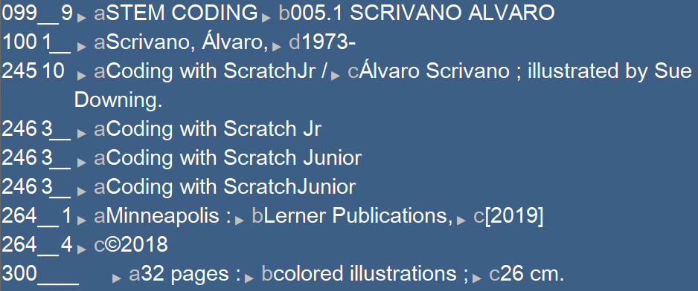
Final Mapping
Production
17
Notes:
On August 25th we received the final data set from Deschutes for mapping. On September 7th the completed data and final counts were delivered back to Deschutes. Because of they way records were to be loaded into their ILS via a custom load table, this initial Data-set was just for informational purposes and would be loaded with classification updated during the physical Relabeling portion of the project. Here are just a couple examples of the MARC with their new 099 field. This information was also mapped to the item record.

Slide 18
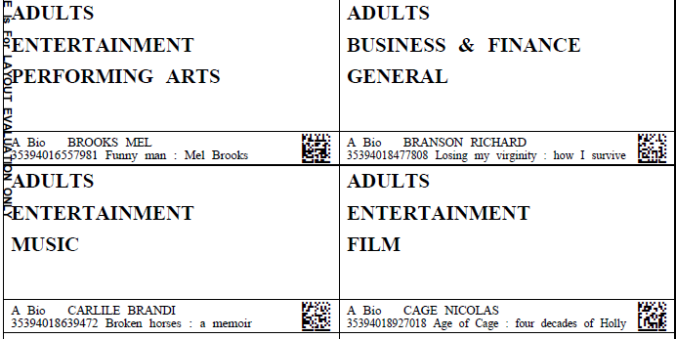
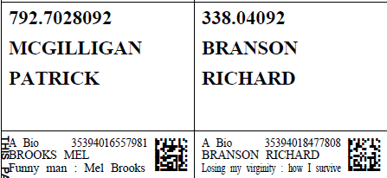
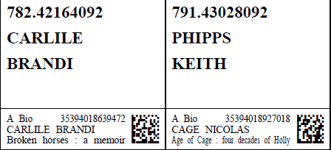
Label Preparation
Production
18
Notes:
We started prepping the data for label printing on September 8th (which included separating the data by branch and sorting in a specific way) and the order was sent to the printer on 9/22. PDF proofs were provided on 10/6, were approved by staff on 10/7 and printing commenced.
On the left we have the “WayFinder label” and on the right we have their corresponding “call number label”. Each label has a verification strip that is not applied to the item but instead serves as a check-and-balances system to ensure that the correct label is being applied to the correct item. In this case the verification label contains the current collection (A Bio is Adult Biography), the barcode, Author, and title.
A few days after the printing began we became aware just how large collection float was between the branches. Typically we’d seen float between 5-10% on previous reclassification projects, but it was discovered that Deschutes’ collection floats up to 40%. Unfortunately, even at a few days past printing commencement, it was too late to change the order of how everything was printed. 24 boxes of labels left our vendor partner on 11/8.

Slide 19
Transition
On-site
19
Notes:
The next couple of weeks were a transition period as labels were making their way to Downtown Bend and the Onsite Project Manager, Matt Roveto, was getting ready to prepare for the next phase of physical labeling and shifting of the materials. During this transitionary pre-production phase, Matt began establishing workflows, setting up and testing equipment, hiring, and training the project team as well as coordinating with the Library how items that are being returned from patrons should be handled. I also worked with Matt to familiarize himself with our internal programs that would separate out the MARC records for the items that his team relabeled that day so Library staff could reload them into their system.

Slide 20
Production
On-site
Pull items
Locate labels (Check all branches)
Scan barcode
Verify label
Is final location open?
Yes: move to final location
No: shelve in swing space
Apply label
20
Notes:
The first branch to tackle was Redmond since that building needed to be vacated first. The team then moved to Downtown Bend after which they’ll move to East Bend and then Sunriver.
The labeling process itself involves pulling items from a specific section of the collection and after locating the 2 newly printed labels for the item the technician will scan the item’s barcode and the label sheet to ensure the correct label has been located. Once verified, the labels will be applied and a label protector is applied. The item is then set aside for arrangement & shelving.
If an item’s final location is available, the item will be shelved into it's final location. However, if the final location is still occupied by items not yet labled, the item will be placed into swing space until it’s final location is available. Regular quality control checks are performed on at least 3% of the labeling and shelving.
This relabeling & reshelving is still in progress so I don’t have a lot to say about this part at this time!
.

Slide 21
What did we learn?
Lessons
21

Slide 22
Floating Collections
Lessons
22
Notes:
As I’d mentioned previously the amount of float and the order the labels were printed was an issue. Because the labels were not printed in order with the branches combined as one, one technician needs to look through the labels of ALL branches to find the labels for those items that were not initially grouped with the branch that is being relabeled. This issue has caused us to rethink our workflow for future projects like this, one where the labels will be printed on-the-fly by the technicians themselves. This is something Jacob and one of his other teams will hopefully be testing out later this year.

Slide 23
Diacritics
lessons
23
Notes:
There were a number of the call number labels that were missing a diacritic in the author’s name. When we first began testing, some of the functions within the programming I was using to map author’s name was not capturing diacritics properly so it was realized early on that I would remove diacritics for the labels (especially since our printer cannot print diacritics). However, what I didn’t take into consideration was the nordic and polish letters or diacritics that were precomposed versus decomposed I HAD noticed a larger number of these while we were prepping the data prior to label printing, but these special cases slipped through unnoticed.
Luckily the Onsite Project Manager would just reprint those and I’d resupply the MARC for reloading and I now have workflows in place to check for differences prior to label creation.

Slide 24
Incorrect Category Labels
Lessons
Ancient History
Or
Ancient & Middle Ages?
24
Notes:
There was a discovery that some of the Wayfinder Category Labels for the Adult collection were incorrect. Specifically a subcategory under History. There was a discrepancy as to whether the subcategory should be “Ancient History” or “Ancient & Middle Ages”.
Upon review of all the documentation that I’d received from Emily and her staff it appears that there was an older version of the categories that had been inadvertently sent to me later in the process that had this particular error. Unfortunately, this was not caught during any sampling prior. On the bright side, there were only a couple hundred of these so the library staff corrected those.
The lesson here is to doublecheck any anomalies and changes with the client just to be absolutely sure.

Slide 25
Labels Out of Order
Lessons
25
Notes:
As i was ordering all the files prior to label printing there were a handful that got out of their normal order so Matt originally contacted me thinking that somehow they got missed from the process altogether. Thankfully, we were able to find them in the label sets by using the raw label data and Matt’s staff was able to locate the sneaky label sets.
Unfortunately, as I was getting the MARC data ready for label formatting, I’d split the MARC files by collection and verified that any anomalies were in their rightful file, but I inadvertently forgot to re-sort the files into the proper order. I did supply Matt with the raw text file data in case he came across any others like this.

Slide 26
Conclusion
Success!
26
Notes:
Even with those hiccups, I do think that this project has been a success and we humbly thank Emily for trusting in us to help them with this huge undertaking! It’s been a great experience for us and has showed us better ways of moving forward with similar projects of this size.

